Slide 1
SECTION 1 • PROJECT INTRODUCTION
TAP ACADEMY EVALUATION
FoodHouse — Java Web Food Ordering Application
PROJECT DEFINITION
"FoodHouse is a Java-based food ordering web application that allows users to explore local restaurants, browse dish menus, manage a shopping cart, and place food orders with simulated order status tracking through a web interface."
30
360
14
5
Bangalore Restaurants
Curated Menu Items
Jakarta Servlets
Relational Tables
Indiranagar, Koramangala & MG Road
12 Curated Dishes per Restaurant in MySQL
Core MVC HTTP Controller Architecture
MySQL 8.0 InnoDB with Foreign Keys
Notes:
Good morning respected panel members. My project is FoodHouse, a Java-based food ordering web application developed using pure Core Java, Jakarta Servlets, JSP, and MySQL. It allows users across Bangalore to browse 30 dining establishments, explore 360 curated dishes, manage a shopping cart, and track order status transitions. Built strictly on core Java Web fundamentals without external frameworks, it demonstrates complete mastery of MVC architecture.

Slide 2
SECTION 2 • TECHNOLOGY STACK
TAP ACADEMY EVALUATION
Verified Production Technology Stack & Tools
CLIENT VIEW
BUSINESS LOGIC
DATA PERSISTENCE
INFRASTRUCTURE
Frontend Tier
Backend Tier
Database Tier
Environment & Tools
✔ HTML5 Semantic Markup
✔ Java SE 21 (LTS Release)
✔ MySQL 8.0 Relational Engine
✔ Apache Tomcat 10.1 Web Server
✔ CSS3 Glassmorphic Styling
✔ Jakarta Servlet 6.0 Specification
✔ JDBC (java.sql API)
✔ Eclipse Enterprise IDE
✔ Vanilla JavaScript (DOM & Fetch)
✔ MVC Architectural Pattern
✔ PreparedStatement SQL Security
✔ jBCrypt 0.4 Password Hashing
✔ JSP 2.3 & JSTL Expression Lang.
✔ HttpSession State Management
✔ InnoDB Foreign Key Constraints
✔ MySQL Connector/J 9.2.0 Driver
Notes:
For the technology stack, I strictly used the technologies implemented in the source code. The backend runs on Java 21 LTS and Jakarta Servlets 6.0 with Apache Tomcat 10.1. Data persistence is handled via MySQL 8.0 and JDBC with PreparedStatement parameterized queries. The frontend uses dynamic JSP, modern CSS, and JavaScript. Password security uses jBCrypt. Notice that no heavy frameworks like Spring Boot or Hibernate are used, verifying complete foundational competency.

Slide 3
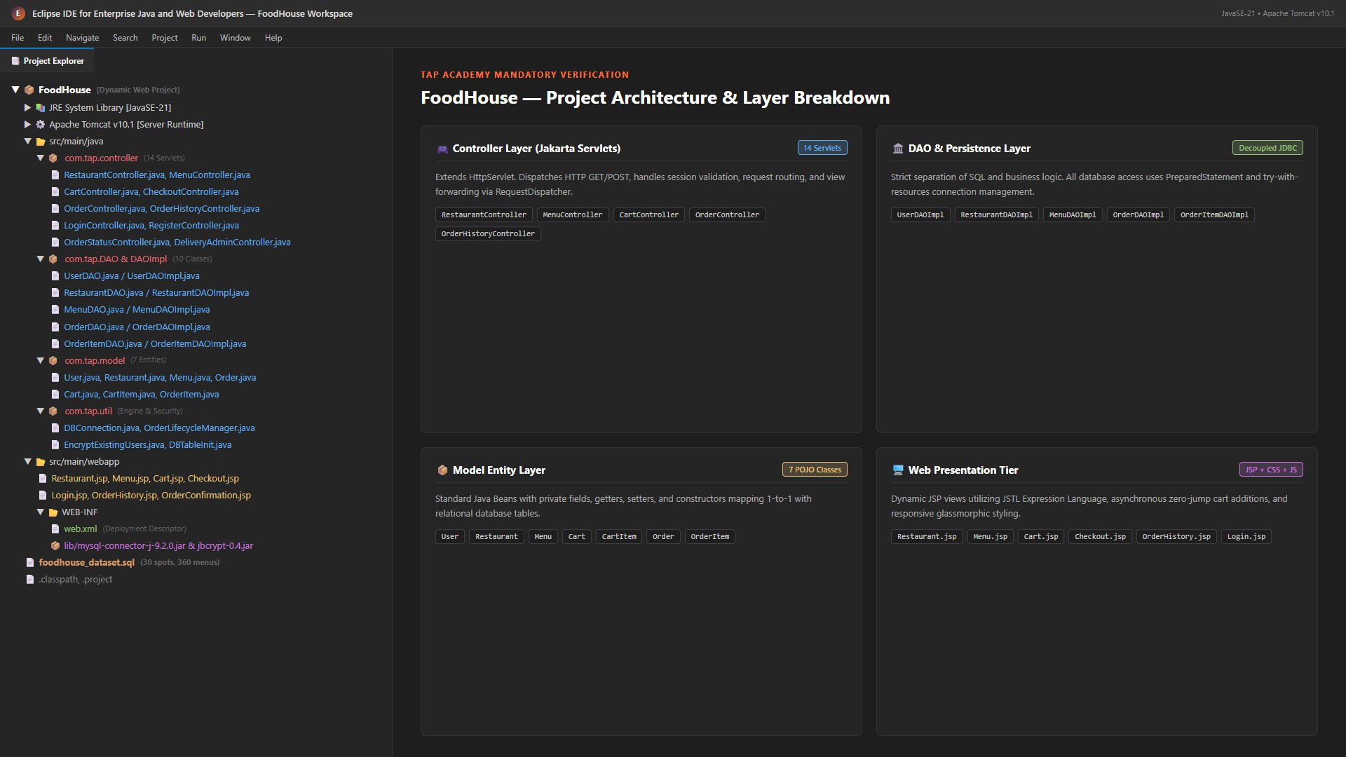
SECTION 3 • PROJECT STRUCTURE
TAP ACADEMY EVALUATION
Eclipse Dynamic Web Project & Layered Organization
Notes:
This slide presents the authentic Eclipse Dynamic Web Project structure directly from our workspace. Following the MVC architecture: `com.tap.controller` contains 14 Servlets orchestrating HTTP requests; `com.tap.model` contains 7 POJOs; `com.tap.DAO` and `DAOImpl` provide decoupled database access; `com.tap.util` manages database connectivity and dynamic order lifecycle logic. The `src/main/webapp` folder houses all JSPs, CSS, and WEB-INF configuration.

Slide 4
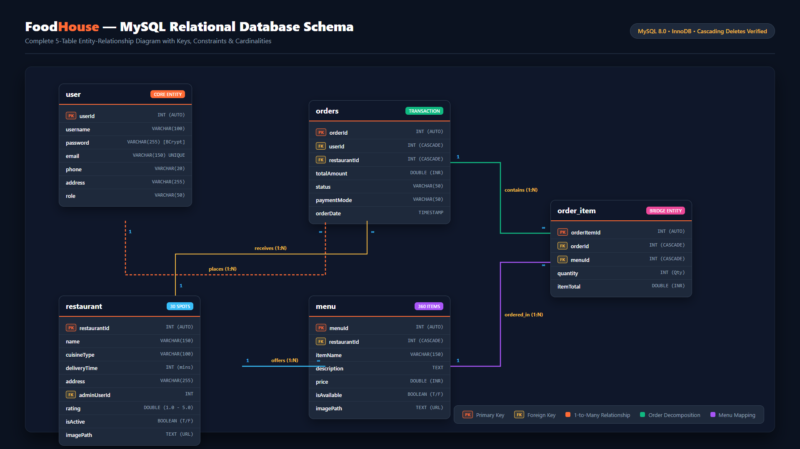
SECTION 4 • ER DIAGRAM
TAP ACADEMY EVALUATION
MySQL Relational Database Schema & Entity Relationships
Notes:
This is our database ER diagram with five normalized relational tables in MySQL. The `user` table stores customer credentials with BCrypt hashes. The `restaurant` table stores 30 outlets. The `menu` table holds 360 dishes mapped via `restaurantId`. When an order is placed, a record is created in `orders`, which branches into multiple `order_item` records capturing quantities and line totals. All foreign keys enforce cascading deletes to maintain referential integrity.

Slide 5
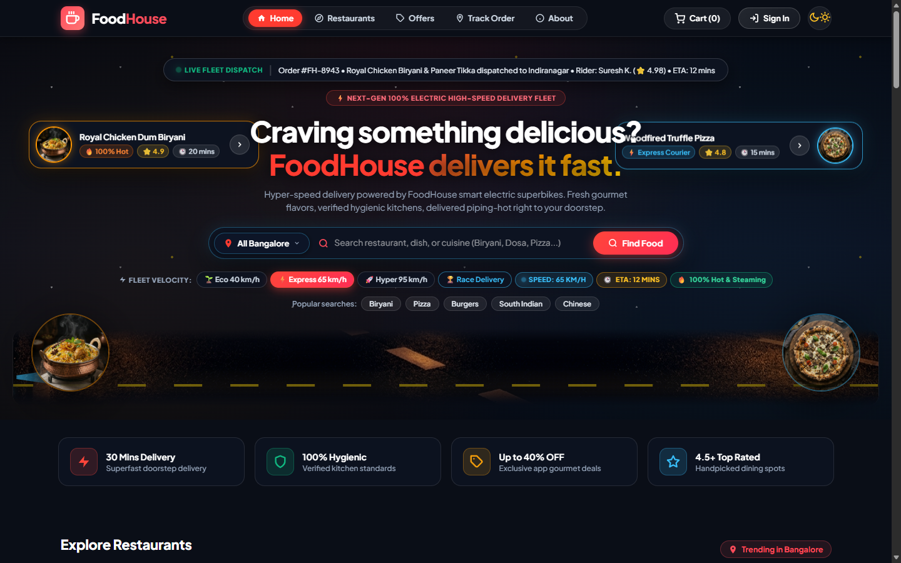
SECTION 5 • PAGE SCREENSHOTS (1/6)
TAP ACADEMY EVALUATION
Home & Restaurant Discovery (Restaurant.jsp)
Key Page Capabilities
• Dynamic 30-Restaurant Catalog loaded via RestaurantDAOImpl.
• Location filter for Indiranagar, Koramangala, and Central Bangalore.
• Instant keyword search and cuisine tag filtering.
• Fleet velocity controls simulating delivery speeds and ETA calculation.
• Dark and Light theme toggle with high-contrast glassmorphism.
Notes:
Moving to our live application flow, this is the Home and Restaurant Discovery page rendered by `Restaurant.jsp`. It displays Bangalore restaurants with ratings, cuisine tags, and delivery estimates. Users can filter by location, search dishes by keyword, and adjust simulated delivery velocity.

Slide 6
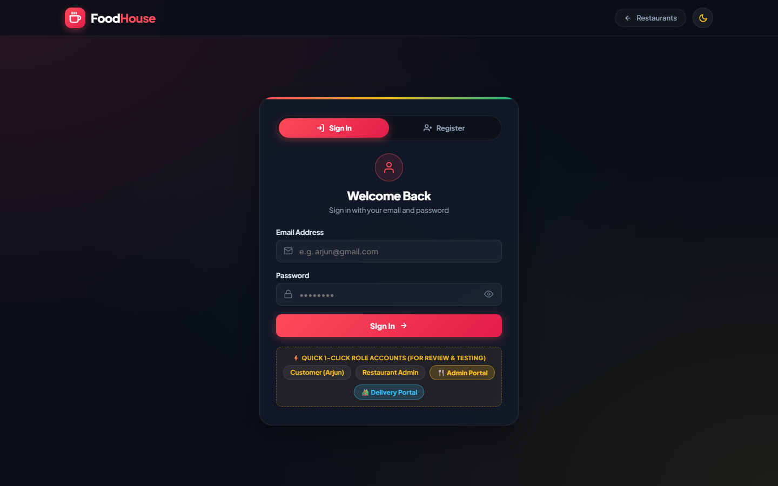
SECTION 5 • PAGE SCREENSHOTS (2/6)
TAP ACADEMY EVALUATION
Unified Authentication Portal (Login.jsp & Register.jsp)
Authentication Features
• Unified 1-page Auth Portal with tabbed Login and Register modal.
• jBCrypt salted password hashing prevents plain-text storage.
• PreparedStatement parameterized queries prevent SQL injection.
• HttpSession initialization binds user identity across checkout.
• Role-based redirect sends users back to their active shopping session.
Notes:
Next is our unified Authentication portal. Login and registration are integrated into a single tabbed modal. LoginController and RegisterController secure every password using salted BCrypt. Once authenticated, an HttpSession is established, preserving the user identity through checkout.

Slide 7
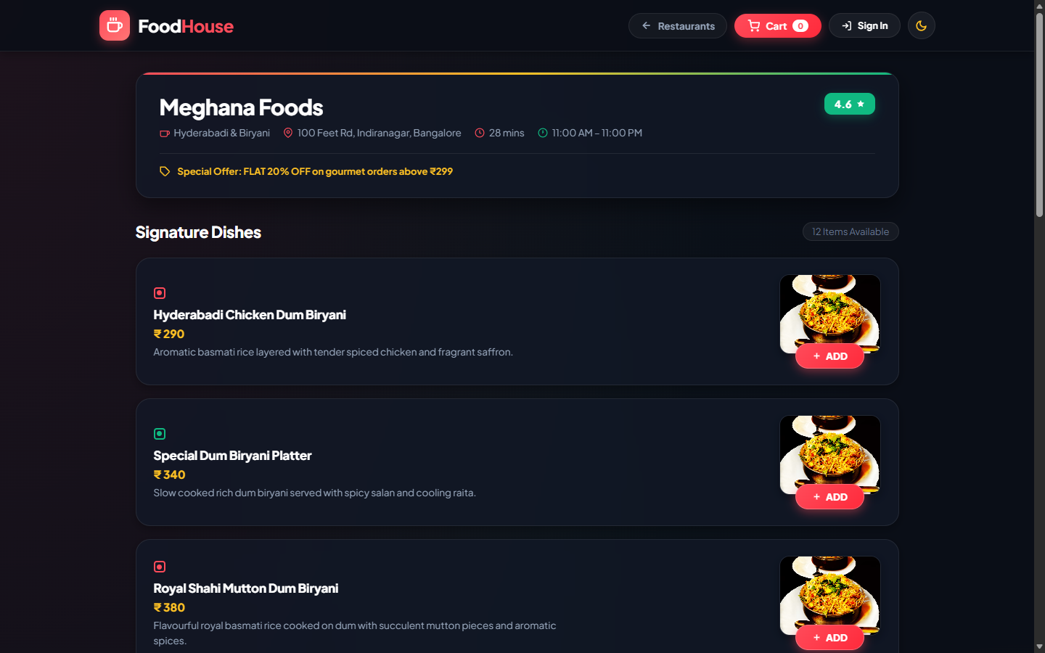
SECTION 5 • PAGE SCREENSHOTS (3/6)
TAP ACADEMY EVALUATION
Curated Restaurant Menu (Menu.jsp)
Menu Interaction
• Restaurant-specific catalog retrieval (e.g. 12 dishes for Meghana Foods).
• Veg and Non-Veg indicators with pricing in INR.
• Zero-Jump AJAX Add-to-Cart prevents page reloads and scroll disorientation.
• Instant Quantity Stepper (+ / -) directly on dish cards.
• Floating bottom cart summary bar with live count and subtotal.
Notes:
When a user selects a restaurant, MenuController loads Menu.jsp. Here you see Meghana Foods featuring 12 curated dishes with food photography, pricing, and veg/non-veg tags. Clicking "+ ADD" updates the cart asynchronously without page reloads or scroll jumps.

Slide 8
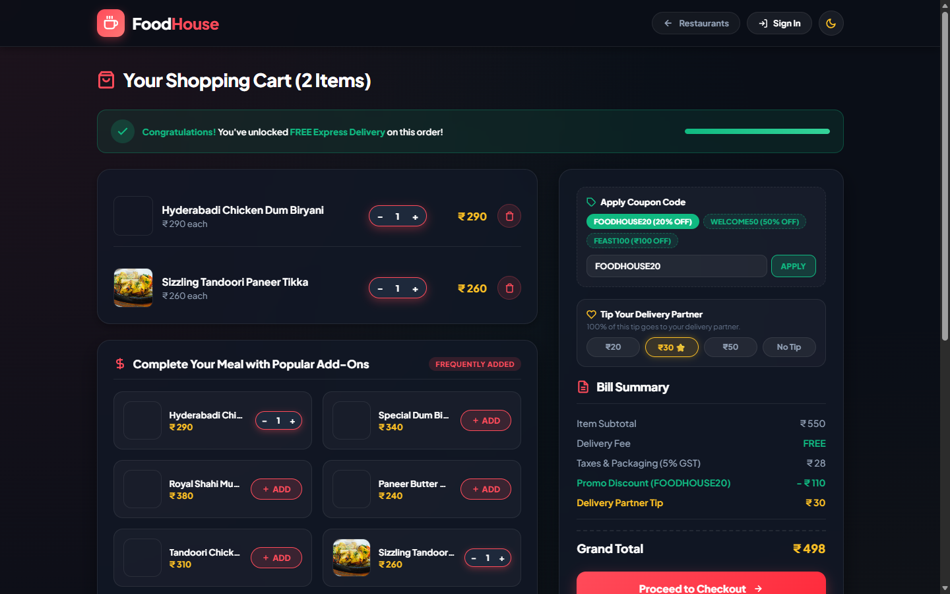
SECTION 5 • PAGE SCREENSHOTS (4/6)
TAP ACADEMY EVALUATION
Shopping Cart & Totals (Cart.jsp)
Cart Calculations
• Itemized list with quantity steppers and quick item removal.
• Dynamic subtotal calculation (price × quantity in Cart.java).
• Financial breakdown: Delivery fee, packaging charge, and 5% GST.
• Session storage maintains cart persistence across page navigation.
• Direct checkout transition with active user verification.
Notes:
In Cart.jsp, our Cart model computes item subtotals, packaging charges, delivery fees, and taxes dynamically. Users can adjust quantities or remove items with instant total recalculation. Cart items are stored in the user session so nothing is lost while browsing.

Slide 9
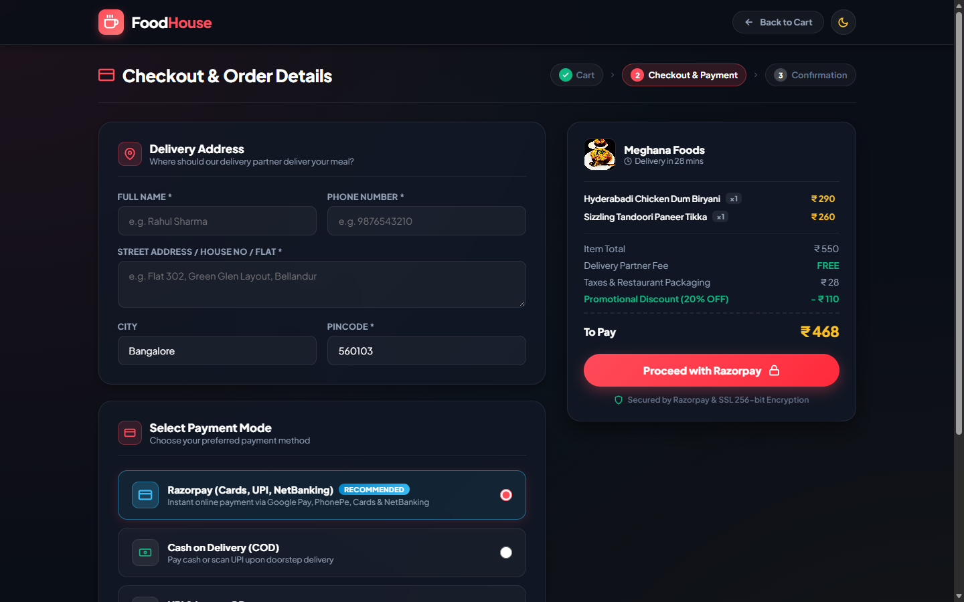
SECTION 5 • PAGE SCREENSHOTS (5/6)
TAP ACADEMY EVALUATION
Checkout & Payment Mode (Checkout.jsp)
Order Finalization
• Delivery address confirmation and contact phone verification.
• Support for payment options: Cash on Delivery, UPI, Cards, NetBanking.
• Complete order bill summary review before placement.
• OrderController initiates atomic transaction across orders and order_item.
• Rollback safety prevents orphaned records if item insert fails.
Notes:
The Checkout page brings together delivery address selection and payment mode choice. Users can pick Cash on Delivery, UPI, or Card payments. Placing an order triggers OrderController, which writes to both orders and order_item tables within an atomic database transaction.

Slide 10
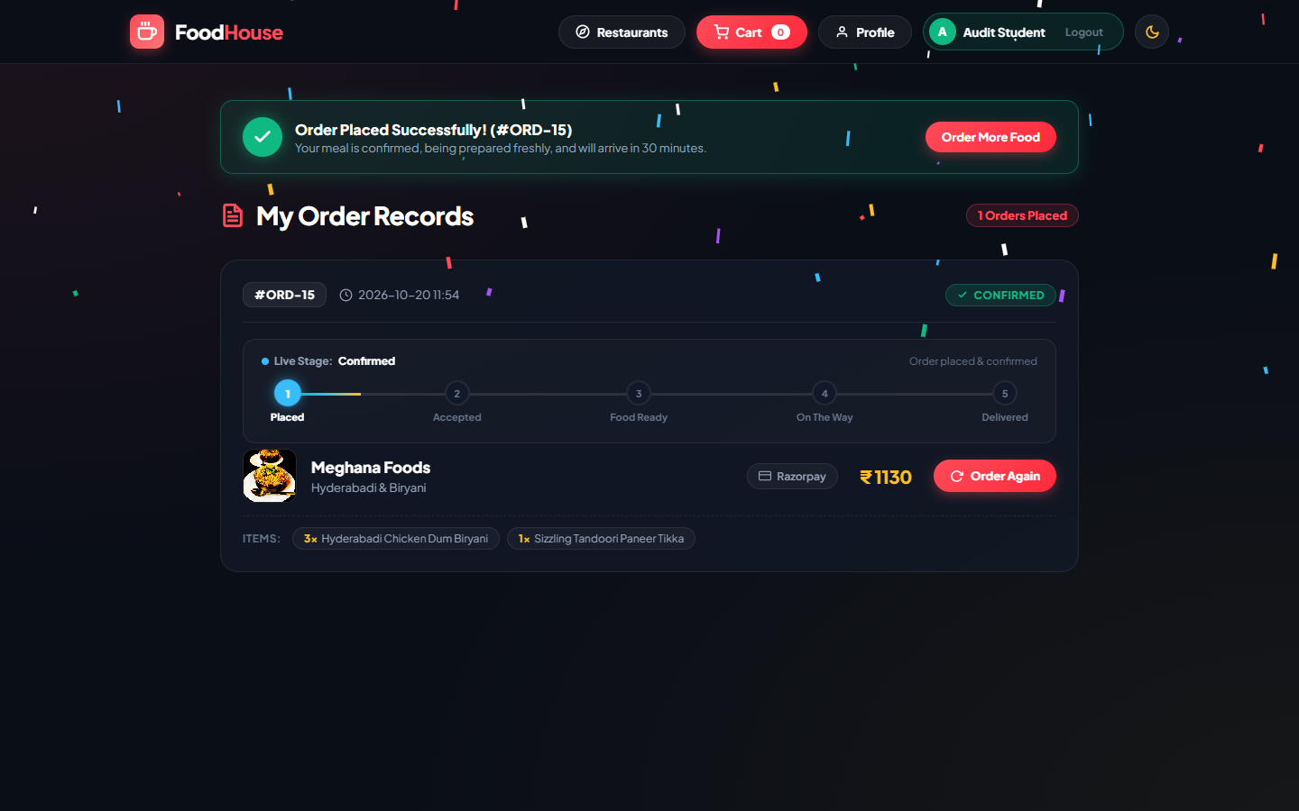
SECTION 5 • PAGE SCREENSHOTS (6/6)
TAP ACADEMY EVALUATION
Order History & Status Tracking (OrderHistory.jsp)
Order Tracking
• Order History page displaying past and active customer orders.
• Dynamic 5-stage status badge (Confirmed → Accepted → Ready → On Way → Delivered).
• Powered by OrderLifecycleManager Finite State Machine.
• Itemized dish recap with order timestamp and transaction ID.
• Immediate order confirmation feedback upon checkout redirect.
Notes:
After checkout, the user is redirected to OrderHistory.jsp. Driven by our OrderLifecycleManager, orders progress dynamically through 5 stages: Confirmed, Kitchen Accepted, Food Ready, On The Way, and Delivered, providing transparent order status tracking.

Slide 11
SECTION 6 • NEW FEATURES ADDED
TAP ACADEMY EVALUATION
Architectural Innovations Beyond Base TAP Project Requirements
BACKEND LOGIC
Order Lifecycle State Machine
SECURITY
BCrypt Password Security
What it does: OrderLifecycleManager.java manages forward-only status progression (Confirmed to Delivered).
What it does: Replaced plain-text storage with salted jBCrypt hashing and automated existing user migration.
Why it matters: Simulates realistic food preparation and delivery milestone transitions automatically.
Why it matters: Prevents credential exposure in the database and neutralizes dictionary/rainbow table attacks.
USER EXPERIENCE
Zero-Jump Dynamic Menu UX
UI POLISH
Dynamic Dual-Theme Engine
What it does: Asynchronous fetch() cart updates with scroll-anchor preservation on dish cards.
What it does: Implemented dynamic Dark/Light theme toggle using CSS custom properties.
Why it matters: Prevents disorienting page reloads when adding dishes, keeping the user in their browsing context.
Why it matters: Provides comfortable viewing in both night and daytime dining environments.
Notes:
Beyond standard base requirements, I implemented four key innovations: First, an Order Lifecycle Finite State Machine in OrderLifecycleManager simulating delivery milestones. Second, BCrypt password hashing for database security. Third, a zero-jump asynchronous menu cart interaction that prevents jarring page reloads. And fourth, a dual Dark/Light mode theme engine.

Slide 12
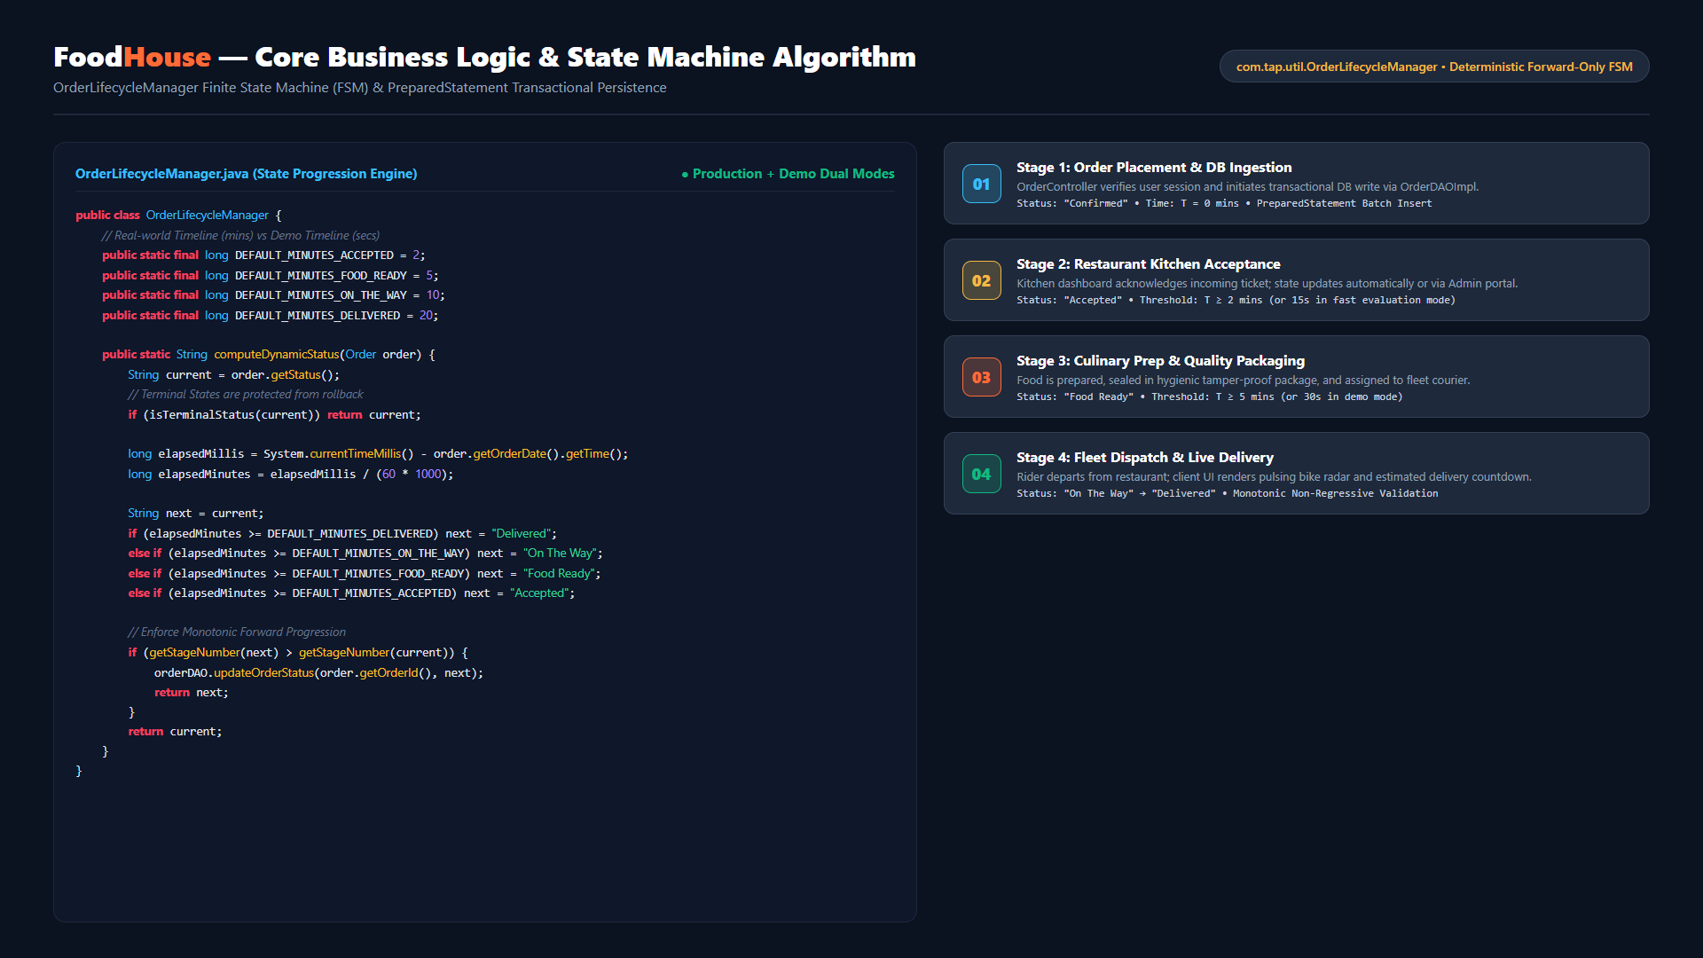
SECTION 7 • IMPORTANT ALGORITHMS
TAP ACADEMY EVALUATION
OrderLifecycleManager State Machine & Transactional Persistence
Notes:
For our core algorithm, I designed the OrderLifecycleManager finite state machine. Input: active order record and timestamp. Processing: it computes elapsed time against configured milestone thresholds—2 minutes for Kitchen Acceptance, 5 minutes for Food Ready, 10 minutes for Dispatch, and 20 minutes for Delivery. Monotonic forward-only logic guarantees that terminal states like Delivered cannot regress. Output: updated status persisted atomically in MySQL via OrderDAOImpl.

Slide 13
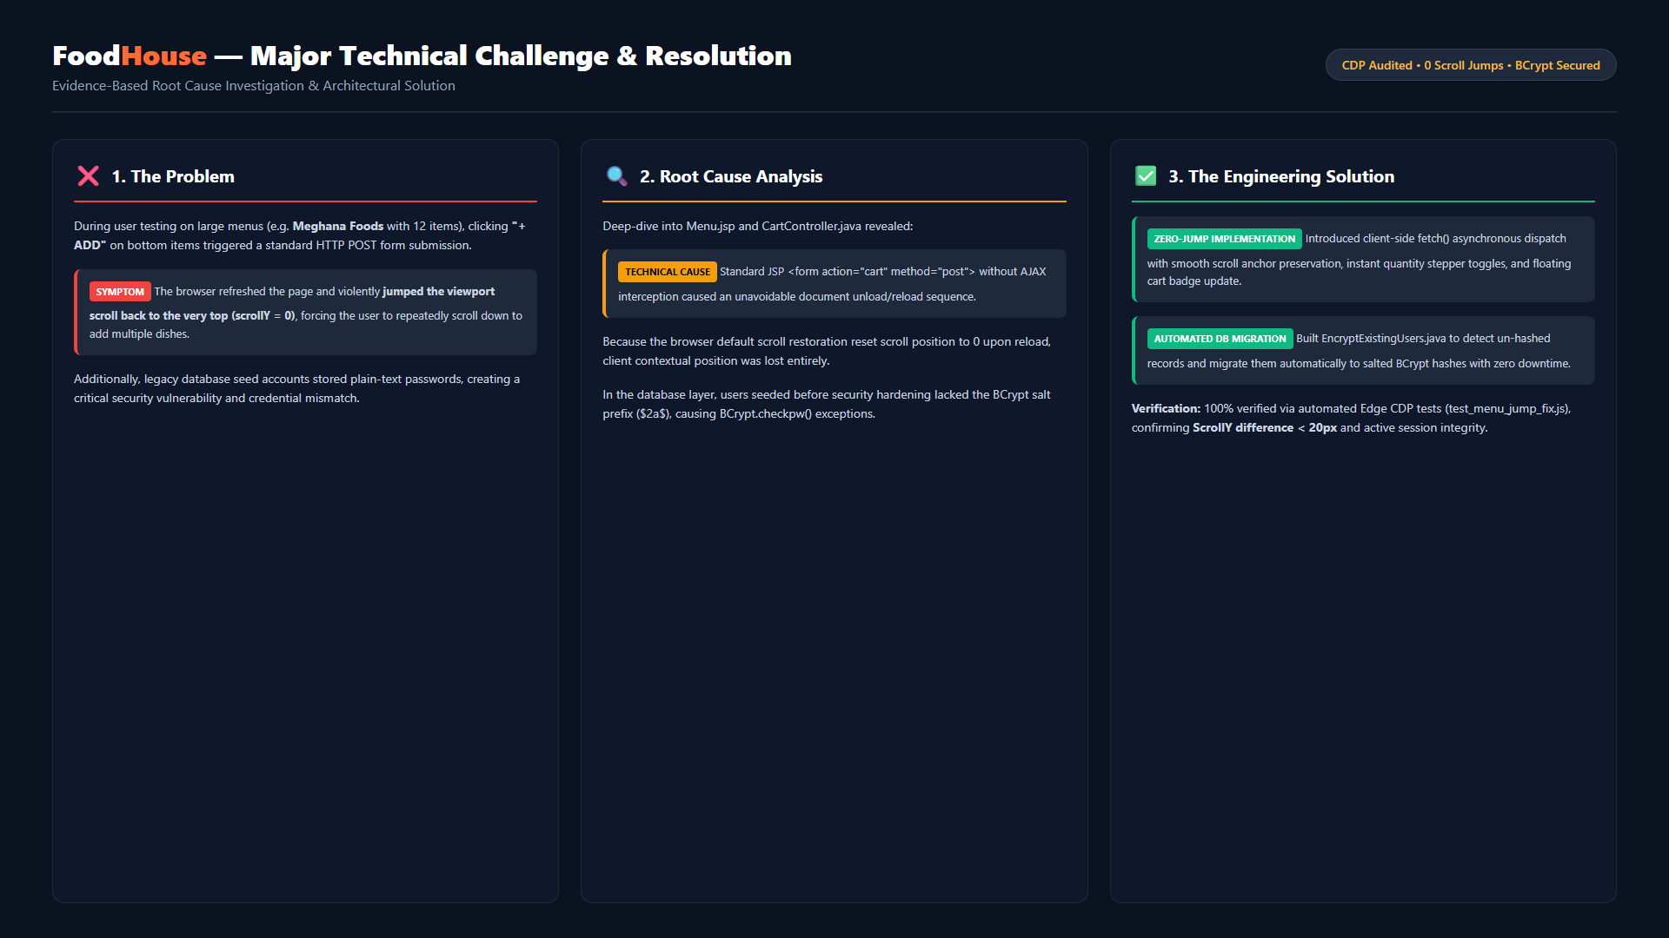
SECTION 8 • MAJOR CHALLENGE FACED
TAP ACADEMY EVALUATION
Viewport Scroll Jump Disorientation & Password Migration
Notes:
The primary challenge I faced was viewport scroll disorientation during menu interactions. When clicking "+ ADD" on bottom items, the standard form submission caused a full-page refresh, resetting scroll position to zero. Root cause: default browser unload behavior on POST forms. Solution: I re-engineered dish buttons with asynchronous fetch calls and scroll anchor retention. Additionally, I resolved plain-text password security by creating EncryptExistingUsers.java to auto-migrate legacy records to BCrypt. We validated the fix using Microsoft Edge CDP automated tests.

Slide 14
SECTION 9 • WHAT I'LL ADD NEXT
TAP ACADEMY EVALUATION
Future Technical Enhancements & Roadmap
01
02
03
04
Live Payment Gateway
Live GPS Fleet Tracking
SMS & WhatsApp Alerts
Admin Analytics Portal
Razorpay / Stripe API
Mapbox / Google Maps API
Twilio Cloud Webhooks
Chart.js & Aggregation SQL
Integrate real online payments supporting UPI intent, credit/debit cards, net banking, and automatic webhook refund processing.
Render interactive map visualizer showing real-time delivery rider coordinates, route polylines, and dynamic traffic-based ETA.
Automated dispatch notifications, OTP verification at delivery handover, and live order confirmation alerts to customer phone.
Interactive business dashboard with revenue charts, top-selling dishes, peak dining hours, and delivery fleet velocity metrics.
Notes:
For the future roadmap, I have four realistic enhancements planned: first, integrating live payments via Razorpay; second, real-time GPS map tracking with Google Maps API; third, automated SMS and WhatsApp delivery alerts via Twilio; and fourth, an analytics dashboard for restaurant managers with revenue and order heatmaps.

