Slide 1

BRITISH AIRWAYS
WEB SCRAPING ON USER REVIEWS

Slide 2
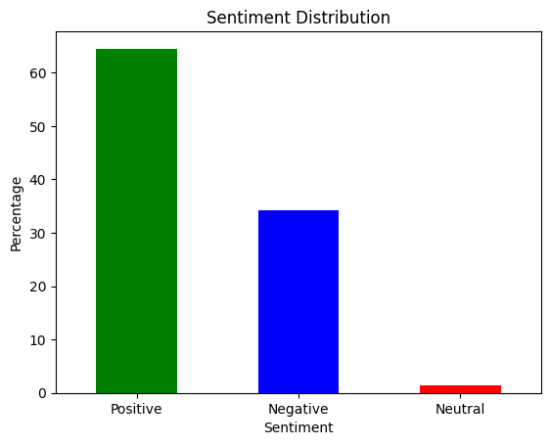
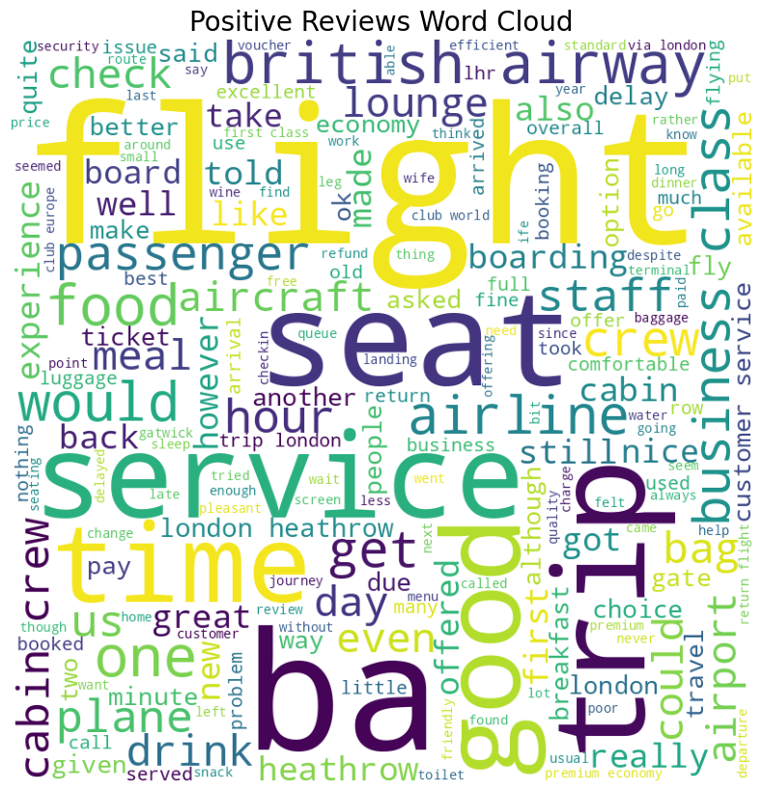
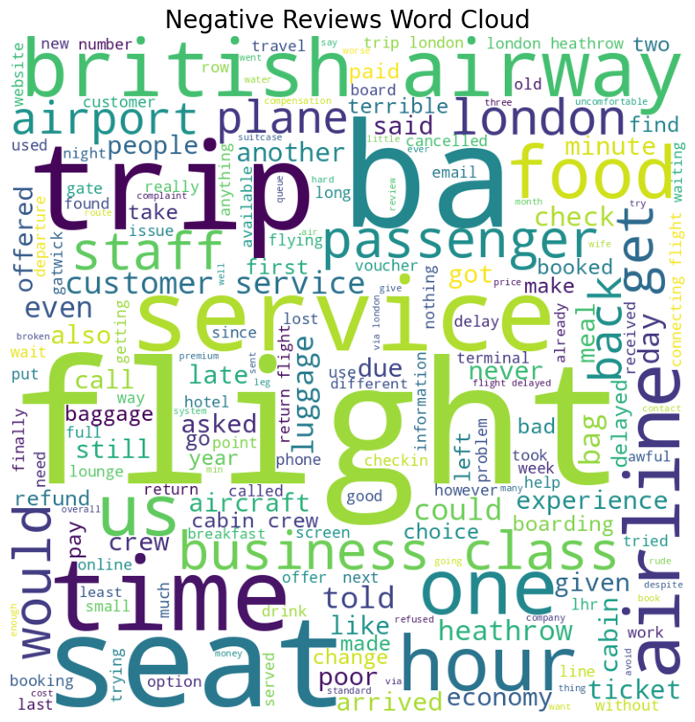
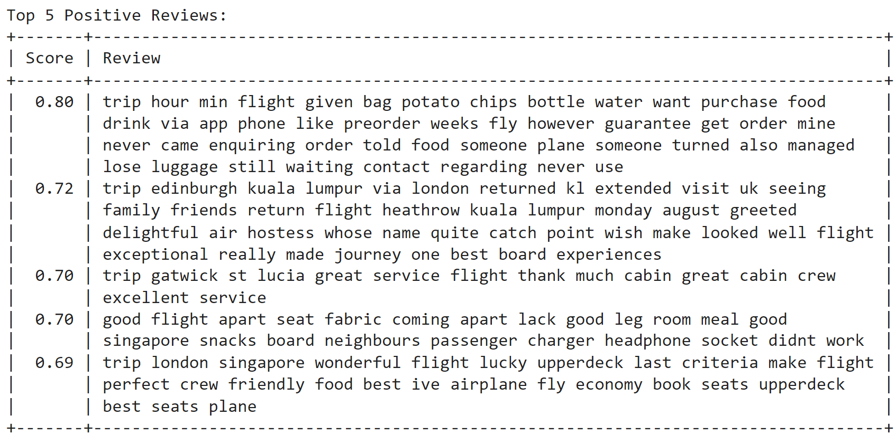
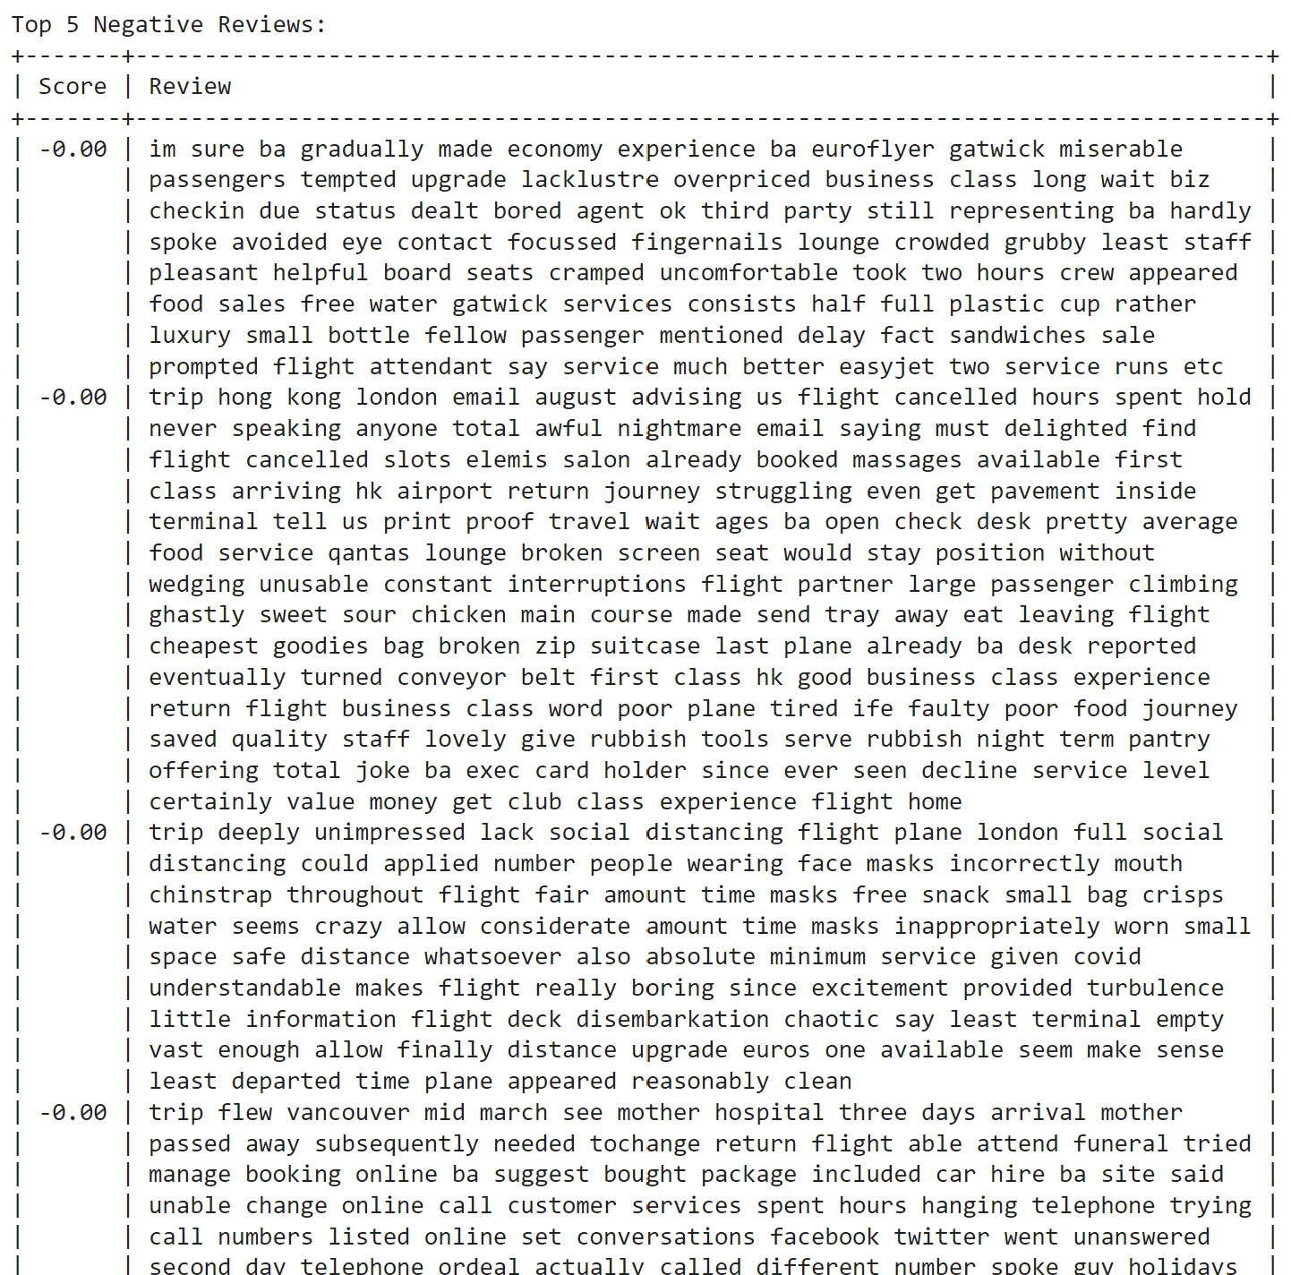
Findings from Customer Reviews
Fig 1: Sentiment distribution of over 1700 reviews, showing high percentage of positive reviews at 65%, negative reviews at 32%
Fig 2: Top words among positive reviews
Fig 3: Words like Baggage claim, food, customer service were frequent in negative reviews
Fig 5 : Top negative reviews
Fig 4 : Top positive reviews

