Slide 1
CAPSTONE PROJECT: END-TO-END DATA SCIENCE PROJECT
By Ganesh Kumar
DA DS

Slide 2
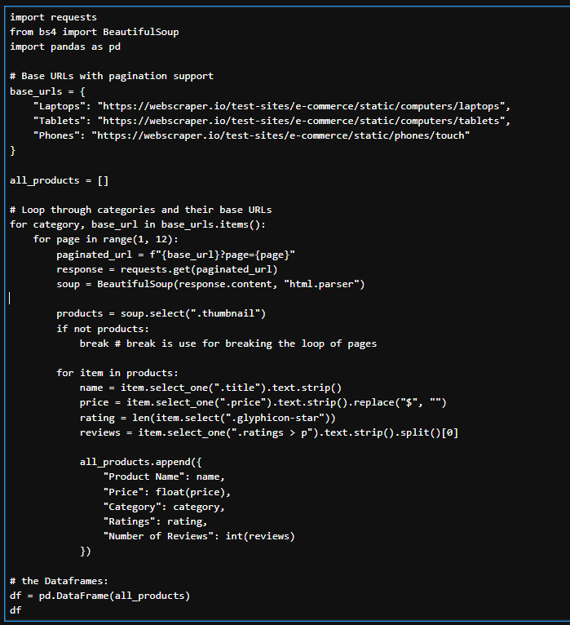
WEB SCRAPING
Data was collected using Web Scraping techniques in Python.
REQUESTS python library is used - to send HTTP requests and fetch the Web content of the web pages.
BEAUTIFUL SOUP is used - to parse and extract specific elements like product name, price, ratings, number of reviews, etc.
Stored the extracted data in a structured format using a Pandas DataFrame.
Exported the dataset to CSV for further preprocessing and analysis.

Slide 3
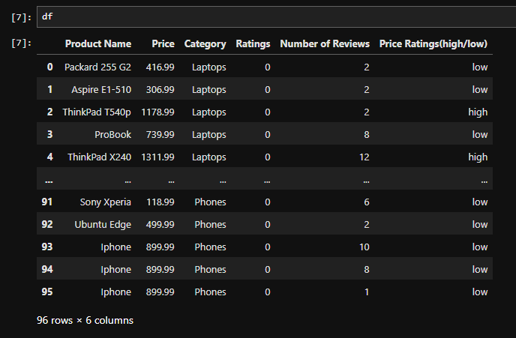
ABOUT THE DATA SET
The dataset contains product information scraped from an e-commerce site. It includes the following columns:
Product Name – title of the product
Price – Product price in USD
Category – Type of product (e.g., Laptop, Tablet, Mobile)
Ratings – Average user rating
Number of Reviews – Count of user reviews per product

Slide 4
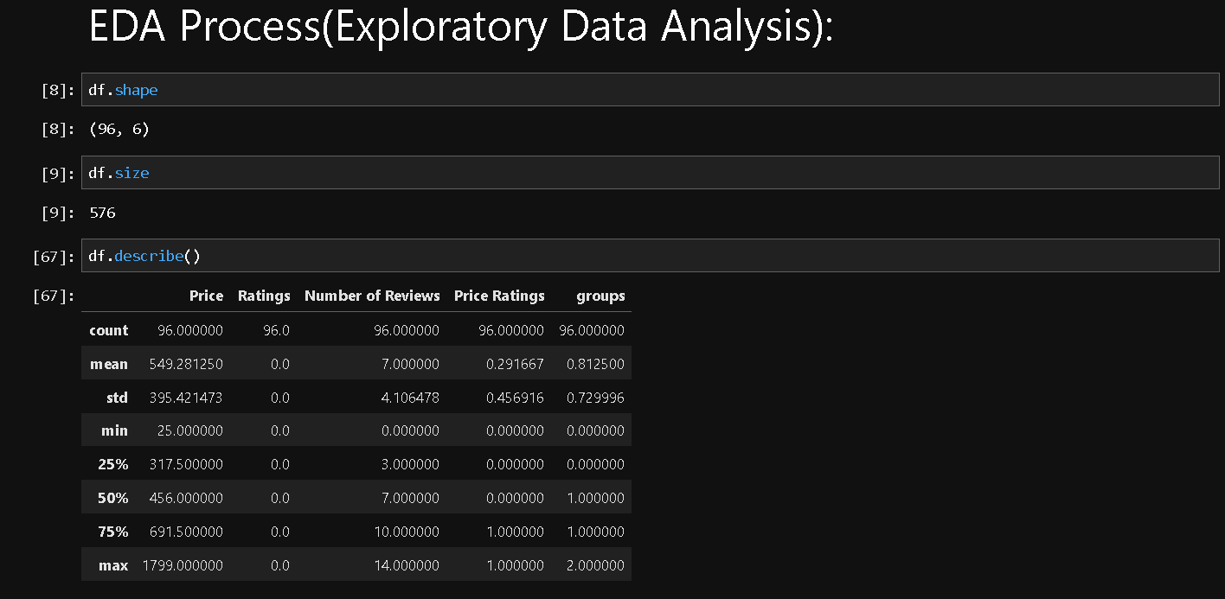
THE EDA PROCESS
EDA was performed to understand the structure and patterns in the dataset.
Handled missing values, corrected data types, and removed duplicates.
Bar plots to compare product counts by category.
Distribution plots to explore price range.

Slide 5
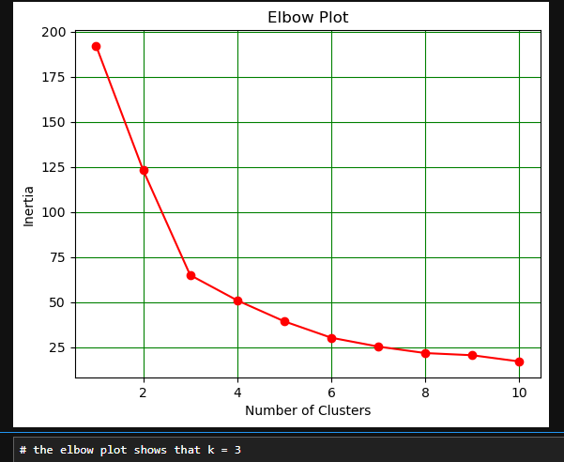
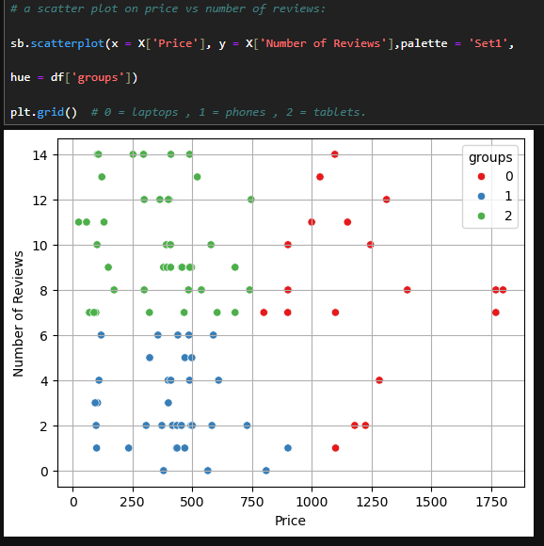
UNSUPERVISED LEARNING
K-Means Clustering Algorithm was applied to segment products based on features like price and reviews.
It helped to identify the hidden patterns and similar product groups.
Used elbow method to find optimal number of clusters (NUMBER OF CLUSTERS = 3)
Results were visualized using scatter plots.

Slide 6
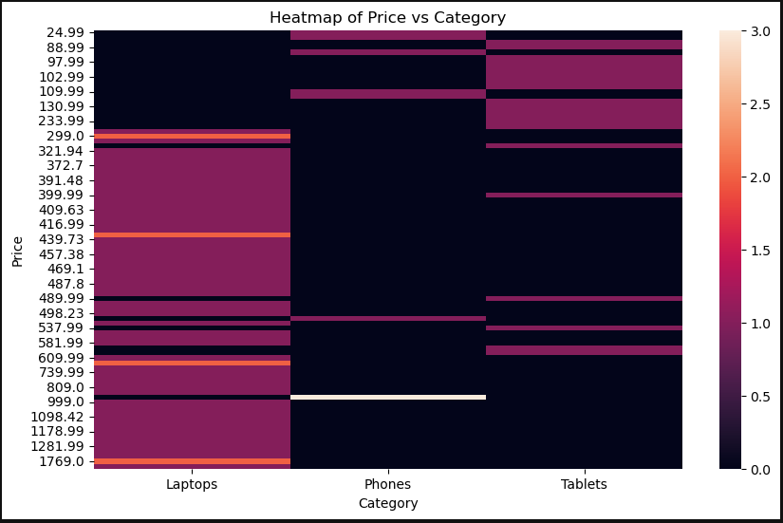
OTHER VISUVALS (Heatmap)
Heatmap of Price vs Category:
The goal of this heatmap was to visually compare how product prices are distributed across different categories
Key Insights from the Heatmap:
Identifies which price ranges are most common for each category.
Helps detect price clustering — for example, mobiles are more frequent in the lower price bins, while laptops are spread in higher ranges.
Useful for understanding product positioning and pricing strategy across categories.

Slide 7
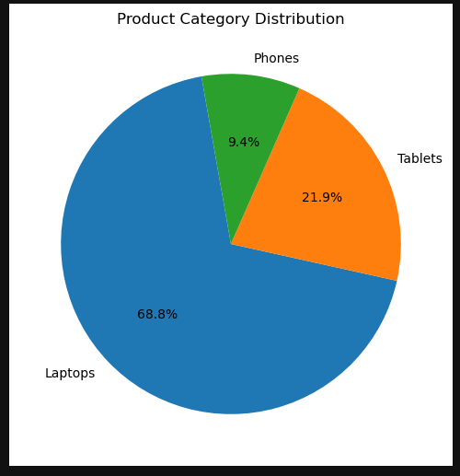
OTHER VISUVALS (Pie chart)
A pie chart was used to visualize the distribution of products across different categories,
such as:
Laptops
Tablets
Mobile Phones
Key Insights from the pie chart:
The Pie charts help quickly identify dominant categories.
Useful for understanding category distribution.
It shows that laptops have more product dominance with
68% followed by Tablets and Phones .

Slide 8
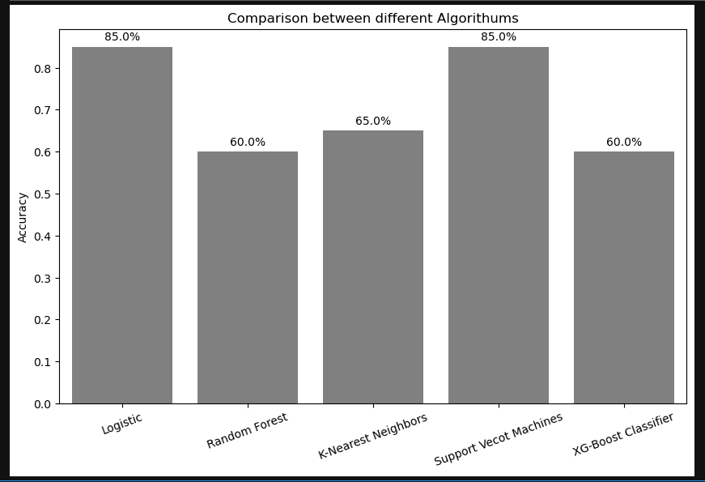
SUPERVISED LEARNING
In this project, supervised learning was used to predict product categories based on features such as the number of reviews and price ratings.
Train-Test Split method:
The dataset was split into training and testing sets using an 80-20 ratio.
Models Used:
LogisticRegression – 85.0 %
Random Forest Classifier - 60.0%
K-Nearest Neighbors (KNN) – 65.0 %
Support Vector Machine (SVM) – 85.0 %
XGBoost Classifier - 60.0%
Model Evaluation:
Models were evaluated using accuracy score.
The results were printed to compare performance.

Slide 9
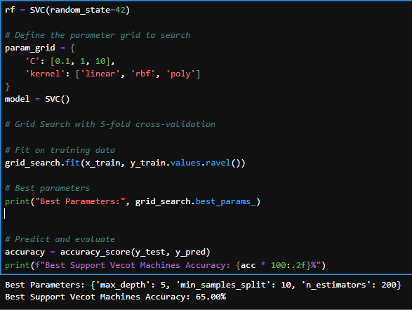
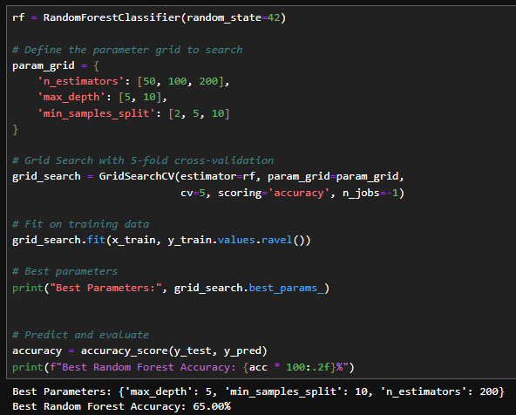
HYPERPARAMETER TUNING
Grid Search CV was used with Random Forest and Support Vector Machine to find the best parameters for improved accuracy.
Random Forest – 60.00 % – 65.06 %
Support Vector Machine – 60.00 % – 63.00 %

Slide 10
KEY INSIGHTS
Category DistributionProducts are grouped into:
Laptops
Tablets
Mobile Phones
Most entries are from the Laptops category, showing higher product availability in that segment.
Price Analysis:
Laptops have the highest average price, followed by tablets and mobile phones.
Wide price range observed, from budget to premium products.
Ratings Insight:
Most products have ratings between 3.5 to 4.5 stars.
Few products have 5-star ratings, indicating potential user satisfaction gaps.

Slide 11
CONCIUSION
Extracted patterns in pricing, ratings, and category-wise distribution of products.
Implemented multiple classification algorithms such as Logistic Regression, Random Forest, KNN, SVM, and XGBoost to predict price ratings based on review counts.
Compared model accuracies to identify the best-performing algorithm.
Fine-tuned models using GridSearchCV to enhance prediction accuracy.
Overall, the project showcases how real-world data can be collected, cleaned, analyzed, and modeled to drive actionable insights.

Slide 12
THANK YOU

