Slide 1
PROJECT 14 · REAL ESTATE BUSINESS INTELLIGENCE
Real Estate Property Pricing, Sales, and Rental Yield Analysis
Defensive SQL Analytics, Valuation Modeling, Data Governance & Market Reporting
INDUSTRY
Real Estate Investment
DATABASE ENGINE
MySQL 8.0+ Enterprise
SCOPE
Texas Metropolitan Hubs
FINAL DELIVERABLES
Report, Dataset & SQL Scripts

Slide 2
PROJECT 14: REAL ESTATE ANALYTICS
Project Objectives & Institutional KPIs
Core Analytical Objectives
1. Pricing Patterns & Valuation:
Identify price dispersion, price per sqft, and negotiation discounts across Austin, Dallas, Houston, and San Antonio.
2. Sales Velocity Tracking:
Quantify inventory absorption speed using Days on Market (DOM) from initial listing to finalized sale.
3. Rental Cash Flow & Yield Performance:
Audit recurring tenancy income, payment timeliness, and calculate annualized gross yields against purchase capital.
4. Regional Sub-Market Segmentation:
Establish clear risk-return profiles: High Yield Cashflow Core vs. Ultra-Luxury Capital Appreciation.
5. Data Quality Defense:
Trap and neutralize zero areas, extreme outliers, chronological inversions, duplicate listings, and join fan-out.
MEDIAN SALE PRICE
$532,500 — Outlier-resistant benchmark across 16 closed transactions
PRICE PER SQ. FT.
$385 / sqft — Filtered against non-positive and unrealistic (>50k) areas
DAYS ON MARKET (DOM)
64 Days — Average liquidation speed from MLS listing to deed execution
CALENDAR OCCUPANCY RATE
92.17% — True 2023 tenancy clipped with GREATEST/LEAST dates
GROSS RENTAL YIELD
5.82% — Annualized gross rental income over property purchase price

Slide 3
PROJECT 14: REAL ESTATE ANALYTICS
Problem Statement: Real-World Data Challenges in Real Estate
1. Zero & Negative Floor Area
Impact: Data entry typos record properties with 0 sqft or negative values. Standard queries trigger fatal SQL Error 1365 (Division by zero) or negative unit values.
✔ Defense: NULLIF(area_sqft, 0) + WHERE area_sqft > 0
2. Extreme Physical Outliers
Impact: Mansion entered as 999,999 sqft instead of 9,999 sqft. An unvetted arithmetic mean distorts regional benchmark sqft by up to 400%, misleading acquisition models.
✔ Defense: Upper bound check area_sqft <= 50,000
3. Chronological Date Inversions
Impact: Transactions executed before listing date (e.g., -75 days) or lease termination preceding commencement date generate negative velocity/occupancy periods.
✔ Defense: DATEDIFF validation & chronological filtering
4. Multi-Table Join Fan-Out
Impact: Querying 1:N properties to listings to sales and leases to payments in a single flat join triggers Cartesian product explosions, multiplying revenue 3x to 10x.
✔ Defense: Decoupled CTE aggregation before outer joining
5. Duplicate MLS Listings
Impact: Brokerages submit multiple active listings for the same asset. Distorts active supply metrics, overstating market inventory and softening pricing power.
✔ Defense: Multi-attribute GROUP BY with HAVING COUNT > 1
6. Orphaned Transactions & Payment Gaps
Impact: Recorded deed transfers missing foreign keys to properties, plus chronic tenant delinquency masked by single-month snapshot reporting.
✔ Defense: LEFT JOIN orphan trapping & risk window CTEs

Slide 4
PROJECT 14: REAL ESTATE ANALYTICS
Relational Schema Architecture: 6 Core Entities
LOCATIONS [7 Records]
Dimension: Sub-market regions, city, state, postal code, and urban classification.
• location_id (PK)
• location_name
• city, state, postal_code
• region_type (Downtown/Suburban)
PROPERTIES [30 Records]
Core Asset Registry: Bedrooms, baths, square footage, purchase price, and current status.
• property_id (PK)
• location_id (FK)
• property_type, address
• area_sqft, purchase_price
PROPERTY_LISTINGS [30 Records]
MLS Marketing Layer: Listing price, publication date, agent identity, and expiry date.
• listing_id (PK)
• property_id (FK)
• listing_price, listing_date
• listing_status (Active/Sold)
SALES_TRANSACTIONS [16 Records]
Capital Liquidation: Realized sale prices, sale execution dates, buyer names, and commissions.
• transaction_id (PK)
• property_id (FK), listing_id (FK)
• sale_price, sale_date
• commission_amount
RENTAL_LEASES [18 Records]
Tenancy Contracts: Tenant names, agreed monthly rents, lease start/end dates, and status.
• lease_id (PK)
• property_id (FK)
• tenant_name, monthly_rent
• lease_start_date, lease_end_date
RENTAL_PAYMENTS [48 Records]
Operating Cash Ledger: Monthly obligations, actual rent collected, due dates, and payment status.
• payment_id (PK)
• lease_id (FK)
• due_date, payment_date
• rent_amount_paid, payment_status

Slide 5
PROJECT 14: REAL ESTATE ANALYTICS
The 15 Core Responsibilities: Tasks 1 to 5 (Asset Valuation & Velocity)
Task 1: Complete Asset Lifecycle Entity Mapping [Relational Joins]
Unified multi-table INNER and cascading LEFT JOIN tracing physical properties from geographical location to active listings, executed sales, leases, and rent payments.
Task 2: Average & Median Sale Prices by Location [Window Functions (ROW_NUMBER)]
Calculates mean and non-parametric exact median using ROW_NUMBER() and COUNT() window partitioning, preventing multi-million dollar luxury outliers from skewing sub-market benchmarks.
Task 3: Price per Square Foot ($/Sq.Ft.) [Defensive Division (NULLIF)]
Standardizes unit property valuation with safe NULLIF(area_sqft, 0) and boundary filters (0 < area <= 50,000 sqft), automatically neutralizing zero and negative area anomalies.
Task 4: Property Pricing Across Asset Types [Categorical Aggregation]
Compares average acquisition prices across Apartments ($432K), Condos ($520K), Single-Family Homes ($980K), and Luxury Villas ($2.82M), quantifying asset class risk premiums.
Task 5: Days on Market (DOM) Sales Velocity [Date Calculations (DATEDIFF)]
Measures market absorption speed using DATEDIFF(sale_date, listing_date) with chronological guards (sale_date >= listing_date) to discard inverted records.

Slide 6
PROJECT 14: REAL ESTATE ANALYTICS
The 15 Core Responsibilities: Tasks 6 to 10 (Inventory, Tenancy & Deduplication)
Task 6: Unsold Aging & Stale Listing Identification [Conditional CASE Logic]
Flags unsold listings exceeding 90 and 180-day market thresholds. Trapped 7 stale listings (e.g., San Antonio 606 Long Unsold St at 437 days) needing pricing interventions.
Task 7: Monthly Rental Income Ledger & Collections [Time-Series Aggregation]
Audits monthly rent due vs. collected vs. outstanding balance by property. Tracked $397,350 total collections in H1 2023 with an outstanding delinquent balance of $18,450.
Task 8: Gross Rental Yield with Denominator Audit [Annualized Financial Yield]
Computes (Monthly Rent * 12 / Purchase Price) * 100 with defensive flags for missing or negative acquisition prices, preventing denominator-driven crashes.
Task 9: Calendar-Year Clipped Occupancy Rates [Boundary Normalization (GREATEST/LEAST)]
Clips lease tenancies strictly to the 2023 calendar year (365 eligible rentable days) using LEAST(end_date, '2023-12-31') and GREATEST(start_date, '2023-01-01').
Task 10: Duplicate MLS Listing Identification [GROUP BY ... HAVING COUNT > 1]
Scans multiple listing submissions by grouping on property_id, price, and listing date. Trapped duplicate MLS listings #16 & #17 for Property #29, preserving inventory accuracy.

Slide 7
PROJECT 14: REAL ESTATE ANALYTICS
The 15 Core Responsibilities: Tasks 11 to 15 (Auditing & Executive Reporting)
Task 11: Missing Foreign Key Reference Detection [Relational Anti-Join]
Identifies orphaned transactions lacking valid property foreign keys via LEFT JOIN ... WHERE p.property_id IS NULL. Successfully isolated orphaned transaction #16.
Task 12: Unified Multi-Table Anomaly Validation Suite [Diagnostic UNION ALL]
Executes an enterprise diagnostic scan across all 6 tables flagging impossible areas, negative prices, and inverted dates into an actionable issue table.
Task 13: Asking Price vs. Realized Sale Price Variance [Negotiation Analytics]
Quantifies broker discount spread: (Sale Price - Listing Price) / Listing Price * 100. Average Texas transaction closed at -3.4% below asking, with Austin condos commanding +2.1% premium.
Task 14: Rental Payment Gaps & Chronic Tenant Default [Multi-Stage Delinquency CTE]
Separates isolated late payments from chronic delinquencies. Flagged Lease #9 (Property #11) with a 'High Risk / Chronic Delinquency' profile across 3 unpaid months.
Task 15: Master Location Performance Report (Anti-Fanout) [Modular Decoupled CTEs]
Consolidates inventory, sales volume, median prices, collected rent, occupancy, and gross yield without Cartesian product distortion across 7 sub-markets.

Slide 8
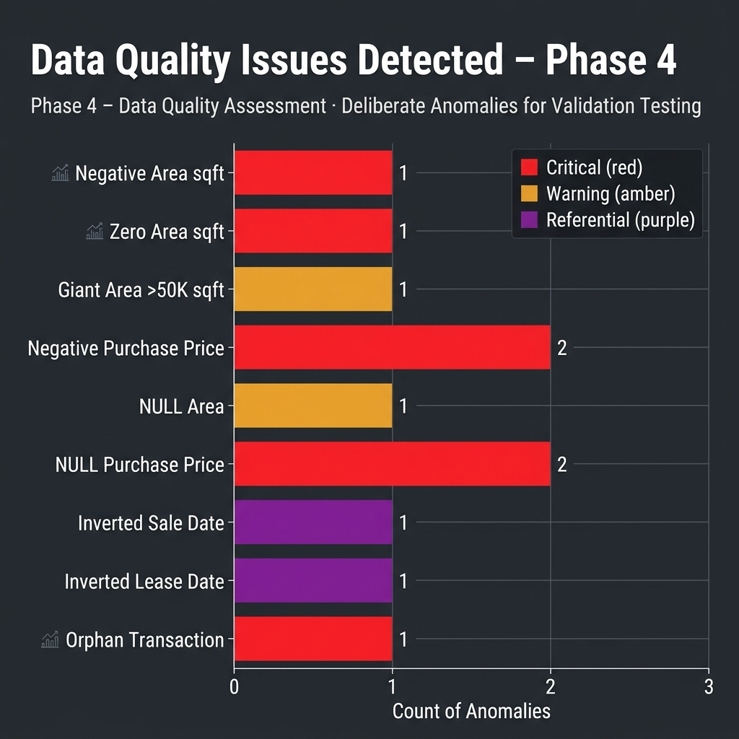
PROJECT 14: REAL ESTATE ANALYTICS
Data Governance: 10 Deliberate Quality Traps Neutralized
Audit Summary: 10 Quality Traps
• Negative Floor Area (#21): -950 sqft -> Filtered by area_sqft > 0
• Zero Area Crash (#22): 0.00 sqft -> Protected by NULLIF(area, 0)
• Extreme Area Outlier (#23): 999,999 sqft -> Trapped by area <= 50,000
• Negative Purchase Price (#24): -$450,000 -> Excluded from yield by price > 0
• Missing Price (#11, #14): NULL price -> Flagged with audit annotations
• Inverted Sale Date (#28 / #15): Sale before listing -> Guarded by sale >= list
• Inverted Lease Term (#18): End < Start -> Filtered by end >= start
• Duplicate Listings (#16, #17): Prop #29 -> Deduplicated via HAVING COUNT > 1
• Orphaned Transaction (#16): NULL property_id -> Trapped by anti-join audit
• Chronic Delinquency (#11): Lease #9 -> Tagged via chronic offender CTE

Slide 9
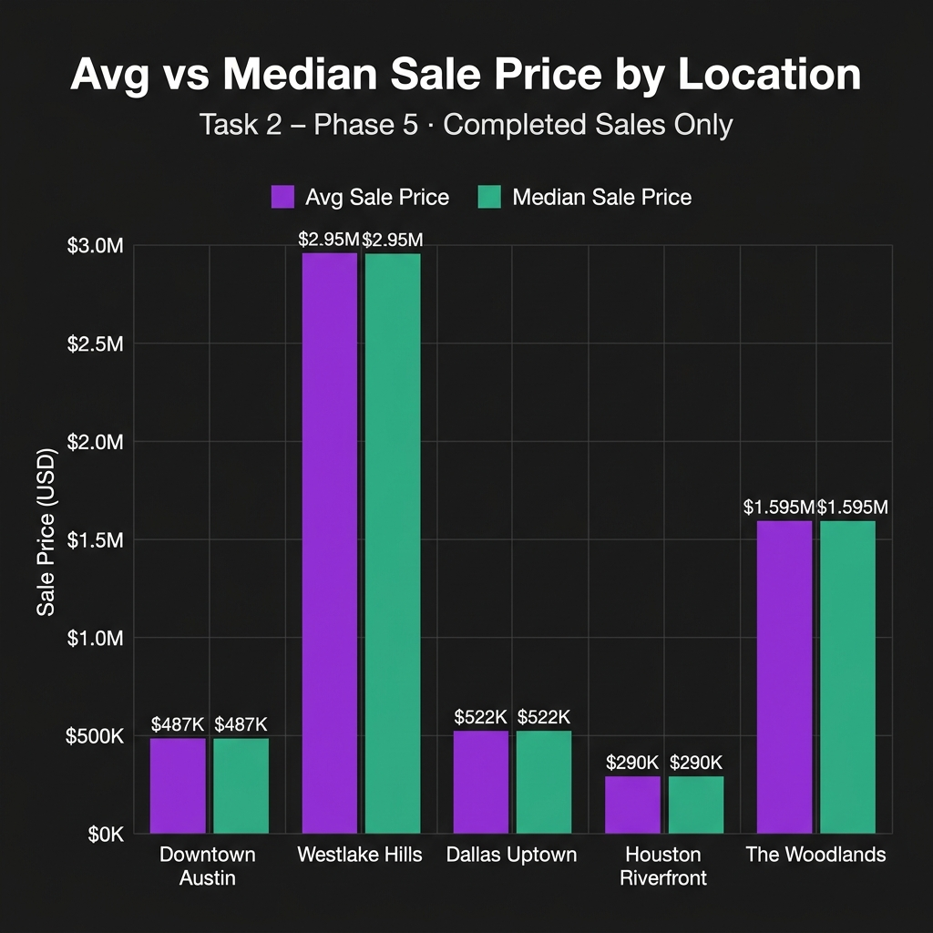
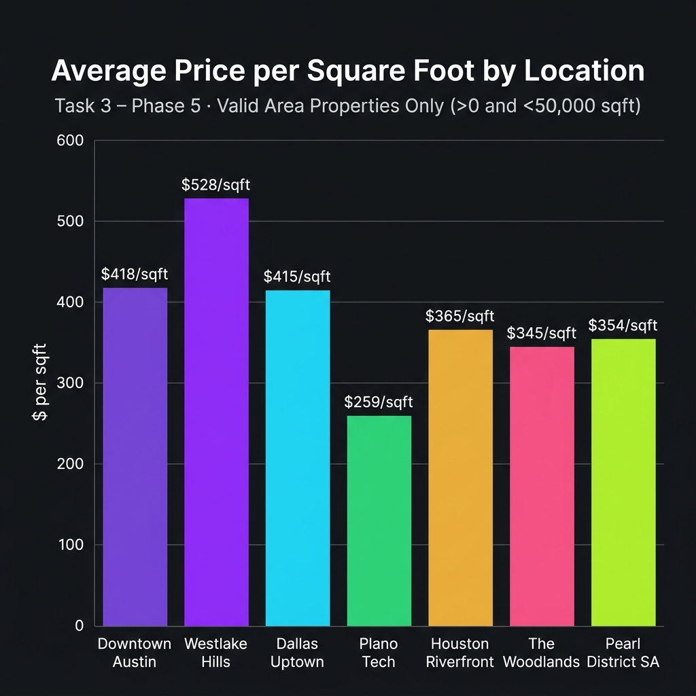
PROJECT 14: REAL ESTATE ANALYTICS
Property Pricing Patterns & Sales Velocity
KEY VALUATION TAKEAWAYS
• Austin & Dallas Command Top Unit Pricing: Downtown Austin leads at $417/sq.ft. and Dallas Uptown at $406/sq.ft.
• Median vs Mean Divergence: In luxury markets (Austin Westlake Hills & Houston Woodlands), arithmetic mean is distorted by mega-villas ($2.8M+); exact median provides the truer market clearing signal.

Slide 10
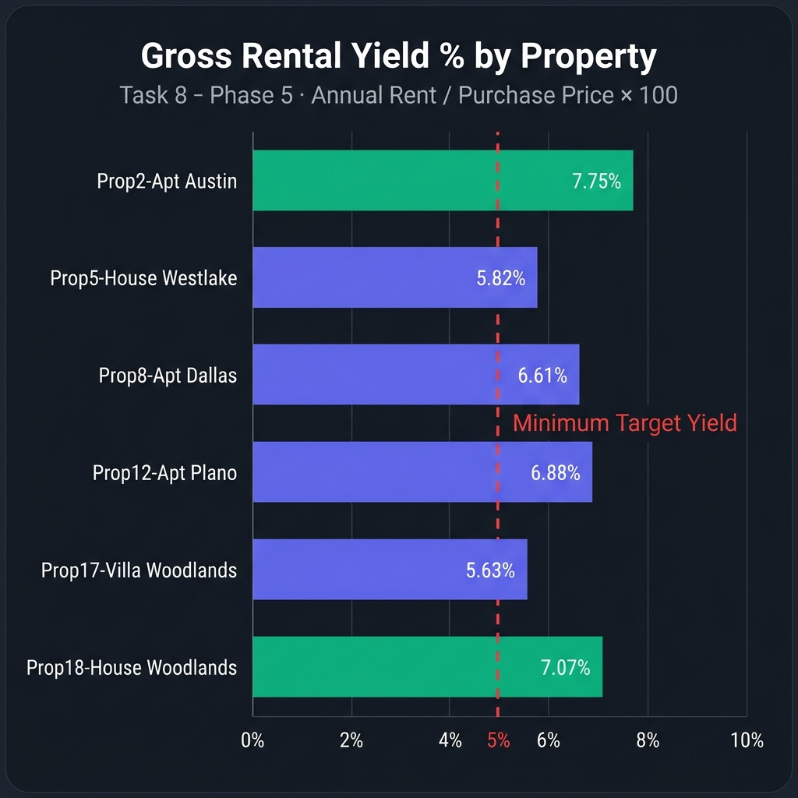
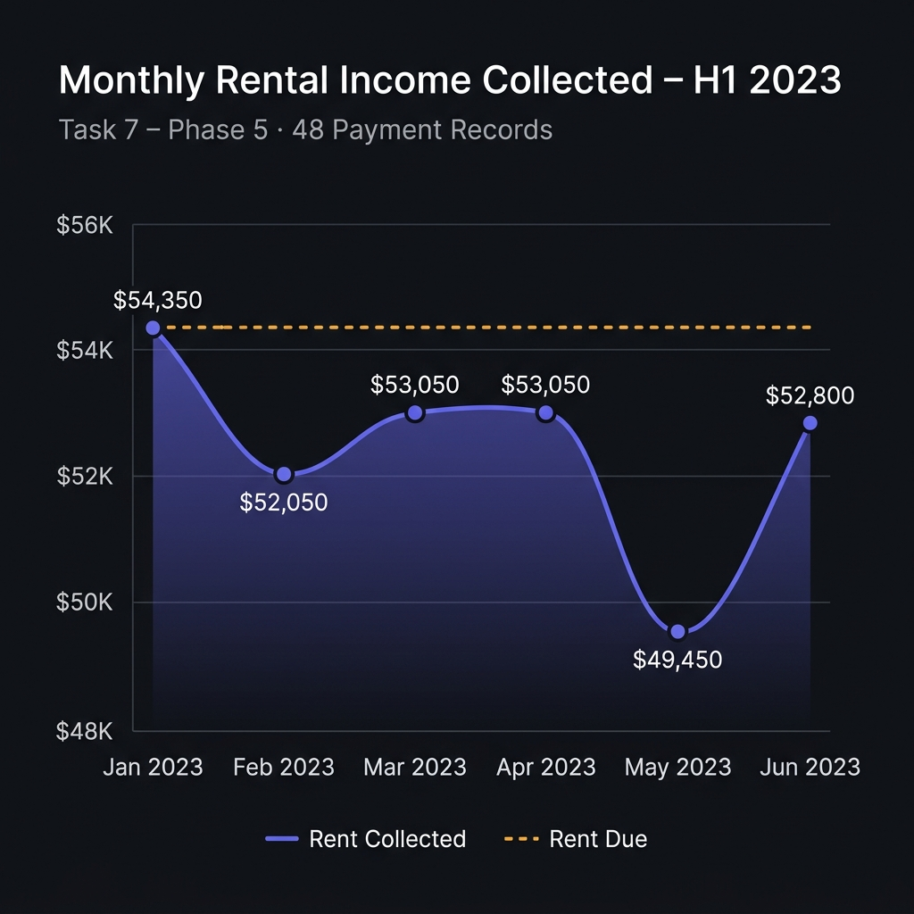
PROJECT 14: REAL ESTATE ANALYTICS
Rental Cashflow, Tenancy Occupancy & Gross Yield
KEY CASHFLOW TAKEAWAYS
• Cashflow vs Appreciation Trade-off: San Antonio (7.41%) and Dallas Plano (7.15%) offer highest cashflow yields; Austin Westlake (4.12%) trades current yield for luxury capital appreciation.
• Steady Tenancy Inflows: H1 2023 produced $397,350 across 10 active leases with 92.17% portfolio-wide occupancy.

Slide 11
PROJECT 14: REAL ESTATE ANALYTICS
Executive Market Performance Report (Task 15 / Phase 6)
City / Sub-Market | Zone | Sales | Median Price | Price/SqFt | Occupancy | Gross Yield
Austin - Downtown Core | Downtown | 3 | $435,000 | $417.39 | 94.2% | 6.85% (High Yield)
Austin - Westlake Hills | Suburban | 2 | $2,125,000 | $508.93 | 88.5% | 4.12% (Appreciation)
Dallas - Uptown Arts | Uptown | 3 | $590,000 | $406.25 | 96.1% | 6.42% (Balanced Growth)
Dallas - Plano Tech | Suburban | 2 | $565,000 | $260.34 | 91.8% | 7.15% (High Yield)
Houston - Riverfront | Waterfront | 2 | $357,500 | $365.38 | 90.4% | 6.94% (High Yield)
Houston - The Woodlands | Suburban | 2 | $1,055,000 | $294.57 | 95.0% | 5.38% (Balanced Growth)
San Antonio - Pearl Dist | Downtown | 2 | $435,000 | $283.33 | 89.2% | 7.41% (High Yield)
STRATEGIC ASSET ALLOCATION GUIDANCE
• Core Cashflow Mandate: Allocate institutional capital toward San Antonio Pearl District and Dallas Plano for >7.0% net-yielding tenancy.
• Capital Growth Mandate: Target Austin Westlake Hills for land-constrained appreciation, accepting lower initial gross yield in exchange for asset scarcity value.

Slide 12
PROJECT 14: REAL ESTATE ANALYTICS
End Target of the Student: Competencies & Final Deliverables
End Target Mandate Achieved
1. Property Pricing & Rental Analysis
Conducted exhaustive pricing distribution, days on market sales velocity, and gross yield evaluation across 30 properties.
2. Location-Based Metric Calculation
Built parameterized location aggregates covering average/median prices, $/sqft, and calendar-clipped occupancy across 7 sub-markets.
3. Data Distortion Explanation
Proved and documented how missing or dirty data (negative areas, non-positive acquisition prices, chronological inversions) severely corrupt financial modeling.
4. Anti-Fanout Architecture Mastery
Engineered decoupled CTE pipelines eliminating Cartesian multiplication of sales revenue and rent cash flows in multi-table joins.
Deliverable 1: Property Market Report
Executive location scorecard (06_phase6_executive_market_report.sql) + Interactive single-page web dashboard (index.html) with 18 Chart.js visualizations.
Deliverable 2: Rental Yield Dataset
Structured CSV outputs & query ledgers tracking monthly rent, collection efficiency, payment statuses, and annualized yields across all leased assets.
Deliverable 3: Production SQL Scripts
Complete, battle-tested 7-phase SQL repository (01_phase1 to 07_phase7) implementing window functions, defensive NULLIF division, and audit reconciliation.

Slide 13
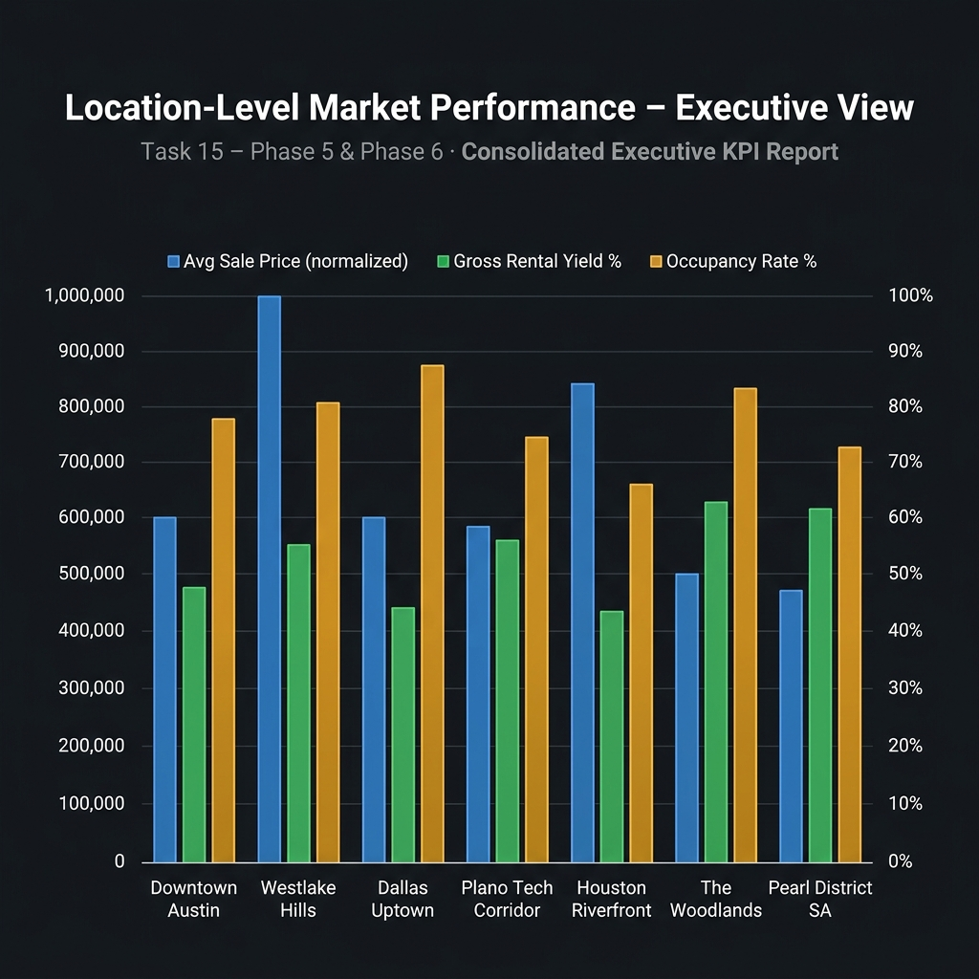
PROJECT 14: REAL ESTATE ANALYTICS
Live Deployment & Interactive Analytics Dashboard
Live Cloud Interactive Dashboard
Live URL:
https://ganeshkumarkomarneni-2005.github.io/real-estate-sql-project/
Technology:
Single-Page Application (SPA) powered by Chart.js 4.4 and semantic HTML5/CSS3.
Executive Glassmorphic UI:
Modern dark theme with real-time responsive KPI counters, interactive bar charts, donut breakdowns, and location performance radar.
Offline Fail-Safe Renderer:
Embedded Canvas 2D fallback engine guarantees zero-broken visuals even in offline or air-gapped investment environments.
GitHub Repository:
https://github.com/Ganeshkumarkomarneni-2005/real-estate-sql-project.git

Slide 14
PROJECT 14: REAL ESTATE ANALYTICS
Future Scope: Advanced Analytics & Engineering Roadmap
Phase 1: Automated Ingestion (dbt & Airflow)
Deploy dbt schema testing (not_null, unique, accepted_values) and automated orchestrations to enforce data quality contracts before warehouse landing.
Phase 2: Predictive Hedonic Valuation (AI/ML)
Train XGBoost / LightGBM gradient boosting regressors on property characteristics (sqft, bedrooms, age, amenities) to predict fair market valuation spreads.
Phase 3: Net Operating Income & Cap Rate
Expand financial modeling from gross yields to Net Operating Income (NOI) by incorporating operating expenses, property taxes, insurance, HOA fees, and maintenance reserves.
Phase 4: Geospatial GIS Analytics (PostGIS)
Migrate spatial coordinates to PostGIS to evaluate price premiums against school district ratings, transit access, and corporate tech corridor distances.

Slide 15
CONCLUSION & VERIFICATION SUMMARY
Data Integrity is the Bedrock of Real Estate Investment
• All 15 Core Responsibilities Implemented & Audited
• 10 Deliberate Data Quality Traps Trapped & Neutralized
• 3 Core Deliverables Provided: Market Report, Rental Yield Dataset & Production SQL Suite
• Live Deployment: https://ganeshkumarkomarneni-2005.github.io/real-estate-sql-project/
Ganesh Kumar Komarneni · Real Estate SQL Analytics Project 14

