Slide 1
Artificial intelligence
21001-CS-059
M.GANESH

Slide 2
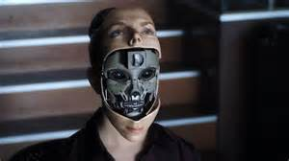
contents
DEFINITION OF AI
EARLY HISTORY
CURRENT STATUS OF AI
CHALLENGES FOR AI
FUTURE OF AI
PROS AND CONS
CONCLUSION

Slide 3
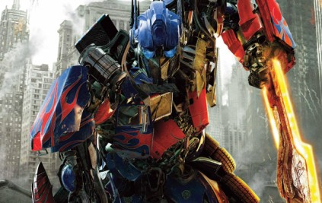
WHAT IS ARTIFICIAL INTELLIGENCE?
The study of computer systems that attempts to model and apply the intelligence
of the human mind
the capability of a machine to imitate intelligent human behaviour.

Slide 4

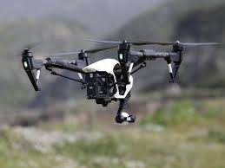
Categories of ai
Strong ai
A machine with strong ai is able to think and act just like a human. It is able to learn from human experience.
Weak ai
Machine with weak ai are made to respond to specific situations but can not think for themselves.

Slide 5
EARLY HISTORY OF AI
IN 1950 ENGLISH MATHEMATICIAN ALAN TURING PUBLISHED A LANDMARK PAPER TITLED AS “COMPUTING MACHINERY AND INTELLIGENCE”.
FURHTER WORK CAME OUT OF A 1956 WORKSHOP AT DARTMOUTH CONFERENCE SPONSORED BY JOHN MCCARTHY.

Slide 6
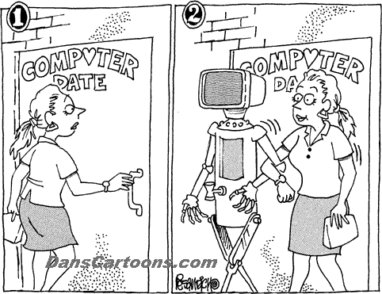
CURRENT STATUS OF AI
AI HAS BEEN TAKEN MANY SHAPES AN FORMS OVER RECENT YEARS .
MOBILE PHONES.
VIDEO GAMES.
GPS
DEEP LEARNING
ROBOTICS
DIGITAL ASSISTANCE

Slide 7
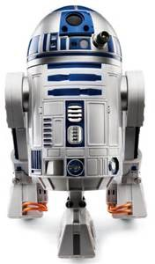
FUTURE OF AI
MILITARY OF BOTS
SELF DRIVING CARS
IMPROVED MEDICAL CARE AND TREATMENT.
SMART HOME BY MOBILE APPLIANCES AND VOICE RECOGNITION.

Slide 8
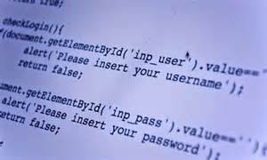
PROS AND CONS
PROS
PRECISON AND ACCURACY
SPACE EXPLORATION
USED FOR MINING PROCESS
FRAUD DETECTION
DIAGNOSTIC AND TREATMENT

Slide 9
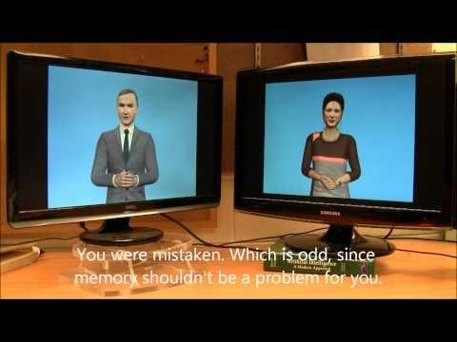
CONS
LACK THE HUMAN TOUCH
LACK CREATIVE MIND
UNEMPLOYMENT
OVER DEPENDENCY OF HUMANS ON MACHINES
LACK OF COMMON SENSE

Slide 10
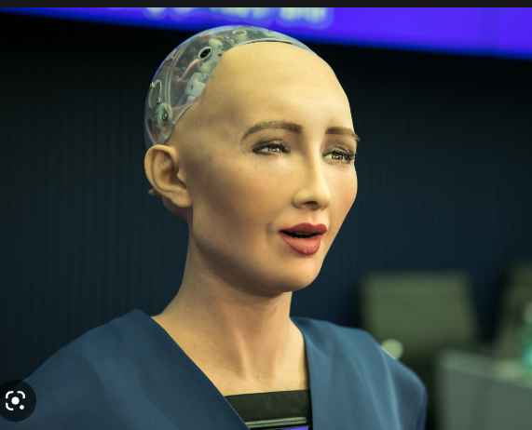
LATEST INNOVATIONS IN AI
Sophia
Created by the hong kong company known as hanson robotics.
Latest breakthrough in artificial intelligence.

Slide 11
CONCLUSION
FINALLY WE CAN SAY THAT AI IS THE INTELLIGENCE OF THE MACHINE IN THE BRANCH OF COMPUTER SCIENCE THAT AIMS TO CREATE IT.
AI HOLDS THE KEY TO UNLOCKING A MAGNIFICIENT FUTURE WHERE,DRIVEN BY DATA AND COMPUTERS THAT UNDERSTAND HUMAN LANGUAGE.

Slide 12
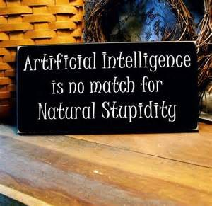
THANK YOU

