Slide 1



Name of Project:
Garbage Classification model​
NAME : Ganesh venkata surya puvvala​
E.mail : ganeshpuvvala@gmail.com​
AICTE Internship Student Registration ID:STU67d2be1d3c2591741864477​
AICTE Internship ID :INTERNSHIP_1746416864681834e0e35d8​
​
​
​

Slide 2

Learning Objectives
1. Data Collection​
Collected labeled images representing different trash categories, such as glass, paper, metal, plastic, and others.​
Organized the dataset into a clear folder hierarchy to facilitate efficient loading and accurate classification.​
2. Data Preprocessing​
Resized and normalized images to a standard size (e.g., 224×224 pixels) for consistency with model input requirements.​
Split the dataset into training, validation, and test sets, and applied data augmentation techniques (e.g., flips, rotations, zooms) to improve model robustness.​
3. Class Imbalance Handling​
Analyzed the distribution of samples across categories to detect class imbalances.​
Calculated and applied class weights during training to ensure fair learning across all trash types and reduce bias toward overrepresented classes.​
4. Model Development​
Developed a Convolutional Neural Network (CNN) using TensorFlow and Keras to classify trash images into their respective categories.​
GOAL

Slide 3
Tools and Technology used
Programming Language​
Python – Used for image preprocessing, model training, evaluation, and backend development.​
Machine Learning & Deep Learning​
TensorFlow / Keras – ​
Leveraged Keras’ Sequential API for ease of stacking layers.​
Used ResNet101V2 from tensorflow.keras.applications as the pretrained backbone.​
Computer Vision​
tf.keras.utils.image_dataset_from_directory — efficient loading of image datasets directly from directorystructure with train/val/test splits.​
Data Augmentation​
Keras Layers API — RandomFlip, RandomRotation, RandomZoom, RandomContrast — applied via a Sequentialaugmentation pipeline.​
Data Processing & Analysis​
NumPy — numerical operations, especially for class weights calculation.​
Matplotlib & Seaborn — data visualization (e.g., sample images, class distributions).​
Dataset Used​
KaggleHub​
Additional Tools​
Google Colab – Cloud-based Jupyter environment.​

Slide 4
Methodology
1. Data Collection:​ Collected and organized labeled images of various trash categories, such as glass, paper, metal, and plastic, into category-specific folders.​
2. Preprocessing:​ Resized, normalized, and augmented image data; split the dataset into training, validation, and test sets to ensure robust model evaluation.​
3. Model Training:​ Trained a Convolutional Neural Network (CNN) using TensorFlow/Keras, leveraging pre-trained models like ResNet101V2 to boost classification accuracy.​
4. Evaluation:​ Assessed model performance using metrics including Accuracy, Precision, Recall, F1 Score, and confusion matrix analysis to evaluate class-wise performance.​
​
​

Slide 5
Problem Statement:
In this project, we aim to develop a sophisticated garbage classification system leveragingthe ResNet101V2 architecture. Our primary dataset serves as a foundation for building models thatcan eventually automate waste segregation, a critical step in optimizing recycling and wastemanagement, ultimately aiding in environmental conservation.​
​
​
Objective: To develop an accurate and efficient garbage classification modelusing ResNet101V2 and transfer learning for automated waste sorting.​
​

Slide 6
Solution:
A deep learning-based image classification system takes anuploaded trash image as input and uses a trained ConvolutionalNeural Network (CNN) model based on ResNet101V2 to identify thetrash category (e.g., glass, paper, metal, plastic).​
The system automates and accelerates the sorting process,enabling accurate classification to support efficient recycling andwaste management efforts.​
Results are presented with clear predictions and confidence scoresto assist in informed decision-making for effective waste segregation.​

Slide 7
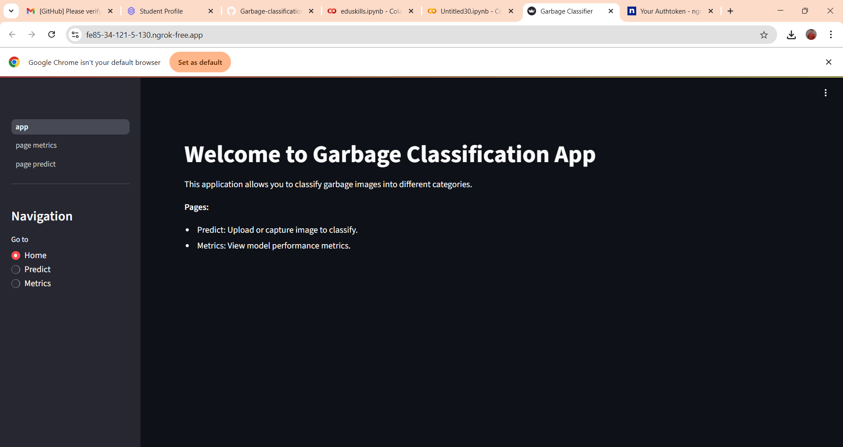
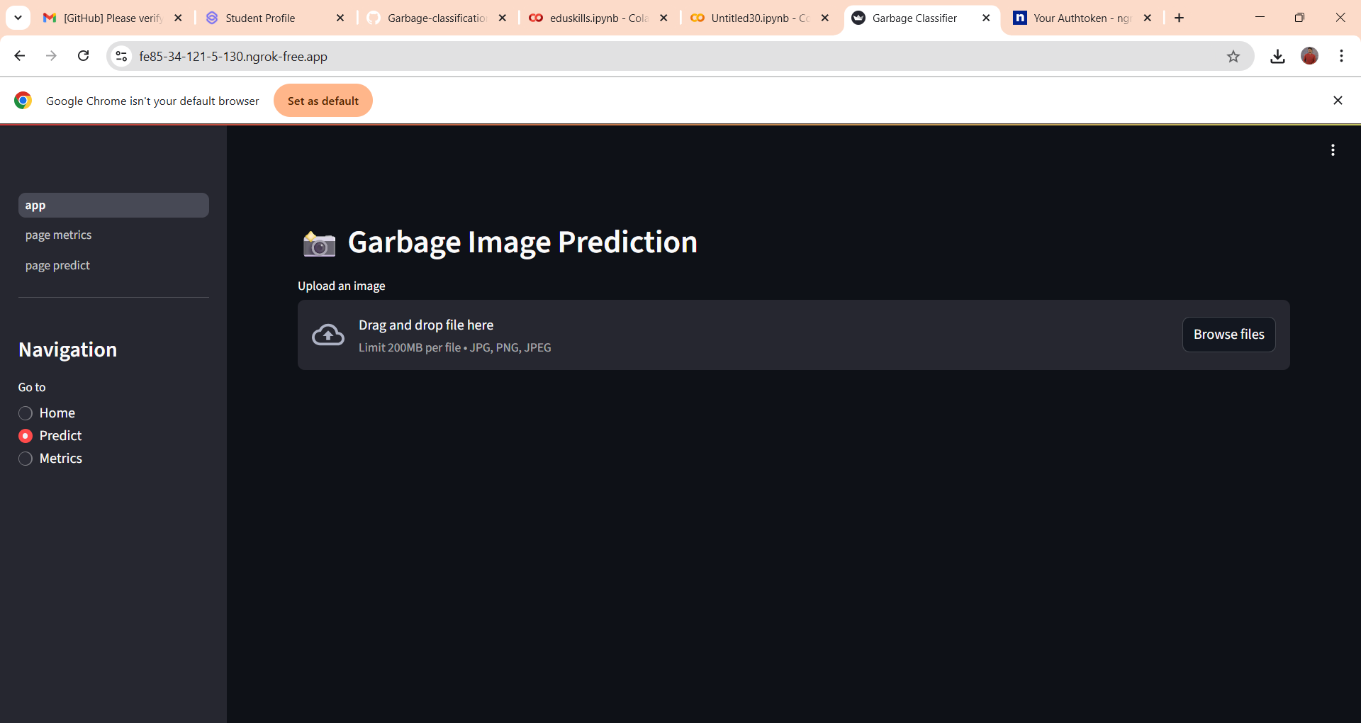
Screenshot of Output:

Slide 8
Conclusion:
​
The model accurately classifies different types of trash, enabling faster and more reliable sorting to improve recycling processes.​
High classification accuracy supports effective waste management practices and promotes environmental sustainability.​
Future improvements may include expanding the dataset with additional trash categories, integrating real-time image capture systems, and exploring more advanced deep learning architectures to further enhance performance.​
​
​

