Slide 1
Chapter 20 – ASP .Net, Web Forms and Web Controls
Outline
20.1 Introduction
20.2 Simple HTTP Transaction
20.3 System Architecture
20.4 Creating and Running a Simple Web Form Example
20.5 Web Controls
20.5.1 Text and Graphics Controls
20.5.2 AdRotator Control
20.5.3 Validation Controls
20.6 Session Tracking
20.6.1 Cookies
20.6.2 Session Tracking with HttpSessionState
20.7 Case Study: Online Guest book
20.8 Case Study: Connecting to a Database in ASP .NET
20.9 Tracing

Slide 2
20.1 Introduction
Web-Based Application Development
  Creates Web content for Web browser clients
    HyperText Markup Language (HTML)
    Client-side scripting
    Images and binary data
  Web Forms (Web Form pages)
    File extension .aspx
    ASPX (Web Form files) contain written code, event handlers, utility methods and other supporting code

Slide 3
20.2 Simple HTTP Transaction
HyperText Transfer Protocol (HTTP)
  Defines methods and headers which allows clients and servers exchange information in uniform way
Uniform Resource Locator (URL)
  IP address indicating the location of a resource
  All HTML documents have a corresponding URL
Domain Name Server (DNS)
  A computer that maintains a database of hostnames and their corresponding IP addresses

Slide 4
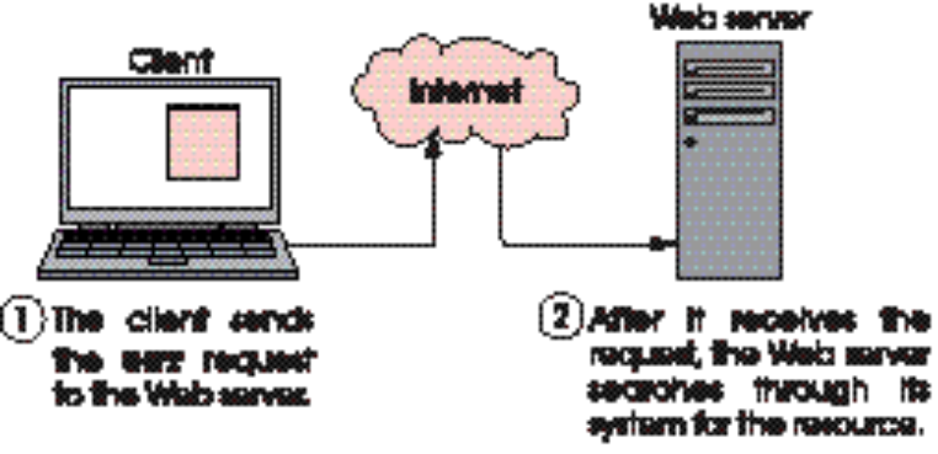
20.2 A Simple HTTP Transaction
Fig. 20.1 Client interacting with Web server. Step 1: The GET request, GET /books/downloads.htm HTTP/1.1.

Slide 5

20.2 A Simple HTTP Transaction
Fig. 20.2 Client interacting with Web server. Step 2: The HTTP response, HTTP/1.1 200 OK.

Slide 6
20.3 System Architecture
Multi-tier Applications
  Web-based applications (n-tier applications)
    Tiers are logical groupings of functionality
Information Tier (data tier or bottom tier)
  Maintains data pertaining to the applications
  Usually stores data in a relational database management systems (RDBMS)
Middle Tier
  Acts as an intermediary between data in the information tier and the application's clients

Slide 7
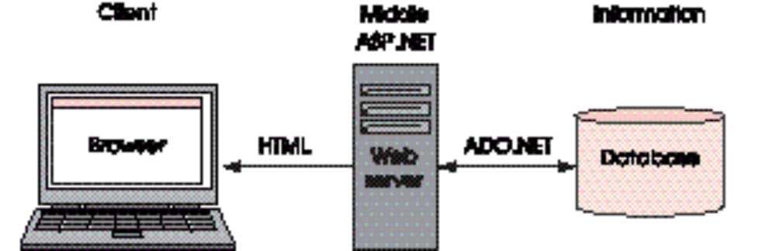
20.3 System Architecture
Fig. 20.3 Three-tier architecture.

Slide 8
20.4 Creating and Running a Simple Web-Form Example
Visual Component
  Clickable buttons and other GUI components which users interact
Nonvisual Component
  Hidden inputs that store any data that document author specifies such as e-mail address

Slide 9
WebTime.aspx
Directive to specify information needed to process file
This attribute determines how event handlers are linked to a control’s events
1 <%-- Fig. 20.4: WebTime.aspx --%>
2 <%-- A page that contains two labels. --%>
3
4 <%@ Page language="c#" Codebehind="WebTime.aspx.cs"
5 AutoEventWireup="false" Inherits="WebTime.WebTimeTest"
6 EnableSessionState="False" enableViewState="False"%>
7
8 <!DOCTYPE HTML PUBLIC "-//W3C//DTD HTML 4.0 Transitional//EN" >
9
10 <HTML>
11 <HEAD>
12 <title>WebTime</title>
13 <meta name="GENERATOR"
14 Content="Microsoft Visual Studio 7.0">
15 <meta name="CODE_LANGUAGE" Content="C#">
16 <meta name="vs_defaultClientScript"
17 content="JavaScript">
18 <meta name="vs_targetSchema"
19 content="http://schemas.microsoft.com/intellisense/ie5">
20 </HEAD>
Document type declaration, specifies document element name and URI
Specify class in the code-behind file from which this ASP .NET document
Title for web page
AutoEventWireUp set to false because Visual Studio generates necessary event delegates
Meta-element that contain information about document

Slide 10
WebTime.aspx
Body tag, beginning of Web page’s viewable content
21
22 <body MS_POSITIONING="GridLayout">
23 <form id="WebForm1" method="post" runat="server">
24 <asp:Label id="promptLabel" style="Z-INDEX: 101;
25 LEFT: 25px; POSITION: absolute; TOP: 23px"
26 runat="server" Font-Size="Medium">
27 A Simple Web Form Example
28 </asp:Label>
29
30 <asp:Label id="timeLabel" style="Z-INDEX: 102;
31 LEFT: 25px; POSITION: absolute; TOP: 55px"
32 runat="server" Font-Size="XX-Large"
33 BackColor="Black" ForeColor="LimeGreen">
34 </asp:Label>
35 </form>
36 </body>
37 </HTML>
The asp:Label control maps to HTML span element
Attribute indicate the server processes the form and generate HTML for client

Slide 11
WebTime.aspx.cs
1 // Fig. 20.5: WebTime.aspx.cs
2 // The code-behind file for a page
3 // that displays the Web server's time.
4
5 using System;
6 using System.Collections;
7 using System.ComponentModel;
8 using System.Data;
9 using System.Drawing;
10 using System.Web;
11 using System.Web.SessionState;
12
13 // definitions for graphical controls used in Web Forms
14 using System.Web.UI;
15 using System.Web.UI.WebControls;
16 using System.Web.UI.HtmlControls;
17
18 namespace WebTime
19 {
20 /// <summary>
21 /// display current time
22 /// </summary>
23 public class WebTimeTest : System.Web.UI.Page
24 {
25 protected System.Web.UI.WebControls.Label promptLabel;
26 protected System.Web.UI.WebControls.Label timeLabel;
27
28 // event handler for Load event
29 private void Page_Load(
30 object sender, System.EventArgs e )
31 {
Contains classes that manage client requests and server responses
Contain classes for creation of Web-based applications and controls
Web control labels defined in System.Web.UI.WebControls

Slide 12
WebTime.aspx.cs
32 // display current time
33 timeLabel.Text =
34 String.Format( "{0:D2}:{1:D2}:{2:D2}",
35 DateTime.Now.Hour, DateTime.Now.Minute,
36 DateTime.Now.Second );
37 }
38
39 // event handler for Init event; sets
40 // timeLabel to Web server's time
41 #region Web Form Designer generated code
42 override protected void OnInit( EventArgs e )
43 {
44 //
45 // CODEGEN: This call is required by the
46 // ASP.NET Web Form Designer.
47 //
48 InitializeComponent();
49 base.OnInit( e );
50 }
51
52 /// <summary>
53 /// Required method for Designer support - do not modify
54 /// the contents of this method with the code editor.
55 /// </summary>
56 private void InitializeComponent()
57 {
58 this.Load += new System.EventHandler(
59 this.Page_Load );
60 }
61 #endregion
62
63 } // end class WebTimeTest
64
65 } // end namespace WebTime
Set timeLabel’s Text property to Web server’s time
Event raised when Web page loads

Slide 13
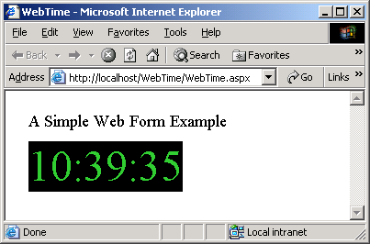
WebTime.cs
Program Output

Slide 14
WebTime.html
1 <!-- Fig. 20.6: WebTime.html -->
2 <!-- The HTML generated when WebTime is loaded. -->
3
4 <!DOCTYPE HTML PUBLIC "-//W3C//DTD HTML 4.0 Transitional//EN" >
5
6 <HTML>
7 <HEAD>
8 <title>WebTime</title>
9 <meta name="GENERATOR"
10 Content="Microsoft Visual Studio 7.0">
11 <meta name="CODE_LANGUAGE" Content="C#">
12 <meta name="vs_defaultClientScript" content="JavaScript">
13 <meta name="vs_targetSchema"
14 content="http://schemas.microsoft.com/intellisense/ie5">
15 </HEAD>
16
17 <body MS_POSITIONING="GridLayout">
18 <form name="WebForm1" method="post"
19 action="WebTime.aspx" id="WebForm1">
20 <input type="hidden" name="__VIEWSTATE"
21 value="dDwtNjA2MTkwMTQ5Ozs+" />
22
23 <span id="promptLabel"
24 style="font-size:Medium;Z-INDEX: 101; LEFT: 25px;
25 POSITION: absolute; TOP: 23px">
26 A Simple Web Form Example
27 </span>
28
29 <span id="timeLabel" style="color:LimeGreen;
30 background-color:Black;font-size:XX-Large;
31 Z-INDEX: 102; LEFT: 25px; POSITION: absolute;
32 TOP: 55px">10:39:35
Defines the body of the document
Hidden inputs from the user

Slide 15
WebTime.html
33 </span>
34 </form>
35 </body>
36 </HTML>

Slide 16
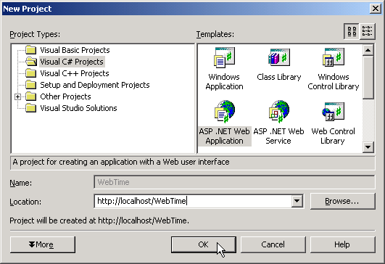
20.4 Creating and Running a Simple Web Form Example
Fig. 20.7 Creating an ASP.NET Web Application in Visual Studio.

Slide 17
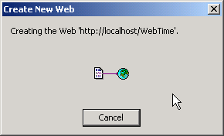
20.4 Creating and Running a Simple Web Form Example
Fig. 20.8 Visual Studio creating and linking a virtual directory for the WebTime project folder.

Slide 18
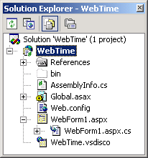
20.4 Creating and Running a Simple Web Form Example
displays all files
code-behind file
ASPX file
Fig. 20.9 Solution Explorer window for project WebTime.

Slide 19
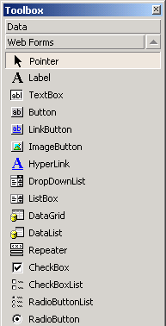
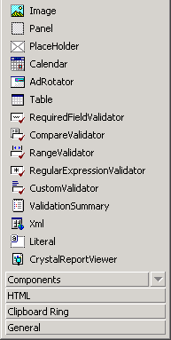
20.4 Creating and Running a Simple Web Form Example
Fig. 20.10 Web Forms menu in the Toolbox. .

Slide 20
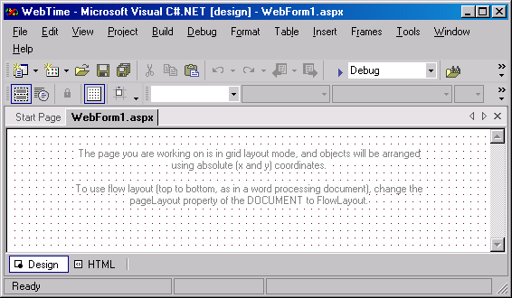
20.4 Creating and Running a Simple Web Form Example
grids
Fig. 20.11 Design mode of Web Form designer.

Slide 21
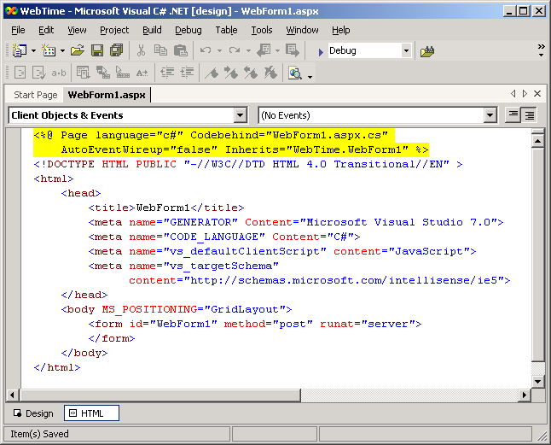
20.4 Creating and Running a Simple Web Form Example
Fig. 20.12 HTML mode of Web Form designer.

Slide 22
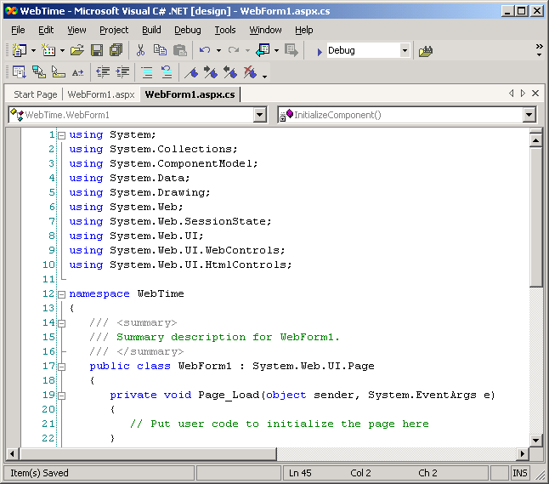
20.4 Creating and Running a Simple Web Form Example
Fig. 20.13 Code-behind file for WebForm1.aspx generated by Visual Studio .NET (part 1).

Slide 23
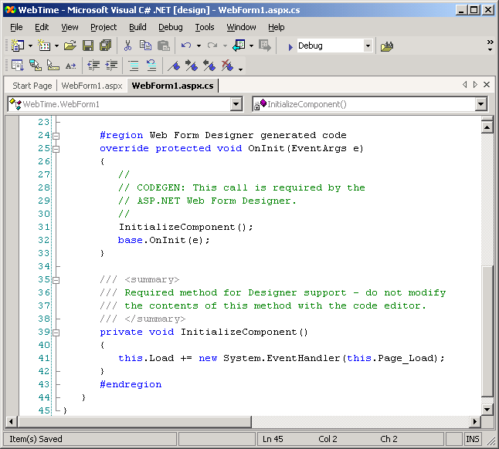
20.4 Creating and Running a Simple Web Form Example
Fig. 20.13 Code-behind file for WebForm1.aspx generated by Visual Studio .NET (part 2).

Slide 24
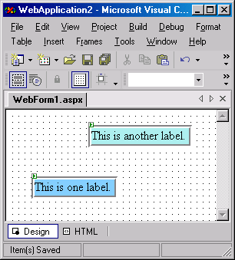
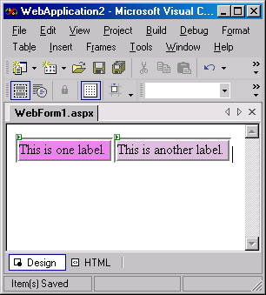
20.4 Creating and Running a Simple Web Form Example
FlowLayout— Controls are placed one after the other
GridLayout—Controls are placed where they are dropped on the page
cursor indicates where next control will go
Fig. 20.14 FlowLayout and GridLayout illustration.

Slide 25
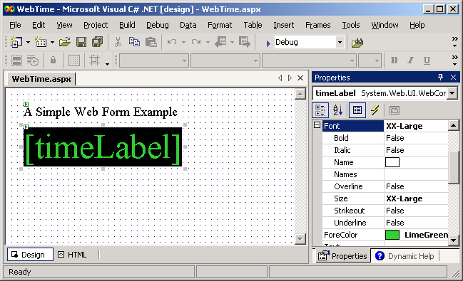
20.4 Creating and Running a Simple Web Form Example
labels
Web Form
Fig. 20.15 WebForm.aspx after adding two Labels and setting their properties.

Slide 26
20.5 Web Controls
Text and Graphics Control
  Label, Button, TextBox, Image RadioButtonList and DropDownList
AdRotator Control
  Randomly selects an image to display and then generates a hyperlink to the Web page associated with that image
Validation Controls
  Determines whether the data in another Web control are in the proper format
    Validates user input

Slide 27
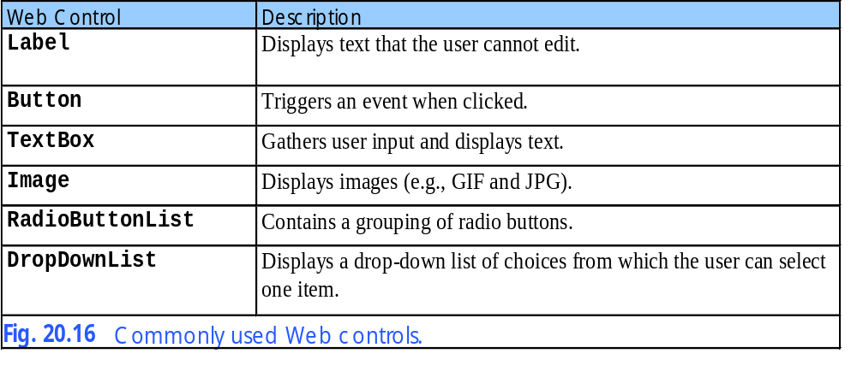
20.5 Web Controls

Slide 28
WebControls.aspx
1 <%-- Fig. 20.17: WebControls.aspx --%>
2 <%-- Demonstrating some Web controls. --%>
3
4 <%@ Page language="c#" Codebehind="WebControls.aspx.cs"
5 AutoEventWireup="false" Inherits="WebControls.WebForm1"
6 EnableSessionState="False" enableViewState="False"%>
7
8 <!DOCTYPE HTML PUBLIC "-//W3C//DTD HTML 4.0 Transitional//EN" >
9
10 <HTML>
11 <HEAD>
12
13 <title>WebForm1</title>
14 <meta name="GENERATOR"
15 Content="Microsoft Visual Studio 7.0">
16 <meta name="CODE_LANGUAGE" Content="C#">
17 <meta name="vs_defaultClientScript"
18 content="JavaScript">
19 <meta name="vs_targetSchema"
20 content="http://schemas.microsoft.com/intellisense/ie5">
21
22 </HEAD>
23
24 <body MS_POSITIONING="GridLayout">
25
26 <form id="Form1" method="post" runat="server">
27
28 <asp:Label id="welcomeLabel" style="Z-INDEX: 101;
29 LEFT: 21px; POSITION: absolute; TOP: 17px"
30 runat="server" Font-Bold="True" Font-Size="Medium">
31 This is a sample registration form.
32 </asp:Label>
33

Slide 29
WebControls.aspx
34 <asp:Image id="operatingImage" style="Z-INDEX: 121;
35 LEFT: 21px; POSITION: absolute; TOP: 371px"
36 runat="server" ImageUrl="images\os.png">
37 </asp:Image>
38
39 <asp:Image id="publicationImage" style="Z-INDEX: 120;
40 LEFT: 21px; POSITION: absolute; TOP: 245px"
41 runat="server" ImageUrl="images\downloads.png">
42 </asp:Image>
43
44 <asp:Image id="userImage" style="Z-INDEX: 119;
45 LEFT: 21px; POSITION: absolute; TOP: 91px"
46 runat="server" ImageUrl="images\user.png">
47 </asp:Image>
48
49 <asp:TextBox id="emailTextBox" style="Z-INDEX: 118;
50 LEFT: 95px; POSITION: absolute;
51 TOP: 161px" runat="server">
52 </asp:TextBox>
53
54 <asp:TextBox id="firstTextBox" style="Z-INDEX: 117;
55 LEFT: 95px; POSITION: absolute; TOP: 127px"
56 runat="server">
57 </asp:TextBox>
58
59 <asp:TextBox id="lastTextBox" style="Z-INDEX: 116;
60 LEFT: 341px; POSITION: absolute;
61 TOP: 127px" runat="server">
62 </asp:TextBox>
63
64 <asp:TextBox id="phoneTextBox" style="Z-INDEX: 115;
65 LEFT: 341px; POSITION: absolute;
66 TOP: 161px" runat="server">
67 </asp:TextBox>
68
Image control to place image on Web page
Specify file location of image display

Slide 30
WebControls.aspx
69 <asp:RadioButtonList id="operatingRadioButtonList"
70 style="Z-INDEX: 114; LEFT: 21px;
71 POSITION: absolute; TOP: 409px" runat="server">
72
73 <asp:ListItem Value="Windows NT">Windows NT
74 </asp:ListItem>
75
76 <asp:ListItem Value="Windows 2000">Windows 2000
77 </asp:ListItem>
78
79 <asp:ListItem Value="Windows XP">Windows XP
80 </asp:ListItem>
81
82 <asp:ListItem Value="Linux">Linux</asp:ListItem>
83
84 <asp:ListItem Value="Other">Other</asp:ListItem>
85
86 </asp:RadioButtonList>
87
88 <asp:HyperLink id="booksHyperLink" style="Z-INDEX: 113;
89 LEFT: 21px; POSITION: absolute; TOP: 316px"
90 runat="server" NavigateUrl="http://www.deitel.com">
91 Click here to view more information about our books.
92 </asp:HyperLink>
93
94 <asp:DropDownList id="booksDropDownList"
95 style="Z-INDEX: 112; LEFT: 21px;
96 POSITION: absolute; TOP: 282px" runat="server">
97
98 <asp:ListItem Value="XML How to Program 1e">
99 XML How to Program 1e
100 </asp:ListItem>
101
102 <asp:ListItem Value="C# How to Program 1e">
103 C# How to Program 1e
NavigateUrl property specifies the resource that is requested
Defines the ListItems that display when
the drop-down list is expanded

Slide 31
WebControls.aspx
104 </asp:ListItem>
105
106 <asp:ListItem Value="Visual Basic .NET How to Program 2e">
107 Visual Basic .NET How to Program 2e
108 </asp:ListItem>
109
110 <asp:ListItem Value="C++ How to Program 3e">
111 C++ How to Program 3e
112 </asp:ListItem>
113
114 </asp:DropDownList>
115
116 <asp:Image id="phoneImage" style="Z-INDEX: 111;
117 LEFT: 266px; POSITION: absolute; TOP: 161px"
118 runat="server" ImageUrl="images\phone.png">
119 </asp:Image>
120
121 <asp:Image id="emailImage" style="Z-INDEX: 110;
122 LEFT: 21px; POSITION: absolute; TOP: 161px"
123 runat="server" ImageUrl="images\email.png">
124 </asp:Image>
125
126 <asp:Image id="lastImage" style="Z-INDEX: 109;
127 LEFT: 266px; POSITION: absolute; TOP: 127px"
128 runat="server" ImageUrl="images\lname.png">
129 </asp:Image>
130
131 <asp:Image id="firstImage" style="Z-INDEX: 108;
132 LEFT: 21px; POSITION: absolute;
133 TOP: 127px" runat="server"
134 ImageUrl="images\fname.png">
135 </asp:Image>
136

Slide 32
WebControls.aspx
137 <asp:Button id="registerButton" style="Z-INDEX: 107;
138 LEFT: 21px; POSITION: absolute; TOP: 547px"
139 runat="server" Text="Register">
140 </asp:Button>
141
142 <asp:Label id="bookLabel" style="Z-INDEX: 106;
143 LEFT: 216px; POSITION: absolute; TOP: 245px"
144 runat="server" ForeColor="DarkCyan">
145 Which book would you like information about?
146 </asp:Label>
147
148 <asp:Label id="fillLabel" style="Z-INDEX: 105;
149 LEFT: 218px; POSITION: absolute; TOP: 91px"
150 runat="server" ForeColor="DarkCyan">
151 Please fill out the fields below.
152 </asp:Label>
153
154 <asp:Label id="phoneLabel" style="Z-INDEX: 104;
155 LEFT: 266px; POSITION: absolute;
156 TOP: 198px" runat="server">
157 Must be in the form (555)555-5555.
158 </asp:Label>
159
160 <asp:Label id="operatingLabel" style="Z-INDEX: 103;
161 LEFT: 220px; POSITION: absolute; TOP: 371px"
162 runat="server" Height="9px" ForeColor="DarkCyan">
163 Which operating system are you using?
164 </asp:Label>
165
166 <asp:Label id="registerLabel" style="Z-INDEX: 102;
167 LEFT: 21px; POSITION: absolute; TOP: 46px"
168 runat="server" Font-Italic="True">
169 Please fill in all fields and click Register.
170 </asp:Label>
171
Button Web control typically maps to an input HTML element with attribute type and value “button”

Slide 33
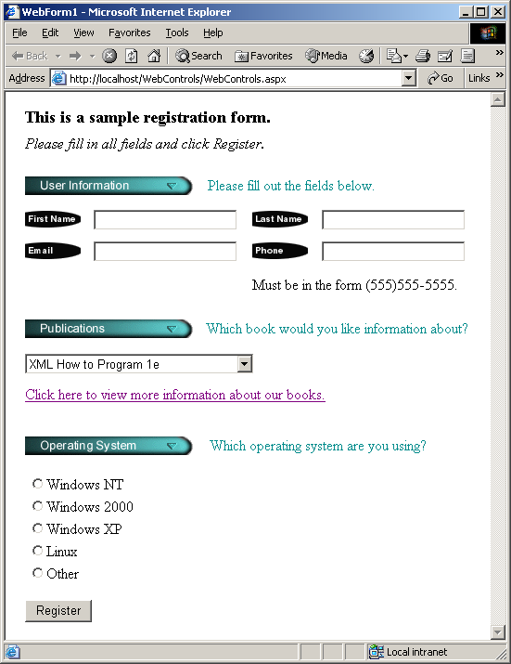
WebControls.aspx
172 </form>
173 </body>
174 </HTML>
Image control
TextBox control
DropDownList control
Hyperlink control
RadioButtonList control
Button control

Slide 34
20.5.2 AdRotator Control
Address problem of displaying sponsor advertisement
Randomly selects an image to display
  Generate hyperlink to Web page

Slide 35
AdRotator.aspx
1 <%-- Fig. 20.18: AdRotator.aspx --%>
2 <%-- A Web Form that demonstrates class AdRotator. --%>
3
4 <%@ Page language="c#" Codebehind="AdRotator.aspx.cs"
5 AutoEventWireup="false" Inherits="AdRotatorTest.AdRotator"
6 EnableSessionState="False" enableViewState="False"%>
7
8 <!DOCTYPE HTML PUBLIC "-//W3C//DTD HTML 4.0 Transitional//EN" >
9 <HTML>
10 <HEAD>
11 <title>WebForm1</title>
12 <meta name="GENERATOR"
13 Content="Microsoft Visual Studio 7.0">
14 <meta name="CODE_LANGUAGE" Content="C#">
15 <meta name="vs_defaultClientScript"
16 content="JavaScript">
17 <meta name="vs_targetSchema"
18 content="http://schemas.microsoft.com/intellisense/ie5">
19 </HEAD>
20
21 <body MS_POSITIONING="GridLayout">
22 background="images/background.png">
23 <form id="Form1" method="post" runat="server">
24
25 <asp:AdRotator id="adRotator" style="Z-INDEX: 101;
26 LEFT: 17px; POSITION: absolute; TOP: 69px"
27 runat="server" Width="86px" Height="60px"
28 AdvertisementFile="AdRotatorInformation.xml">
29 </asp:AdRotator>
30
31 <asp:Label id="adRotatorLabel" style="Z-INDEX: 102;
32 LEFT: 17px; POSITION: absolute; TOP: 26px"
33 runat="server" Font-Size="Large">
34 AdRotator Example
35 </asp:Label>&nbsp;
Set AdRotator control’s AdvertisementFile property to AdrotatorInformation.xml

Slide 36
AdRotator.aspx
36
37 </form>
38 </body>
39 </HTML>

Slide 37
AdRotator.aspx.cs
1 // Fig. 20.19: AdRotator.aspx.cs
2 // The code-behind file for a page that
3 // demonstrates the AdRotator class.
4
5 using System;
6 using System.Collections;
7 using System.ComponentModel;
8 using System.Data;
9 using System.Drawing;
10 using System.Web;
11 using System.Web.SessionState;
12 using System.Web.UI;
13 using System.Web.UI.WebControls;
14 using System.Web.UI.HtmlControls;
15
16 namespace AdRotatorTest
17 {
18 /// page that demonstrates AdRotator
19 public class AdRotator : System.Web.UI.Page
20 {
21 protected System.Web.UI.WebControls.AdRotator adRotator;
22 protected System.Web.UI.WebControls.Label adRotatorLabel;
23
24 // Visual Studio .NET generated code
25
26 } // end class AdRotator
27
28 } // end namespace AdRotatorTest
No code-behind because AdRotator control does “all the work”

Slide 38
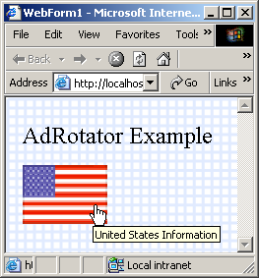
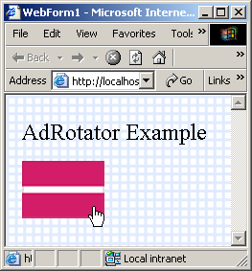
AdRotator.aspx.cs program output
AlternateText
AdRotator image

Slide 39
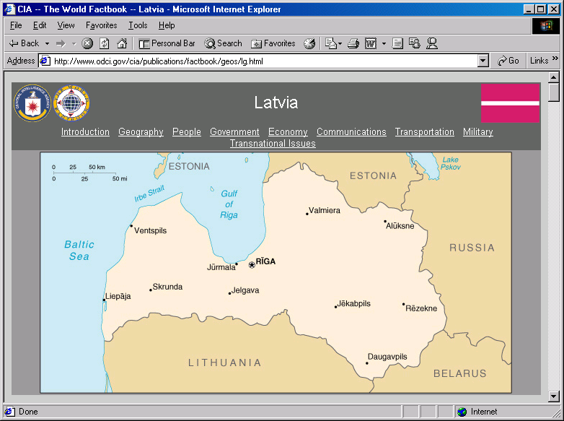
AdRotator.aspx.cs
Program Output

Slide 40
AdRotatorInformation.xml
1 <?xml version="1.0" encoding="utf-8"?>
2
3 <!-- Fig. 20.20: AdRotatorInformation.xml -->
4 <!-- XML file containing advertisement information. -->
5
6 <Advertisements>
7 <Ad>
8 <ImageUrl>images/us.png</ImageUrl>
9 <NavigateUrl>
10 http://www.odci.gov/cia/publications/factbook/geos/us.html
11 </NavigateUrl>
12 <AlternateText>United States Information</AlternateText>
13 <Impressions>1</Impressions>
14 </Ad>
15
16 <Ad>
17 <ImageUrl>images/france.png</ImageUrl>
18 <NavigateUrl>
19 http://www.odci.gov/cia/publications/factbook/geos/fr.html
20 </NavigateUrl>
21 <AlternateText>France Information</AlternateText>
22 <Impressions>1</Impressions>
23 </Ad>
24
25 <Ad>
26 <ImageUrl>images/germany.png</ImageUrl>
27 <NavigateUrl>
28 http://www.odci.gov/cia/publications/factbook/geos/gm.html
29 </NavigateUrl>
30 <AlternateText>Germany Information</AlternateText>
31 <Impressions>1</Impressions>
32 </Ad>
33
34 <Ad>
35 <ImageUrl>images/italy.png</ImageUrl>
Ad elements each provide information
about the advertisement
AlternateText is a tool tip which displays the
message when mouse points over image
The higher the Impression value the the more
often the advertisement will appear
ImageUrl specifies the location
of the advertisement image

Slide 41
AdRotatorInformation.xml
36 <NavigateUrl>
37 http://www.odci.gov/cia/publications/factbook/geos/it.html
38 </NavigateUrl>
39 <AlternateText>Italy Information</AlternateText>
40 <Impressions>1</Impressions>
41 </Ad>
42
43 <Ad>
44 <ImageUrl>images/spain.png</ImageUrl>
45 <NavigateUrl>
46 http://www.odci.gov/cia/publications/factbook/geos/sp.html
47 </NavigateUrl>
48 <AlternateText>Spain Information</AlternateText>
49 <Impressions>1</Impressions>
50 </Ad>
51
52 <Ad>
53 <ImageUrl>images/latvia.png</ImageUrl>
54 <NavigateUrl>
55 http://www.odci.gov/cia/publications/factbook/geos/lg.html
56 </NavigateUrl>
57 <AlternateText>Latvia Information</AlternateText>
58 <Impressions>1</Impressions>
59 </Ad>
60
61 <Ad>
62 <ImageUrl>images/peru.png</ImageUrl>
63 <NavigateUrl>
64 http://www.odci.gov/cia/publications/factbook/geos/pe.html
65 </NavigateUrl>
66 <AlternateText>Peru Information</AlternateText>
67 <Impressions>1</Impressions>
68 </Ad>
69
NavigateUrl indicates URL for the
web page that loads when a user
clicks the advertisement

Slide 42
AdRotatorInformation.xml
70 <Ad>
71 <ImageUrl>images/senegal.png</ImageUrl>
72 <NavigateUrl>
73 http://www.odci.gov/cia/publications/factbook/geos/sg.html
74 </NavigateUrl>
75 <AlternateText>Senegal Information</AlternateText>
76 <Impressions>1</Impressions>
77 </Ad>
78
79 <Ad>
80 <ImageUrl>images/sweden.png</ImageUrl>
81 <NavigateUrl>
82 http://www.odci.gov/cia/publications/factbook/geos/sw.html
83 </NavigateUrl>
84 <AlternateText>Sweden Information</AlternateText>
85 <Impressions>1</Impressions>
86 </Ad>
87
88 <Ad>
89 <ImageUrl>images/thailand.png</ImageUrl>
90 <NavigateUrl>
91 http://www.odci.gov/cia/publications/factbook/geos/th.html
92 </NavigateUrl>
93 <AlternateText>Thailand Information</AlternateText>
94 <Impressions>1</Impressions>
95 </Ad>
96
97 <Ad>
98 <ImageUrl>images/unitedstates.png</ImageUrl>
99 <NavigateUrl>
100 http://www.odci.gov/cia/publications/factbook/geos/us.html
101 </NavigateUrl>
102 <AlternateText>United States Information</AlternateText>
103 <Impressions>1</Impressions>
104 </Ad>
ImageUrl specifies the location
of the advertisement image
NavigateUrl indicates URL for the
web page that loads when a user
clicks the advertisement

Slide 43
AdRotatorInformation.xml
105 </Advertisements>

Slide 44
20.5.3 Validation Controls
Validators
  Determine if data in Web controls are proper format

Slide 45
Generator.aspx
1 <%-- Fig. 20.21: Generator.aspx --%>
2 <%-- A Web Form demonstrating the use of validators. --%>
3
4 <%@ Page language="c#" Codebehind="Generator.aspx.cs"
5 AutoEventWireup="false" Inherits="WordGenerator.Generator" %>
6
7 <!DOCTYPE HTML PUBLIC "-//W3C//DTD HTML 4.0 Transitional//EN" >
8
9 <HTML>
10 <HEAD>
11 <title>WebForm1</title>
12 <meta name="GENERATOR"
13 Content="Microsoft Visual Studio 7.0">
14 <meta name="CODE_LANGUAGE" Content="C#">
15 <meta name="vs_defaultClientScript" content="JavaScript">
16 <meta name="vs_targetSchema" content=
17 "http://schemas.microsoft.com/intellisense/ie5">
18 </HEAD>
19
20 <body MS_POSITIONING="GridLayout">
21 <form id="Form1" method="post" runat="server">
22 <asp:Label id="promptLabel" style="Z-INDEX: 101;
23 LEFT: 16px; POSITION: absolute; TOP: 23px"
24 runat="server">
25 Please enter a phone number in the form 555-4567:
26 </asp:Label>
27
28 <asp:RegularExpressionValidator
29 id="phoneNumberValidator" style="Z-INDEX: 106;
30 LEFT: 217px; POSITION: absolute; TOP: 73px"
31 runat="server" ErrorMessage=
32 "The phone number must be in the form 555-4567."
33 ControlToValidate="inputTextBox"
34 ValidationExpression="^\d{3}-\d{4}$">
35 </asp:RegularExpressionValidator>
<HTML> and <HEAD> start tags
Create a RegularExpressionValidator name phoneNumberValidator
Indicate that that phoneNumberValidator verifies inputTextBox’s contents
Regular expression with which to validate user input
ErrorMessage’s text to display if error occurs

Slide 46
Generator.aspx
36
37 <asp:RequiredFieldValidator
38 id="phoneInputValidator" style="Z-INDEX: 105;
39 LEFT: 217px; POSITION: absolute; TOP: 47px"
40 runat="server" ErrorMessage=
41 "Please enter a phone number."
42 ControlToValidate="inputTextBox">
43 </asp:RequiredFieldValidator>
44
45 <asp:TextBox id="outputTextBox" style="Z-INDEX: 104;
46 LEFT: 16px; POSITION: absolute; TOP: 146px"
47 runat="server" Visible="False" TextMode="MultiLine"
48 Height="198px" Width="227px" Font-Bold="True"
49 Font-Names="Courier New">
50 </asp:TextBox>
51
52 <asp:Button id="submitButton" style="Z-INDEX: 103;
53 LEFT: 16px; POSITION: absolute; TOP: 86px"
54 runat="server" Text="Submit">
55 </asp:Button>
56
57 <asp:TextBox id="inputTextBox" style="Z-INDEX: 102;
58 LEFT: 16px; POSITION: absolute; TOP: 52px"
59 runat="server">
60 </asp:TextBox>
61 </form>
62 </body>
63 </HTML>
Displays the words generated from the phone number
Confirm that inputTextBox’s content is not empty

Slide 47
Generator.aspx.cs
1 // Fig. 20.22: Generator.aspx.cs
2 // The code-behind file for a page that
3 // generates words from a phone number.
4
5 using System;
6 using System.Collections;
7 using System.ComponentModel;
8 using System.Data;
9 using System.Drawing;
10 using System.Web;
11 using System.Web.SessionState;
12 using System.Web.UI;
13 using System.Web.UI.WebControls;
14 using System.Web.UI.HtmlControls;
15
16 namespace WordGenerator
17 {
18 // page that computes all combinations of letters for first
19 // three digits and last four digits in phone number
20 public class Generator : System.Web.UI.Page
21 {
22 protected System.Web.UI.WebControls.TextBox
23 outputTextBox;
24 protected System.Web.UI.WebControls.TextBox
25 inputTextBox;
26
27 protected
28 System.Web.UI.WebControls.RegularExpressionValidator
29 phoneNumberValidator;
30 protected
31 System.Web.UI.WebControls.RequiredFieldValidator
32 phoneInputValidator;
33
34 protected System.Web.UI.WebControls.Button submitButton;
35 protected System.Web.UI.WebControls.Label promptLabel;

Slide 48
Generator.aspx.cs
36
37 private void Page_Load(
38 object sender, System.EventArgs e )
39 {
40 // if page loaded due to a postback
41 if ( IsPostBack )
42 {
43 outputTextBox.Text = "";
44
45 // retrieve number and remove "-"
46 string number = Request.Form[ "inputTextBox" ];
47 number = number.Remove( 3, 1 );
48
49 // generate words for first 3 digits
50 outputTextBox.Text += "Here are the words for\n";
51 outputTextBox.Text +=
52 "the first three digits:\n\n";
53 ComputeWords( number.Substring( 0, 3 ), "" );
54 outputTextBox.Text += "\n";
55
56 // generate words for last 4 digits
57 outputTextBox.Text += "Here are the words for\n";
58 outputTextBox.Text +=
59 "the first four digits:\n\n";
60 ComputeWords( number.Substring( 3 ), "" );
61
62 outputTextBox.Visible = true;
63
64 } // end if
65
66 } // end method Page_Load
67
68 // Visual Studio .NET generated code
69
Determine whether the page is being loaded due to postback
To prepare the outputTextBox for display
Removes hyphen from the phone number string
Request object to retrieve phoneTextBox’s value from Form array
Set outputTextBox’s Visible property to true
Method ComputeWords is passed a substring
And a empty string

Slide 49
Generator.aspx.cs
Recursive method generate list of words from string of digits
70 private void ComputeWords(
71 string number, string temporaryWord )
72 {
73 if ( number == "" )
74 {
75 outputTextBox.Text += temporaryWord + "\n";
76 return;
77 }
78
79 int current =
80 Int32.Parse( number.Substring( 0, 1 ) );
81
82 number = number.Remove( 0, 1 );
83
84 switch ( current )
85 {
86 // 0 can be q or z
87 case 0:
88 ComputeWords( number, temporaryWord + "q" );
89 ComputeWords( number, temporaryWord + "z" );
90 break;
91
92 // 1 has no letters associated with it
93 case 1:
94 ComputeWords( number, temporaryWord + " " );
95 break;
96
97 // 2 can be a, b or c
98 case 2:
99 ComputeWords( number, temporaryWord + "a" );
100 ComputeWords( number, temporaryWord + "b" );
101 ComputeWords( number, temporaryWord + "c" );
102 break;
103
Contains digits that are being converted to letters
Builds up the list that the program displays
Recursion base case, occurs when number equals empty string
Switch structure to make correct recursive call based on number in current

Slide 50
Generator.aspx.cs
104 // 3 can be d, e or f
105 case 3:
106 ComputeWords( number, temporaryWord + "d" );
107 ComputeWords( number, temporaryWord + "e" );
108 ComputeWords( number, temporaryWord + "f" );
109 break;
110
111 // 4 can be g, h or i
112 case 4:
113 ComputeWords( number, temporaryWord + "g" );
114 ComputeWords( number, temporaryWord + "h" );
115 ComputeWords( number, temporaryWord + "i" );
116 break;
117
118 // 5 can be j, k or l
119 case 5:
120 ComputeWords( number, temporaryWord + "j" );
121 ComputeWords( number, temporaryWord + "k" );
122 ComputeWords( number, temporaryWord + "l" );
123 break;
124
125 // 6 can be m, n or o
126 case 6:
127 ComputeWords( number, temporaryWord + "m" );
128 ComputeWords( number, temporaryWord + "n" );
129 ComputeWords( number, temporaryWord + "o" );
130 break;
131
132 // 7 can be p, r or s
133 case 7:
134 ComputeWords( number, temporaryWord + "p" );
135 ComputeWords( number, temporaryWord + "r" );
136 ComputeWords( number, temporaryWord + "s" );
137 break;
138
temporaryWord concatenated with new letter
Make recursive call for each possible option
Contains one less digit as a result of the call to method Remove

Slide 51
Generator.aspx.cs
139 // 8 can be t, u or v
140 case 8:
141 ComputeWords( number, temporaryWord + "t" );
142 ComputeWords( number, temporaryWord + "u" );
143 ComputeWords( number, temporaryWord + "v" );
144 break;
145
146 // 9 can be w, x or y
147 case 9:
148 ComputeWords( number, temporaryWord + "w" );
149 ComputeWords( number, temporaryWord + "x" );
150 ComputeWords( number, temporaryWord + "y" );
151 break;
152
153 } // end switch
154
155 } // end method ComputeWords
156
157 } // end class Generator
158
159 } // end namespace WordGenerator

Slide 52
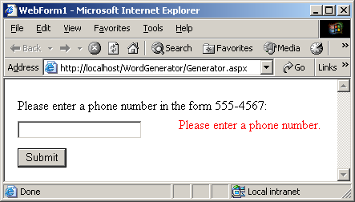
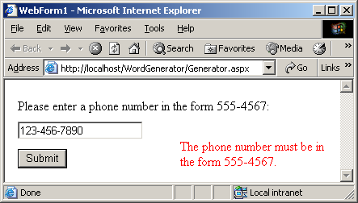
Generator.aspx.cs
Program Output

Slide 53
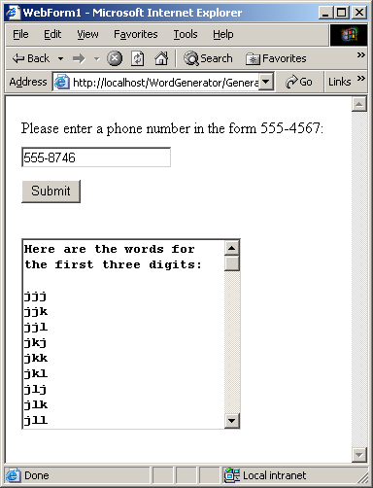
Generator.aspx.cs
Program Output

Slide 54
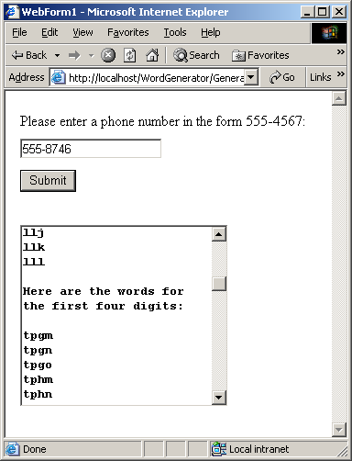
Generator.aspx.cs
Program Output

Slide 55
Generator.html
1 <!-- Fig. 20.23: Generator.html -->
2 <!-- The HTML page that is sent to the client browser. -->
3
4 <!DOCTYPE HTML PUBLIC "-//W3C//DTD HTML 4.0 Transitional//EN" >
5 <HTML>
6 <HEAD>
7 <title>WebForm1</title>
8 <meta name="GENERATOR"
9 content="Microsoft Visual Studio 7.0">
10 <meta name="CODE_LANGUAGE" content="C#" >
11 <meta name="vs_defaultClientScript"
12 content="JavaScript">
13 <meta name="vs_targetSchema"
14 content="http://schemas.microsoft.com/intellisense/ie5">
15 </HEAD>
16
17 <body MS_POSITIONING="GridLayout">
18
19 <form name="Form1" method="post"
20 action="Generator.aspx" language="javascript"
21 onsubmit="ValidatorOnSubmit();" id="FORM1">
22 <input type="hidden" name="__VIEWSTATE"
23 value="dDwxMjgyMzM3ozs+" />
24
25 <script language="javascript"
26 src=
27 "/aspnet_client/system_web/1_0_3215_11/WebUIValidation.js">
28 </script>
29
ECMAScript provides implementation
for validation controls

Slide 56
Generator.html
30 <span id="phoneNumberValidator"
31 controltovalidate="inputTextBox"
32 errormessage=
33 "The phone number must be in the form 555-4567."
34 evaluationfunction=
35 "RegularExpressionValidatorEvaluateIsValid"
36 validationexpression="^\d{3}-\d{4}$"
37 style="color:Red;Z-INDEX:106;LEFT:217px;
38 POSITION:absolute;TOP:73px;visibility:hidden;">
39 The phone number must be in the form 555-4567.
40 </span>
41
42 <input name="inputTextBox" type="text"
43 id="inputTextBox"
44 style="Z-INDEX: 102; LEFT: 16px;
45 POSITION: absolute; TOP: 52px" />
46
47 <input type="submit" name="submitButton"
48 value="Submit"
49 onclick= "if ( " +
50 "typeof(Page_ClientValidate) == 'function') " +
51 "Page_ClientValidate(); " language="javascript"
52 id="submitButton" style="Z-INDEX: 103;
53 LEFT: 16px;
54 POSITION: absolute;
55 TOP: 86px" />
56
57 <span id="phoneInputValidator"
58 controltovalidate="inputTextBox"
59 errormessage="Please enter a phone number."
60 evaluationfunction=
61 "RequiredFieldValidatorEvaluateIsValid"
62 initialvalue="" style="color:Red;Z-INDEX:105;
63 LEFT:217px;POSITION:absolute;TOP:47px;
64 visibility:hidden;">Please enter a phone number.

Slide 57
Generator.html
65 </span>
66
67 <span id="promptLabel" style="Z-INDEX: 101;
68 LEFT: 16px; POSITION: absolute; TOP: 23px">
69 Please enter a phone number in the form 555-4567:
70 </span>
71
72 <script language="javascript">
73 <!--
74 var Page_Validators = new Array(
75 document.all["phoneNumberValidator"],
76 document.all["phoneInputValidator"] );
77 // -->
78 </script>
79
80 <script language="javascript">
81 <!--
82 var Page_ValidationActive = false;
83
84 if (
85 typeof(clientInformation) != "undefined" &&
86 clientInformation.appName.indexOf("Explorer")
87 != -1 ) {
88
89 if ( typeof(Page_ValidationVer) == "undefined" )
90 alert(
91 "Unable to find script library " +
92 "'/aspnet_client/system_web/'"+
93 "'1_0_3215_11/WebUIValidation.js'. " +
94 "Try placing this file manually, or " +
95 "reinstall by running 'aspnet_regiis -c'.");
ECMAScript provides implementation
for validation controls

Slide 58
Generator.html
96 else if ( Page_ValidationVer != "125" )
97 alert(
98 "This page uses an incorrect version " +
99 "of WebUIValidation.js. The page " +
100 "expects version 125. " +
101 "The script library is " +
102 Page_ValidationVer + ".");
103 else
104 ValidatorOnLoad();
105 }
106
107 function ValidatorOnSubmit() {
108 if (Page_ValidationActive) {
109 ValidatorCommonOnSubmit();
110 }
111 }
112 // -->
113 </script>
114 </form>
115 </body>
116 </HTML>

Slide 59
20.6 Session Tracking
Personalization
  Tailored to client’s needs
  Customer loyalty
  Session ID
Privacy protection
  Release of vital possibly private data

Slide 60
20.6.1 Cookies
Cookies
  Text file stored by a Web site on a individual’s computer that allows the site to track the actions of the visitor
    Records sites that the user visits and identifies shopping preferences
    Cookies can store name-value pairs
    Web Server can never access cookies created outside the domain associated with that server

Slide 61
OptionsPage.aspx
1 <%-- Fig. 20.24: OptionsPage.aspx --%>
2 <%-- This ASPX page allows the user to choose a language. --%>
3
4 <%@ Page language="c#" Codebehind="OptionsPage.aspx.cs"
5 AutoEventWireup="false"
6 Inherits="Cookies.OptionsPage" %>
7
8 <!DOCTYPE HTML PUBLIC "-//W3C//DTD HTML 4.0 Transitional//EN" >
9
10 <HTML>
11 <HEAD>
12 <title>RecommendationsPage</title>
13 <meta name="GENERATOR" Content=
14 "Microsoft Visual Studio 7.0">
15 <meta name="CODE_LANGUAGE" Content="C#">
16 <meta name="vs_defaultClientScript" content=
17 "JavaScript">
18 <meta name="vs_targetSchema" content=
19 "http://schemas.microsoft.com/intellisense/ie5">
20 </HEAD>
21
22 <body>
23 <form id="RecommendationsPage" method="post"
24 runat="server">
25 <P>
26 <asp:Label id="promptLabel" runat="server"
27 Font-Bold="True">Select a programming language:
28 </asp:Label>
29
30 <asp:Label id="welcomeLabel" runat="server"
31 Font-Bold="True" Visible="False">
32 Welcome to Cookies! You selected
33 </asp:Label>
34 </P>
35
Label Web control

Slide 62
OptionsPage.aspx
36 <P>
37 <asp:RadioButtonList id="languageList" runat=
38 "server">
39 <asp:ListItem Value="C#">C#</asp:ListItem>
40
41 <asp:ListItem Value="C++">C++</asp:ListItem>
42
43 <asp:ListItem Value="C">C</asp:ListItem>
44
45 <asp:ListItem Value="Python">Python
46 </asp:ListItem>
47
48 <asp:ListItem Value="Visual Basic .NET">
49 Visual Basic .NET
50 </asp:ListItem>
51 </asp:RadioButtonList>
52 </P>
53
54 <P>
55 <asp:Button id="submitButton" runat="server" Text=
56 "Submit">
57 </asp:Button>
58 </P>
59
60 <P>
61 <asp:HyperLink id="languageLink" runat="server"
62 NavigateUrl="OptionsPage.aspx" Visible="False">
63 Click here to choose another language.
64 </asp:HyperLink>
65 </P>
66
67 <P>
68 <asp:HyperLink id="recommendationsLink" runat=
69 "server" NavigateUrl="RecommendationsPage.aspx"
Defines five radio buttons
Request current page, does not cause a postback

Slide 63
OptionsPage.aspx
70 Visible="False">Click here to get book recommendations.
71 </asp:HyperLink>
72 </P>
73 </form>
74 </body>
75 </HTML>

Slide 64
OptionsPage.aspx.cs
1 // Fig. 20.25: OptionPage.aspx.cs
2 // A listing of program languages that the user can choose from.
3
4 using System;
5 using System.Collections;
6 using System.ComponentModel;
7 using System.Data;
8 using System.Drawing;
9 using System.Web;
10 using System.Web.SessionState;
11 using System.Web.UI;
12 using System.Web.UI.WebControls;
13 using System.Web.UI.HtmlControls;
14
15 namespace Cookies
16 {
17 // page contains language options in a RadioButtonList,
18 // will add a cookie to store their choice
19 public class OptionsPage : System.Web.UI.Page
20 {
21 protected System.Web.UI.WebControls.Label promptLabel;
22 protected System.Web.UI.WebControls.Label welcomeLabel;
23
24 protected System.Web.UI.WebControls.RadioButtonList
25 languageList;
26
27 protected System.Web.UI.WebControls.HyperLink
28 languageLink;
29 protected System.Web.UI.WebControls.HyperLink
30 recommendationsLink;
31
32 protected System.Web.UI.WebControls.Button
33 submitButton;
34
35 protected Hashtable books = new Hashtable();
Define books as a Hashtable, stores key-value

Slide 65
OptionsPage.aspx.cs
36
37 // event handler for Load event
38 private void Page_Load(
39 object sender, System.EventArgs e )
40 {
41 if ( IsPostBack )
42 {
43 // if postback has occurred, user has submitted
44 // information, so display welcome message
45 // and appropriate hyperlinks
46 welcomeLabel.Visible = true;
47 languageLink.Visible = true;
48 recommendationsLink.Visible = true;
49
50 // hide option information
51 submitButton.Visible = false;
52 promptLabel.Visible = false;
53 languageList.Visible = false;
54
55 // notify user of what they have chosen
56 if ( languageList.SelectedItem != null )
57 welcomeLabel.Text +=
58 languageList.SelectedItem.ToString() + ".";
59 else
60 welcomeLabel.Text += "no language.";
61
62 } // end if
63
64 } // end method Page_Load
65
Two hyperlinks are made visible
Determines whether the user selected a language

Slide 66
OptionsPage.aspx.cs
66 override protected void OnInit( EventArgs e )
67 {
68 // add values to Hashtable
69 books.Add( "C#", "0-13-062221-4" );
70 books.Add( "C++", "0-13-089571-7" );
71 books.Add( "C", "0-13-089572-5" );
72 books.Add( "Python", "0-13-092361-3" );
73 books.Add( "Visual Basic .NET", "0-13-456955-5" );
74
75 InitializeComponent();
76 base.OnInit( e );
77 }
78
79 // Visual Studio .NET generated code
80
81 // when user clicks Submit button
82 // create cookie to store user's choice
83 private void submitButton_Click(
84 object sender, System.EventArgs e )
85 {
86 // if choice was made by user
87 if ( languageList.SelectedItem != null )
88 {
89 string language =
90 languageList.SelectedItem.ToString();
91
92 string ISBN = books[ language ].ToString();
93
94 // create cookie, name-value pair is
95 // language chosen and ISBN number from Hashtable
96 HttpCookie cookie = new HttpCookie(
97 language, ISBN );
98
Returns value corresponding to key contained in language
New cookie object created to store language and ISBN number

Slide 67
OptionsPage.aspx.cs
99 // add cookie to response,
100 // thus placing it on user's machine
101 Response.Cookies.Add( cookie );
102
103 } // end if
104
105 } // end method submitButton_Click
106
107 } // end class OptionsPage
108
109 } // end namespace Cookies
Cookie is added to the cookie collection sent as part of HTTP response header

Slide 68
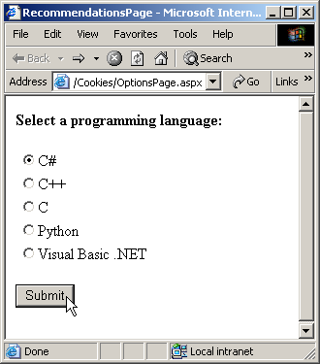
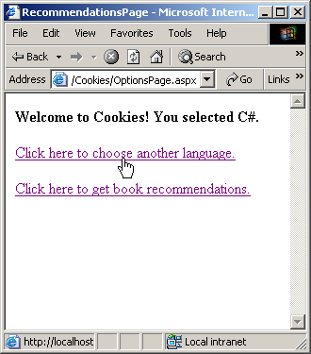
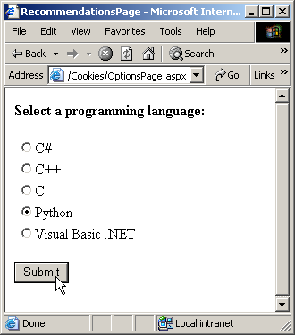
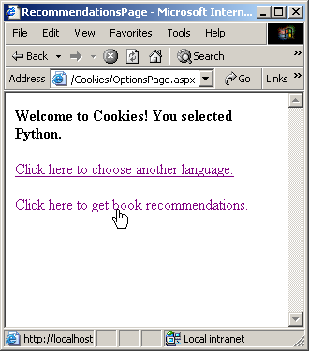
OptionsPage.aspx.cs
Program Output

Slide 69
RecommendationsPage.aspx
1 <%-- Fig. 20.26: RecommendationsPage.aspx --%>
2 <%-- This page shows recommendations --%>
3 <%-- retrieved from the Hashtable. --%>
4
5 <%@ Page language="c#" Codebehind="RecommendationsPage.aspx.cs"
6 AutoEventWireup="false"
7 Inherits="Cookies.RecommendationsPage" %>
8
9 <!DOCTYPE HTML PUBLIC "-//W3C//DTD HTML 4.0 Transitional//EN" >
10
11 <HTML>
12 <HEAD>
13 <title>WebForm1</title>
14 <meta name="GENERATOR" Content=
15 "Microsoft Visual Studio 7.0">
16 <meta name="CODE_LANGUAGE" Content="C#">
17 <meta name="vs_defaultClientScript" content="JavaScript">
18 <meta name="vs_targetSchema" content=
19 "http://schemas.microsoft.com/intellisense/ie5">
20 </HEAD>
21
22 <body MS_POSITIONING="GridLayout">
23
24 <form id="Form1" method="post" runat="server">
25
26 <asp:Label id="recommendationsLabel"
27 style="Z-INDEX: 101; LEFT: 21px; POSITION: absolute;
28 TOP: 25px" runat="server" Font-Bold="True"
29 Font-Size="X-Large">Recommendations
30 </asp:Label>
31
32 <asp:ListBox id="booksListBox" style="Z-INDEX: 102;
33 LEFT: 21px; POSITION: absolute; TOP: 82px" runat=
34 "server" Width="383px" Height="91px">
35 </asp:ListBox>
Label displays text recommendations
Displays the recommendations created
by the code-behind file

Slide 70
RecommendationsPage.aspx
36 </form>
37 </body>
38 </HTML>

Slide 71
RecommendationsPage.aspx.cs
1 // Fig 20.27: RecommendationsPage.aspx.cs
2 // Reading cookie data from the client.
3
4 using System;
5 using System.Collections;
6 using System.ComponentModel;
7 using System.Data;
8 using System.Drawing;
9 using System.Web;
10 using System.Web.SessionState;
11 using System.Web.UI;
12 using System.Web.UI.WebControls;
13 using System.Web.UI.HtmlControls;
14
15 namespace Cookies
16 {
17 // page displays cookie information and recommendations
18 public class RecommendationsPage : System.Web.UI.Page
19 {
20 protected System.Web.UI.WebControls.ListBox booksListBox;
21 protected System.Web.UI.WebControls.Label
22 recommendationsLabel;
23
24 // Visual Studio .NET generated code
25
26 override protected void OnInit( EventArgs e )
27 {
28 InitializeComponent();
29 base.OnInit( e );
30
31 // retrieve client's cookies
32 HttpCookieCollection cookies = Request.Cookies;
33
Method to retrieve cookies from the client

Slide 72
RecommendationsPage.aspx.cs
34 // if there are cookies other than the ID cookie,
35 // list appropriate books and ISBN numbers
36 if ( cookies != null && cookies.Count != 1 )
37 for ( int i = 1; i < cookies.Count; i++ )
38 booksListBox.Items.Add(
39 cookies[ i ].Name +
40 " How to Program. ISBN#: " +
41 cookies[ i ].Value );
42
43 // if no cookies besides ID, no options were
44 // chosen, so no recommendations made
45 else
46 {
47 recommendationsLabel.Text = "No Recommendations.";
48 booksListBox.Items.Clear();
49 booksListBox.Visible = false;
50 }
51
52 } // end method OnInit
53
54 } // end class RecommendationsPage
55
56 } // end namespace Cookies
Ensure that there is at least one cookie besides ASP.NET_SessionID
Determine whether at least two cookies exist
Add information in other cookies into list box
Execute if no language was selected

Slide 73
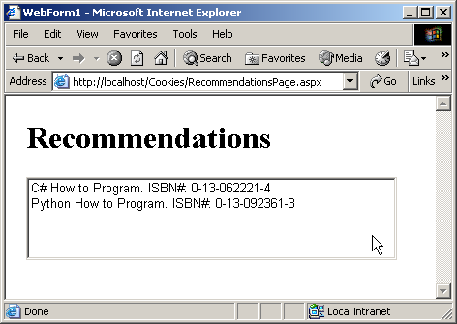
RecommendationsPage.aspx.cs
Program Output

Slide 74
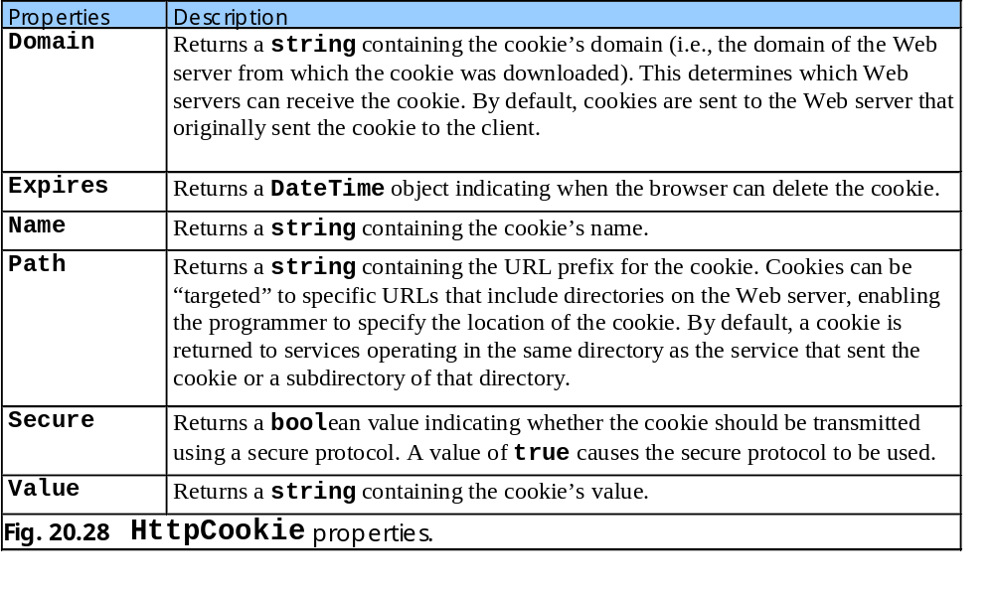
20.6.1 Cookies

Slide 75
20.6.2 Session Tracking with HttpSessionState
HttpSessionState
  HttpSessionState objects can store any type of objects (not just Strings) as attribute values

Slide 76
OptionsPage.aspx
1 <%-- Fig. 20.29: OptionsPage.aspx --%>
2 <%-- Page that presents a list of language options. --%>
3
4 <%@ Page language="c#" Codebehind="OptionsPage.aspx.cs"
5 AutoEventWireup="false" Inherits=
6 "Sessions.OptionsPage" %>
7
8 <!DOCTYPE HTML PUBLIC "-//W3C//DTD HTML 4.0 Transitional//EN" >
9 <HTML>
10 <HEAD>
11 <title>RecommendationsPage</title>
12 <meta name="GENERATOR" Content=
13 "Microsoft Visual Studio 7.0">
14 <meta name="CODE_LANGUAGE" Content="C#">
15 <meta name="vs_defaultClientScript" content="JavaScript">
16 <meta name="vs_targetSchema" content=
17 "http://schemas.microsoft.com/intellisense/ie5">
18 </HEAD>
19
20 <body>
21 <form id="RecommendationsPage" method="post"
22 runat="server">
23 <P>
24 <asp:Label id="promptLabel" runat="server"
25 Font-Bold="True">Select a programming language:
26 </asp:Label>
27
28 <asp:Label id="welcomeLabel" runat="server"
29 Font-Bold="True" Visible="False">
30 Welcome to Cookies! You selected
31 </asp:Label>
32 </P>
33
34 <P>

Slide 77
OptionsPage.aspx
35 <asp:RadioButtonList id="languageList" runat=
36 "server">
37
38 <asp:ListItem Value="C#">C#</asp:ListItem>
39
40 <asp:ListItem Value="C++">C++</asp:ListItem>
41
42 <asp:ListItem Value="C">C</asp:ListItem>
43
44 <asp:ListItem Value="Python">Python
45 </asp:ListItem>
46
47 <asp:ListItem Value="Visual Basic .NET">
48 Visual Basic .NET
49 </asp:ListItem>
50 </asp:RadioButtonList>
51 </P>
52
53 <P>
54 <asp:Button id="submitButton" runat="server"
55 Text="Submit">
56 </asp:Button>
57 </P>
58
59 <P>
60 <asp:Label id="idLabel" runat="server">
61 </asp:Label>
62 </P>
63
64 <P>
65 <asp:Label id="timeoutLabel" runat="server">
66 </asp:Label>
67 </P>
68
69 <P>

Slide 78
OptionsPage.aspx
70 <asp:Label id="newSessionLabel" runat="server">
71 </asp:Label>
72 </P>
73
74 <P>
75 <asp:HyperLink id="languageLink" runat="server"
76 NavigateUrl="OptionsPage.aspx" Visible="False">
77 Click here to choose another language.
78 </asp:HyperLink>
79 </P>
80
81 <P>
82 <asp:HyperLink id="recommendationsLink" runat=
83 "server" NavigateUrl="RecommendationsPage.aspx"
84 Visible="False">
85 Click here to get book recommendations.
86 </asp:HyperLink>
87 </P>
88 </form>
89 </body>
90 </HTML>

Slide 79
OptionsPage.aspx.cs
1 // Fig. 20.30: OptionsPage.aspx.cs
2 // A listing of programming languages,
3 // choice is stored in page’s Session object.
4
5 using System;
6 using System.Collections;
7 using System.ComponentModel;
8 using System.Data;
9 using System.Drawing;
10 using System.Web;
11 using System.Web.SessionState;
12 using System.Web.UI;
13 using System.Web.UI.WebControls;
14 using System.Web.UI.HtmlControls;
15
16 namespace Sessions
17 {
18 // page contains language options in a RadioButtonList
19 // will add cookie to store user’s choice
20 public class OptionsPage : System.Web.UI.Page
21 {
22 protected System.Web.UI.WebControls.Label promptLabel;
23 protected System.Web.UI.WebControls.Label welcomeLabel;
24 protected System.Web.UI.WebControls.Label idLabel;
25 protected System.Web.UI.WebControls.Label timeoutLabel;
26
27 protected System.Web.UI.WebControls.HyperLink
28 languageLink;
29 protected System.Web.UI.WebControls.HyperLink
30 recommendationsLink;
31
32 protected System.Web.UI.WebControls.RadioButtonList
33 languageList;
34 protected System.Web.UI.WebControls.Button submitButton;
35

Slide 80
OptionsPage.aspx.cs
36 private Hashtable books = new Hashtable();
37
38 // event handler for Load event
39 private void Page_Load(
40 object sender, System.EventArgs e )
41 {
42 // if page is loaded due to postback, load session
43 // information, hide language options from user
44 if ( IsPostBack )
45 {
46 // display components that contain session information
47 welcomeLabel.Visible = true;
48 languageLink.Visible = true;
49 recommendationsLink.Visible = true;
50
51 // hide components
52 submitButton.Visible = false;
53 promptLabel.Visible = false;
54 languageList.Visible = false;
55
56 // set labels to display Session information
57 if ( languageList.SelectedItem != null )
58 welcomeLabel.Text +=
59 languageList.SelectedItem.ToString() + ".";
60 else
61 welcomeLabel.Text += "no language.";
62
63 idLabel.Text += "Your unique session ID is: " +
64 Session.SessionID;
65
66 timeoutLabel.Text += "Timeout: " + Session.Timeout +
67 " minutes";
68
69 } // end if
70
Specify maximum amount of time that an HttpSessionState object can be inactive before discarded
SessionID contains session’s unique ID

Slide 81
OptionsPage.aspx.cs
71 } // end method Page_Load
72
73 override protected void OnInit( EventArgs e )
74 {
75 // add values to Hashtable
76 books.Add( "C#", "0-13-062221-4" );
77 books.Add( "C++", "0-13-089571-7" );
78 books.Add( "C", "0-13-089572-5" );
79 books.Add( "Python", "0-13-092361-3" );
80 books.Add( "Visual Basic .NET", "0-13-456955-5" );
81
82 InitializeComponent();
83 base.OnInit( e );
84 }
85
86 // Visual Studio .NET generated code
87
88 // when user clicks Submit button,
89 // store user's choice in session object
90 private void submitButton_Click(
91 object sender, System.EventArgs e )
92 {
93 if ( languageList.SelectedItem != null )
94 {
95 string language =
96 languageList.SelectedItem.ToString();
97 string ISBN = books[ language ].ToString();
98
99 // store in session object as name-value pair
100 // name is language chosen, value is
101 // ISBN number for corresponding book
102 Session.Add( language, ISBN );
103
104 } // end if
Method Add to place language and its corresponding recommended book’s ISBN into HttpSessionState object

Slide 82
OptionsPage.aspx.cs
105
106 } // end method submitButton_Click
107
108 } // end class OptionsPage
109
110 } // end namespace Sessions

Slide 83

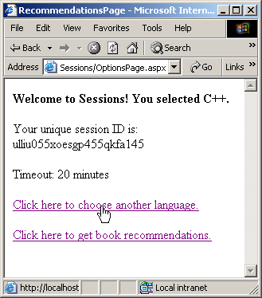

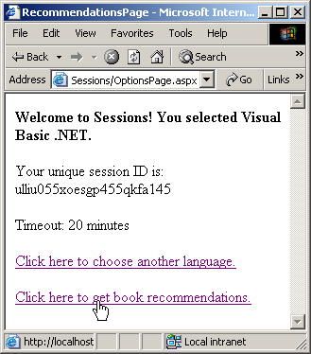
OptionsPage.aspx.cs
Program Output

Slide 84
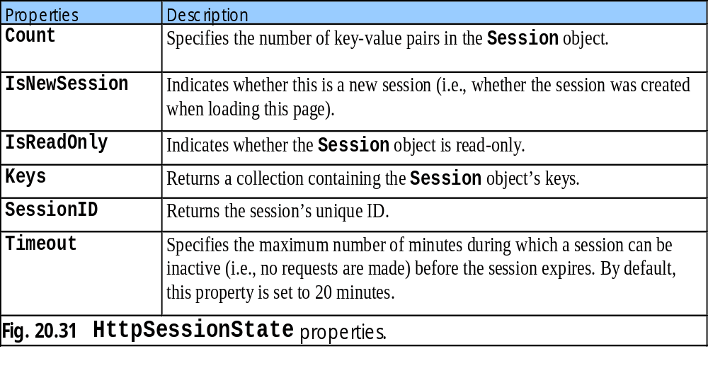
20.6.2 Session Tracking with HttpSessionState

Slide 85
RecommendationsPage.aspx
1 <%-- Fig. 20.32: RecommendationsPage.aspx --%>
2 <%-- Read the user's session data. --%>
3
4 <%@ Page language="c#" Codebehind="RecommendationsPage.aspx.cs"
5 AutoEventWireup="false"
6 Inherits="Sessions.RecommendationsPage" %>
7
8 <!DOCTYPE HTML PUBLIC "-//W3C//DTD HTML 4.0 Transitional//EN" >
9
10 <HTML>
11 <HEAD>
12 <title>WebForm1</title>
13 <meta name="GENERATOR" Content=
14 "Microsoft Visual Studio 7.0">
15 <meta name="CODE_LANGUAGE" Content="C#">
16 <meta name="vs_defaultClientScript" content=
17 "JavaScript">
18 <meta name="vs_targetSchema" content=
19 "http://schemas.microsoft.com/intellisense/ie5">
20 </HEAD>
21
22 <body MS_POSITIONING="GridLayout">
23 <form id="Form1" method="post" runat="server">
24 <asp:Label id="recommendationsLabel"
25 style="Z-INDEX: 101; LEFT: 21px; POSITION: absolute;
26 TOP: 25px" runat="server" Font-Bold="True"
27 Font-Size="X-Large">Recommendations
28 </asp:Label>
29
30 <asp:ListBox id="booksListBox" style="Z-INDEX: 102;
31 LEFT: 21px; POSITION: absolute; TOP: 84px" runat=
32 "server" Width="383px" Height="91px">
33 </asp:ListBox>
ListBox Web control that is used to present recommendations to user

Slide 86
RecommendationsPage.aspx
34 </form>
35 </body>
36 </HTML>

Slide 87
RecommendationsPage.aspx.cs
1 // Fig. 20.33: RecommendationsPage.aspx.cs
2 // Reading session data from the user.
3
4 using System;
5 using System.Collections;
6 using System.ComponentModel;
7 using System.Data;
8 using System.Drawing;
9 using System.Web;
10 using System.Web.SessionState;
11 using System.Web.UI;
12 using System.Web.UI.WebControls;
13 using System.Web.UI.HtmlControls;
14
15 namespace Sessions
16 {
17 // page displaying session information and recommendations
18 public class RecommendationsPage : System.Web.UI.Page
19 {
20 protected System.Web.UI.WebControls.ListBox booksListBox;
21
22 protected System.Web.UI.WebControls.Label
23 recommendationsLabel;
24
25 // Visual Studio .NET generated code
26
27 // event handler for Init event
28 override protected void OnInit( EventArgs e )
29 {
30 InitializeComponent();
31 base.OnInit( e );
32
Event handler OnInit retrieves session information

Slide 88
RecommendationsPage.aspx.cs
33 // determine if Session contains information
34 if ( Session.Count != 0 )
35 {
36 // iterate through Session values,
37 // display in ListBox
38 for ( int i = 0; i < Session.Count; i++ )
39 {
40 // store current key in sessionName
41 string keyName = Session.Keys[ i ];
42
43 // use current key to display
44 // Session's name/value pairs
45 booksListBox.Items.Add( keyName +
46 " How to Program. ISBN#: " +
47 Session[ keyName ] );
48
49 } // end for
50
51 }
52 else
53 {
54 recommendationsLabel.Text = "No Recommendations";
55 booksListBox.Visible = false;
56 }
57
58 } // end method OnInit
59
60 } // end class RecommendationsPage
61
62 } // end namespace Sessions
Iterates through the Session object
Indexing the Session object with key name
If no language was ever selected

Slide 89
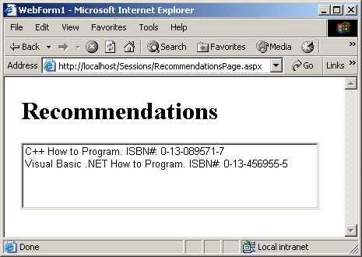
RecommendationsPage.aspx.cs
Program Output

Slide 90
20.7 Case Study: Online Guest Book
Guest Book
  Data submitted on the guest-book form often are stored in a database located on the Web server’s machine

Slide 91
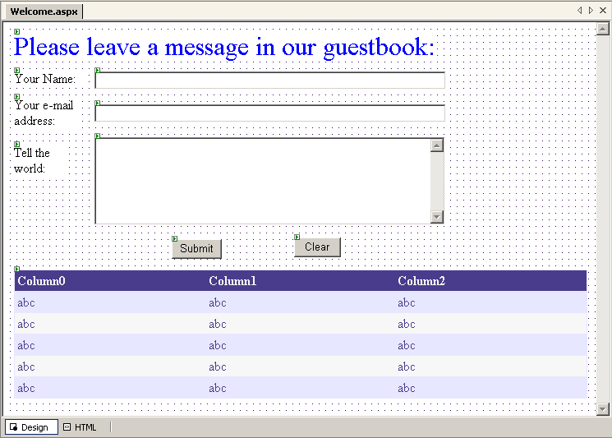
20.7 Case Study: Online Guest Book
Fig. 20.34 Guest book application GUI.

Slide 92
Welcome.aspx
1 <%-- Fig. 20.35: Welcome.aspx --%>
2 <%-- A Web Form demonstrating a guest book. --%>
3
4 <%@ Page language="c#" Codebehind="Welcome.aspx.cs"
5 AutoEventWireup="false"
6 Inherits="Guestbook.GuestBookTest" %>
7
8 <!DOCTYPE HTML PUBLIC "-//W3C//DTD HTML 4.0 Transitional//EN" >
9
10 <HTML>
11 <HEAD>
12 <title>WebForm1</title>
13 <meta name="GENERATOR" Content=
14 "Microsoft Visual Studio 7.0">
15 <meta name="CODE_LANGUAGE" Content="C#">
16 <meta name="vs_defaultClientScript" content="JavaScript">
17 <meta name="vs_targetSchema" content=
18 "http://schemas.microsoft.com/intellisense/ie5">
19 </HEAD>
20
21 <body MS_POSITIONING="GridLayout">
22 <form id="Form1" method="post" runat="server">
23 <asp:DataGrid id="dataGrid" style="Z-INDEX: 101;
24 LEFT: 13px; POSITION: absolute; TOP: 301px" runat=
25 "server" Width="698px" HorizontalAlign="Left"
26 BorderColor="#E7E7FF" BorderWidth="1px"
27 GridLines="Horizontal" BackColor="White"
28 DataSource="<%# dataView %>" BorderStyle="None"
29 CellPadding="3">
30
31 <SelectedItemStyle Font-Bold="True" ForeColor=
32 "#F7F7F7" BackColor="#738A9C">
33 </SelectedItemStyle>
34
35 <AlternatingItemStyle BackColor="#F7F7F7">
Figure presents the ASPX file
dataGid displays all guest-book entries

Slide 93
Welcome.aspx
36 </AlternatingItemStyle>
37
38 <ItemStyle HorizontalAlign="Left" ForeColor=
39 "#4A3C8C" BackColor="#E7E7FF">
40 </ItemStyle>
41
42 <HeaderStyle Font-Bold="True" ForeColor="#F7F7F7"
43 BackColor="#4A3C8C">
44 </HeaderStyle>
45
46 <FooterStyle ForeColor="#4A3C8C" BackColor=
47 "#B5C7DE">
48 </FooterStyle>
49
50 <PagerStyle HorizontalAlign="Right" ForeColor=
51 "#4A3C8C" BackColor="#E7E7FF" Mode=
52 "NumericPages">
53 </PagerStyle>
54 </asp:DataGrid>
55
56 <asp:Button id="clearButton" style="Z-INDEX: 111;
57 LEFT: 354px; POSITION: absolute; TOP: 262px"
58 runat="server" Width="57px" Text="Clear">
59 </asp:Button>
60
61 <asp:Button id="submitButton" style="Z-INDEX: 110;
62 LEFT: 205px; POSITION: absolute; TOP: 264px"
63 runat="server" Text="Submit">
64 </asp:Button>
65
66 <asp:TextBox id="messageTextBox" style="Z-INDEX: 109;
67 LEFT: 111px; POSITION: absolute; TOP: 139px"
68 runat="server" Width="427px" Height="107px"
69 TextMode="MultiLine">
70 </asp:TextBox>

Slide 94
Welcome.aspx
71
72 <asp:Label id="messageLabel" style="Z-INDEX: 108;
73 LEFT: 13px; POSITION: absolute; TOP: 149px"
74 runat="server" Width="59px" Height="9px">
75 Tell the world:
76 </asp:Label>
77
78 <asp:Label id="emailLabel" style="Z-INDEX: 107;
79 LEFT: 13px; POSITION: absolute; TOP: 91px"
80 runat="server" Width="76px">E-mail address:
81 </asp:Label>
82
83 <asp:TextBox id="emailTextBox" style="Z-INDEX: 106;
84 LEFT: 111px; POSITION: absolute; TOP: 99px"
85 runat="server" Width="428px">
86 </asp:TextBox>
87
88 <asp:Label id="nameLabel" style="Z-INDEX: 104;
89 LEFT: 13px; POSITION: absolute; TOP: 59px"
90 runat="server" Width="84px">First Name:
91 </asp:Label>
92
93 <asp:TextBox id="nameTextBox" style="Z-INDEX: 105;
94 LEFT: 111px; POSITION: absolute; TOP: 59px"
95 runat="server" Width="428px">
96 </asp:TextBox>
97
98 <asp:Label id="promptLabel" style="Z-INDEX: 102;
99 LEFT: 13px; POSITION: absolute; TOP: 12px"
100 runat="server" ForeColor="Blue" Font-Size="X-Large">
101 Please leave a message in our guest book:
102 </asp:Label>
103 </form>
104 </body>
105 </HTML>

Slide 95
Welcome.aspx.cs
1 // Fig. 20.36: Welcome.aspx.cs
2 // The code-behind file for the guest book page.
3
4 using System;
5 using System.Collections;
6 using System.ComponentModel;
7 using System.Data;
8 using System.Drawing;
9 using System.Web;
10 using System.Web.SessionState;
11 using System.Web.UI;
12 using System.Web.UI.WebControls;
13 using System.Web.UI.HtmlControls;
14 using System.IO;
15
16 namespace Guestbook
17 {
18 // allows user to leave messages
19 public class GuestBookForm : System.Web.UI.Page
20 {
21 protected System.Web.UI.WebControls.Label promptLabel;
22 protected System.Web.UI.WebControls.Label nameLabel;
23 protected System.Web.UI.WebControls.Label emailLabel;
24 protected System.Web.UI.WebControls.Label messageLabel;
25
26 protected System.Web.UI.WebControls.DataGrid dataGrid;
27
28 protected System.Web.UI.WebControls.Button submitButton;
29 protected System.Web.UI.WebControls.Button clearButton;
30
31 protected System.Web.UI.WebControls.TextBox nameTextBox;
32 protected System.Web.UI.WebControls.TextBox
33 emailTextBox;
34 protected System.Web.UI.WebControls.TextBox
35 messageTextBox;

Slide 96
Welcome.aspx.cs
37 protected System.Data.DataView dataView;
38
39 // handle Page's Load event
40 private void Page_Load(
41 object sender, System.EventArgs e )
42 {
43 dataView = new DataView( new DataTable() );
44
45 } // end method Page_Load
46
47 // Visual Studio .NET generated code
48
49 // places all the messages in the guest book into a
50 // table; messages are separated by horizontal rules
51 public void FillMessageTable()
52 {
53 DataTable table = dataView.Table;
54 table.Columns.Add( "Date" );
55 table.Columns.Add( "First Name" );
56 table.Columns.Add( "e-mail" );
57 table.Columns.Add( "Message" );
58
59 // open guest book file for reading
60 StreamReader reader = new StreamReader(
61 Request.PhysicalApplicationPath +
62 "guestbook.txt" );
63
64 char[] separator = { '\t' };
65
66 // read in line from file
67 string message = reader.ReadLine();
68
Method to place guest book entries in DataTable table
Create DataTable object from DataView’s Table property
Form necessary columns using Columns collection’s Add method
Begin to read each line in text file

Slide 97
Welcome.aspx.cs
69 while ( message != null )
70 {
71 // split the string into its four parts
72 string[] parts = message.Split( separator );
73
74 // load data into table
75 table.LoadDataRow( parts, true );
76
77 // read in one line from file
78 message = reader.ReadLine();
79 }
80
81 // update grid
82 dataGrid.DataSource = table;
83 dataGrid.DataBind();
84
85 reader.Close();
86
87 } // end method FillMessageTable
88
89 // add user’s entry to guest book
90 private void submitButton_Click(
91 object sender, System.EventArgs e )
92 {
93 // open stream for appending to file
94 StreamWriter guestbook =
95 new StreamWriter( Request.PhysicalApplicationPath +
96 "guestbook.txt", true );
97
98 // write new message to file
99 guestbook.WriteLine(
100 DateTime.Now.Date.ToString().Substring( 0, 10 ) +
101 "\t" + nameTextBox.Text + "\t" + emailTextBox.Text
102 + "\t" + messageTextBox.Text );
103
parts added to table through LoadDataRow
Break each line read from file into four tokens
Indicate that changes will be accepted
Method to refresh DataView
Create StreamWriter that references file containing guestbook entries
Event handler to add user’s information to guestbook.txt
Concatenate project folder with file name
Retrieve path of application’s root directory
Append appropriate message to guestbook file
True specify that new information will be appended to file

Slide 98
Welcome.aspx.cs
104 // clear textboxes and close stream
105 nameTextBox.Text = "";
106 emailTextBox.Text = "";
107 messageTextBox.Text = "";
108 guestbook.Close();
109
110 FillMessageTable();
111 } // end method submitButton_Click
112
113 // clear all text boxes
114 private void clearButton_Click(
115 object sender, System.EventArgs e )
116 {
117 nameTextBox.Text = "";
118 emailTextBox.Text = "";
119 messageTextBox.Text = "";
120
121 } // end method clearButton_Click
122
123 } // end class GuestBookForm
124
125 } // end namespace Guestbook
Clears all the TextBoxes by setting properties to empty string

Slide 99
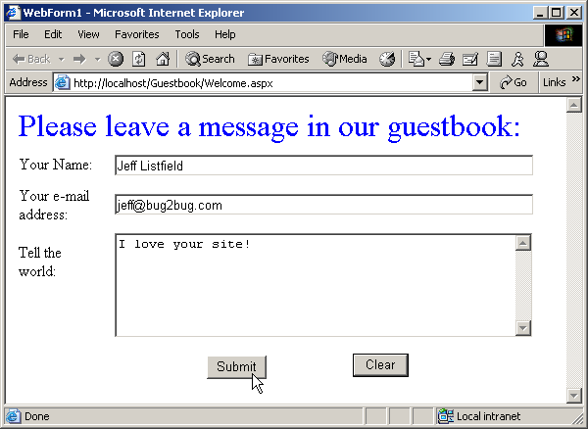
Welcome.aspx.cs
Program Output

Slide 100
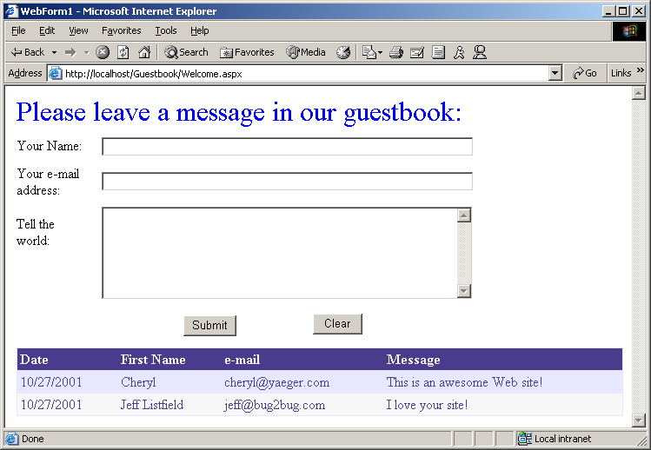
Welcome.aspx.cs
Program Output

Slide 101
20.8 Case Study: Connecting to a Database in ASP .NET
Web-based application to view list of publications by specified author

Slide 102
Login.aspx
1 <%-- Fig. 20.37: Login.aspx --%>
2 <%-- A page that allows the user to log in. --%>
3
4 <%@ Page language="c#" Codebehind="login.aspx.cs"
5 AutoEventWireup="false" Inherits="Database.Login" %>
6 <%@ Register TagPrefix="Header" TagName="ImageHeader"
7 Src="ImageHeader.ascx" %>
8
9 <!DOCTYPE HTML PUBLIC "-//W3C//DTD HTML 4.0 Transitional//EN" >
10 <HTML>
11 <HEAD>
12 <title>WebForm1</title>
13 <meta name="GENERATOR" Content="Microsoft Visual Studio 7.0">
14 <meta name="CODE_LANGUAGE" Content="C#">
15 <meta name="vs_defaultClientScript" content="JavaScript">
16 <meta name="vs_targetSchema"
17 content="http://schemas.microsoft.com/intellisense/ie5">
18 </HEAD>
19 <body MS_POSITIONING="GridLayout" bgColor="#ffebff">
20 <form id="Form1" method="post" runat="server">
21 <asp:label id="nameLabel" style="Z-INDEX: 101;
22 LEFT: 15px; POSITION: absolute; TOP: 188px"
23 runat="server">Name
24 </asp:label>
25
26 <asp:label id="promptLabel" style="Z-INDEX: 108;
27 LEFT: 15px; POSITION: absolute; TOP: 145px"
28 runat="server">Please select your name and
29 enter your password to log in:
30 </asp:label>
31
32 <asp:customvalidator id="invalidPasswordValidator"
33 style="Z-INDEX: 107; LEFT: 262px; POSITION: absolute;
34 TOP: 221px" runat="server"
35 ControlToValidate="passwordTextBox" Font-Bold="True"
Add Web user control to ASPX file
User control’s tag name and tag prefix

Slide 103
Login.aspx
36 ForeColor="DarkCyan" ErrorMessage="Invalid password!">
37 </asp:customvalidator>
38
39 <asp:requiredfieldvalidator id="requiredPasswordValidator"
40 style="Z-INDEX: 106; LEFT: 262px; POSITION: absolute;
41 TOP: 221px" runat="server"
42 ControlToValidate="passwordTextBox" Font-Bold="True"
43 ForeColor="DarkCyan"
44 ErrorMessage="Please enter a password!">
45 </asp:requiredfieldvalidator>
46
47 <asp:dropdownlist id="nameList" style="Z-INDEX: 105;
48 LEFT: 92px; POSITION: absolute; TOP: 185px"
49 runat="server" Width="154px">
50 </asp:dropdownlist>
51
52 <asp:button id="submitButton" style="Z-INDEX: 104;
53 LEFT: 92px; POSITION: absolute; TOP: 263px"
54 runat="server" Text="Submit">
55 </asp:button>
56
57 <asp:textbox id="passwordTextBox" style="Z-INDEX: 103;
58 LEFT: 92px; POSITION: absolute; TOP: 221px"
59 runat="server" TextMode="Password">
60 </asp:textbox>
61
62 <asp:label id="passwordLabel" style="Z-INDEX: 102;
63 LEFT: 15px; POSITION: absolute; TOP: 220px"
64 runat="server">Password
65 </asp:label>
66
67 <Header:ImageHeader id="ImageHeader1" runat="server">
ImageHeader element is added to the file

Slide 104
Login.aspx
68 </Header:ImageHeader>
69 </form>
70 </body>
71 </HTML>

Slide 105
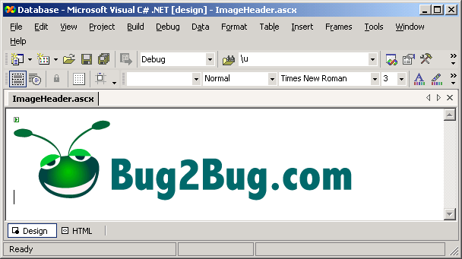
ImageHeader.ascx
1 <%-- Fig. 20.38: ImageHeader.ascx --%>
2 <%-- Listing for the header user control. --%>
3
4 <%@ Control Language="c#" AutoEventWireup="false"
5 Codebehind="ImageHeader.ascx.cs"
6 Inherits="Database.ImageHeader"
7 TargetSchema="http://schemas.microsoft.com/intellisense/ie5" %>
8
9 <asp:Image id="Image1" runat="server" ImageUrl="bug2bug.png">
10 </asp:Image>

Slide 106
Login.aspx.cs
1 // Fig. 20.39: Login.aspx.cs
2 // The code-behind file for the page that logs the user in.
3
4 using System;
5 using System.Collections;
6 using System.ComponentModel;
7 using System.Data;
8 using System.Drawing;
9 using System.Web;
10 using System.Web.SessionState;
11 using System.Web.UI;
12 using System.Web.UI.WebControls;
13 using System.Web.UI.HtmlControls;
14 using System.Web.Security;
15
16 namespace Database
17 {
18 // allows users to log in
19 public class Login : System.Web.UI.Page
20 {
21 protected System.Data.OleDb.OleDbDataAdapter
22 oleDbDataAdapter1;
23 protected System.Data.OleDb.OleDbCommand
24 oleDbSelectCommand1;
25 protected System.Data.OleDb.OleDbCommand
26 oleDbInsertCommand1;
27 protected System.Data.OleDb.OleDbCommand
28 oleDbUpdateCommand1;
29 protected System.Data.OleDb.OleDbCommand
30 oleDbDeleteCommand1;
31 protected System.Data.OleDb.OleDbConnection
32 oleDbConnection1;
33

Slide 107
Login.aspx.cs
34 protected System.Web.UI.WebControls.Label passwordLabel;
35 protected System.Web.UI.WebControls.Label nameLabel;
36 protected System.Web.UI.WebControls.Label promptLabel;
37
38 protected System.Web.UI.WebControls.DropDownList nameList;
39 protected System.Web.UI.WebControls.Button submitButton;
40 protected System.Web.UI.WebControls.RequiredFieldValidator
41 requiredPasswordValidator;
42 protected System.Web.UI.WebControls.CustomValidator
43 invalidPasswordValidator;
44 protected System.Web.UI.WebControls.TextBox passwordTextBox;
45
46 protected System.Data.OleDb.OleDbDataReader dataReader;
47
48 // handle Page's Load event
49 private void Page_Load( object sender, System.EventArgs e )
50 {
51 // if page loads due to postback, process information
52 // otherwise, page is loading for first time, so
53 // do nothing
54 if ( !IsPostBack )
55 {
56 // open database connection
57 oleDbConnection1.Open();
58
59 // execute query
60 dataReader =
61 oleDbDataAdapter1.SelectCommand.ExecuteReader();
62
63 // while we can read a row from query result,
64 // add first item to drop-down list
65 while ( dataReader.Read() )
66 nameList.Items.Add( dataReader.GetString( 0 ) );
67
Two validators
Allow specification on validity condition of a field
If page is loaded for first time
Execute SQL query, retrieve all rows from Authors table of Books database
Place item in first column of each row into namelist

Slide 108
Login.aspx.cs
68 // close database connection
69 oleDbConnection1.Close();
70 }
71 } // end Page_Load
72
73 // Visual Studio .NET generated code
74
75 // validate user name and password
76 private void invalidPasswordValidator_ServerValidate(
77 object source,
78 System.Web.UI.WebControls.ServerValidateEventArgs args )
79 {
80 // open database connection
81 oleDbConnection1.Open();
82
83 // set select command to find password of username
84 // from drop-down list
85 oleDbDataAdapter1.SelectCommand.CommandText =
86 "SELECT * FROM Users WHERE loginID = '" +
87 Request.Form[ "nameList" ].ToString() + "'";
88
89 dataReader =
90 oleDbDataAdapter1.SelectCommand.ExecuteReader();
91
92 dataReader.Read();
93
Execute every time user click Submit, use to validate password

Slide 109
Login.aspx.cs
94 // if password is correct, create
95 // authentication ticket for this user and redirect
96 // user to Authors.aspx; otherwise set IsValid to false
97 if ( args.Value == dataReader.GetString( 1 ) )
98 {
99 FormsAuthentication.SetAuthCookie(
100 Request.Form[ "namelist" ], false );
101 Session.Add(
102 "name", Request.Form[ "nameList" ].ToString() );
103 Response.Redirect( "Authors.aspx" );
104 }
105 else
106 args.IsValid = false;
107
108 // close database connection
109 oleDbConnection1.Close();
110
111 } // end method invalidPasswordValidator_ServerValidate
112
113 } // end class Login
114
115 } // end namespace Database
Method SetAuthCookie writes an encrypted cookie to client containing information necessary to authenticate the user
Value property contains value of the control that CustomValidator is validating
String containing user name
A boolean to specify whether this cookie should persist
IsValid contains boolean representing result
If authenticated, user redirected to Authors.aspx
If IsValid is true, HTML form is submitted to Web server

Slide 110
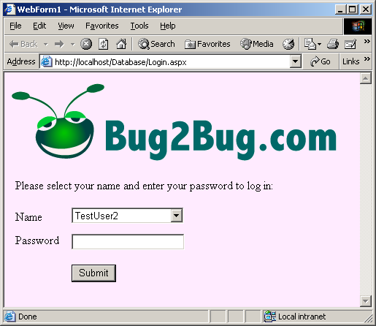
Login.aspx.cs
Program Output

Slide 111
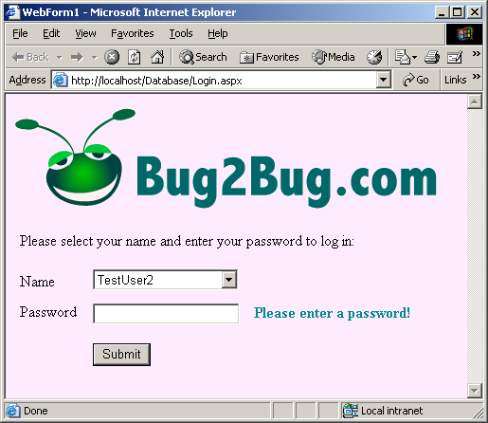
Login.aspx.cs
Program Output

Slide 112
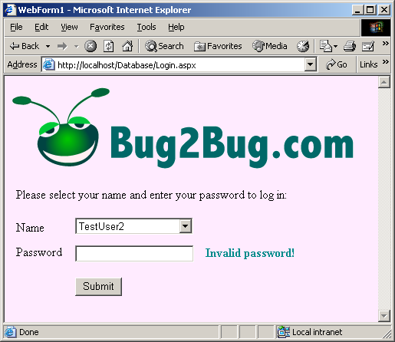
Login.aspx.cs
Program Output

Slide 113
Authors.aspx
1 <%-- Fig. 20.40: Authors.aspx --%>
2 <%-- This page allows a user to chose an author and display --%>
3 <%-- that author's books. --%>
4
5 <%@ Page language="c#" Codebehind="Authors.aspx.cs"
6 AutoEventWireup="false" Inherits="Database.Authors" %>
7 <%@ Register TagPrefix="Header" TagName="ImageHeader"
8 Src="ImageHeader.ascx" %>
9 <!DOCTYPE HTML PUBLIC "-//W3C//DTD HTML 4.0 Transitional//EN" >
10 <HTML>
11 <HEAD>
12 <title>Authors</title>
13 <meta name="GENERATOR" Content="Microsoft Visual Studio 7.0">
14 <meta name="CODE_LANGUAGE" Content="C#">
15 <meta name="vs_defaultClientScript" content="JavaScript">
16 <meta name="vs_targetSchema"
17 content="http://schemas.microsoft.com/intellisense/ie5">
18 </HEAD>
19 <body MS_POSITIONING="GridLayout" bgColor="#ffebff">
20 <form id="Authors" method="post" runat="server">
21 <asp:DropDownList id="nameList" style="Z-INDEX: 103;
22 LEFT: 90px; POSITION: absolute; TOP: 157px"
23 runat="server" Width="158px" Height="22px">
24 </asp:DropDownList>
25
26 <Header:ImageHeader id="Head1" runat="server">
27 </Header:ImageHeader>
28

Slide 114
Authors.aspx
29 <asp:Label id="Label2" style="Z-INDEX: 102; LEFT: 28px;
30 POSITION: absolute; TOP: 157px" runat="server"
31 Width="48px" Height="22px">Authors:
32 </asp:Label>
33
34 <asp:Button id="Button1" style="Z-INDEX: 104; LEFT: 29px;
35 POSITION: absolute; TOP: 188px" runat="server"
36 Width="78px" Text="Select">
37 </asp:Button>
38
39 <asp:Label id="Label3" style="Z-INDEX: 105; LEFT: 19px;
40 POSITION: absolute; TOP: 127px" runat="server"
41 Width="210px" Visible="False">You chose
42 </asp:Label>
43
44 <asp:DataGrid id="dataGrid" style="Z-INDEX: 106;
45 LEFT: 12px; POSITION: absolute; TOP: 151px"
46 runat="server" Height="23px" Width="700px"
47 ForeColor="Black" AllowPaging="True"
48 DataSource="<%# dataView1 %>" Visible="False"
49 AllowSorting="True">
50
51 <EditItemStyle BackColor="White"></EditItemStyle>
52
53 <AlternatingItemStyle ForeColor="Black"
54 BackColor="LightGoldenrodYellow">
55 </AlternatingItemStyle>
56
57 <ItemStyle BackColor="White"></ItemStyle>
58
59 <HeaderStyle BackColor="LightGreen"></HeaderStyle>
60
61 <PagerStyle NextPageText="Next &amp;gt;"
62 PrevPageText="&amp;lt; Previous">
63 </PagerStyle>
Visible property set to false, control not visible

Slide 115
Authors.aspx
64 </asp:DataGrid>
65 </form>
66 </body>
67 </HTML>

Slide 116
Authors.aspx.cs
1 // Fig. 20.41: Authors.aspx.cs
2 // The code-behind file for a page that allows a user to choose an
3 // author and then view a list of that author's books.
4
5 using System;
6 using System.Collections;
7 using System.ComponentModel;
8 using System.Data;
9 using System.Drawing;
10 using System.Web;
11 using System.Web.SessionState;
12 using System.Web.UI;
13 using System.Web.UI.WebControls;
14 using System.Web.UI.HtmlControls;
15
16 namespace Database
17 {
18 // let user pick an author, then display that author's books
19 public class Authors : System.Web.UI.Page
20 {
21 protected System.Web.UI.WebControls.DropDownList nameList;
22 protected System.Web.UI.WebControls.Label choseLabel;
23 protected System.Web.UI.WebControls.Button selectButton;
24 protected System.Web.UI.WebControls.Label authorsLabel;
25 protected System.Web.UI.WebControls.DataGrid dataGrid;
26
27 protected System.Data.OleDb.OleDbDataAdapter
28 oleDbDataAdapter1;
29 protected System.Data.OleDb.OleDbConnection
30 oleDbConnection1;
31 protected System.Data.OleDb.OleDbDataReader dataReader;
32
33 protected System.Data.OleDb.OleDbCommand
34 oleDbSelectCommand1;

Slide 117
Authors.aspx.cs
35 protected System.Data.OleDb.OleDbCommand
36 oleDbInsertCommand1;
37 protected System.Data.OleDb.OleDbCommand
38 oleDbUpdateCommand1;
39 protected System.Data.OleDb.OleDbCommand
40 oleDbDeleteCommand1;
41
42 protected System.Data.DataTable dataTable1 =
43 new DataTable();
44 protected System.Data.DataView dataView1;
45
46 protected static string sortString = "Title";
47
48 // on page load
49 private void Page_Load( object sender, System.EventArgs e )
50 {
51 // test whether page was loaded due to postback
52 if ( !IsPostBack )
53 {
54 // open database connection
55 try
56 {
57 oleDbConnection1.Open();
58
59 // execute query
60 dataReader =
61 oleDbDataAdapter1.SelectCommand.ExecuteReader();
62
63 // while we can read a row from result of
64 // query, add first item to dropdown list
65 while ( dataReader.Read() )
66 nameList.Items.Add( dataReader.GetString( 0 ) +
67 " " + dataReader.GetString( 1 ) );
68 }
69
Sort string in ascending order by title
Determine if page loaded as result of postback event
Execute database command to retrieve author’s first and last name
Open database connection
Iterate through result set and add author’s first and last names to nameList

Slide 118
Authors.aspx.cs
70 // if database cannot be found
71 catch( System.Data.OleDb.OleDbException )
72 {
73 authorsLabel.Text =
74 "Server Error: Unable to load database!";
75 }
76
77 // close database connection
78 finally
79 {
80 oleDbConnection1.Close();
81 }
82 }
83 else
84 {
85 // set some controls to be invisible
86 nameList.Visible = false;
87 selectButton.Visible = false;
88 choseLabel.Visible = false;
89
90 // set other controls to be visible
91 authorsLabel.Visible = true;
92 dataGrid.Visible = true;
93
94 // add author name to label
95 authorsLabel.Text =
96 "You Chose " + nameList.SelectedItem + ".";
97 int authorID = nameList.SelectedIndex + 1;
98
99 try
100 {
101 // open database connection
102 oleDbConnection1.Open();
103
The initial set of controls displayed to user are hidden in the postback
Add the selected author’s name to the label control

Slide 119
Authors.aspx.cs
104 // grab title, ISBN and publisher name for each book
105 oleDbDataAdapter1.SelectCommand.CommandText =
106 "SELECT Titles.Title, Titles.ISBN, " +
107 "Publishers.PublisherName FROM AuthorISBN " +
108 "INNER JOIN Titles ON AuthorISBN.ISBN = " +
109 "Titles.ISBN, Publishers WHERE " +
110 "(AuthorISBN.AuthorID = " + authorID + ")";
111
112 // fill dataset with results
113 oleDbDataAdapter1.Fill( dataTable1 );
114 dataView1 = new DataView( dataTable1 );
115 dataView1.Sort = sortString;
116 dataGrid.DataBind(); // bind grid to data source
117 }
118
119 // if database cannot be found
120 catch( System.Data.OleDb.OleDbException )
121 {
122 authorsLabel.Text =
123 "Server Error: Unable to load database!";
124 }
125
126 // close database connection
127 finally
128 {
129 oleDbConnection1.Close();
130 }
131 }
132
133 } // end method Page_Load
134
Populates DataTable argument with rows returned by query
Create database query to retrieve information and assign to CommandText property

Slide 120
Authors.aspx.cs
135 // on new page
136 private void OnNewPage( object sender,
137 DataGridPageChangedEventArgs e )
138 {
139 // set current page to next page
140 dataGrid.CurrentPageIndex = e.NewPageIndex;
141
142 dataView1.Sort = sortString;
143 dataGrid.DataBind(); // rebind data
144
145 } // end method OnNewPage
146
147 // Visual Studio .NET generated code
148
149 // handles Sort event
150 private void dataGrid_SortCommand( object source,
151 System.Web.UI.WebControls.DataGridSortCommandEventArgs e )
152 {
153 // get table to sort
154 sortString = e.SortExpression.ToString();
155 dataView1.Sort = sortString; // sort
156 dataGrid.DataBind(); // rebind data
157
158 } // end method dataGrid_SortCommand
159
160 } // end class Authors
161
162 } // end namespace Database
Method to handle the DataGrid’s PageIndexChanged event
Sort data and rebind it so that next page of data can be displayed
Method to handle Sort event of DataGrid control
sortString assigned to DataView’s Sort property
SortExpression property of e
Property indicates column by which data is sorted

Slide 121
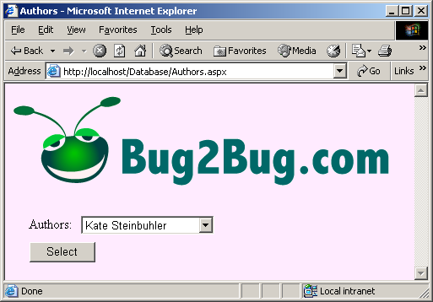
Authors.aspx.cs
Program Output

Slide 122
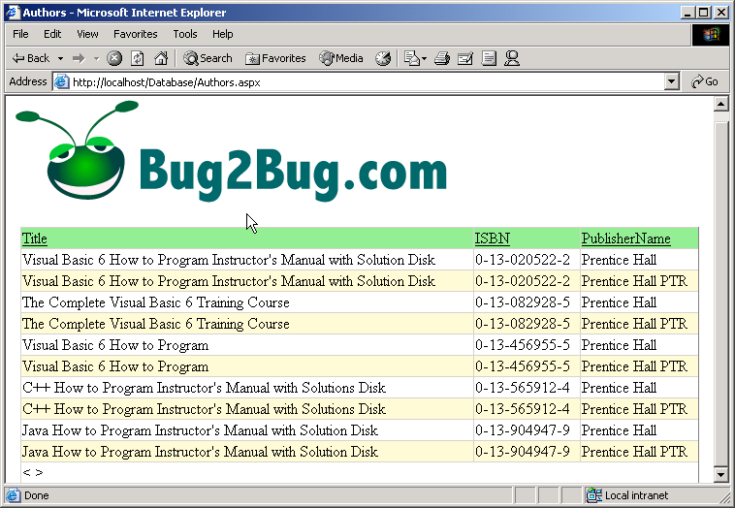
Authors.aspx.cs
Program Output

Slide 123
20.9 Tracing
Place statement throughout code-behind file to output information during execution
Tracing in Web forms
  Response.Write
    Must remove all tracing statement when completed
  Page tracing
    Actions of individual page
  Application tracing
  Control Tree
  Cookie Collection
  Headers Collection
  Server Variables

Slide 124
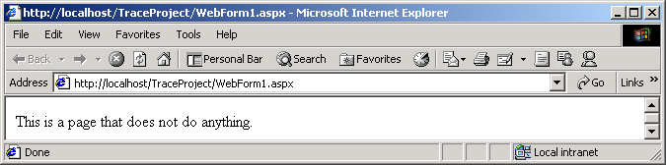
20.9 Tracing
Trace property is set to false, “Using warnings” no displayed
Fig. 20.42 ASPX page with tracing turned off.

Slide 125
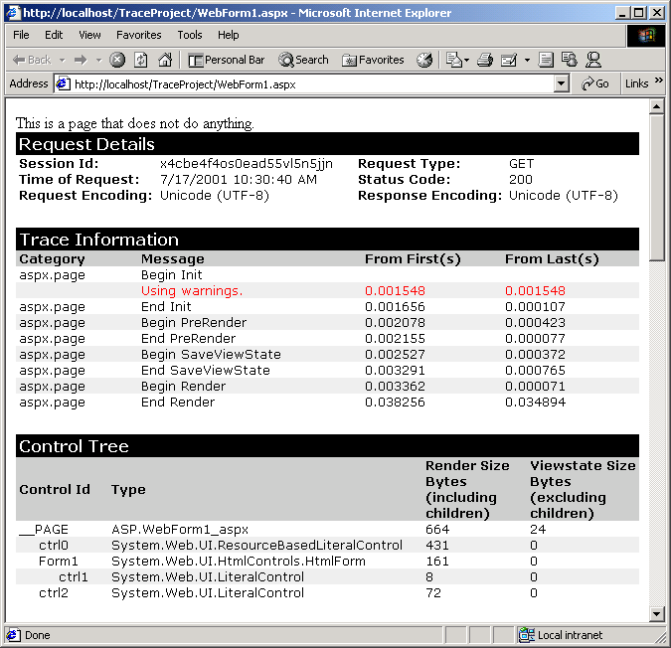
20.9 Tracing
Request Details section provides information about the request
Page when Trace property set to True
Trace Information section contains output by calling methods Write and Warn
List al controls contained on the page
Fig. 20.43 Tracing enabled on a page.

Slide 126
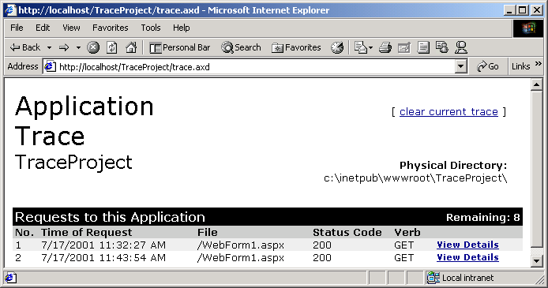
20.9 Tracing
Generated when programmer views the trace.axd file
View Details links direct browser to page similar to Fig. 20.43
Fig. 20.44 Tracing information for a project.

