Slide 1
Overview of C#
CS331

Slide 2
Structure of a C# Program
// Specify namespaces we use classes from here
using System;
using System.Threading; // Specify more specific namespaces
namespace AppNamespace
{
// Comments that start with /// used for
// creating online documentation, like javadoc
/// <summary>
/// Summary description for Class1.
/// </summary>
class Class1
{
// .. Code for class goes here
}
}

Slide 3
Defining a Class
class Class1
{
static void Main(string[] args)
{
// Your code would go here, e.g.
Console.WriteLine("hi");
}
/* We can define other methods and vars for the class */
// Constructor
Class1()
{
// Code
}
// Some method, use public, private, protected
// Use static as well just like Java
public void foo()
{
// Code
}
// Instance, Static Variables
private int m_number;
public static double m_stuff;
}

Slide 4
C# Basics
C# code normally uses the file extension of “.cs”.
Note similarities to Java
  A few annoying differences, e.g. “Main” instead of “main”.
If a namespace is left out, your code is placed into the default, global, namespace.
The “using” directive tells C# what methods you would like to use from that namespace.
  If we left out the “using System” statement, then we would have had to write “System.Console.WriteLine” instead of just “Console.WriteLine”.
It is normal for each class to be defined in a separate file, but you could put all the classes in one file if you wish.
  Using Visual Studio .NET’s “P)roject, Add C)lass” menu option will create separate files for your classes by default.

Slide 5
Getting Help
If MSDN is installed
  Online help resource built into Visual Studio .NET.
  Help Menu, look up C# programming language reference
  Dynamic Help
If MSDN is not installed, you can go online to access the references. It is accessible from:
  http://msdn.microsoft.com/library/default.asp
  You will have to drill down to VS.NET, Documentation, VB and C#, and then to the C# reference.
Both include numerous tutorials, or search on keywords

Slide 6
Basics: Output with WriteLine
System.Console.WriteLine() will output a string to the console. You can use this just like Java’s System.out.println():
  System.Console.WriteLine(“hello world “ + 10/2);
will output:
hello world 5
We can also use {0}, {1}, {2}, … etc. to indicate arguments in the WriteLine statement to print. For example:
  Console.WriteLine(“hi {0} you are {0} and your age is {1}”, “Kenrick”, 23);
will output:
  hi Kenrick you are Kenrick and your age is 23

Slide 7
WriteLine Options
There are also options to control things such as the number of columns to use for each variable, the number of decimals places to print, etc. For example, we could use :C to specify the value should be displayed as currency:
  Console.WriteLine(“you have {0:C} dollars.”, 1.3);
outputs as:
  you have $1.30 dollars.
See the online help or the text for more formatting options.

Slide 8
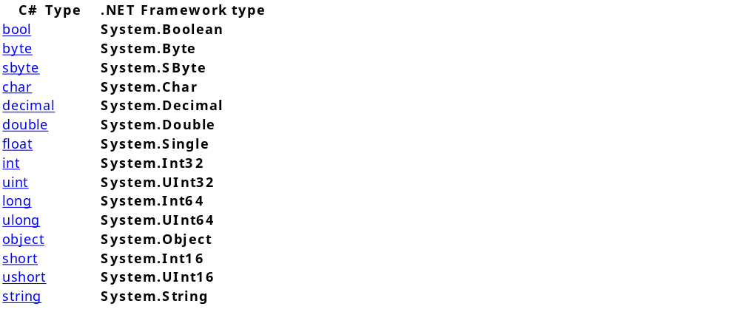
Data Types
C# supports value types and reference types.
  Value types are essentially the primitive types found in most languages, and are stored directly on the stack.
  Reference types are objects and are created on the heap.
Built-In Types
Ref
type

Slide 9
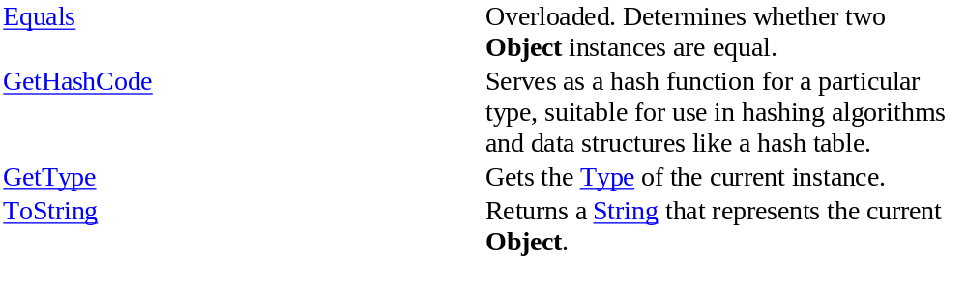
Automatic Boxing/Unboxing
Automatic boxing and unboxing allows value types can be treated like objects.
For example, the following public methods are defined for Object:
We can then write code such as:
int i;
Console.WriteLine(i.ToString());
int hash = i.GetHashCode();
This is equivalent to performing:
z = new Object(i);
Console.WriteLine(z.ToString());
First version more efficient
due to automatic
boxing at VM level

Slide 10
Structures
struct is another value type
  A struct can contain constructors, constants, fields, methods, properties, indexers, operators, and nested types.
  Declaration of a struct looks just like a declaration of a class, except we use the keyword struct instead of class. For example:
    public struct Point {
    public int x, y;
    public Point(int p1, int p2) { x = p1; y = p2; }
    }
So what is the difference between a class and struct? Unlike classes, structs can be created on the stack without using the keyword new, e.g.:
    Point p1, p2;
    p1.x = 3; p1.y = 5;
We also cannot use inheritance with structs.

Slide 11
Enumeration Type
Example:
// Enum goes outside in the class definition
enum Days {Sat, Sun, Mon, Tue, Wed, Thu, Fri};
// Inside some method
Days day1, day2;
int day3;
day1 = Days.Sat;
day2 = Days.Tue;
day3 = (int) Days.Fri;
Console.WriteLine(day1);
Console.WriteLine(day2);
Console.WriteLine(day3);
Enumeration really
maps to Int as the
underlying data type
Output: Sat
Tue
6

Slide 12
Strings
The built-in string type is much like Java’s string type.
  Note lowercase string, not String
  Concatenate using the + operator
  Just like Java, there are a variety of methods available to:
    find the index Of matching strings or characters
    generate substrings
    compare for equality (if we use == on strings we are comparing if the references are equal, just like Java)
    generate clones, trim, etc.
See the reference for more details.

Slide 13
Classes
Basic class definition already covered
To specify inheritance use a colon after the class name and then the base class.
  To invoke the constructor for the base class in a derived class, we must use the keyword “base” after the constructor in the derived class.
  We must also be explicit with virtual methods, methods are not virtual by default as with Java

Slide 14
Class Example
public class BankAccount
{
public double m_amount;
BankAccount(double d) {
m_amount = d;
}
public virtual string GetInfo() {
return “Basic Account”;
}
}
public class SavingsAccount : BankAccount
{
// Savings Account derived from Bank Account
// usual inheritance of methods, variables
public double m_interest_rate;
SavingsAccount(double d) : base(100) { // $100 bonus for signup
m_interest_rate = 0.025;
}
public override string GetInfo() {
string s = base.GetInfo();
return s + “ and Savings Account”;
}
}

Slide 15
Sample Class Usage
SavingsAccount a = new SavingsAccount(0.05);
Console.WriteLine(a.m_amount);
Console.WriteLine(a.m_interest_rate);
Console.WriteLine(a.GetInfo());
Then the output is:
100
0.05
Basic Account and Savings Account

Slide 16
Class Notes
We must explicitly state that a method is virtual if we want to override it
  By default, non-virtual methods cannot be overridden
We also have to explicitly state that we are overriding a method with the override keyword
To invoke a base method, use base.methodName().

Slide 17
Interfaces
An interface in C# is much like an interface in Java
An interface states what an object can do, but not how it is done.
  It looks like a class definition but we cannot implement any methods in the interface nor include any variables.
Here is a sample interface:

Slide 18
Sample Interface
public interface IDrivable {
void Start();
void Stop();
void Turn();
}
public class SportsCar : IDriveable {
void Start() {
// Code here to implement start
}
void Stop() {
// Code here to implement stop
}
void Turn() {
// Code here to implement turn
}
}
Method that uses the Interface:
void GoForward(IDrivable d)
{
d.Start();
// wait
d.Stop();
}

Slide 19
Reading Input
To input data, we must read it as a string and then convert it to the desired type.
  Console.ReadLine() will return a line of input text as a string.
We can then use type.Parse(string) to convert the string to the desired type. For example:
  string s;
  int i;
  s = Console.ReadLine();
  i = int.Parse(s);
we can also use double.Parse(s); float.Parse(s); etc.
There is also a useful Convert class, with methods such as Convert.ToDouble(val); Convert.ToBoolean(val); Convert.ToDateTime(val); etc.

Slide 20
Procedural Stuff
We also have our familiar procedural constructs:
  Arithmetic, relational, Boolean operators: all the same as Java/C++
  For, While, Do, If : all the same as Java/C++
  Switch statements: Like Java, except forces a break after a case. Code is not allowed to “fall through” to the next case, but several case labels may mark the same location.
  Math class: Math.Sin(), Math.Cos(), etc.
Random class:
  Random r = new Random();
  r.NextDouble(); // Returns random double between 0-1
  r.Next(10,20); // Random int, 10 ≤ int < 20

Slide 21
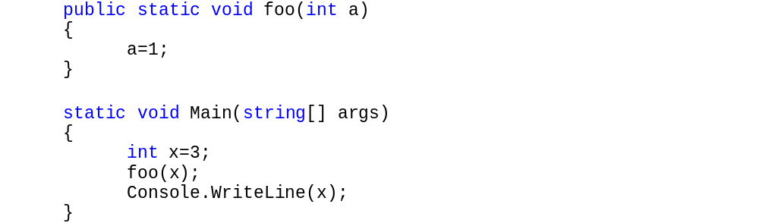
Passing Parameters
Passing a value variable by default refers to the Pass by Value behavior as in Java
This outputs the value of 3 because x is passed by value to method foo, which gets a copy of x’s value under the variable name of a.

Slide 22
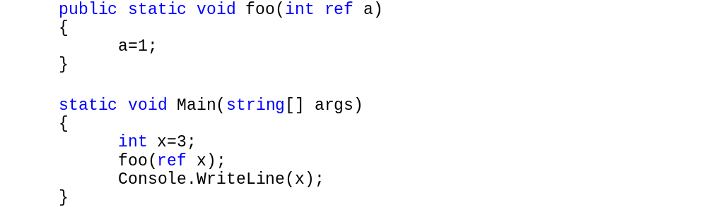
Passing by Reference
C# allows a ref keyword to pass value types by reference:
The ref keyword must be used in both the parameter declaration of the method and also when invoked, so it is clear what parameters are passed by reference and may be changed.
Outputs the value of 1 since variable a in foo is really a reference to where x is stored in Main.

Slide 23
Passing Reference Variables
If we pass a reference variable (Objects, strings, etc. ) to a method, we get the same behavior as in Java.
Changes to the contents of the object are reflected in the caller, since there is only one copy of the actual object in memory and merely multiple references to that object.

Slide 24
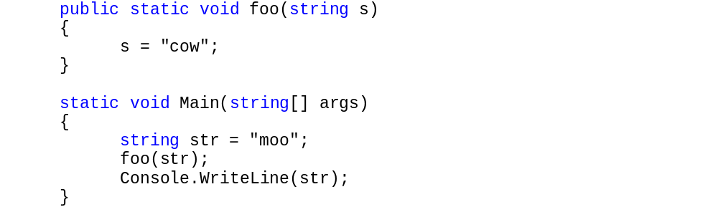
Passing a Reference Variable
Consider the following:
Output is “moo” since inside method foo, the local reference parameter s is set to a new object in memory with the value “cow”. The original reference in str remains untouched.

Slide 25
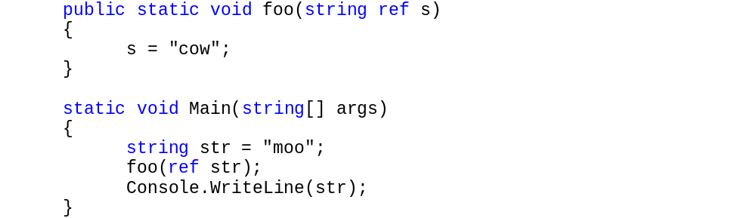
Passing Reference Var by Reference
The following will change the string in the caller
Output = “cow” since foo is passed a reference to str

Slide 26
Arrays
Arrays in C# are quite similar to Java arrays. Arrays are always created off the heap and we have a reference to the array data. The format is just like Java:
  Type arrayname = new Type[size];
For example:
  int arr = new int[100];
This allocates a chunk of data off the heap large enough to store the array, and arr references this chunk of data.

Slide 27
More on Arrays
The Length property tells us the size of an array dynamically
  Console.WriteLine(arr.Length);
  // Outputs 100 for above declaration
If we want to declare a method parameter to be of type array we would use:
  public void foo(int[] data)
To return an array we can use:
  public int[] foo()
Just like in Java, if we have two array variables and want to copy one to the other we can’t do it with just an assignment.
  This would assign the reference, not make a copy of the array.
  To copy the array we must copy each element one at a time, or use the Clone() method to make a copy of the data and set a new reference to it (and garbage collect the old array values).

Slide 28
Multidimensional Arrays
Two ways to declare multidimensional arrays.
The following defines a 30 x 3 array:
  int[,] arr = new int[30][3];
Here we put a comma inside the [] to indicate two dimensions.
  This allocates a single chunk of memory of size 30*3*sizeof(int) and creates a reference to it. We use the formulas for row major order to access each element of the array.
The following defines a 30 x 3 array using an array of arrays:
  int[][] arr = new int[30][3];
To an end user this looks much like the previous declaration, but it creates an array of 30 elements, where each element is an array of 3 elements.
  This gives us the possibility of creating ragged arrays but is slower to access since we must dereference each array index.
  Just like Java arrays

Slide 29
Related to Arrays
Check out the ArrayList class defined in System.Collections.
  ArrayList is a class that behaves like a Java vector in that it allows dynamic allocation of elements that can be accessed like an array or also by name using a key.
Lastly, C# provides a new loop method, called foreach
  Foreach will loop through each element in an array or collection. For example:
    string[] arr = {"hello", "world", "foo", "abracadabra"};
    foreach (string x in arr) Console.WriteLine(x);
Will output each string in the array.

Slide 30
Delegates
C# uses delegates where languages such as C++ use function pointers.
A delegate defines a class that describes one or more methods.
  Another method can use this definition, regardless of the actual code that implements it.
  C# uses this technique to pass the EventHandlers to the system, where the event may be handled in different ways.

Slide 31
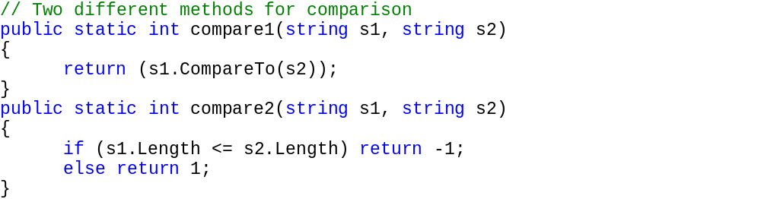
Delegates Example
Compare1 uses alphabetic comparison, Compare2 uses length

Slide 32
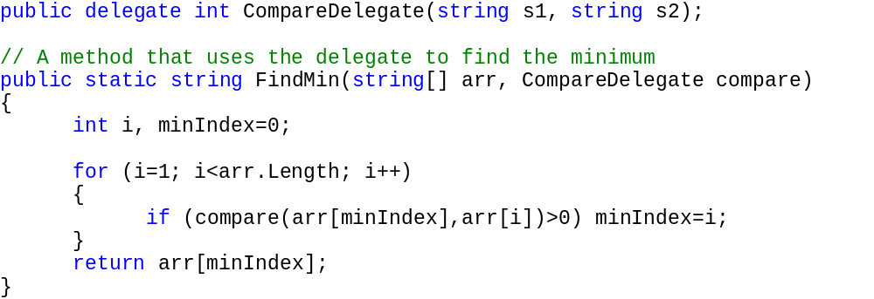
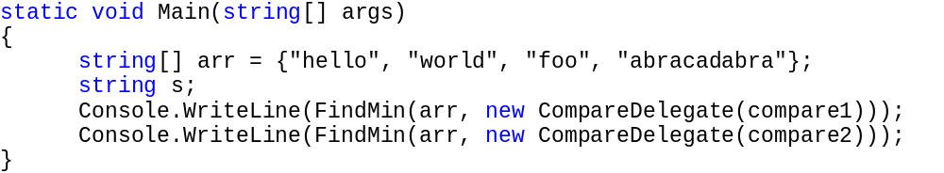
Delegates Example

Slide 33
Next Lecture
Here we have covered all of the basic constructs that exist in the C# language under the Common Language Runtime!
Next we will see how to use various Windows.Forms features to create Windows applications with graphical interfaces.

