Slide 1
Introduction to Web Programming using ASP.NET
IT 533 Lecture Notes
Gülşen Demiröz

Slide 2
About the Course
Objective
  Introduction to web programming using the Microsoft® ASP.NET technology and Microsoft® IIS (Internet Information Server).
Prerequisite
  The programming language will be C#, the participants are expected to have taken the IT519 or IT528 course
Lectures
  Saturday 13:00 – 16:00 at Main Campus FENS G032
Grading
  Final Exam (40% ): Last (7th) week of the course, Saturday
  Homework (60% total): 4 homework will be assigned and they are of different weight depending on their complexity

Slide 3
Outline of the Course
Introduction to web programming and ASP.NET
Create web application using Visual Studio® 2010 and C#
Create and add code-behind file to an ASP.NET web form
Examine common ASP.NET Controls
Connecting to a Database in an ASP.NET application and ASP.NET Data Controls
Session management
Validation controls
Master pages
Configuring and deploying an ASP.NET web application on an IIS server
Securing an ASP.NET web application
Introduction to ASP.NET AJAX
Introduction to WCF (Windows Communication Foundation)

Slide 4



Internet Technologies
WWW Architecture
PC/Mac/Unix
+ Browser (IE, FireFox)
Client
Request:
http://www.msn.com/default.html
Network
HTTP
TCP/IP
Response:
<html>…</html>
Server
Web Server

Slide 5
Web Technologies
HTTP / HTTPS (URL, GET/POST)
Client-side:
  HTML / XHTML (Extensible HyperText Markup Language)
  JavaScript / VBScript (client-side scripting)
  Applets / ActiveX controls
Server-side:
  PHP
  Phython
  JSP (Java Server Pages)
  ASP (Active Server Pages)
  ASP.NET (next generation of ASP)

Slide 6
ASP Architecture
PC/Mac/Unix
+ Browser (IE, FireFox)
Client
Request:
http://www.msn.com/default.aspx
Network
HTTP
TCP/IP
Response:
<html>…</html>
Server
IIS
(Internet Information Server)

Slide 7
Server-Side Code
What is server-side code?
  Software that runs on the server, not the client
  Receives input from
    URL parameters
    HTML form data
  Can access server-side databases, e-mail servers, files, mainframes, etc.
  Dynamically builds a custom HTML response
  for a client
HTTP request
(form data,
HTTP
header data)
HTTP response
HTML, XML
ASP page
(static HTML,
server-side
logic)

Slide 8
ASP.NET Overview and Features
ASP.NET provides services to allow the creation, deployment, and execution of
Web Applications and Web Services
Web Applications are built using Web Forms
Web Forms are designed to make building
web-based applications as easy as building Visual Basic applications
Built on .NET Framework: any .NET programming language can be used (C#, Visual Basic)
Complete object model
Separation of code and UI
Maintains page state
Session management
Caching, Debugging, Extensibility

Slide 9
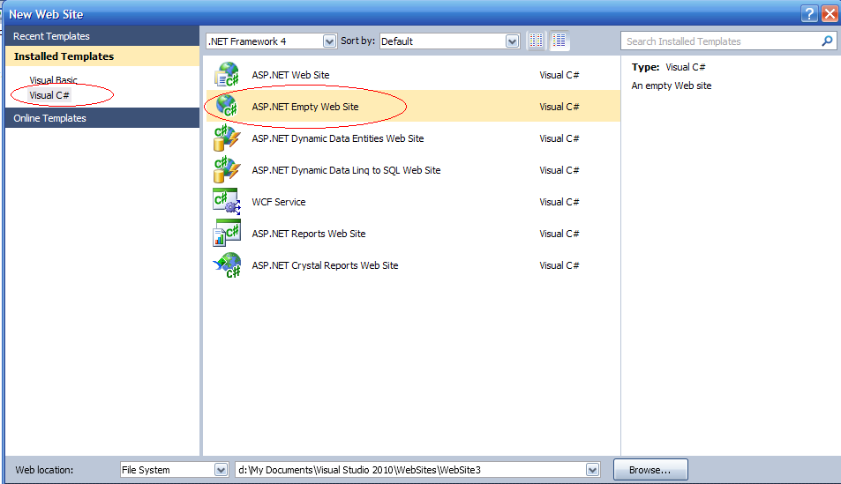
WebTime.aspx Example
Creating an ASP.NET Web Application using Visual Studio
Step 1: Creating the Web Application Project
Select File > New Web Site... and choose ASP.NET Empty Web Site in the Templates pane.
Select File System from the drop-down list closest to Location.
Set the Language to Visual C#, and click OK.

Slide 10
WebTime.aspx Example
Add n ASPX file (i.e., Web Form), default named Default.aspx is created for each new project.
Visual Web Developer creates a code-behind file named Default.aspx.cs.
The View Designer button opens the Web Form in Design mode.
The Copy Web Site button allows you to copy the project’s files to another location, such as a remote web server.
Finally, the ASP.NET Configuration button takes you
to the Web Site Administration Tool.
Look at Toolbox displayed in the IDE when the project loads.
  Standard and Data list of web controls.

Slide 11
Editing the WebTime.aspx
When the project loads for the first time, the Web Forms Designer displays the autogenerated ASPX file in Source mode.
Design mode indicates the XHTML element where the cursor is currently located.
You can also view both the markup and the web-page design at the same time by using Split mode
Right click the ASPX file in the Solution Explorer
and select View Code to open the code-behind file.

Slide 12
WebTime.aspx Example
Let’s create our first ASP.NET page using Visual Studio
  Modify title of the page
  Add a heading <h2>
  Look at the page in Design and Split modes
  Add a Label control from the Toolbox
  Change ID of the Label control
  Change some physical properties of the Label control
  Go to WebTime.aspx.cs file and add Page_Init function to set Text property of the Label control
Notes:
1- Generate the page using the ToolBox in Design mode: add a button and a label
2- Then show aspx markup, run the page
3- Add onClick event using the Design mode and show events
4- Explain code behind file default.aspx.cs: class derives from System.Web.UI.Page
5- set labelHello.Text = “Hello World!”
6- then set labelHello.Text = “Hello World! Time is %s” + DateTime.Now

Slide 13
WebTime.aspx Example
Changing the Title of the Page
We change the page’s title from the default Untitled Page to A Simple Web Form Example.
Open the ASPX file in Source mode and modify the text between the <title> tags.
Alternatively, you can modify the Web Form’s Title property in the Properties window.
To view the Web Form’s properties, select DOCUMENT from the drop-down list in the Properties window.
Designing the Page
To add controls to the page, you can drag and drop them from the Toolbox onto the Web Form in Design mode.
Like the Web Form itself, each control is an object that has properties, methods and events.
You can type text directly on a Web Form at the cursor location or insert XHTML elements using menu commands.

Slide 14
Renaming the WebTime.aspx
Renaming the ASPX File
Right click the ASPX file in the Solution Explorer and select Rename.
Enter the new file name WebTime.aspx and press Enter. Both the ASPX file and the code-behind file are updated.
Renaming the Class in the Code-Behind File and Updating the ASPX File
Visual Studio’s refactoring tool, which automatically updates the existing references to this class in the rest of the project to reflect this change.
Right click the class name in the partial class’s declaration and select Refactor > Rename… to open the Rename dialog.

Slide 15
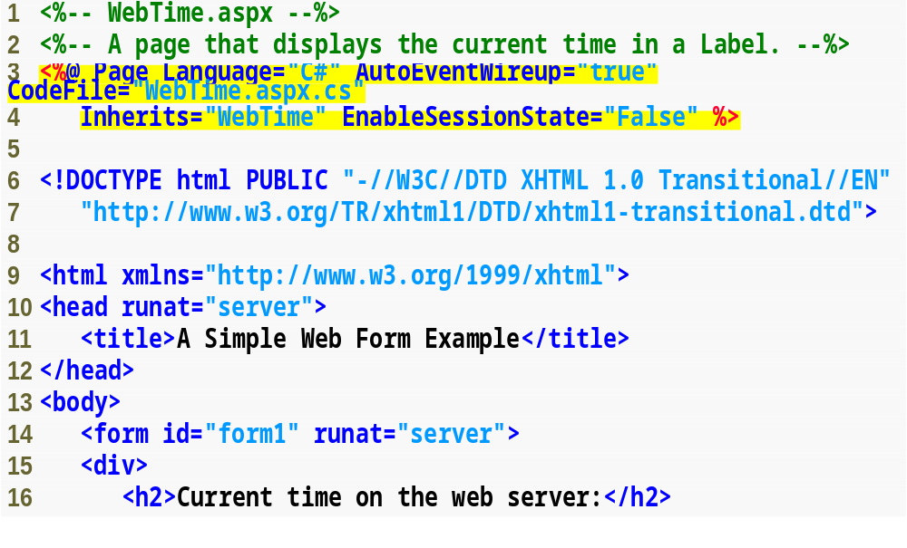
Visual Studio generates the markup shown when you create the GUI.
WebTime.aspx ( 1 of 2 )
ASP.NET comments begin with <%-- and terminate with --%>, and can span multiple lines.
The Page directive specifies information needed by ASP.NET to process this file.
The document type declaration, which specifies the document element name and the PUBLIC URI for the DTD that defines the XHTML vocabulary.
The form that contains our XHTML text and controls is set to execute on the server, which generates equivalent XHTML.
The body contains the main content that the browser displays.
XHTML documents have the root element html and markup information about the document in the head element.
ASPX file that displays the web server’s time.

Slide 16
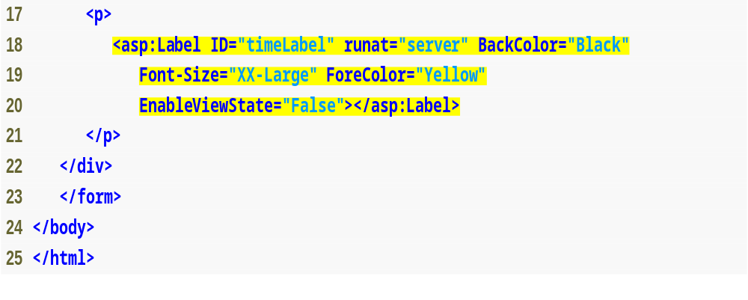
WebTime.aspx
( 2 of 2 )
Markup for a label web control.
The asp: tag prefix indicates that the label is an ASP.NET web control, not an XHTML element.
In an ASPX file a directive is delimited by <%@ and %>.
ASPX file that displays the web server’s time. (Part 2 of 2. )

Slide 17
WebTime.aspx Example
Examining an ASPX File
The Page directive’s Language attribute specifies the
code-behind file’s language.
The CodeFile attribute specifies the code-behind filename.
When AutoEventWireup is true, ASP.NET automatically treats a method of name Page_eventName as an event handler.
When AutoEvent­Wireup is set to false, you specify event handlers using attributes in the Page directive just as you would any other web control.
The Inherits attribute (line 4) specifies the class in the code-behind file from which this ASP.NET class inherits.

Slide 18
WebTime.aspx Example
The document type declaration, which specifies the document element name and the PUBLIC URI for the DTD that defines the XHTML vocabulary.
XHTML documents have the root element html and markup information about the document in the head element.
Setting the runat attribute to "server" indicates that ASP.NET processes the element and its nested elements and generates the corresponding XHTML.
The body contains the main content that the browser displays.
The form that contains our XHTML text and controls is set to execute on the server, which generates equivalent XHTML.

Slide 19
WebTime.aspx Example
The ID attribute assigns a name to a control, used as an identifier in the code-behind file.
The asp: tag prefix indicates that the label is an ASP.NET web control, not an XHTML element.
Each web control maps to a corresponding XHTML element or group of elements.

Slide 20
WebTime.aspx Example
The asp:Label control is written as an XHTML span element.
A span element contains text with formatting styles.
This control is processed on the server so that the server can translate the control into XHTML.
If this is not supported, the asp:Label element is written as text to the client.

Slide 21
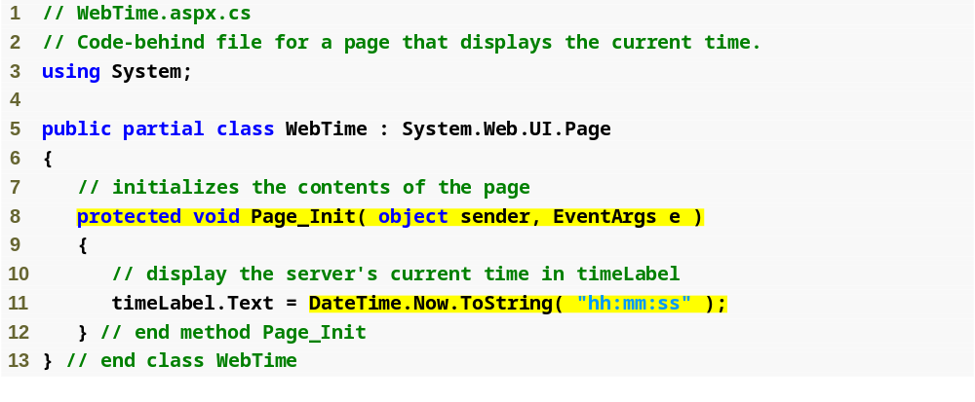
The code-behind file (WebTime.aspx.cs)
The Page_Init method handles the page’s Init event, which indicates that the page is ready to be initialized.
Retrieve the current time and formats it as hh:mm:ss.
Code-behind file for a page that displays
the web server’s time. (Part 1 of 2.)

Slide 22
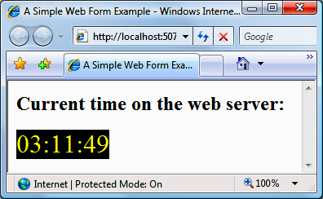
WebTime.aspx Example Run
The Page_Init method handles the page’s Init event, which indicates that the page is ready to be initialized.

Slide 23
WebTime.aspx Example
Relationship Between an ASPX File and a
Code Behind File
The code-behind file inherits from Page, which defines the general functionality of a web page.
The code-behind file contains a partial class.
ASP.NET generates another partial class that defines the remainder of that class, based on the markup in the ASPX file.
The first time the web page is requested, this class is compiled, and an instance is created.
This instance represents our page—it creates the XHTML that is sent to the client.
Once an instance of the web page has been created, multiple clients can use it to access the page—no recompilation is necessary.

Slide 24
WebTime.aspx Example
How the Code in an ASP.NET Web Page Executes
When an instance of the page is created, the PreInit event occurs first, invoking method Page_PreInit, which can be used to set a page’s theme.
The Init event occurs next, invoking method Page_Init, which is used to initialize objects and other aspects of the page.
Next, the Load event occurs, and the Page_Load event handler executes.
  The Init event is raised only once (when the page is first requested).
  The Load event is raised with every request.
The page then processes any events that are generated by the page’s controls.
Once a response has been generated and sent, an Unload event occurs, which calls Page_Unload, which typically releases resources used by the page.

Slide 25
WebTime.aspx Example
To view the XHTML generated by ASP.NET, select View Source from the Page menu ) in Internet Explorer (or View > Page Source if you are using Firefox).
Nonvisual form components, called hidden inputs, store data that the user doesn’t need to see.
Attribute method of the form element specifies the request method (usually get or post). The action attribute identifies the resource that will be requested when a form is submitted.

Slide 26
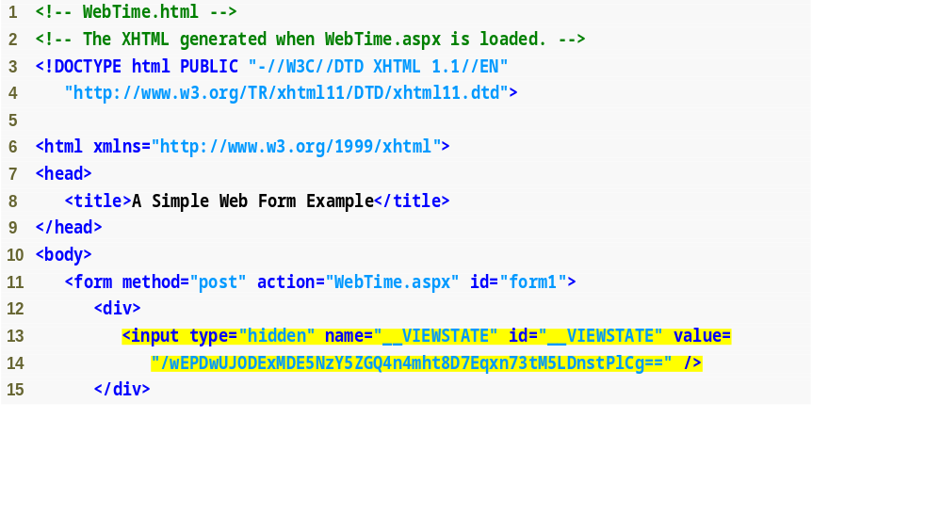
Figure shows the XHTML generated by ASP.NET when a web browser requests WebTime.aspx.
WebTime.html
( 1 of 2 )
Attribute method of the form element specifies the request method (usually get or post). The action attribute identifies the resource that will be requested when a form is submitted.
Nonvisual form components, called hidden inputs, store data that the user doesn’t need to see.
Fig. | XHTML response when the browser requests WebTime.aspx. (Part 1 of 2. )

Slide 27
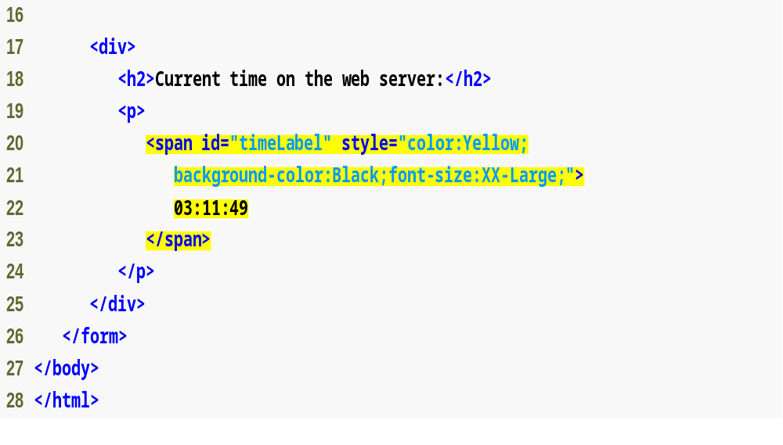
WebTime.html
( 2 of 2 )
The form contains a span element to represent the text in the label. Formatting properties of timeLabel are converted into the style attribute of the span element.
Fig. | XHTML response when the browser requests WebTime.aspx. (Part 2 of 2. )

Slide 28
WebTime.aspx Example
When the form is processed on the server, the runat attribute is removed.
Only those elements marked in the ASPX file with runat="server" are modified or replaced in the generated XHTML.

Slide 29
WebTime.aspx Example
The positions of controls and other elements are relative to the Web Form’s upper-left corner. This type of layout is known as relative positioning.
An alternate type of layout is known as absolute positioning, in which controls are located exactly where they are dropped on the Web Form.
You can enable absolute positioning in Design mode in the HTML Designer > CSS Styling node of the Options dialog.
Absolute positioning is discouraged, because pages designed in this manner may not render correctly in different browsers or on computers with different screen resolutions and font sizes.

Slide 30
Running WebTime.aspx Example
Running the Program
You can view the Web Form several ways.
  You can select Debug > Start Without Debugging, which runs the application by opening it in a browser window.
  To debug your application, you can select Debug > Start Debugging. You cannot debug a web application unless debugging is explicitly enabled by the web.config file.
  To view a specific ASPX file, you can right click either the Web Forms Designer or the ASPX file name and select View In Browser.
  Finally, you can run your application by opening a browser window and typing the web page’s URL in the Address field.

Slide 31
Event Handling
GUIs are event driven.
When the user interacts with a GUI component, the event drives the program to perform a task.
A method that performs a task in response to an event is called an event handler.

Slide 32
Event Handling Example (HelloWorld)
Let’s create another ASP.NET page using Visual Studio
  Add a Button and a Label control
  To create this click event handler, double click the Button on the Form.
  The following empty event handler is declared:
  Set the Text property of the Label control with the current time in this function.
    protected void Button1_Click(object sender, EventArgs e)
    {
    }

Slide 33
Event Handling Example (HelloWorld)
To add an event handler, alternatively in markup (aspx) file:
  Add a onclick="BClick" property to the Button control.
  Add a function BClick to the page class in the code behind.
Notes:
1- Generate the page using the ToolBox in Design mode: add a button and a label
2- Then show aspx markup, run the page
3- Add onClick event using the Design mode and show events
4- Explain code behind file default.aspx.cs: class derives from System.Web.UI.Page
5- set labelHello.Text = “Hello World!”
6- then set labelHello.Text = “Hello World! Time is %s” + DateTime.Now

Slide 34
HelloWorld Example
ASP.NET comments begin with <%-- and terminate with --%>, and can span multiple lines.
<%-- Hello World page that also displays the current time. --%>
<%@ Page Language="C#" AutoEventWireup="true" CodeFile="HelloWorld.aspx.cs" Inherits="HelloWorldPage" %>
<!DOCTYPE html PUBLIC "-//W3C//DTD XHTML 1.0 Transitional//EN" "http://www.w3.org/TR/xhtml1/DTD/xhtml1-transitional.dtd">
<html xmlns="http://www.w3.org/1999/xhtml">
<head runat="server">
<title>Hello World Web Form</title>
</head>
<body>
<form id="form1" runat="server">
<asp:Button ID="buttonClick" runat="server" Font-Size="Medium" Width="102px“ Text="Click Me" onclick="BClick" />
<br />
<asp:Label ID="labelHello" runat="server"></asp:Label>
</form>
</body> </html>
The Page directive specifies information needed by ASP.NET to process this file.
XHTML documents have the root element html and markup information about the document in the head element.
The body contains the main content that the browser displays.
The form that contains our XHTML text and controls is set to execute on the server, which generates equivalent XHTML.
Markup for label & button web controls.
The asp: tag prefix indicates that the label is an ASP.NET web control, not an XHTML element.
Notes:
1- Generate the page using the ToolBox in Design mode: add a button and a label
2- Then show aspx markup, run the page
3- Add onClick event using the Design mode and show events
4- Explain code behind file default.aspx.cs: class derives from System.Web.UI.Page
5- set labelHello.Text = “Hello World!”
6- then set labelHello.Text = “Hello World! Time is %s” +

Slide 35
ASPX Code Behind File
public partial class HelloWorldPage : System.Web.UI.Page
{
protected void BClick(object sender, EventArgs e)
{
labelHello.Text = "Hello World! Time is " +
DateTime.Now;
}
}

Slide 36
Event Handling
By convention, C# names the event-handler method as objectName_eventName (e.g., Button1_Click).
Each event handler receives two parameters when it is
called:
  An object reference named sender—a reference to the object that generated the event.
  A reference to an object of type EventArgs, which contains additional information about the event.

Slide 37
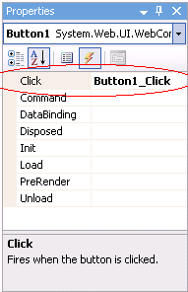
Other Ways to Create Event Handlers
Typically, controls can generate many different types of events.
Clicking the Events icon (the lightning-bolt icon) in the Properties window, displays all the events for the selected control.

Slide 38
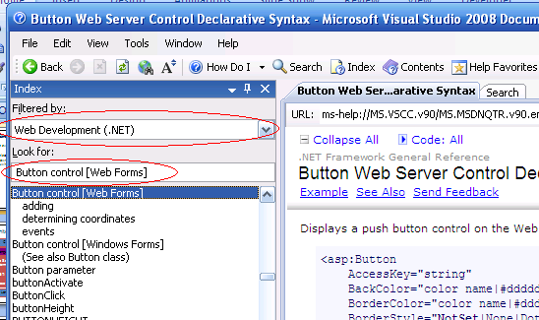
Locating Event Information
To learn about the events raised by a control, select Help > Index.
In the window, select Web Development (.NET) in the Filtered by drop-down list and enter the name of the control’s class in the Index window.

Slide 39
Programming Model
Controls and Events
Button code
...
Button
List code
...
List
Label code
...
Label
Browser
ASP.NET
Event handlers

Slide 40
ASP.NET Architecture
VB
C++
C#
JScript
…
Common Language Specification
ASP.NET: Web Services
and Web Forms
Windows
Forms
Visual Studio.NET
ADO.NET: Data and XML
Base Classes
Common Language Runtime
Notes:
ASP.NET is built upon
.NET Framework
Internet Information Server (IIS)

Slide 41
Programming Model
ASP.NET Object Model
Controls are objects, available in
server-side code
  Derived from System.Web.UI.Control
The web page is an object too
  Derived from System.Web.UI.Page
User code executes on the web server in
page or control event handlers

Slide 42
Resources
  http://msdn.microsoft.com/en-us/aa336522.aspx
  http://www.asp.net/
  http://www.aspfree.com/
  http://www.devx.com/dotnet/

