Slide 1

DEPARTMENT OF ELECTRONICS AND COMMUNICATION ENGINEERING
TITLE OF THE PROJECT: Video-Based Evidence Analysis and Extraction in Digital Forensic Investigation
BATCH NO : 01
PRESENTED BY:
B.HIMA BINDU - 21G05A0405 UNDER THE GUIDANCE OF:
G.RAVETHI - 21G05A0431
K.SUDARSAN REDDY - 21G05A0454 DR.S. VENKATAKIRAN
K.MOHAN KRISHNA - 20G01A0445
K. ROSI REDDY - 20G01A0448

Slide 2
CONTENTS
ABSTRACT
INTRODUCATION
EXISTING
PROPOSAL
ADVANTAGES
APPLICATIONS
CONCLUTION

Slide 3
ABSTRACT
As a result of the popularity of smart mobile devices and the low cost of surveillance systems, visual data are increasingly being used in digital forensic investigation.
Digital videos have been widely used as key evidence sources in evidence identification, analysis, presentation, and report.
The main goal of this paper is to develop advanced forensic video analysis techniques to assist the forensic investigation.
We first propose a forensic video analysis framework that employs an efficient video/image enhancing algorithm for the low quality of footage analysis
An adaptive video enhancement algorithm based on contrast limited adaptive histogram equalization (CLAHE) is introduced to improve the closed-circuit television (CCTV) footage quality for the use of digital forensic investigation

Slide 4
INTRODUCATION
In forensic investigation, digital cameras and mobile devices are routinely seized as evidence sources. Video and images retrieved from these devices are widely used in crime evidence investigation, which can provide key forensic evidence items, piece together existing evidence items, or establish links between evidence items in particular case.
In the past few years, the ‘image enhancement’ techniques have been proposed [2]–​[6], most of them can be grouped into spatial domain methods and frequency domain methods. These techniques shows good potential to improve the quality of images, but only a few of them can be used for low quality of footage, such as cctv footage, mobile video clips, etc Many cctv surveillance systems export footage in their own formats, which need to be re-format or converted to a suitable format that easier for investigation
The footage in digital forensics is often used for comparative analysis, including forensic analysis, comparison of images of questioned about know objects such as subjects, vehicles, clothing, and weapons, with expert opinion being providing on the findings
In many modern CCTV systems, facial recognition services are embedded to identify online criminals or suspects [26]. Other services such as motion detection, body and face recognition, cross-pose recognition, gait recognition, are widely researched in the past few years. In some hard cases (poor viewing conditions), it is very difficult to identify humans take advantage of face, body, still, etc

Slide 5
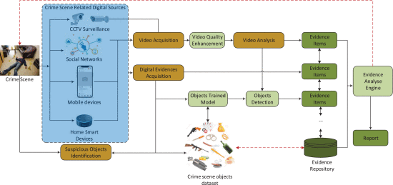
EXISTING PROJECT BLOCK DIAGRAM

Slide 6
ADVANTAGES
Accuracy: Advanced tools enable precise analysis, ensuring accurate interpretation of video evidence.
Enhanced Security: Digital forensics aids in uncovering security breaches and vulnerabilities, contributing to improved overall cybersecurity.
Timely Resolution: Digital forensics expedites investigations, potentially leading to quicker resolution of cases.
Data Recovery: The ability to recover deleted or corrupted data can be crucial in reconstructing events or retrieving important information.

Slide 7
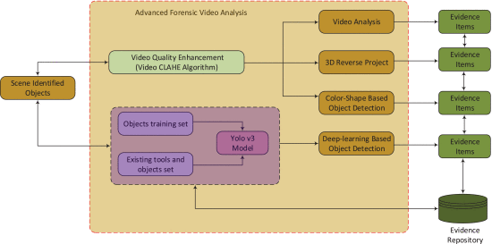
PROPOSAL BLOCK DIAGRAM

Slide 8
APPLICATION
Video Forensics:Analyzing video content for authenticity, tampering, or manipulation.Extracting metadata, such as timestamps and camera details.Enhancing video quality for better visibility of details.
Audio Forensics:Analyzing and enhancing audio recordings for clarity.Identifying
voices or sounds for investigative purposes.

Slide 9
CONCLUSION
It is noted that in digital forensic investigation, the low quality cctv footages are widely used to extract potential evidence items. In this work, we proposed a framework for video based digital forensics investigation, and further we developed a way to enhance the quality of video to extract as much as evidence items. Specifically, we proposed an method to extract more evidence items in a reverse way. It is also useful for anti-crime or fast response when crime activities or behaviors are detected. In the future works, we will further establish the links between existing evidence items and the detected evidence item.

