Slide 1
Economic Forecasting with Multi-Equation Simulation Models
Calvin Price
Stata Conference 2020

Slide 2
Background
Usual case: Look at data, produce a model equation
Not here! Not interested in estimating model parameters
Assume estimated equations already exist, take them as given
Our case: Look at model equations , produce data
Want to produce data, or simulate data, that follows the estimated equation(s) we provide
We can provide multiple equations that all variables must follow simultaneously

Slide 3
Background
Endogenous variables: Values for variables we solve for
Values for these variables are the output of “solving the model”
The set of behavioral equations we provide must all hold true in all solution periods
Q: What value of our variables will make all equations hold true
Exogenous variables: Values for variables we take as given
Data values we provide, not an output from solving the model
Can specify alternate values and re-solve the model, creating multiple scenarios
Express some belief or assumption about policy related variables, or external variables beyond control

Slide 4
Background
Exogenous variables: Harsh reality is exogenous variables can be the most important part of a forecast
Not ideal but assumptions here can be most important part in producing forecasts
Example from Coronavirus 2020: many central banks simply withheld forecasts given extreme uncertainty in exogenous factors
Greater interest in understanding how endogenous variables react to possible scenarios of exogenous variables, rather than trying to predict one outcome of all exogenous + endogenous variables

Slide 5
The –forecast- command
-forecast- is a suite of commands related to solving a multi-equation forecasting model
Feed in multiple equations already estimated
Return data that is constructed (simulated) to satisfy all equations under all periods being forecast

Slide 6
What does “simulation” mean?
Iterative process that searches for a solution at each time period
Simulation
Solving a system of equations at each point in time
Finds a set of values for the endogenous variables
Such that all equations are held true
Algorithm
Usually some variant of Gauss-Seidel
Iterates until the simulated values are stable
Once a solution is found, move to next time period, begin again

Slide 7
Two different “solutions”
Solution path across time
Determined by equations added to model and parameter estimates
Could be explosive, oscillating, dampening, etc. depends on difference equation characteristics
Model user must determine quality of forecast, good, bad, etc
Solution at one point in time
Determined by numerical method algorithm, iterative process

Slide 8
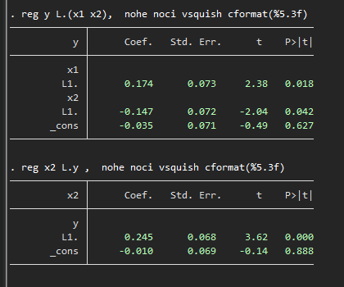
Toy Example
Cook some data with a known relationship (n=200)
Two variables, y and x2
Two estimated equations, mutual dependency (with lags)
Also include one exogenous variable (x1)

Slide 9
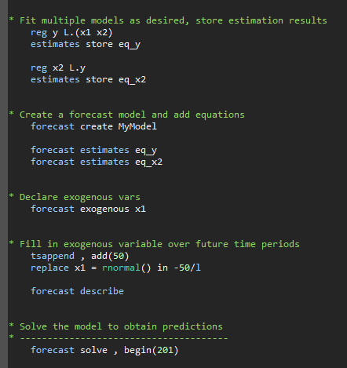
Toy Example
Use –forecast- commands

Slide 10
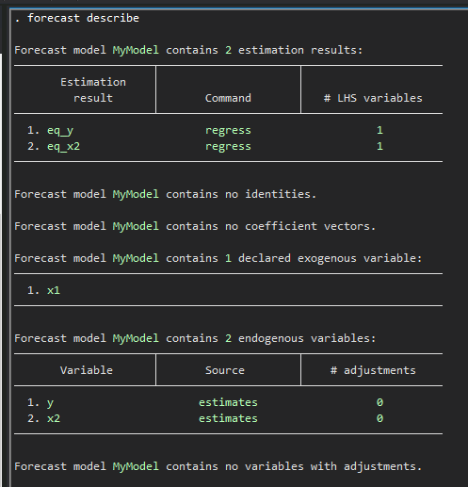
Toy Example
-forecast describe-

Slide 11
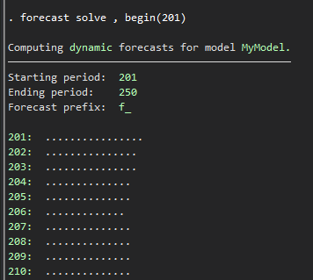
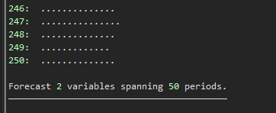
Toy Example
-forecast solve-

Slide 12
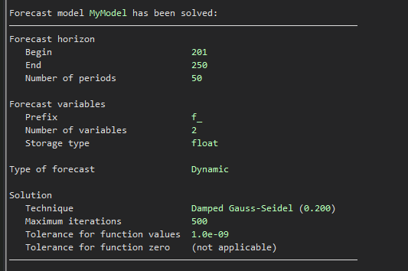
Toy Example
-forecast solve-

Slide 13
Toy Example
-forecast solve-
Every endogenous variable now has a simulated counterpart variable created, containing forecasts over the forecast horizon (and contains actuals elsewhere)
Default prefix is “f_” , so for endogenous variables y and x2, Stata will create f_y and f_x2
Main result: Are the original relationships maintained?
We provided estimates of several behavioral equations
Q: Are these relationships all maintained over the forecast period?
Recall parameters from previous slide using variables y, x1, x2
Now check with the variables f_y, x1, f_x2

Slide 14
Toy Example
Recall original estimated relationships (n=200)

Slide 15
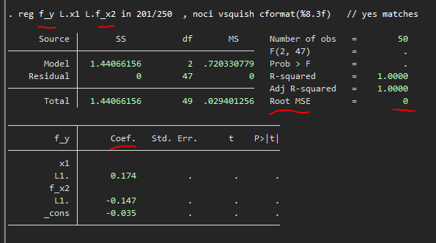
Toy Example
Now check over forecast period (n = 201/250)
Yes, we see the (endogenous) variables contain forecast values that maintain the same relationships we fit from the estimation period
Each of the multiple equations are maintained exactly, zero deviation, the variables were jointly simulated and created to have this exact property
Eq 1:

Slide 16
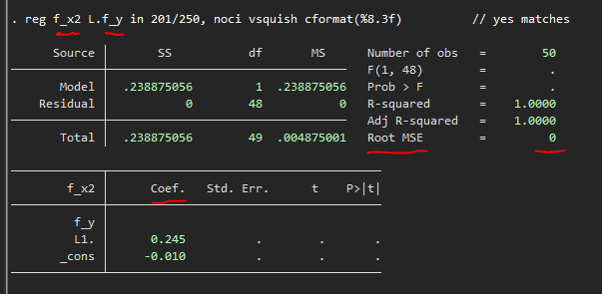
Toy Example
Now check over forecast period (n = 201/250)
Yes, we see the (endogenous) variables contain forecast values that maintain the same relationships we fit from the estimation period
Each of the multiple equations are maintained exactly, zero deviation, the variables were jointly simulated and created to have this exact property
Eq 2:

Slide 17
Toy Example
Summary
We provided multiple equations already estimated
Variable y was a response variable in one and an explanatory variable in another
All behavioral relationships were maintained over the forecast horizon

Slide 18
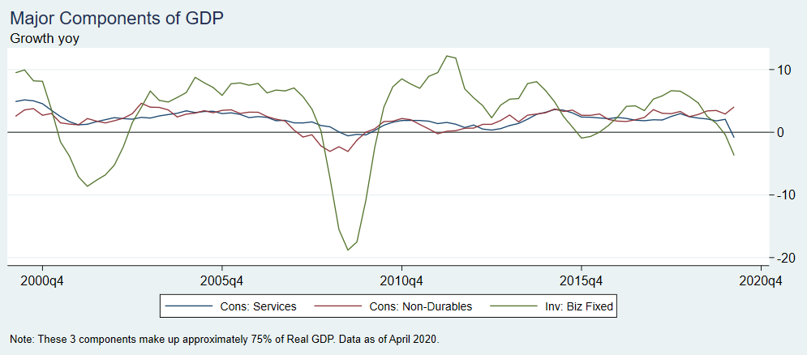
Example: Forecast of US Real GDP Growth
Start with 3 major components of GDP
Consumption: Services
Consumption: Non-Durables
Investment: Business Fixed Investment

Slide 19
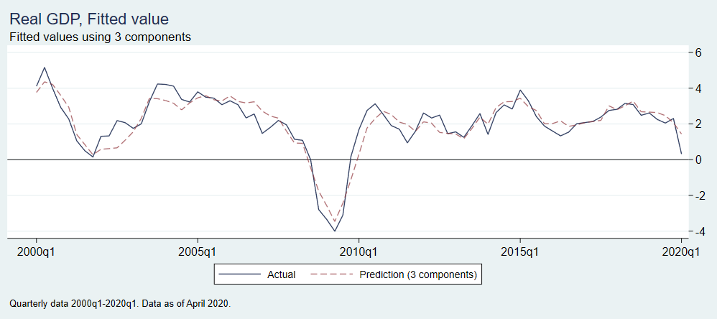
Example: Forecast of US GDP
Given these 3 major components, can predict real GDP fairly well
No surprise, this is hardly a model, more of an identity
Real question: How to forecast these 3 components
After that, easy to construct GDP estimate using this estimated relationship

Slide 20
Example: Forecast of US GDP
Modeling choices
Services consumption usually stable and resilient through cycles, shocks dissipate quickly, AR(4)
Biz Investment and Non-Durables consumption more volatile, allow VAR with longer lags, and also still allow dependency on services consumption
So include services consumption in the two variable VAR as exogenous

Slide 21
Example: Forecast of US GDP
Modeling choices
VAR with exogenous variable, not new
But that variable is still endogenous to the whole forecast model! It has it’s own process that we estimated, and its forecasted values are jointly determined with the two variable VAR in every forecast period
To the VAR it is exogenous, but to the entire multi-equation model it is still an endogenous variable. It is both a response variable following one estimated relationship, and an explanatory variable following another estimated relationship
The –forecast- command does the work of producing forecasts that maintain all behavioral relationships in all forecast periods

Slide 22
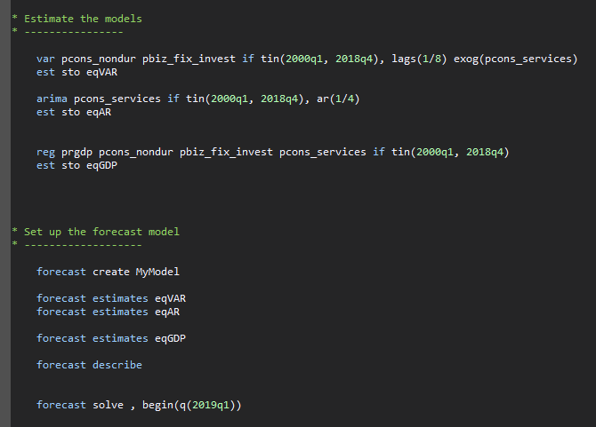
Example: Forecast of US GDP
Use –forecast- commands

Slide 23
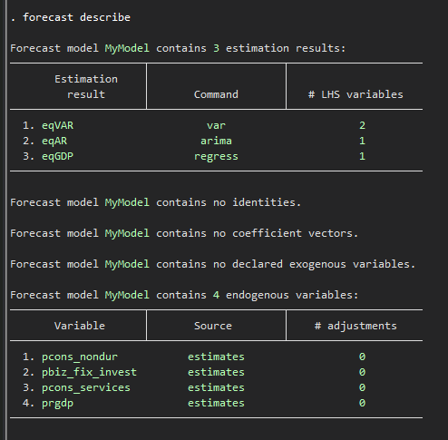
Example: Forecast of US GDP
Use –forecast- commands

Slide 24
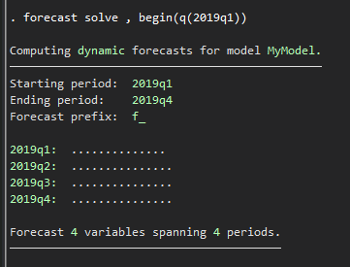
Example: Forecast of US GDP
Use –forecast- commands

Slide 25
Example: Forecast of US GDP
Check results:

Slide 26
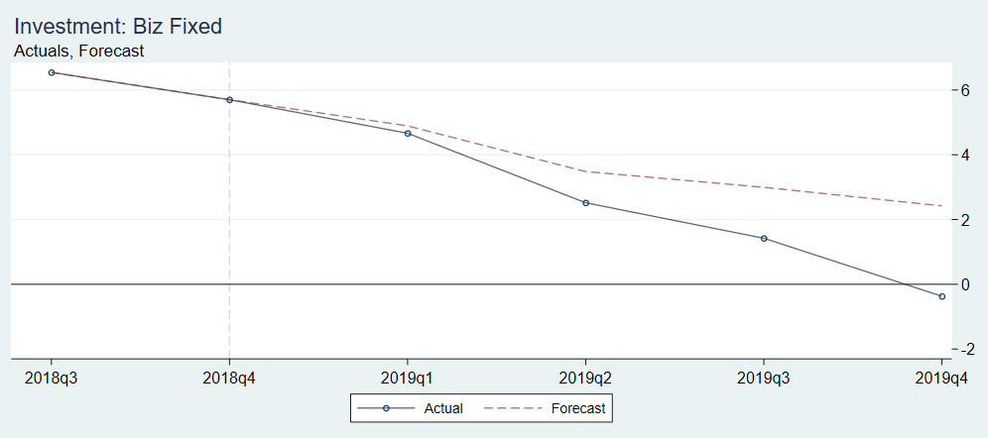
Example: Forecast of US GDP
Check results: Business Fixed Investment
Directionally good, miss grows larger over time

Slide 27
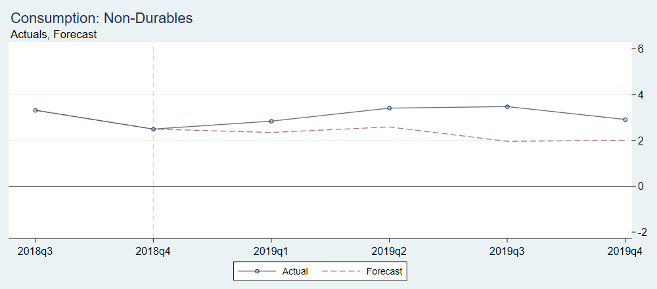
Example: Forecast of US GDP
Check results: Consumption Non-Durables
Kind of ok

Slide 28
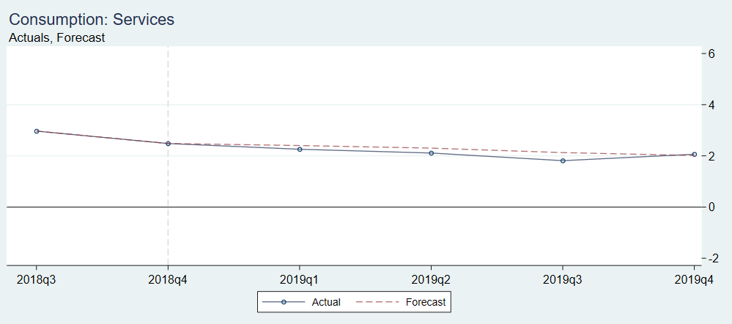
Example: Forecast of US GDP
Check results: Consumption Services
Pretty good

Slide 29
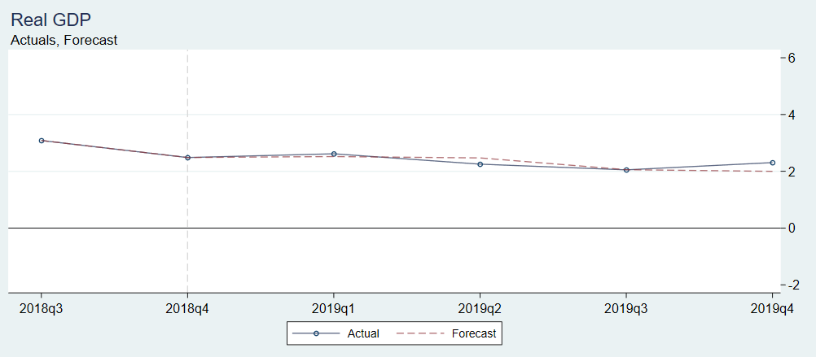
Example: Forecast of US GDP
Check results: Real GDP
Pretty good

Slide 30
Example: Forecast of US GDP
General tips on checking results: Ex post forecast
Error vs actuals
Sensitivity to estimated parameters / choice of equations
Sensitivity to estimation period
Check predictions around turning points
Caution
Set of equations that fit well does not mean simulated values will fit well
Estimated equations with poor fit may produce simulated values that do fit well

Slide 31
Example: Forecast of US GDP
General tips on checking results: Ex ante forecast
No actuals to check against
Sensitivity to estimated parameters / estimation period, how stable is the solution
Check predictions under various scenarios of exogenous variables
Compare with expected behavior and theory

Slide 32
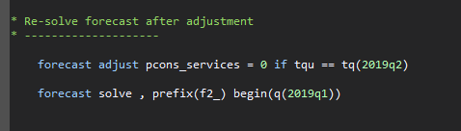
Example: Forecast of US GDP
Creating alternate scenarios: Adjusting endogenous variables
Can make adjustment and force any variable to have a particular value in a particular period
Exogenous variables were always adjustable, the –forecast adjust- command is needed for endogenous
The simulation will continue after that period and maintain all cross equation dynamics
Can observe how the effect will feed through across periods, across variables

Slide 33
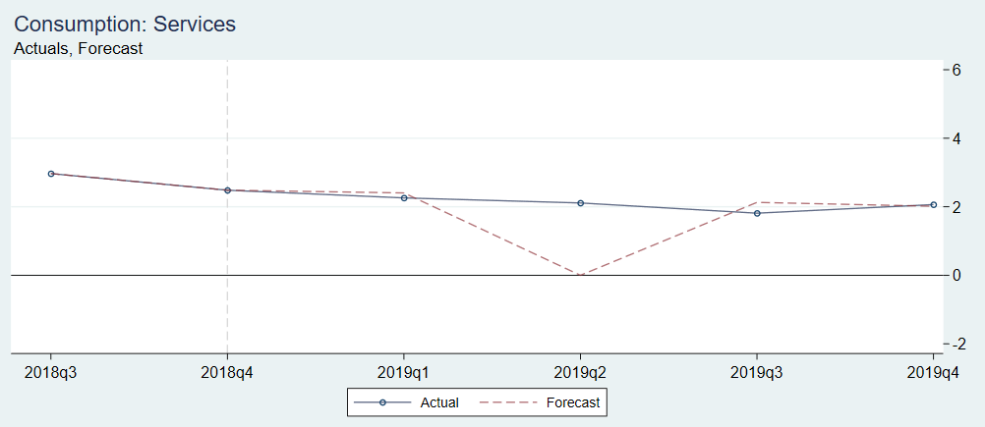
Example: Forecast of US GDP
After adjustment: Consumption Services
Suppose 0 growth in 2019Q2

Slide 34
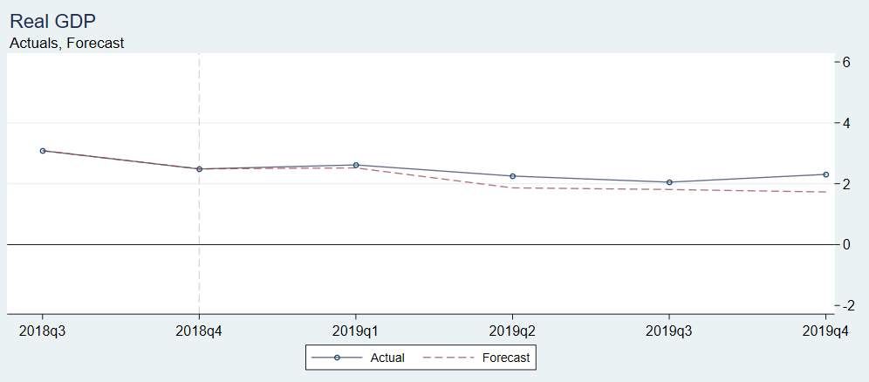
Example: Forecast of US GDP
After adjustment: Real GDP
Weaker growth, as expected

Slide 35
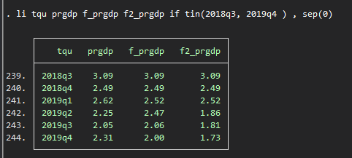
Example: Forecast of US GDP
After adjustment: Real GDP
Weaker growth, as expected

Slide 36
Some History and Criticism
Forecasting with large multi-equation models went in and out of popularity
Famous examples: Cowles Commission, FRB-MIT-Penn, Brookings
Decline in popularity in 1970s
VAR models raised as a direct alternative
Backlash against “incredible assumptions” needed to identify large models (Sims 1980)
Better performance found from pure time series models (Levendis 2019)
Not an either/or choice!
VARs can be one of the component models in a model simulation
VARs with exogenous variables not new
To a VAR, exogenous variable is exogenous. To a larger model, exogenous variable has its own model. Capturing joint behavior is the extra benefit from simulation model

Slide 37
Questions?
Contact: Calvin Price
caprice@us.mufg.jp

Slide 38
Further Reading
References
Asteriou, Hall, (2011) Applied Econometrics
Klein, Young, (1980) Introduction to Econometric Forecasting and Forecasting Models
Levendis, (2019) Time Series Econometrics
Meyer, (1980) Macroeconomics, A Model Building Approach
Pindyck, Rubinfeld, (1991) Econometric Models & Economic Forecasts
Sims, (1980) Macroeconomics and reality. Econometrica: Journal of the Econometric Society
Data Sources
FRED-QD, Vintage 2020-04 https://research.stlouisfed.org/econ/mccracken/fred-databases/

