Slide 1
Expanding Stata’s Capabilities for Sensitivity Analysis
Daniel Litwok, Ph.D.
Stata Conference
July 30, 2020

Slide 2
Outline
Motivation
Sensitivity Analysis
mhbounds
Matching Methods
Refinements to mhbounds
Application
Final thoughts

Slide 3
Sensitivity Analysis
Nonexperimental approaches to estimating treatment effects balance observables to minimize potential for bias, often through matching or stratification
Assumption needed for causal inference: conditional on observables the study is free from hidden bias
Rosenbaum (2002) recommends a sensitivity analysis for such approaches to test this assumption
How are inferences altered by hidden biases of various magnitudes?
How large would hidden bias have to be to alter study conclusions?
For an evaluation with a binary treatment and a binary outcome measure, Rosenbaum (2002) calculates bounds based on the Mantel-Haenszel (1959) statistic

Slide 4

Sensitivity Analysis
Key parameter is $Γ$ (the degree of departure from a study that is free of hidden bias)
Sensitivity analysis returns treatment effect estimates for a range of values of $Γ$
Researcher assesses the strength of the evidence as the largest value of $Γ$ for which there is no change to inference
Γ | Concept | Definition
1 | Good as Randomized | No hidden bias
2 | Positive Selection | For a pair of matched individuals, treated individual is twice as likely to receive the treatment because of unobserved pretreatment differences that are positively correlated with the outcome

Slide 5
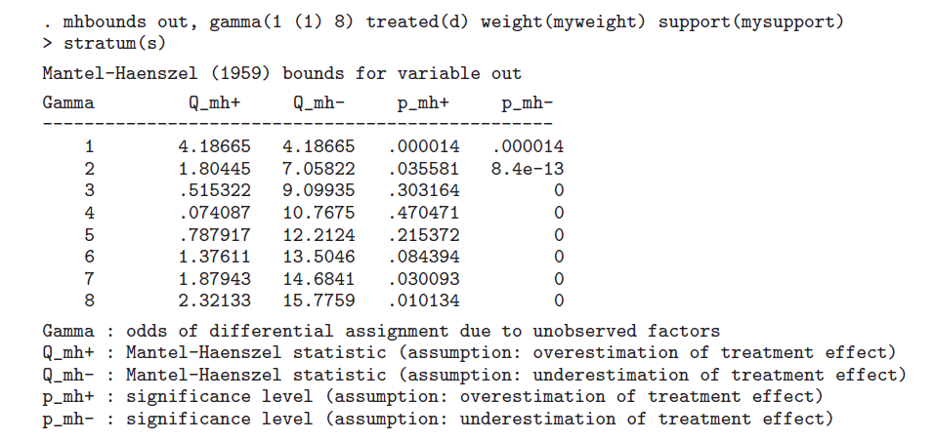
mhbounds
mhbounds (Becker & Caliendo, 2007) implements sensitivity analysis in Stata:
Calculates Rosenbaum bounds where both treatment and outcome variables are binary using the Mantel-Haenszel statistic
Notes:
Medical trial
Those who pursue treatment more likely to have better outcomes

Slide 6
mhbounds
mhbounds (Becker & Caliendo, 2007) implements sensitivity analysis in Stata:
Calculates Rosenbaum bounds where both treatment and outcome variables are binary using the Mantel-Haenszel statistic
Adjusts the MH statistic downward for positive selection (e.g., those with better outcomes more likely to be treated)

Slide 7
mhbounds
mhbounds (Becker & Caliendo, 2007) implements sensitivity analysis in Stata:
Calculates Rosenbaum bounds where both treatment and outcome variables are binary using the Mantel-Haenszel statistic
Suitable for kth nearest neighbor matching without replacement and for stratification matching

Slide 8
mhbounds
mhbounds (Becker & Caliendo, 2007) implements sensitivity analysis in Stata:
Calculates Rosenbaum bounds where both treatment and outcome variables are binary using the Mantel-Haenszel statistic
Suitable for kth nearest neighbor matching without replacement and for stratification matching
Presumably limited to these types of matching because Rosenbaum’s approach focuses on stratified case-control studies

Slide 9
Matching Methods
Many other approaches to matching available (e.g., any matching with replacement)
Remainder of the talk focuses on coarsened exact matching (CEM) (Iacus et al., 2011) implemented using cem (Blackwell et al., 2009)
Coarsen key covariates and exactly match on coarsened values
Creates strata within which treatment (T) and comparison (C) are exactly matched
Analysis includes only strata with both T and C (“common support”)

Slide 10
Matching Methods
Example:
100 T, 100 C
Coarsened Variables: Age (≥25, <25); Education (≥ HS Degree, < HS Degree)
After matching on coarsened values and restricting to common support, CEM can be conceptualized as stratification matching with strata determined by covariates
There may be a large number of strata
 | ≥25 | <25
≥ HS Degree | 75 T / 75 C | 20 T / 5 C
< HS Degree | 5 T / 15 C | 0 T / 5 C

Slide 11
Outline
Motivation
Sensitivity Analysis
mhbounds
Matching Methods
Refinements to mhbounds
Application
Final thoughts

Slide 12
Refinements to mhbounds
Using mhbounds after CEM can fail for two reasons:
Allows no more than 99 strata
Uses large sample approximation for calculating the Mantel-Haenszel statistic

Slide 13
Refinements to mhbounds
Using mhbounds after CEM can fail for two reasons:
Allows no more than 99 strata
Uses large sample approximation for calculating the Mantel-Haenszel statistic
rmhbounds does not have these limitations

Slide 14
Outline
Motivation
Sensitivity Analysis
mhbounds
Matching Methods
Refinements to mhbounds
Application
Final thoughts

Slide 15
Overview of application
National Supported Work Demonstration (LaLonde, 1986)
Training provided to treatment group
Key outcome variable is employment in 1978 (binary)
In context of job training, common to test much smaller values of gamma (very sensitive to hidden bias)
Relevant direction of hidden bias here is positive
Those with better employment outcomes select into training
Note fewer than 99 strata here, so that limitation does not apply to this example

Slide 16
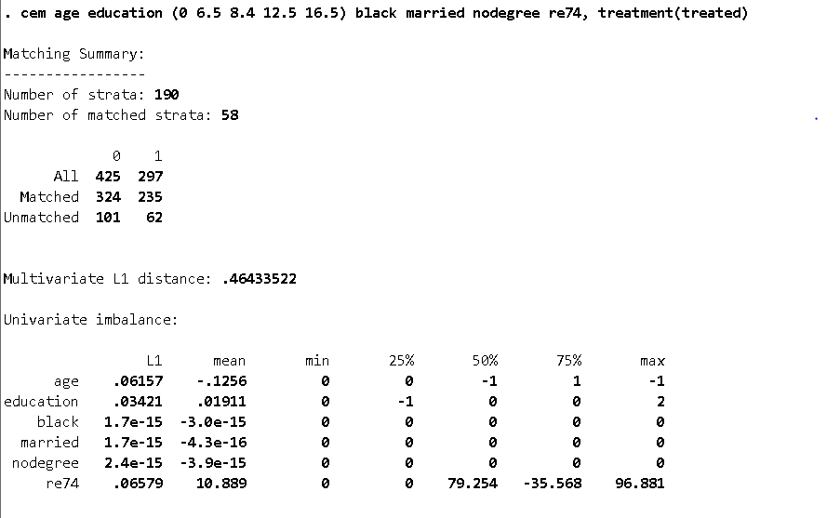
Applying CEM

Slide 17
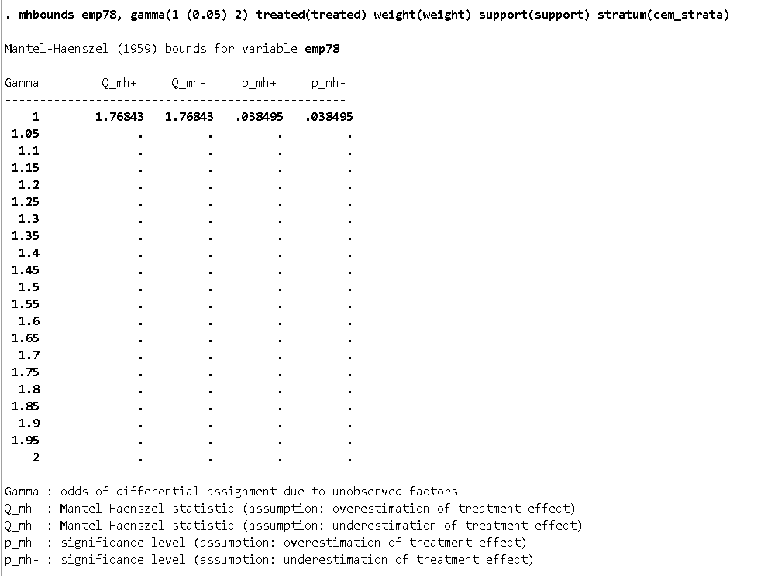
Failure of mhbounds

Slide 18
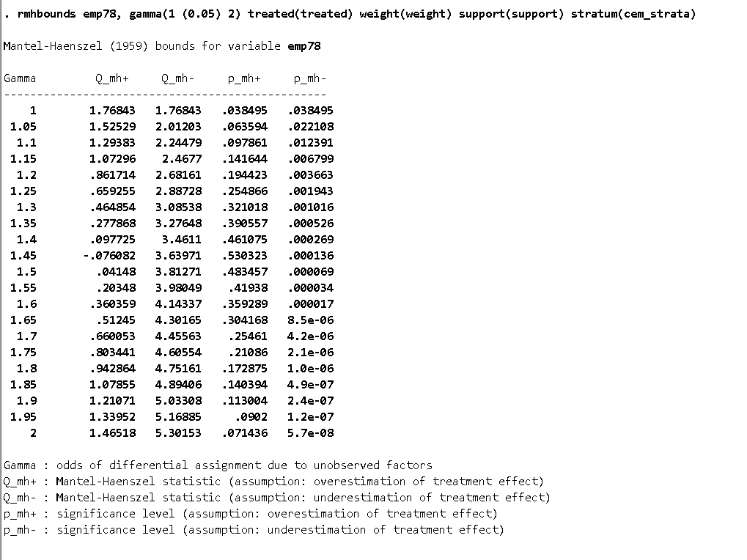
Refinement via rmhbounds

Slide 19
Link to software
Ado file and help file available at:
https://ideas.repec.org/c/boc/bocode/s458807.html
Or: “findit rmhbounds”
Citation: Daniel Litwok, 2020. "RMHBOUNDS: Stata module to refine mhbounds to remove the cap on the number of strata and replace the large sample approximation for E and V with exact moments," Statistical Software Components S458807, Boston College Department of Economics.

Slide 20
References
Becker, S. O., & Caliendo, M. (2007). Sensitivity analysis for average treatment effects. The Stata Journal, 7(1), 71-83.
Blackwell, M., Iacus, S., King, G., & Porro, G. (2009). cem: Coarsened exact matching in Stata. The Stata Journal, 9(4), 524-546.
Iacus, S. M., King, G., & Porro, G. (2011). Multivariate matching methods that are monotonic imbalance bounding. Journal of the American Statistical Association, 106(493), 345-361.
LaLonde, R. J. (1986). Evaluating the econometric evaluations of training programs with experimental data. American Economic Review, 604-620.
Mantel, N. & Haenszel, W. (1959). Statistical aspects of retrospective studies of disease. Journal of the National Cancer Institute, 22, 719-748.
Rosenbaum, P. R. (2002). Sensitivity to hidden bias. In Observational studies (pp. 105-170). Springer, New York, NY.

Slide 21
Contact Daniel Litwok Senior Scientist dan_litwok@abtassoc.com

