Slide 1
Using Stata to simulate the impact of COVID-19 on organ transplantation
Allan B. Massie, PhD
Dorry Segev, MD PhD
Notes:
Say: "My name is [name]. I'm a [title] at Johns Hopkins. I'd like to thank the committee for the opportunity to talk about our work on [High KDPI offers]". Don't repeat the whole title

Slide 2
Core Faculty
Andrew Cameron, MD PhD Professor of Surgery
Nadia Chu, MPH PhD Instructor of Surgery
Christine Durand, MD Assistant Professor of Medicine
Jacqueline Garonzik-Wang, MD PhD Director of Training and Education Assistant Professor of Surgery
Sommer Gentry, PhD Professor of Mathematics (USNA)
Macey Henderson, JD PhD Director of Policy and External Affairs Assistant Professor of Surgery & Nursing
Allan Massie, PhD Director of Data and Analytics Assistant Professor of Surgery and Epidemiology
Mara McAdams-DeMarco, PhD MS Associate Professor of Epidemiology and Surgery
Douglas Mogul, MD MPH Assistant Professor of Pediatrics
Abimereki Muzaale, MD MPH Instructor of Surgery
Lauren Nicholas, PhD Assistant Professor of Health, Policy and Management
Tanjala Purnell, PhD MPH Director of Community and Stakeholder Engagement Assistant Professor of Surgery
Epidemiology Research Group in Organ Transplantation
Affiliates
Fawaz Al Ammary, MD PhD Nephrology
Gerald Brandacher, MD Surgery
Dan Brennan, MD Nephrology
Errol Bush, MD Surgery
Josef Coresh, MD PhD Epidemiology
Morgan Grams, MD PhD Nephrology
Niraj Desai, MD Surgery
Elliott Haut, MD PhD Surgery
Lindsay Pote, PharmD Transplant Pharmacy
Aliaksei Pustavoitau, MD Anesthesiology
Daniel Scharfstein, ScD Biostatistics
Kim Steele, MD PhD Surgery
Ravi Vardhan, PhD Biostatistics
Jason Wheatley, LCSW-C Transplant Social Work
Dorry Segev, MD PhD, Founder and Director
Residents & Fellows
Brian Boyarsky
Amber Kernodle
Kyle Jackson
Martin Kosztowski
Francisco Rivera
Sharon Weeks
Heather Wasik
Research Data Analysts
Jiyoon Ahn | Zhan Shi
Mary Grace Bowring | Hannah Sung
Olivia Chen | Alvin Thomas
Teresa Chiang | Sarah Van Pilsum Rasmussen
Tanveen Ishaque | Sile Yu
Fatemeh Karami | Yifan Yu
Michael Mankowski | Wanying Zhang
Jennifer Motter
Research Assistants
Full Time
Paul Butz | Michelle Krach
Marie Nunez Duarte | Sneha Kunwar
Alexander Ferzola | Shihong (Justin) Lin
Morgan Johnson | Eileen Rosello
Anna Kinter
Part Time
Tumasi Agyapong | Taylor Martin
Shivani Bisen | Sanjana Murthy
Brianna Dang | Aditya Patibandla
Eric Fei | Jamilah Perkins
Maya Flannery | Prakriti Shrestha
Kevin Gianaris | Salma Tayel
Nicole Hada | Tiffany Thomas
Esha Hase | Van To
Angela Lao | Madeleine Waldram
Kathryn Marks | Maisy Webster
Coordinators
Samantha Getsin
Leyla Herbst
Maria (Malu) Lourdes Perez
Arthur Love
Amrita Saha
Carolyn Sidoti
Med/Grad Students
Sunjae Bae | Lucy Nam
Jennifer Chen | Hasina Maredia
Karina Covarrubias | Jessica Ruck
Lindsay Dickerson | Nicholas Siegal
 | Ashton Shaffer
Darius Johnson | Ashley Xu
Collaborators
Elisa Gordon, PhD MPH Bioethics, Northwestern University
Jayme Locke, MD MPH Transplant Surgery, UAB
Krista Lentine, MD PhD Nephrology, Saint Louis University
Babak Orandi, MD PhD MSc Transplant Surgery, UAB
Notes:
Say: "I'd like to thank the Epidemiology Research Group at Johns Hopkins, and I'd be happy to take any questions. Thank you."
11,903 offers were declined- 77 kidneys were discarded
1596 offers were matched on the first run

Slide 3
Epidemiology Research Group in Organ Transplantation: data sources
National registries
Scientific Registry of Transplant Recipients (SRTR)
United States Renal Data System (USRDS)
Primary data collection
HOPE: HIV+ candidates and recipients
WHOLE study: living kidney donors
FAIR: frailty in transplant populations
Severe alcoholic hepatitis in liver transplant
Other sources
Administrative claims
National Kidney Registry (kidney paired donation)
And more…

Slide 4
Transplant in a time of plague
National emergency declared March 13, 2020
At one point in March, recorded COVID-incidence was doubling every two days
Availability of hospital resources (space/equipment/PPE), COVID-associated surgical risk, safety of donor pool all uncertain

Slide 5
Clinical questions
How did the national transplant regime change in the wake of COVID-19?
Is kidney transplantation safe under COVID-19?

Slide 6
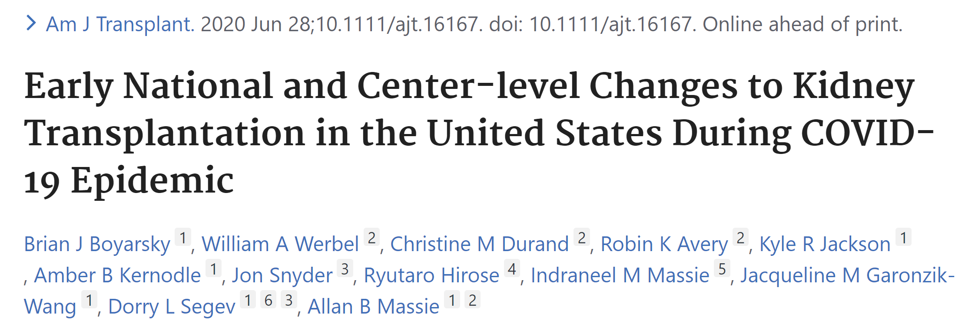
https://pubmed.ncbi.nlm.nih.gov/32594606/

Slide 7
THE PROBLEM: a pandemic is ravaging the land.

Slide 8
THE PROBLEM: a pandemic is ravaging the land.
THE PROBLEM: we have to quickly generate lots of tables, involving similar calculations.

Slide 9
THE PROBLEM: a pandemic is ravaging the land.
THE PROBLEM: we have to quickly generate lots of tables, involving similar calculations.
Also: some data comes from a script run on a remote server by somebody else.

Slide 10
Solution:
Generate "observed" event counts: save in a formatted text file
Model "expected" event counts: save counts as .dta files
Separate script to generate tables of observed/expected counts
Program calc_exp posts a single row of a single table to a Stata frame
Program tablesetup creates an MS-Word table using putdocx and writes headers
Program writerow writes a single formatted row to an MS-Word table
Program compare_obs_exp invokes these functions to write a single table with putdocx
The script obs_expected_tables.do calls compare_obs_exp three times to write three tables

Slide 11
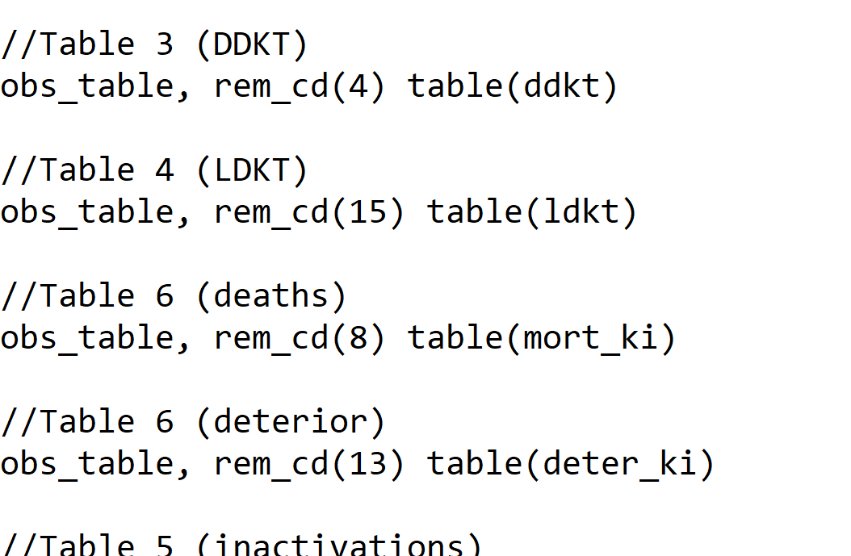
Get_observed_counts_ki.do
Write out each set of counts to a different text file

Slide 12
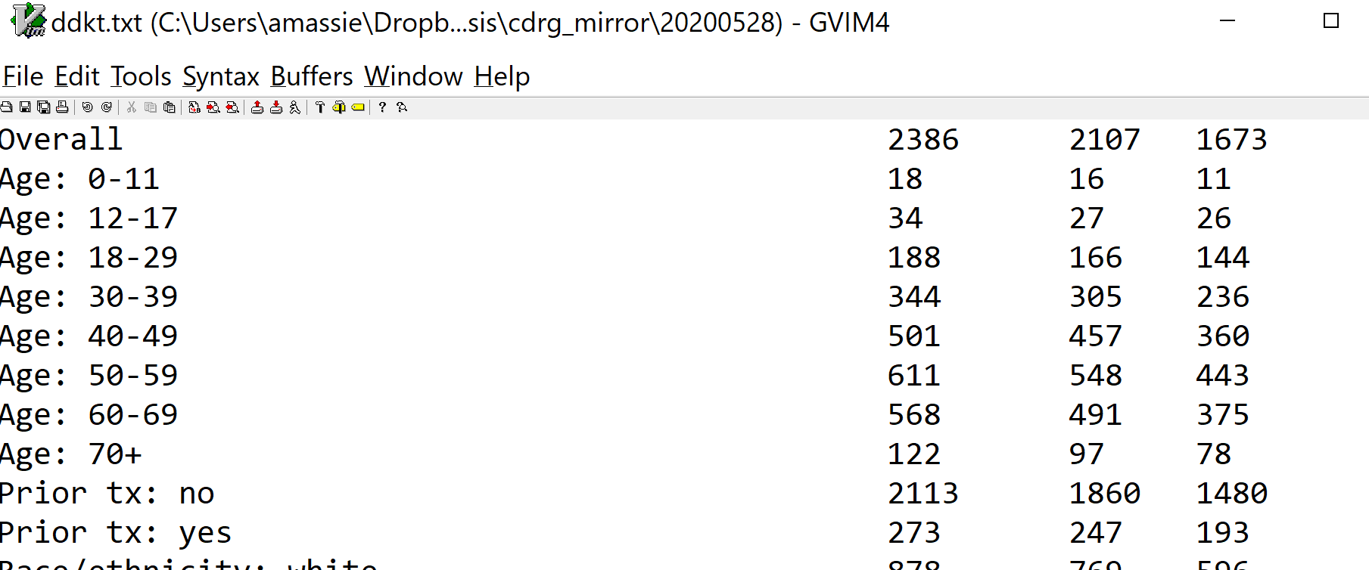
Get_observed_counts_ki.do
Sample output:

Slide 13
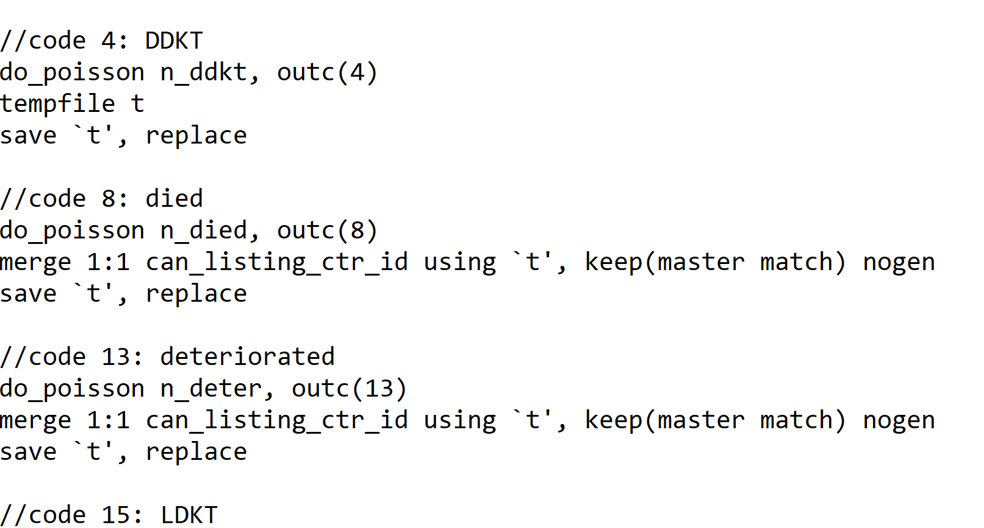
Modeling expected counts
Model one outcome at a time and save in a .dta

Slide 14
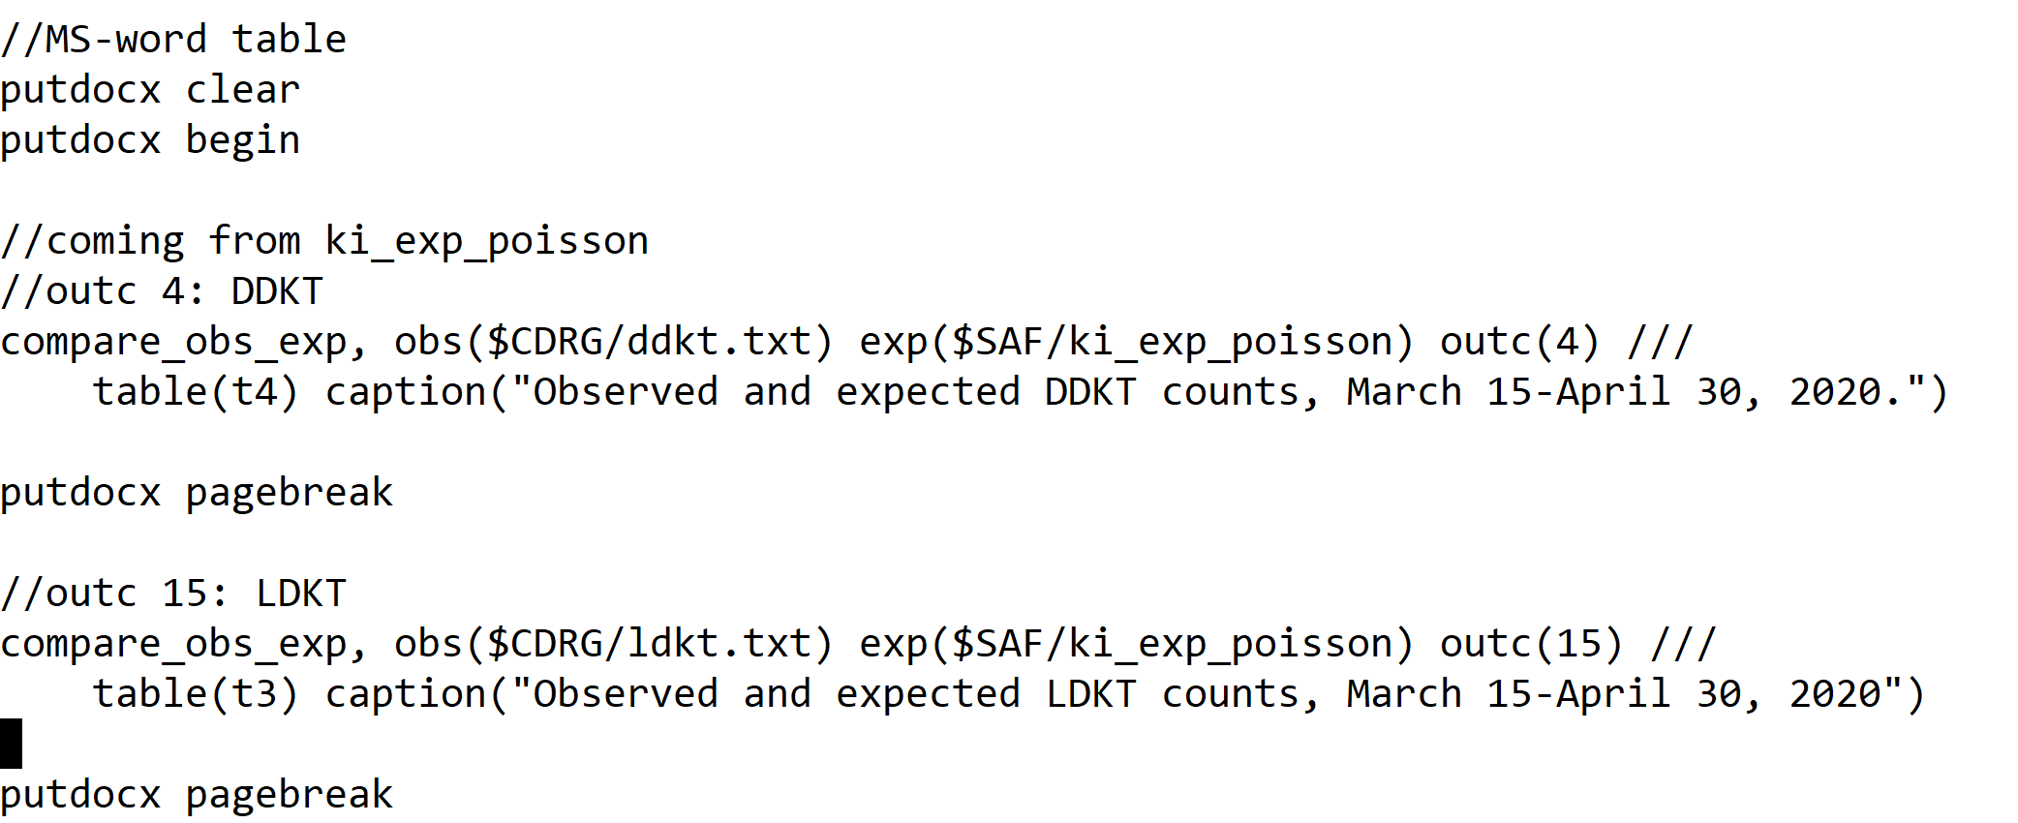
Obs_expected_tables.do
Main body

Slide 15
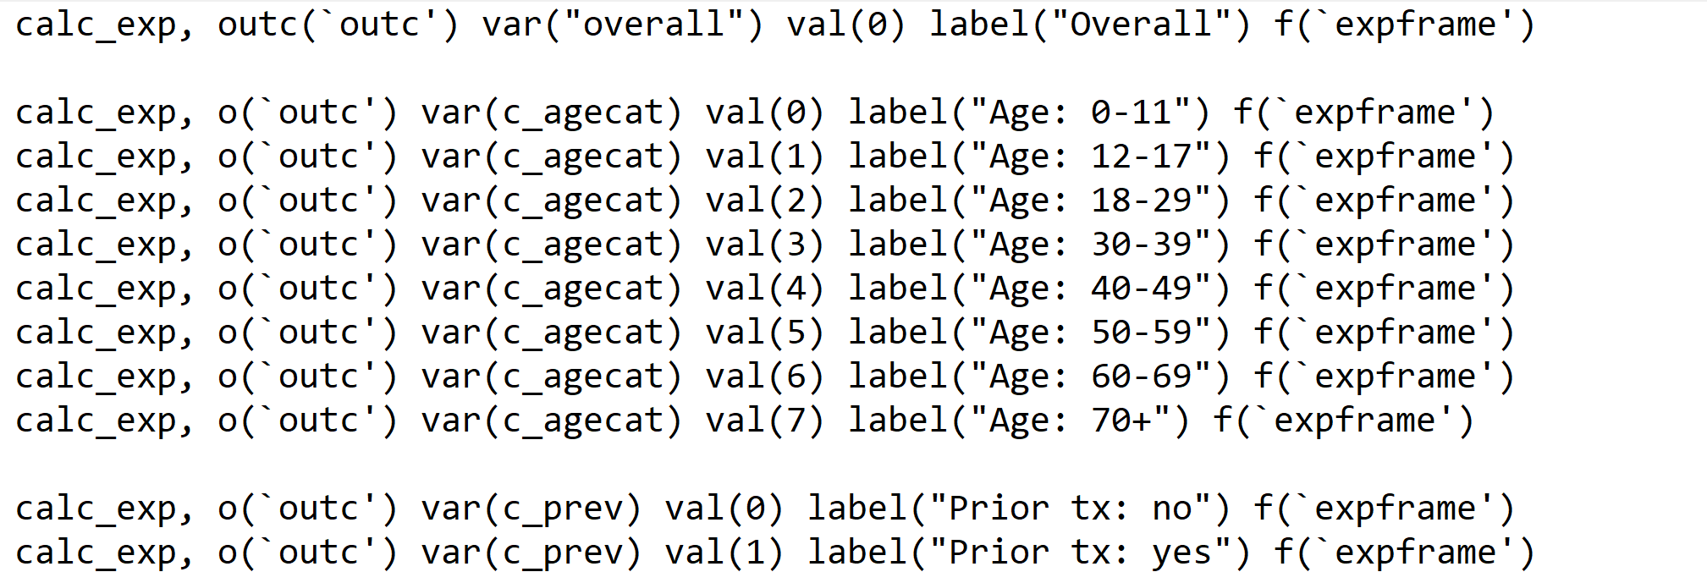
Obs_expected_tables.do
compare_obs_exp: prepare formatted expected counts

Slide 16
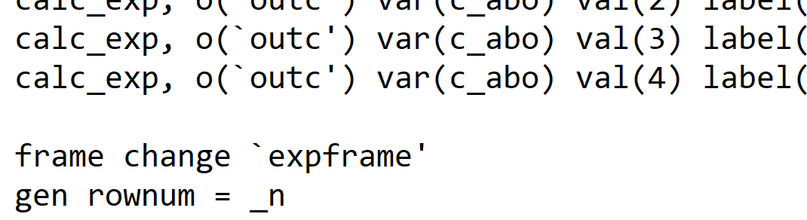
Obs_expected_tables.do
compare_obs_exp: Create a dataset with one row per table line

Slide 17
Obs_expected_tables.do
compare_obs_exp: write the table header

Slide 18
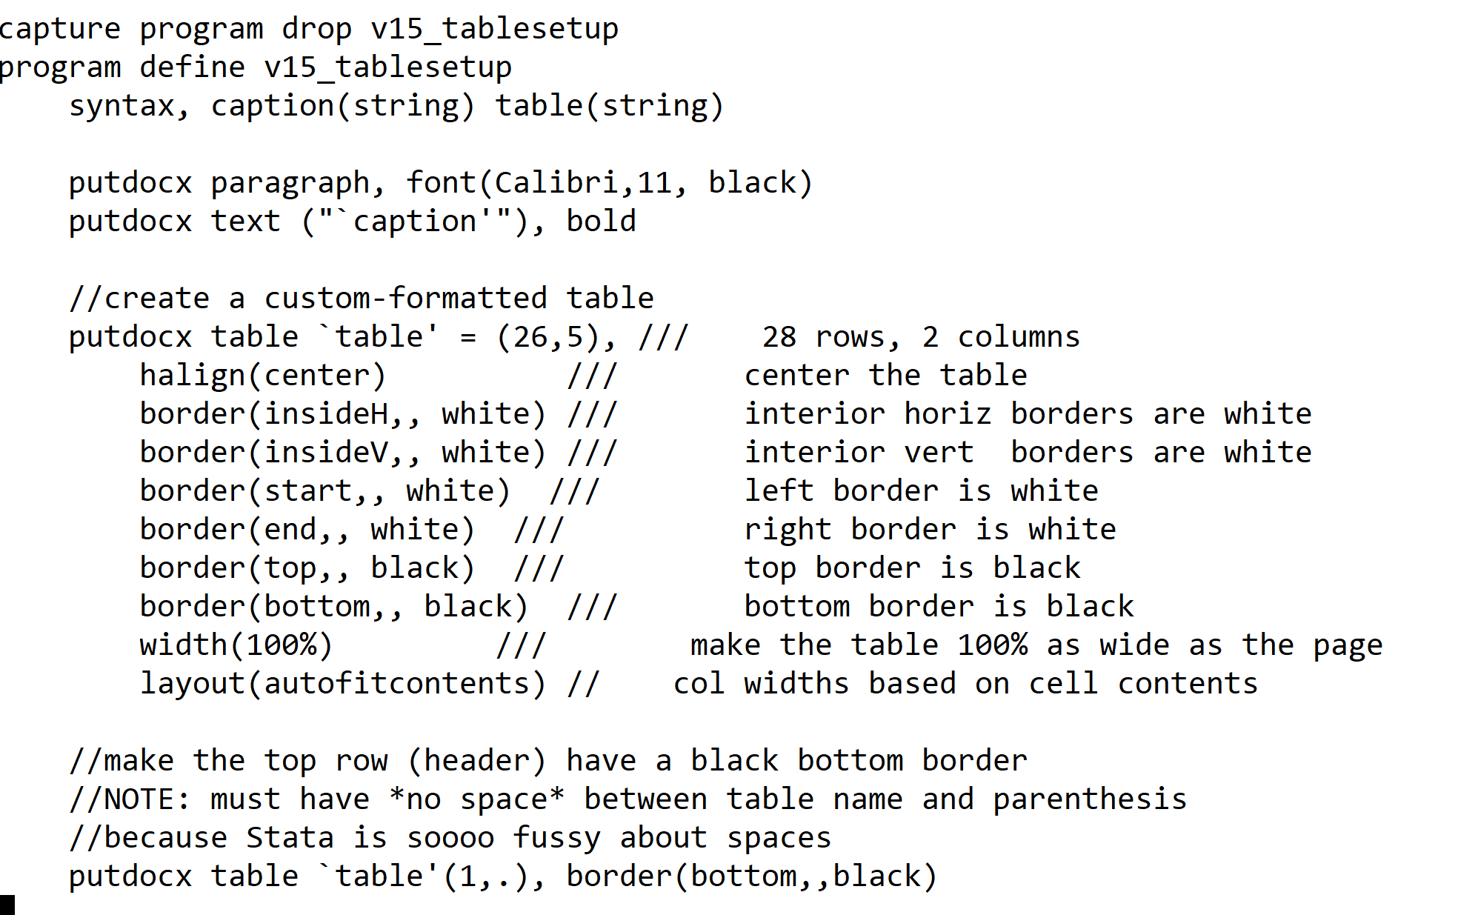
Obs_expected_tables.do
compare_obs_exp: write the table header

Slide 19
Obs_expected_tables.do
compare_obs_exp: write the table header

Slide 20
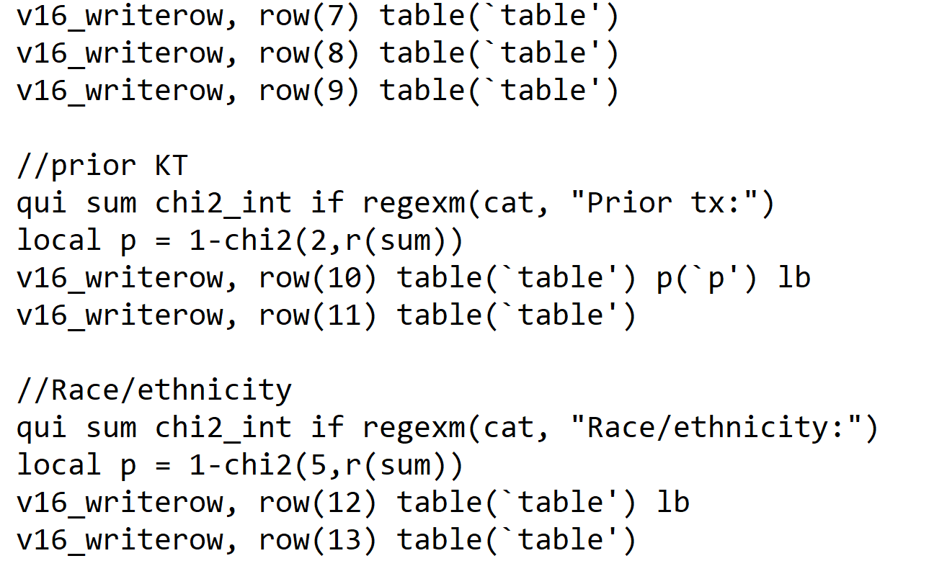
Obs_expected_tables.do
compare_obs_exp: write the table rows

Slide 21
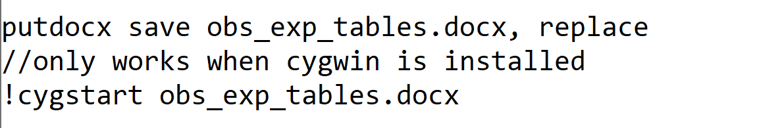
Obs_expected_tables.do
Last line of the script: launch the Word doc automatically

Slide 22
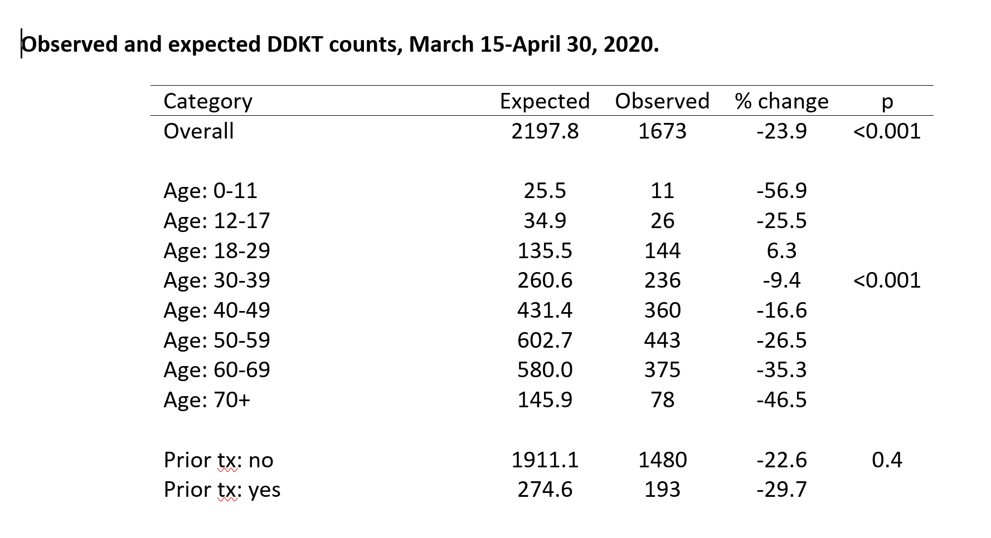
The result

Slide 23
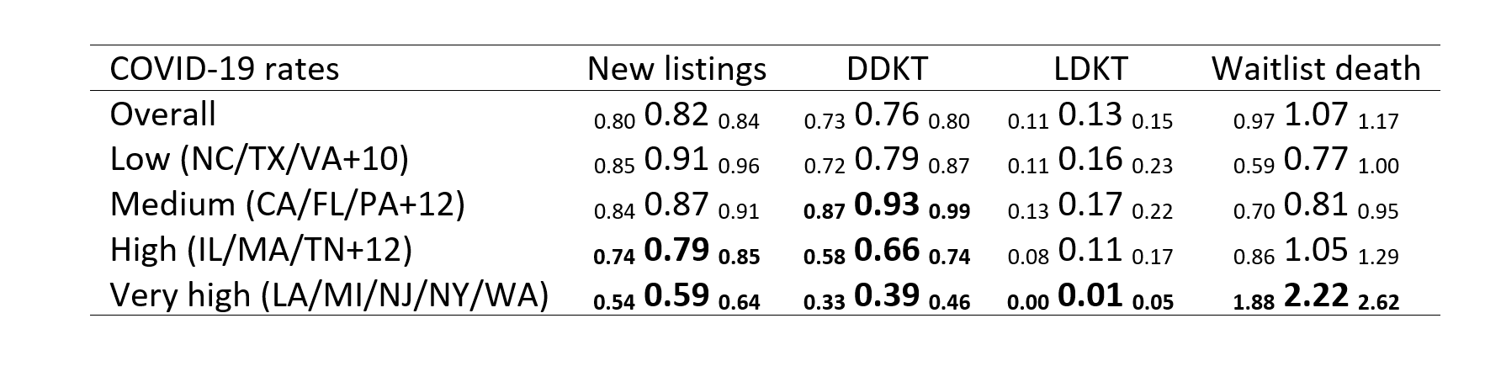
Regression tables using a similar schema

Slide 24
Louis-Zeger confidence intervals

Slide 25
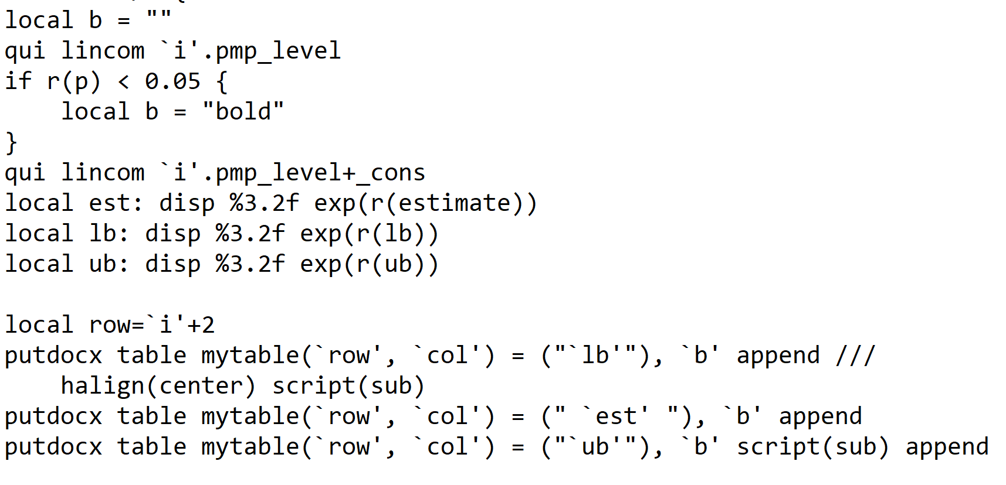
Louis-Zeger confidence intervals

Slide 26
Key Clinical findings
New kidney waitlist registrations dropped by 18%
Deceased-donor KT dropped by 24%
Living donor KT dropped by 87%
Declines in new listings and DDKT were greater among states with more COVID-19
Waitlist mortality increased 2.2-fold in states with the most COVID-19
https://www.ncbi.nlm.nih.gov/pmc/articles/PMC7361931/

Slide 27
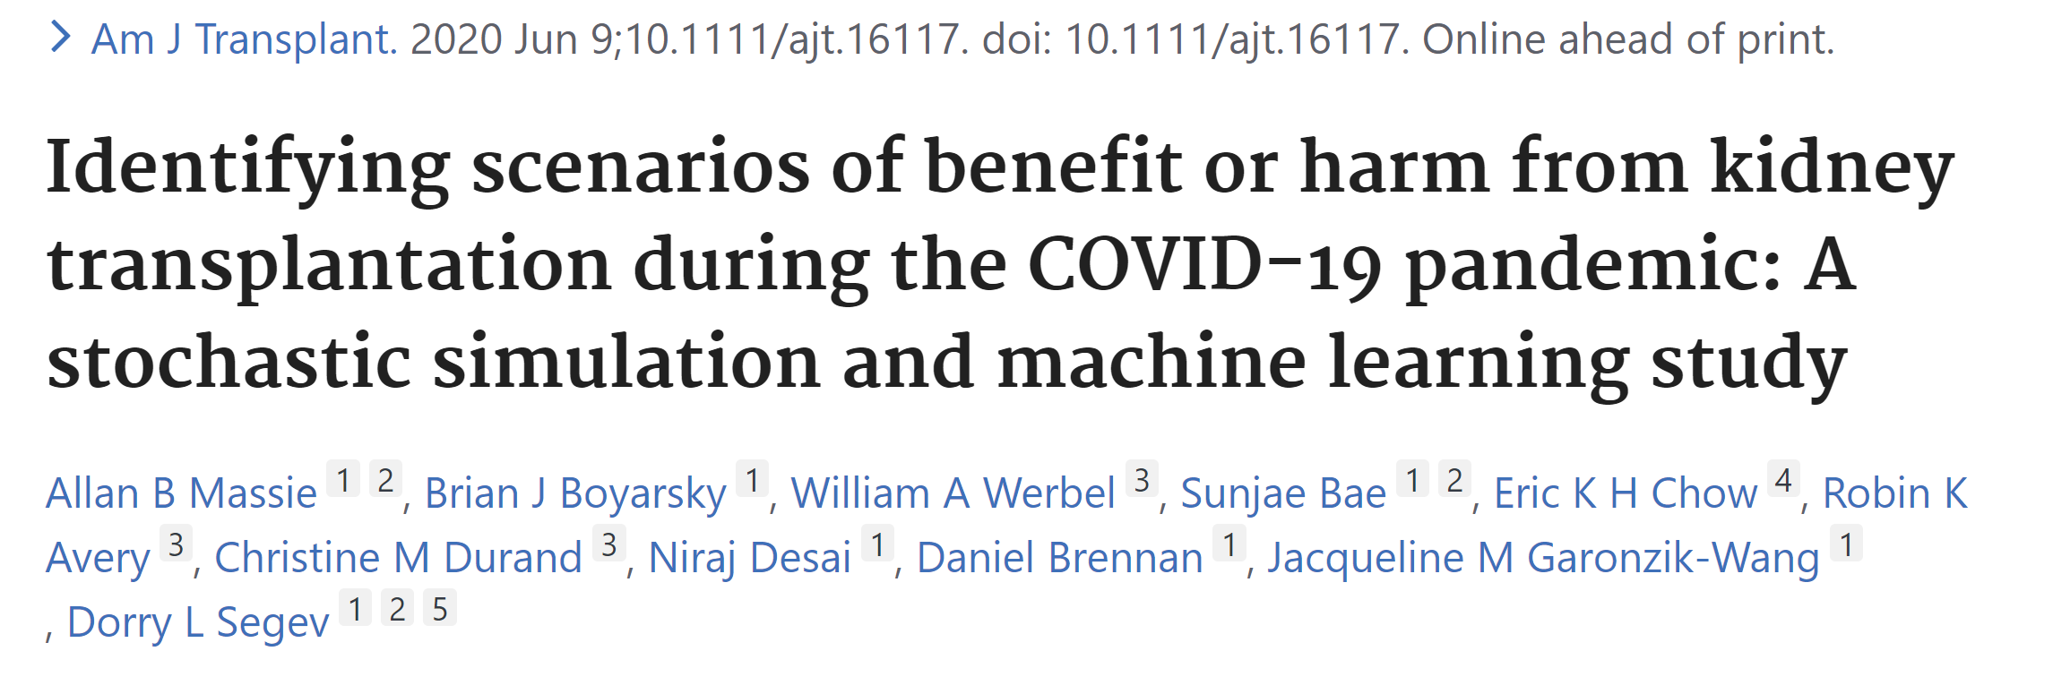
https://pubmed.ncbi.nlm.nih.gov/32515544/

Slide 28
The question
With increased mortality risk due to COVID-19, is kidney transplantation still safe?

Slide 29
The problem
In March of 2020, we didn't have good data on risk of COVID-19 incidence or mortality in transplant populations

Slide 30
The solution
Create a simulated population, give some of them COVID-19, and analyze mortality risk

Slide 31
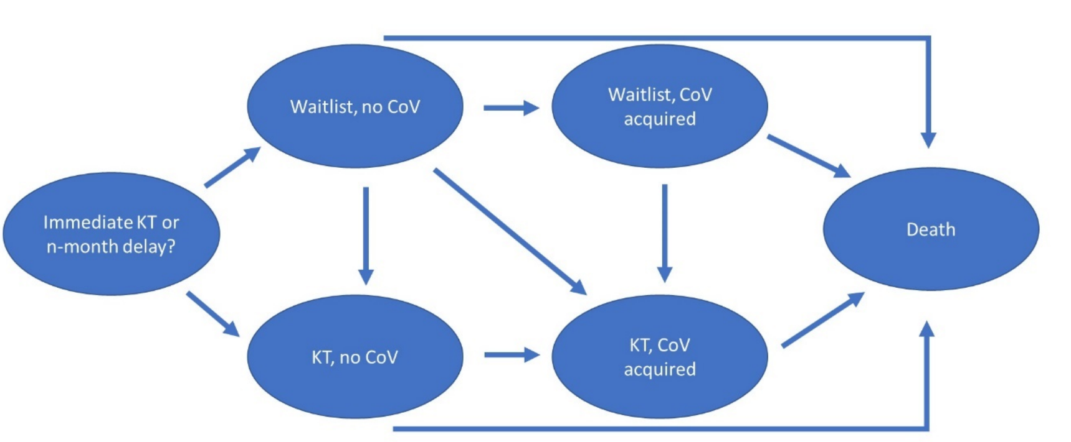
Markov decision process model
Patients choose immediate KT or n-month delay

Slide 32
Markov decision process model
They then advance through the states of the model, one month at a time, for five years

Slide 33
Markov decision process model
Probability going to a different state is determined by simulation parameters, or models from real life

Slide 34
Markov decision process model
See which decision (immediate vs delay) is less likely to lead to death

Slide 35
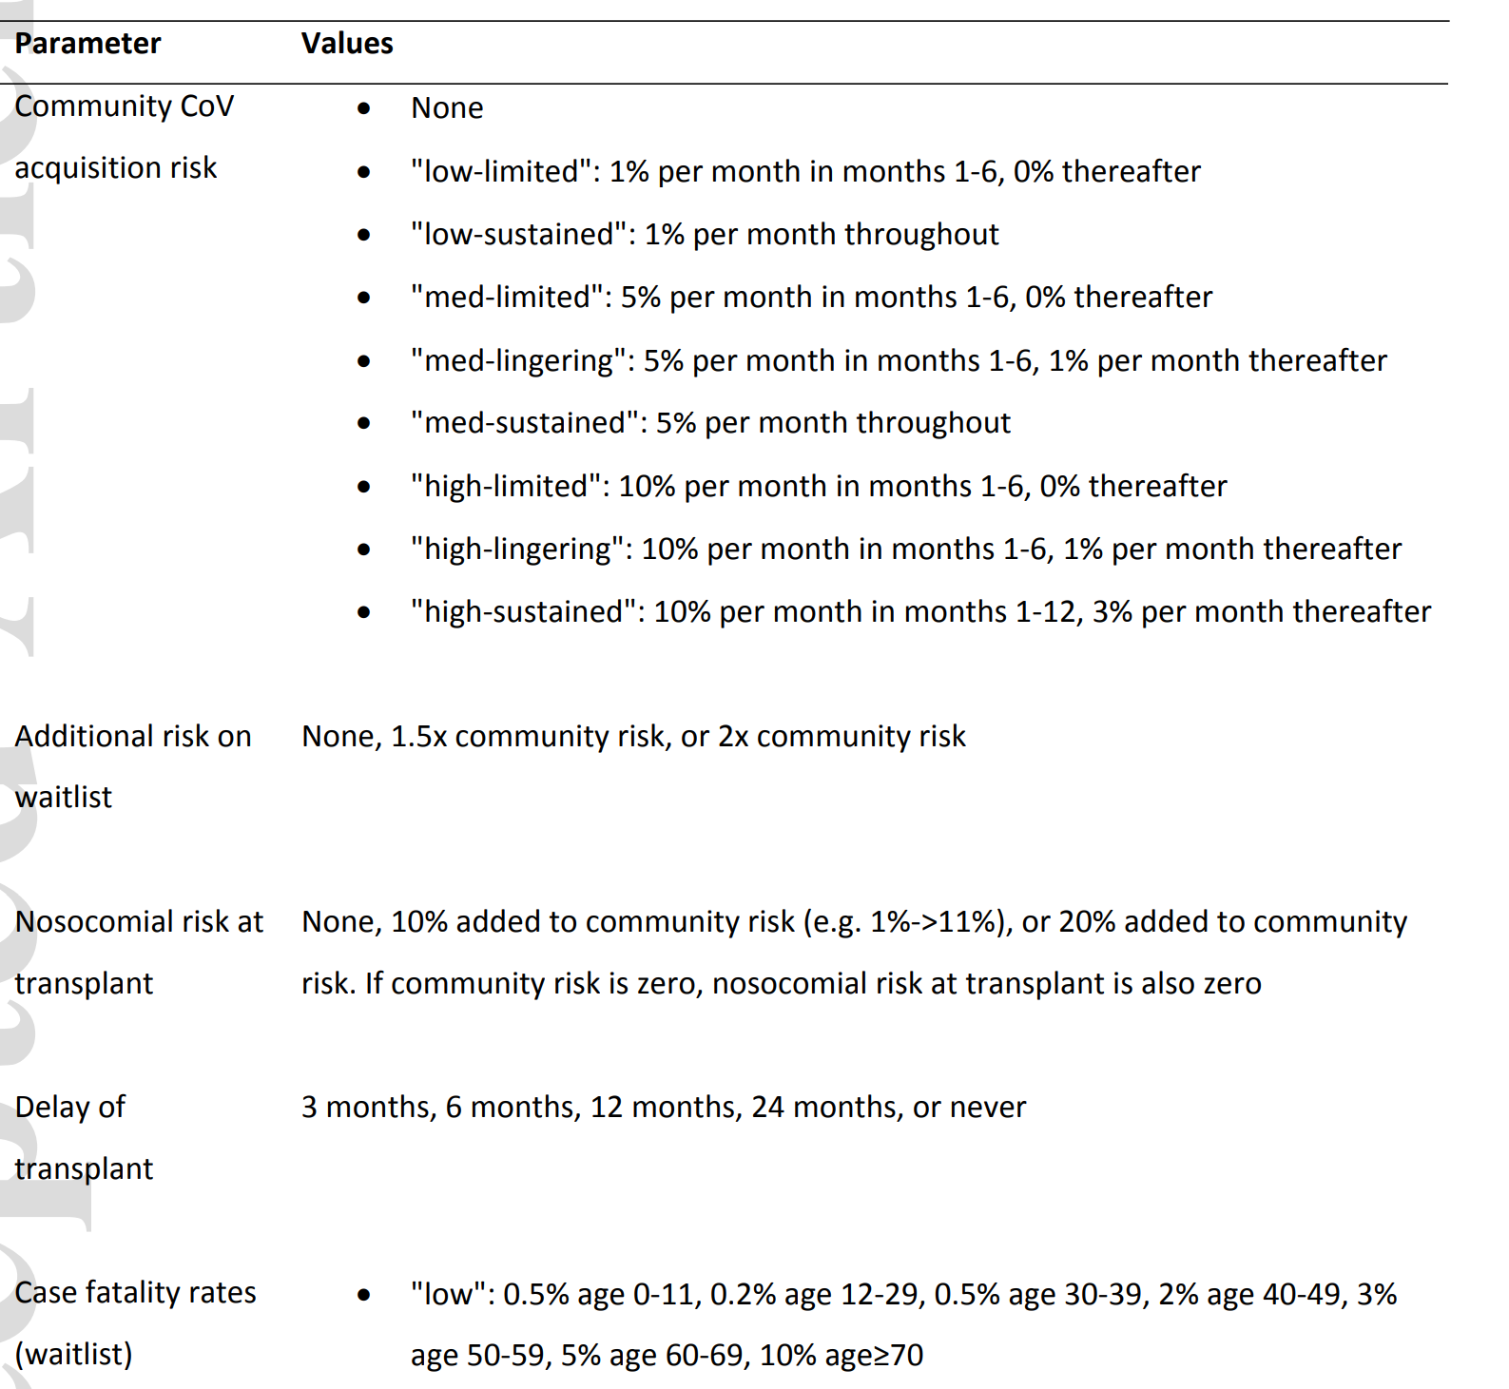
Epidemic parameters for simulation
Epidemic parameters (CoV acquisition/mortality risk) chosen from a range of possible values
Community CoV acquisition risk
Additional risk on waitlist
Nosocomial risk at transplant
Waitlist case fatality rate
Post-KT CFR
Length of transplant delay

Slide 36
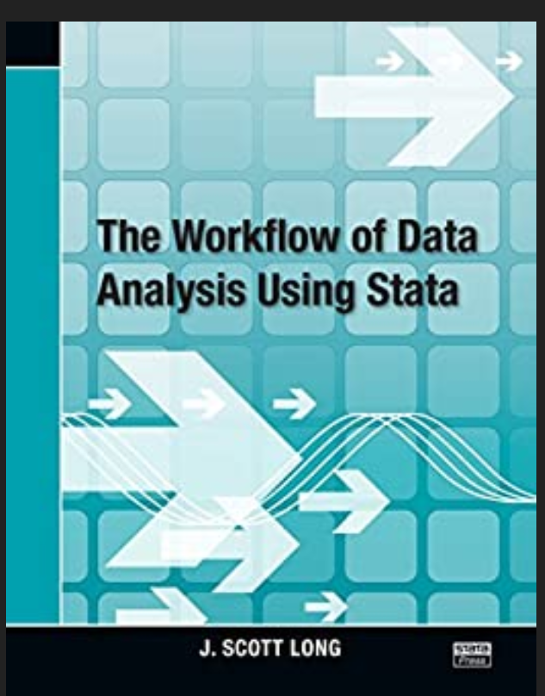
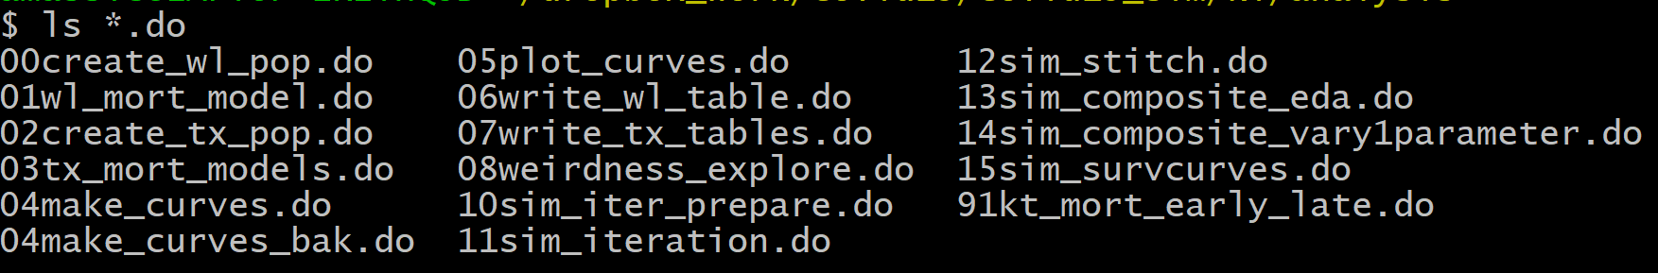
A little trick from J. Scott Long

Slide 37
Simulation workflow
Model waitlist mortality in the absence of COVID-19 (Poisson regression, adjust for candidate characteristics)
Model post-KT mortality in the absence of COVID-19 (also Poisson, vary by months post-KT)
Create a virtual population
Set parameters for COVID-19 risk
Model risk of mortality each month if immediate KT
Model risk of mortality each month if n-month delay

Slide 38
Creating the sim population
In some simulations, can be as simple as
clear
set obs [some big number]
For this one, we had one virtual patient for each unique combination of covariates in the actual dataset
egen x_group = group(`covariates')
drop `id_variables'
duplicates drop
isid x_group

Slide 39
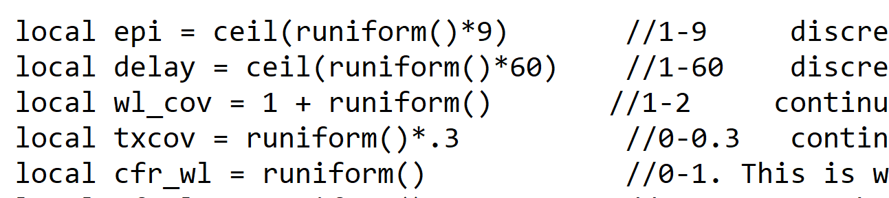
Running the simulation
Select CoV parameters from random distributions

Slide 40
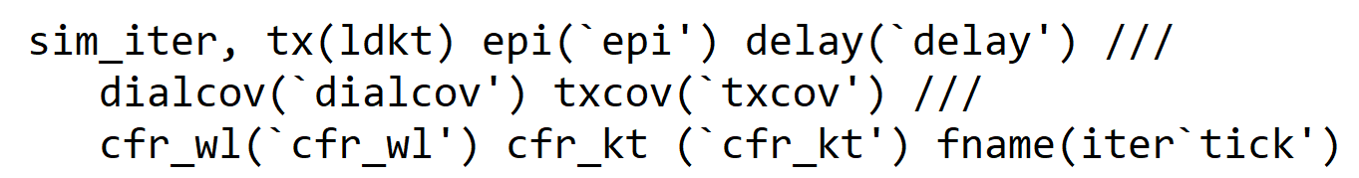
Running the simulation
Calculate risk of mortality for each patient profile under those conditions

Slide 41
Running the simulation
sim_iter generates expected survival at each month 1-60 for each patient under the specific epidemic parameters

Slide 42
Running the simulation
Saves each iteration to a different filename (to spend less time swapping/appending)

Slide 43
Running the simulation
Saves each iteration to a different filename (to spend less time swapping/appending)

Slide 44
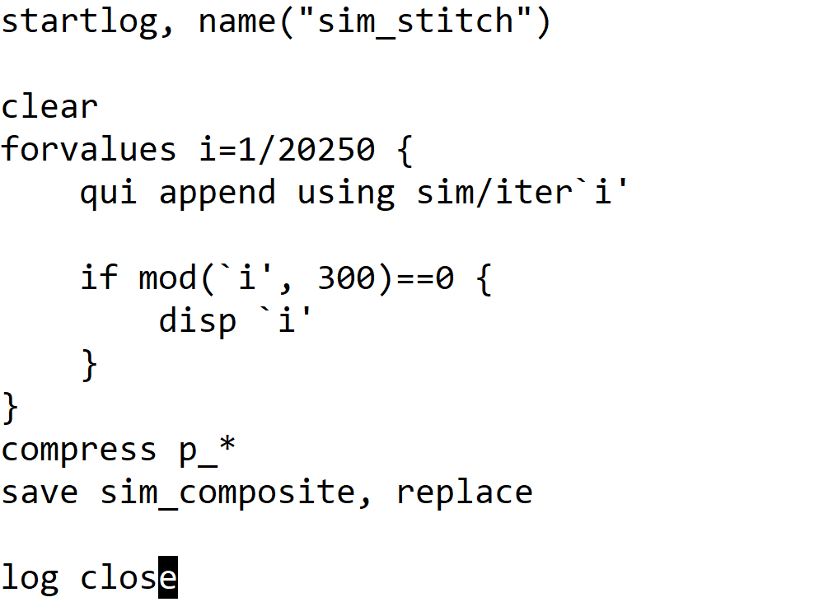
Stitch the simulation results together
In a very short, separate script

Slide 45
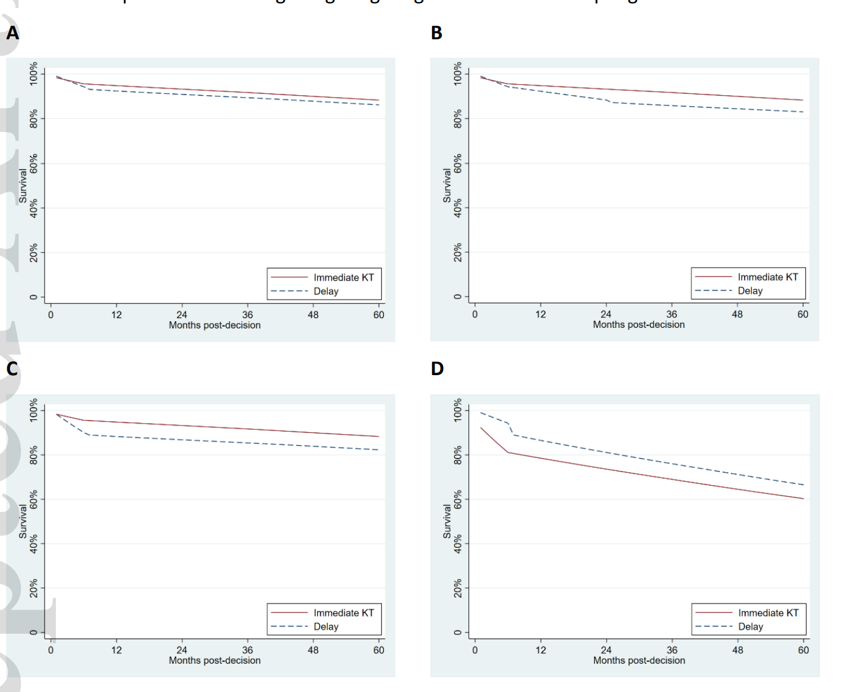
Analyze the output
Representative survival curves

Slide 46
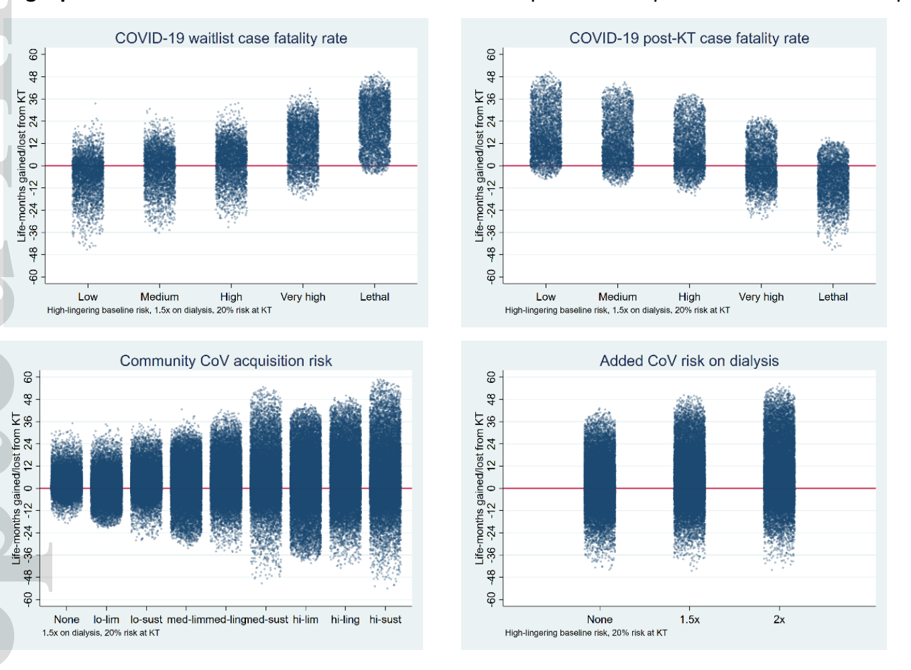
Analyze the output
Characterize the effect of varying a single parameter

Slide 47
Key clinical findings
CoV acquisition parameters, case-fatality ratios, and duration of delay have the greatest effect on survival benefit/harm
KT continues to provide survival benefit under COVID-19 except under unrealistic assumptions of case fatality ratios
For KT, question of survival benefit/harm is generally independent of patient characteristics (not so for liver…)

Slide 48
Implications
Our work helped motivate the restart of KT at our hospital and at other centers across the country
This simulation framework can be useful outside of the context of COVID-19 (e.g. for high-risk patients or marginal donor organs)

