Slide 1
Proximal Policy Optimization
Yikang, Gang

Slide 2
Outline
Background (Gang)
Theoretical Part (YiKang)
Algorithm and Experiment (Gang)

Slide 3
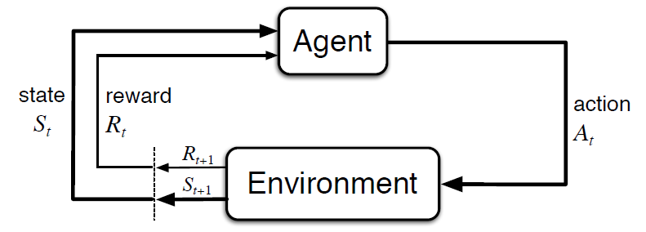
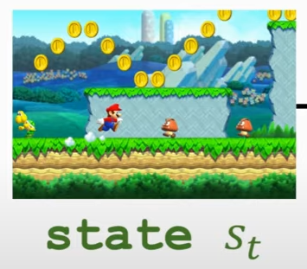
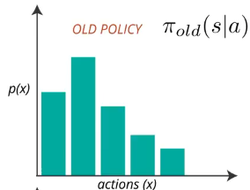
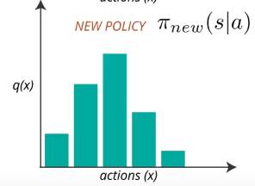
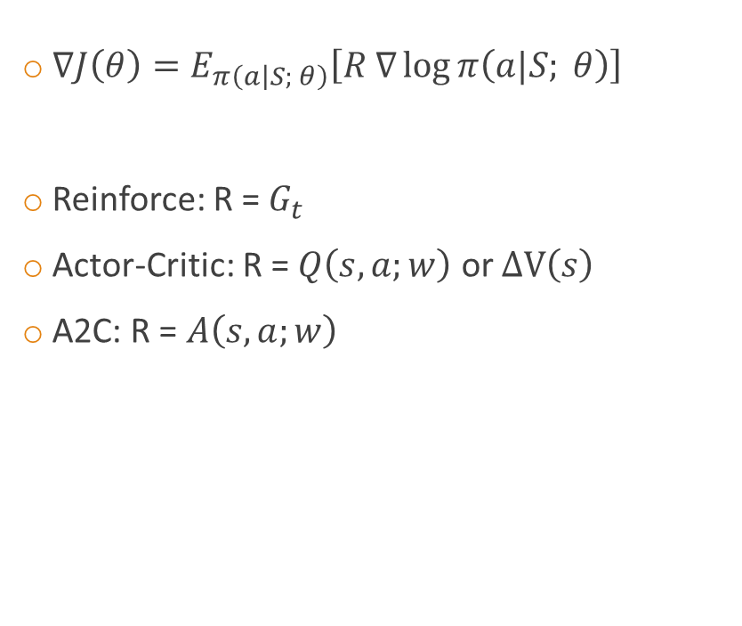

Review of Policy Gradient
$∇J\left(θ\right)=E_{π\left(\left.a\right|S; θ\right)}\left[R ∇\log{π\left(a|S; θ\right)}\right]$
Reinforce: R = $G_{t}$
Actor-Critic: R = $Q\left(s, a;w\right)$ or $ΔV\left(s\right)$
A2C: R = $A\left(s, a;w\right)$
Neural Network
Up = 0.5
Right = 0.2
Left = 0.3
$$θ_{t+1}=θ_{t}+α∇J\left(θ\right)$$
Notes:
1. All RL based on MDP; Unlike value based methods, skip estimation, directly. Use NN, that’s why continuous
2. We try to change the parameter $θ$of the policy network such that we hopefully find the policy that can get high reward in the environment.
3. Understanding is intuitively.

Slide 4
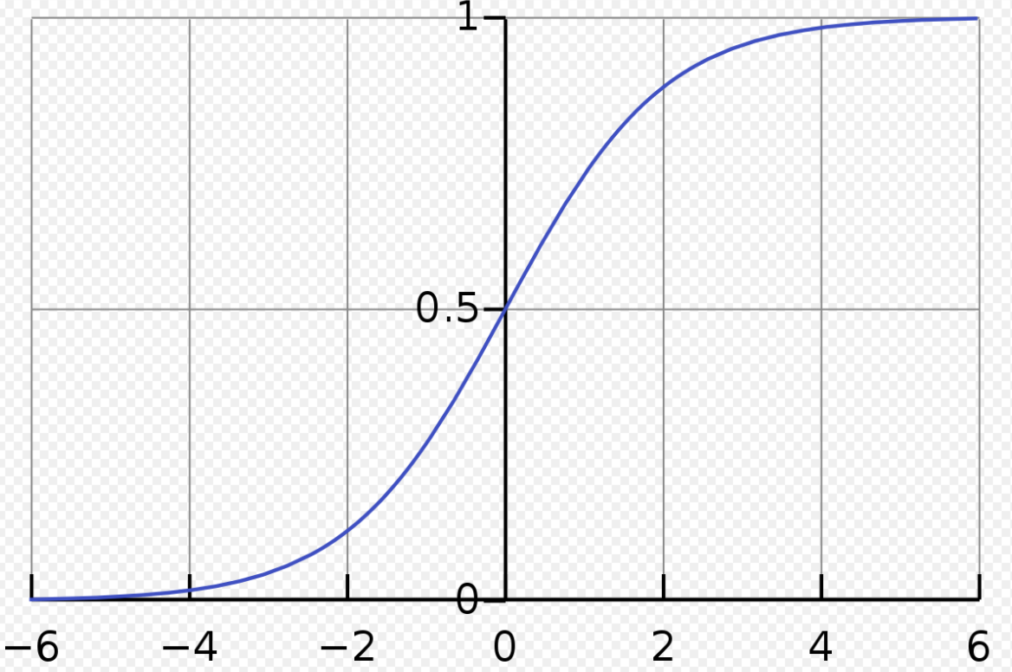
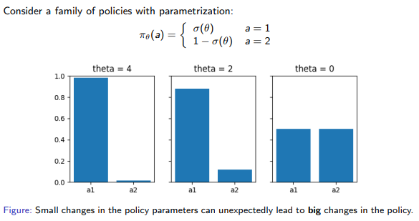
Limitations of Policy Gradient
Data Inefficient
Sample once, update once
On-policy learning can be extremely inefficient.
Not Robust
Notes:
so a single bad step can collapse the policy performance
how can we take the biggest possible improvement step without performance collapse

Slide 5
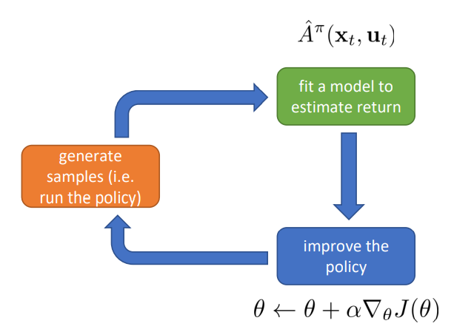
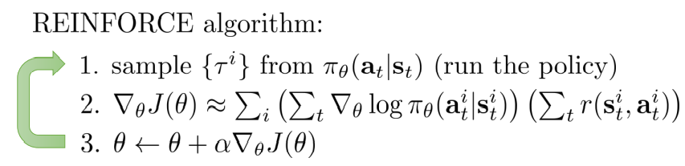
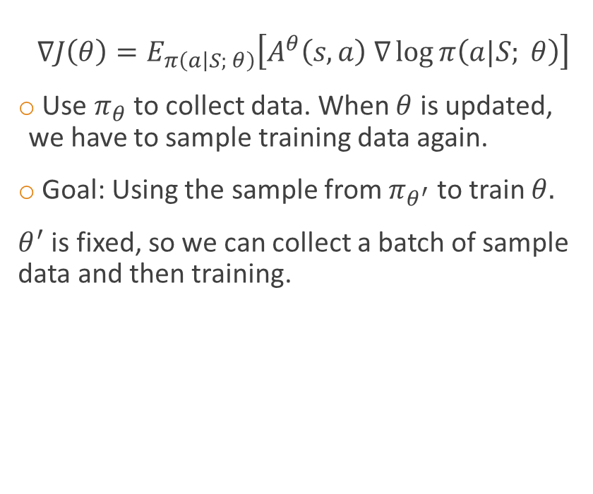
On-Policy -> Off-Policy
$$∇J\left(θ\right)=E_{π\left(\left.a\right|S; θ\right)}\left[A^{θ}\left(s,a\right) ∇\log{π\left(a|S; θ\right)}\right]$$
Use $π_{θ}$ to collect data. When $θ$ is updated, we have to sample training data again.
Goal: Using the sample from $π_{θ^{′}}$ to train $θ.$
$θ^{′}$ is fixed, so we can collect a batch of sample data and then training.
Notes:
Before the introduction to trust region methods, let me first discuss the difference between on-policy method and off-policy method. What is the drawback of the on-policy algorithm? One of the drawbacks is the sample effiency. We use pi_theta to collect data. But when theta is updated. We have to sample training data again. Therefore, the goal is using the sample data from pi_theta_prime to train theta.

Slide 6
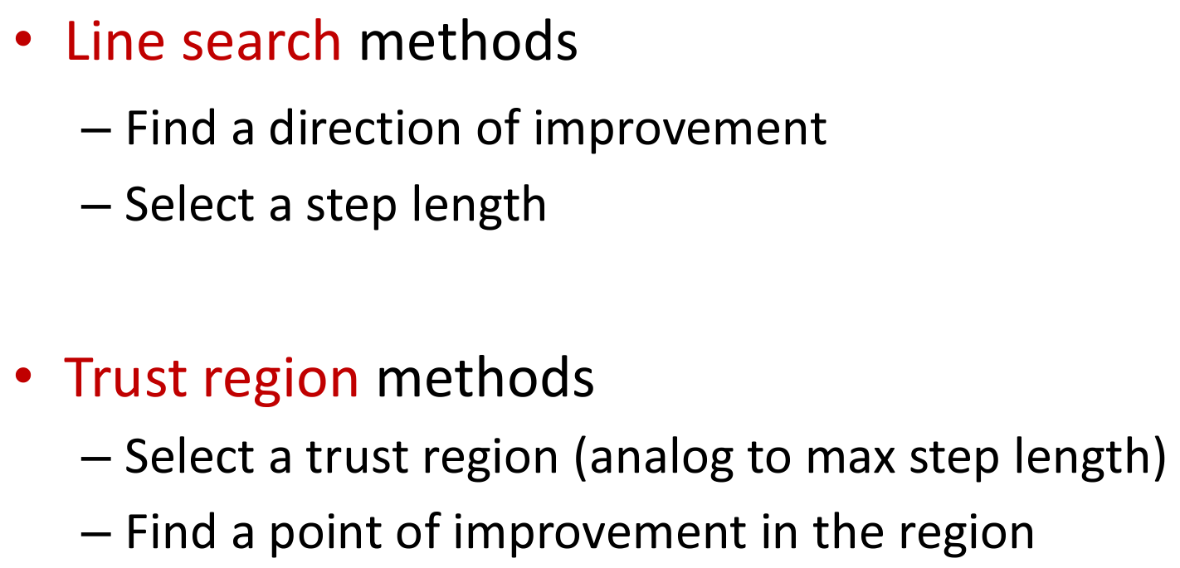
Two Important Classes
Notes:
As we all know, we need objective function for rl problem. How do we optimize these objective functions? There are essentially two important classes, line search methods as well as trust region methods. Now line search methods are by far perhaps the simplest and most well known techniques because they include gradient descent. So what does line search method do? They first find a direction of improvement and then after that, it will take a step in that direction and then try to optimize that step so that you make some good improvement. In contrast, if we consider trust region method, then in their cases, it’s more like the other way around and then you can think of them as some sort of dual to line search methods. Here you first select a trust region and you can think of the trust region as really being some upper bound on a step length. So in other words, it's almost like you're starting with the step length instead of finishing with the step length. So the idea is that we're going to define some region around our current estimate and the we're going to search in that region and then because that region is bounded then we obviously cannot have a step length that's going to be too large

Slide 7
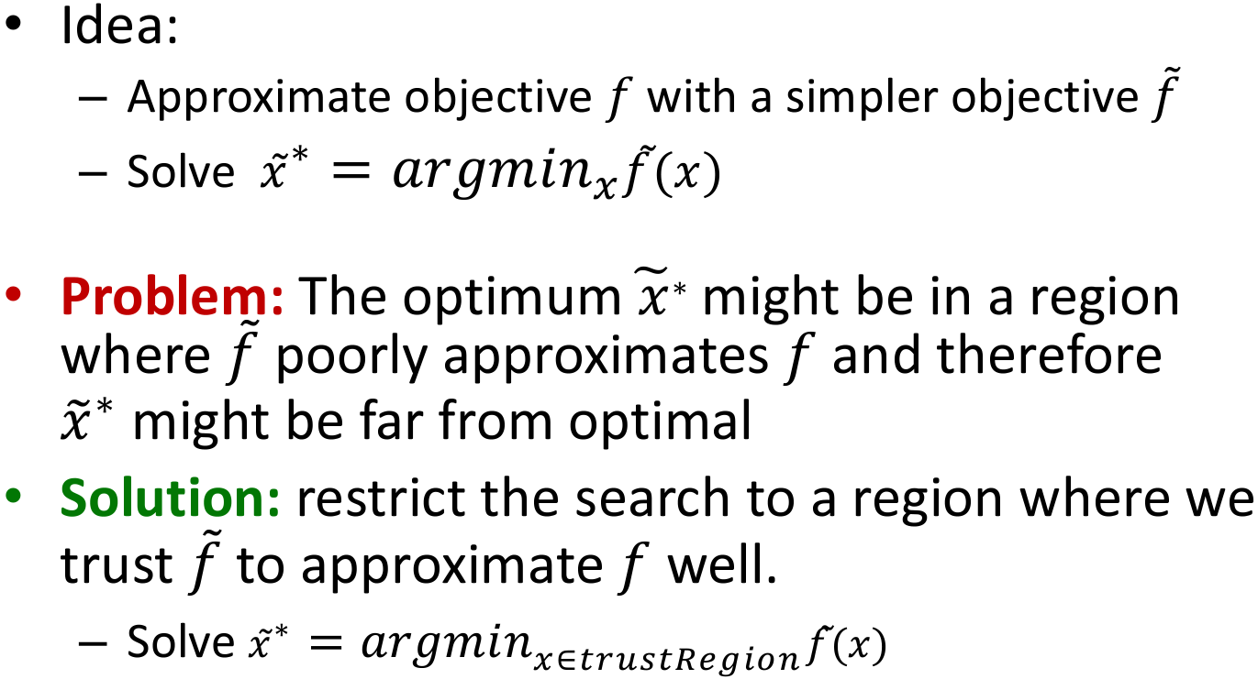
Trust Region Methods
Notes:
Now why should we consider trust region method or what's the advantage of trust region? The idea here here is that in many situations the objective that we want to optimize, let's call it f, is going to be complex and doing optimization based on this is not easy. So one way to get around the complexities is to arppoximate the f with f_tilde. And the f_tilde is a simpler objective. And then what I'll do is solve my opitimization problem with respect to that simpler objective and use that as a solution or another estimate. This is a good approach, however, there is a problem. The optimum x_tilde_star, which is the optimum based on f_tilde, might be ina region where f_tilde poorly approximates f and therefore x_tilde_star might be far from optimal. So one solution to this is restrict the search to a region where we trust f_tilde to approximate f well.

Slide 8
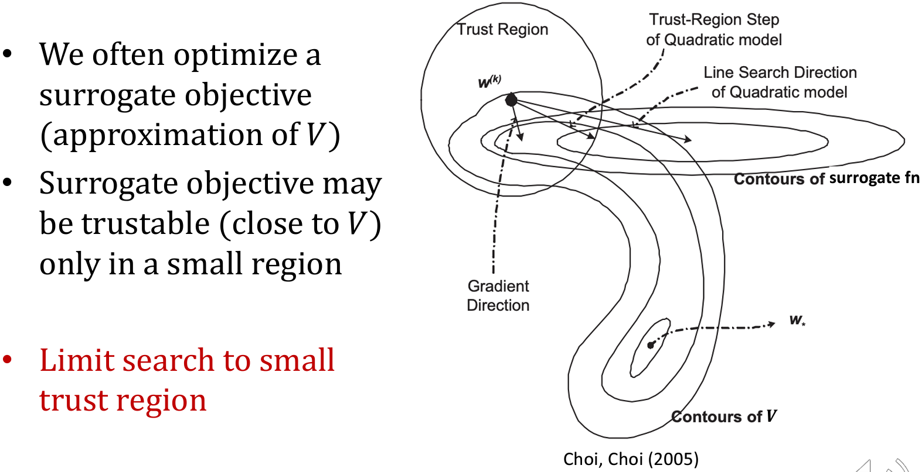

Trust Region Methods
Notes:
Here is an example of trust region method. So here is the idea that we might have an ovjective that is complex let's say high-dimension non-linear and we'll want to approximate it with a surrogate objective that is simpler, perhaps quadratic and can be optimized very efficiently and reliably. So here, our contours of surrogate fn might diverge from the original objective so we need to limit the search to a small region that we can trust. So the idea is that the trust region is a region where the surrogate is a good approximation of the original function and this way any improvements that we estimate based on the surrogate should be a good estimate as well of the imporvement with respect to the original objective. So these trust region method then can ensure good convergence and almost monotonic improvement simply because with the turst region, we can make sure that all these estimates are reliable.

Slide 9
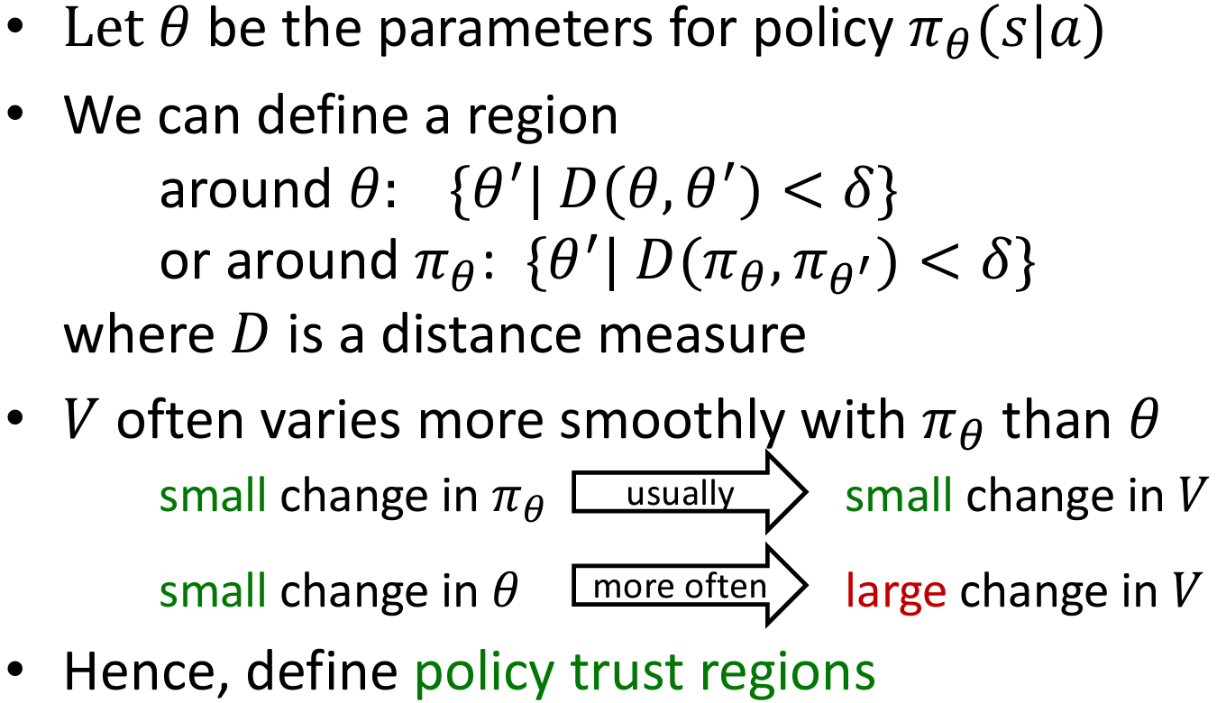
Trust Region for Policies
Notes:
Let's apply trust region method to policy optimization. In doing so, we want to consider some trust region either with respect to the paramter theta or the policy pi_theta. When we choose the trust region, we want to look at what is our ultimate objetive and then in the case of reinforcement learning, the objective is typically to maximize the value function since that encodes the sum of expected rewards. So we choose trust region if it is with respect to the policy and let's policies are stochastic then a small change in a policy would usually correspond to a change in probability of choosing some action and that will lead to a gradual change in the value function. So this is a good thing because the changes tend to be smooth. Now in contrast, if we consider trust regions with respect to parameter theta and let's say theta encodes the weights of neural network either for the value function or something else then if our neural network is quite expressive, it might capture some discontinuities which means that a small chang with respect to the parameters might lead to a large or drastic change in the value function. So it will generally be better for us to work with trust regions defined in terms of the policy simply because that tends to lead to smoother changes.

Slide 10
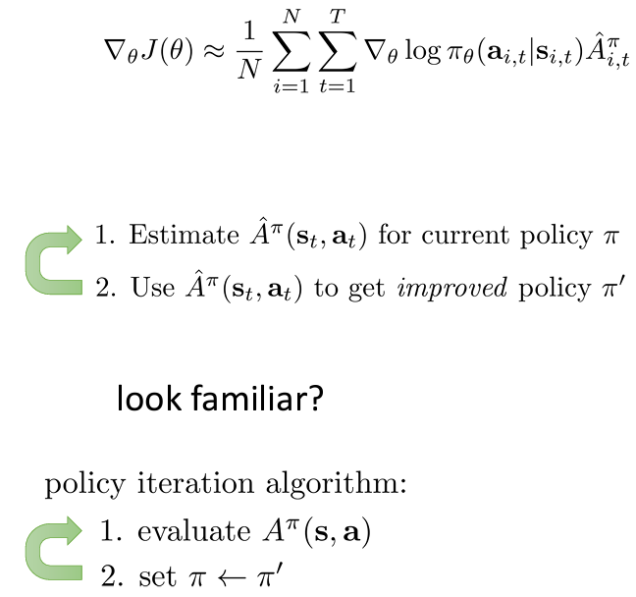
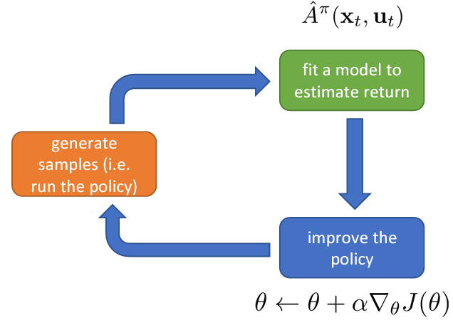
Why Does Policy Gradient Work?

Slide 11
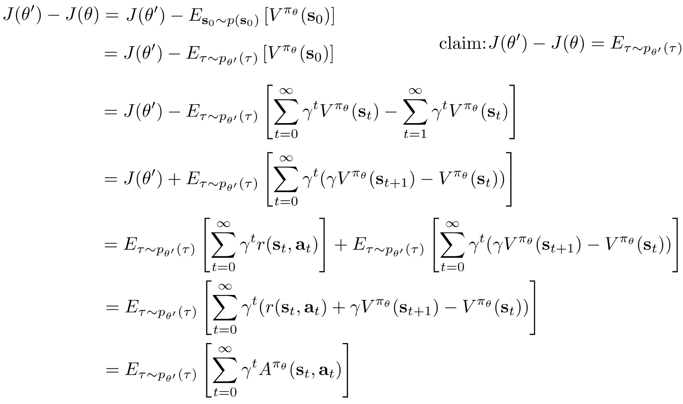
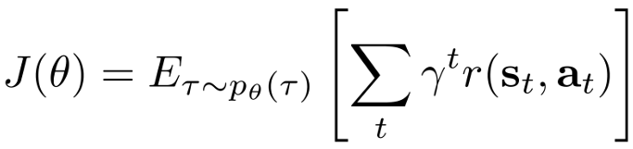

Policy Gradient as Policy Iteration

Slide 12
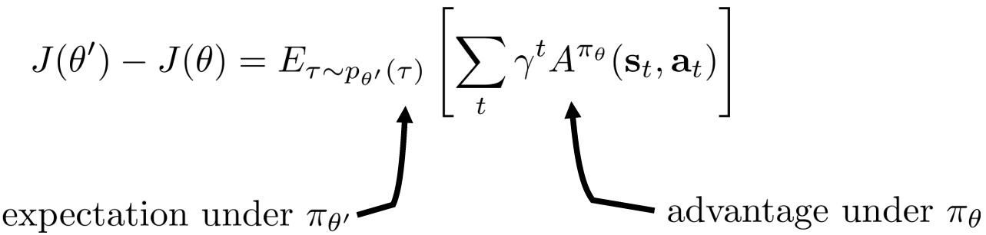
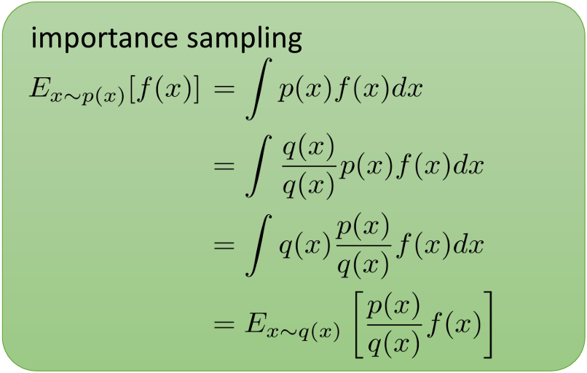
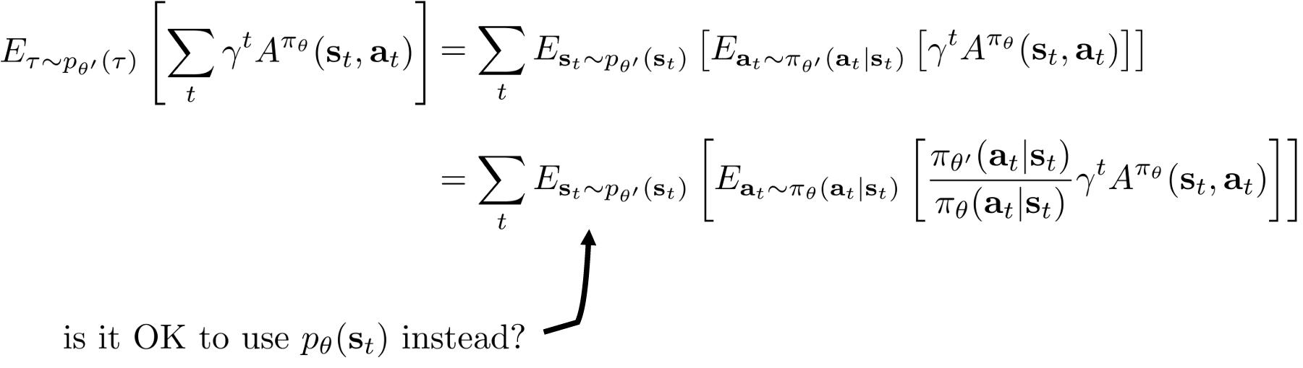
Policy Gradient as Policy Iteration

Slide 13
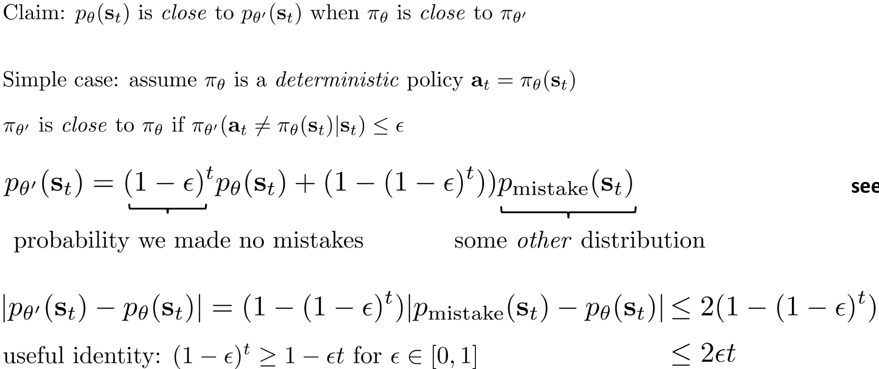

Bounding The Distribution Change

Slide 14
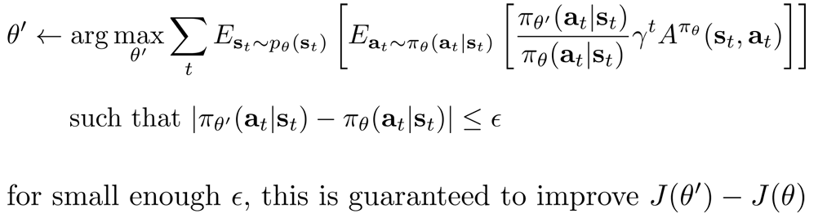
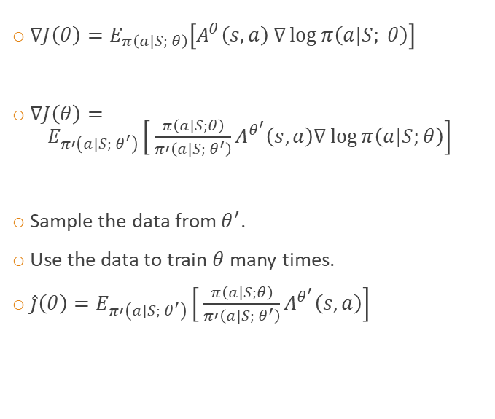
What We Get So Far?
$∇J\left(θ\right)=E_{π\left(\left.a\right|S; θ\right)}\left[A^{θ}\left(s,a\right) ∇\log{π\left(a|S; θ\right)}\right]$
$∇J\left(θ\right)= E_{π′\left(\left.a\right|S; θ^{′}\right)}\left[ \frac{π\left(\left.a\right|S;θ\right)}{π′\left(\left.a\right|S; θ^{′}\right)}A^{θ^{′}}\left(s,a\right)∇\log{π\left(a|S;θ\right)}\right]$
Sample the data from $θ^{′}$.
Use the data to train $θ$many times.
$\hat{j}\left(θ\right)=E_{π′\left(\left.a\right|S; θ^{′}\right)}\left[ \frac{π\left(\left.a\right|S;θ\right)}{π′\left(\left.a\right|S; θ^{′}\right)}A^{θ^{′}}\left(s,a\right)\right]$

Slide 15
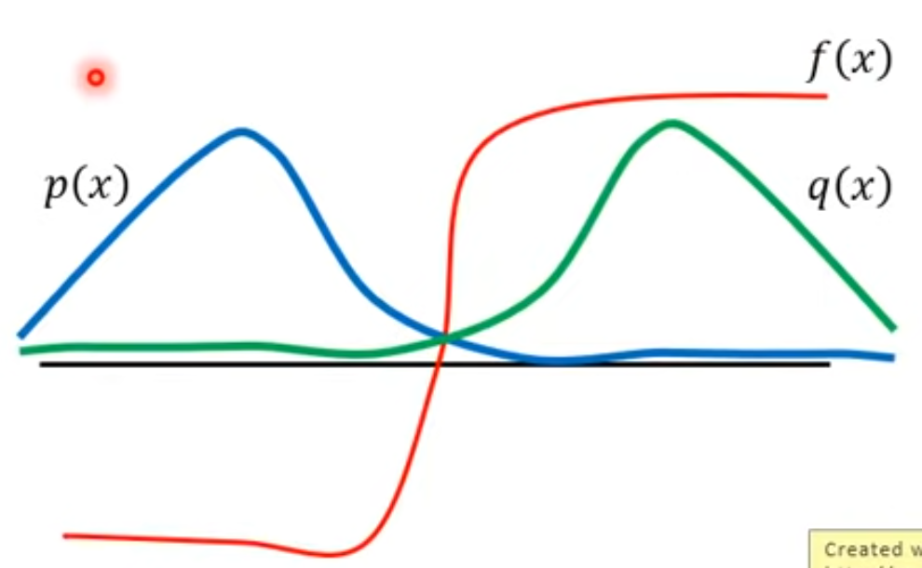

Issue of Important Sampling
Variance
$π′$ close to $π$
KL Divergence? Why use KL Divergence?
$D_{KL}\left(p||q\right)=\sum_{i=1}^{N}{p}\left(x_{i}\right)⋅\log{\frac{p\left(x_{i}\right)}{q\left(x_{i}\right)}}$

Slide 16
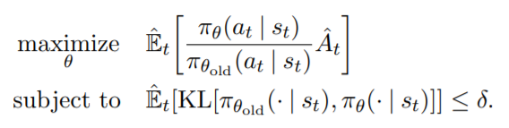

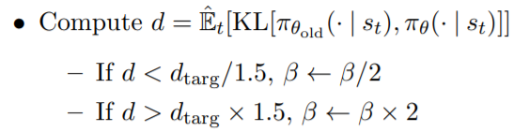
PPO Algorithm (Adaptive KL Penalty)
Trust Region Policy Optimization (TRPO)
Computation is complicated.
Proximal Policy Optimization (PPO)

Slide 17


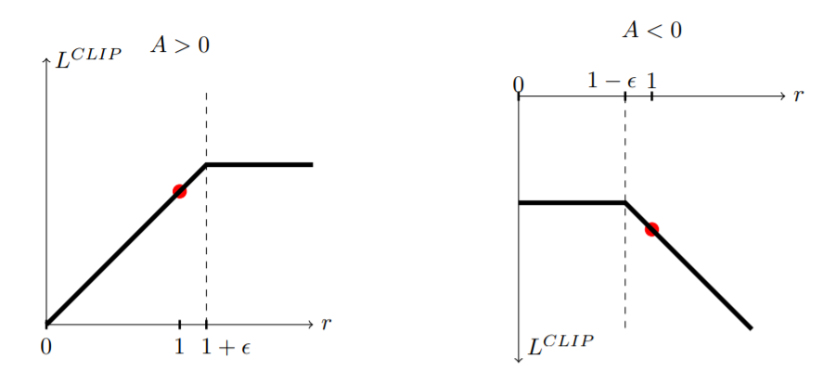
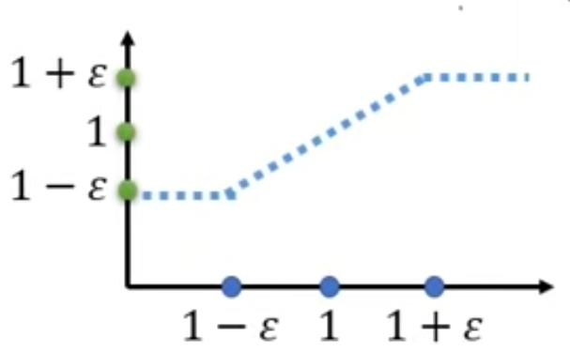
PPOv2 Algorithm (Clip)

Slide 18
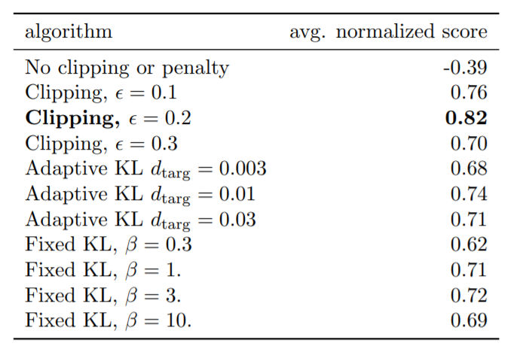
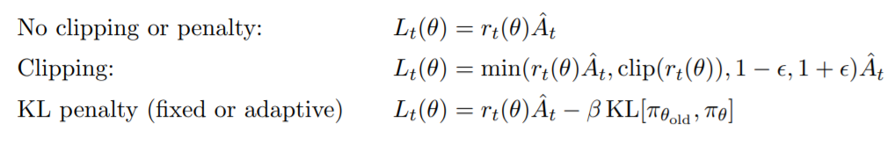
Comparison

Slide 19
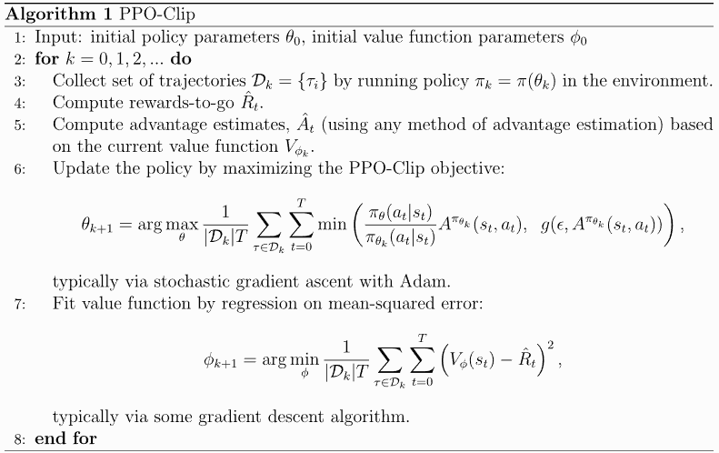
PPOv2 Pseudocode
PPO-PyTorch/PPO.py at master · nikhilbarhate99/PPO-PyTorch (github.com)

Slide 20
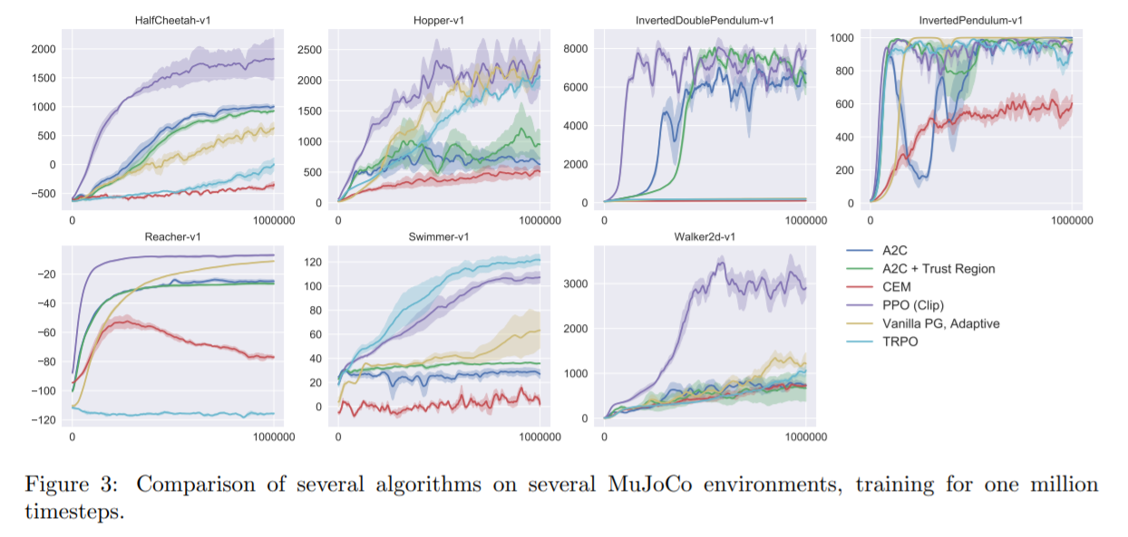
Experiments in Continuous Domain

Slide 21
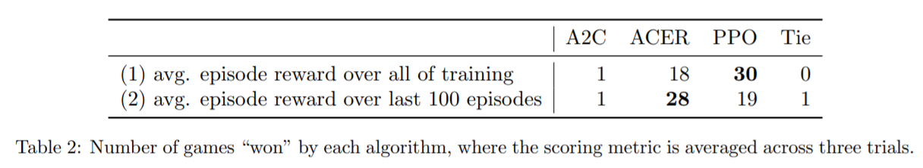
Experiments in Atari Domain

Slide 22
Reference
Schulman, John et al. “Trust Region Policy Optimization.” ArXiv abs/1502.05477 (2015): n. pag.
Schulman, John et al. “Proximal Policy Optimization Algorithms.” ArXiv abs/1707.06347 (2017): n. pag.
Proximal Policy Optimization — Spinning Up documentation (openai.com)
PowerPoint Presentation (berkeley.edu)

