Slide 1
Neural Network Midterm Presentation
Group 2
LivingBytheSee
M10612001蘇衍嘉
M10612008唐世謙

Slide 2
Problem Analysis
Predict concentration levels of PM2.5、PM10、O3, over the coming 48 hours for two cities: Beijing and London
On each day throughout the competition, air quality data and meteorological data for both cities will be provided on the hourly basis.

Slide 3
Data Description
beijing_17_18_aq
(station_id,latitude,longtitude,utc_time,PM2.5,PM10,NO2,CO,O3,SO2)
beijing_17_18_meo
(station_id,latitude,longtitude,utc_time,temperature,pressure,humidity,wind_direction,wind_speed,weather)
Beijing_AirQuality_Stations
(Stations at Beijing)
Beijing_historical_meo_grid
(Grid_name,longitude,latitude,utc_time,temperature,pressure,humidity
,wind_direction,wind_speed)
Beijing_grid_weather_station
(Grids’ lat and lon)

Slide 4
Data Description cont.
London_historical_meo_grid
(Grids’ lat and lon)
London_historical_aqi_forecast_stations
(MeasurementDateGMT, station_id, PM2.5, PM10, NO2)
London_historical_aqi_other_stations
(MeasurementDateGMT,Station_ID,PM2.5,PM10,NO2)
London_AirQuality_Stations
(Station_name,api_data,need_prediction,historical_data,Latitude,Longitude,SiteType,SiteName)
London_grid_weather_station
(Grids’ lat and lon)

Slide 5
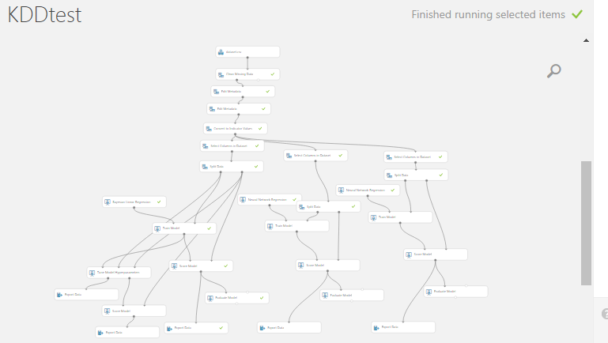
Platform
Microsoft azure machine learning studio

Slide 6

Tools
Python
Spyder
pandas

Slide 7
Features for Beijing
Station_id as category
Temperature
Pressure
Humidity
wind_direction
wind_speed
weather

Slide 8
Features for London
Latitude
Longtitude
Temperature
Pressure
Humidity
wind_direction
wind_speed

Slide 9
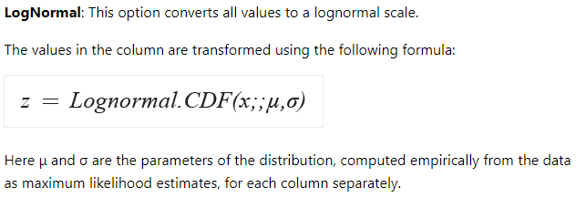
Difficulties
推測可能是因為特徵之間的梯度太小，而線性模型無法完全擬合全部的資料
透過將特徵正規化，可以稍微解決這個問題，但成效有限。

Slide 10
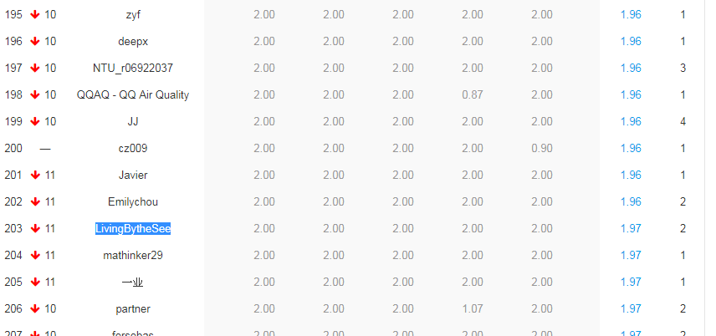
Results

Slide 11
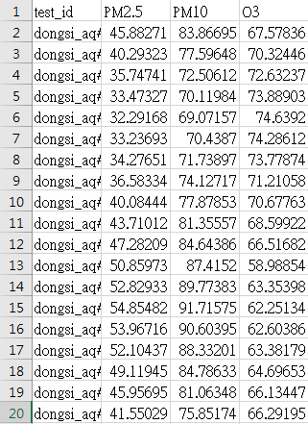
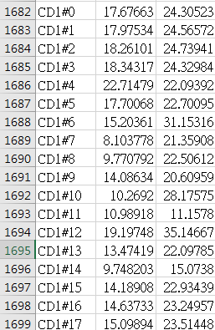
Results of 5/1 prediction
Beijing
London

Slide 12
Future
考慮時間序列：可能會因為時間(早、晚)，而有所不同
考慮處在不同地區特性之城市

