Slide 1

SMART INDIA HACKATHON 2026
Problem Statement ID - SIH26094
Problem Statement Title - AI-Powered Dynamic Mental Health
Monitoring and Distress Prediction System for Victims of Atrocities
Theme - MedTech / BioTech / HealthTech
PS Category - Software
Team ID - <fill in your registered Team ID>
Team Name - JAMMERZ

Slide 2
AI-Powered Mental Health Monitoring for Atrocity Victims
JAMMERZ
Proposed Solution
  AI system that continuously monitors victims registered via NHAA 14566 / Integrated Portal
  Regular well-being checks - chatbot, IVRS, SMS, mobile app
  AI analysis - NLP, sentiment, emotion, voice stress, behaviour/engagement
  Dynamic Distress Score + trend + prediction - is distress increasing?
  Real-time alerts to counsellors/officials when risk is high
  Recommended interventions - counselling, medical, financial aid
  District / State / National dashboards, explainable AI, privacy & security
5 Core Modules
  Victim Module - login, dashboard, well-being check-in
  Mental Health Monitoring Module - questionnaire, multilingual chatbot/IVRS/SMS
  AI Risk Engine - sentiment/voice-stress analysis, distress score, prediction
  Official/Counsellor Module - risk dashboard, case details, intervention tracking
  Administration & Security Module - district/state/national dashboards, RBAC

Slide 3
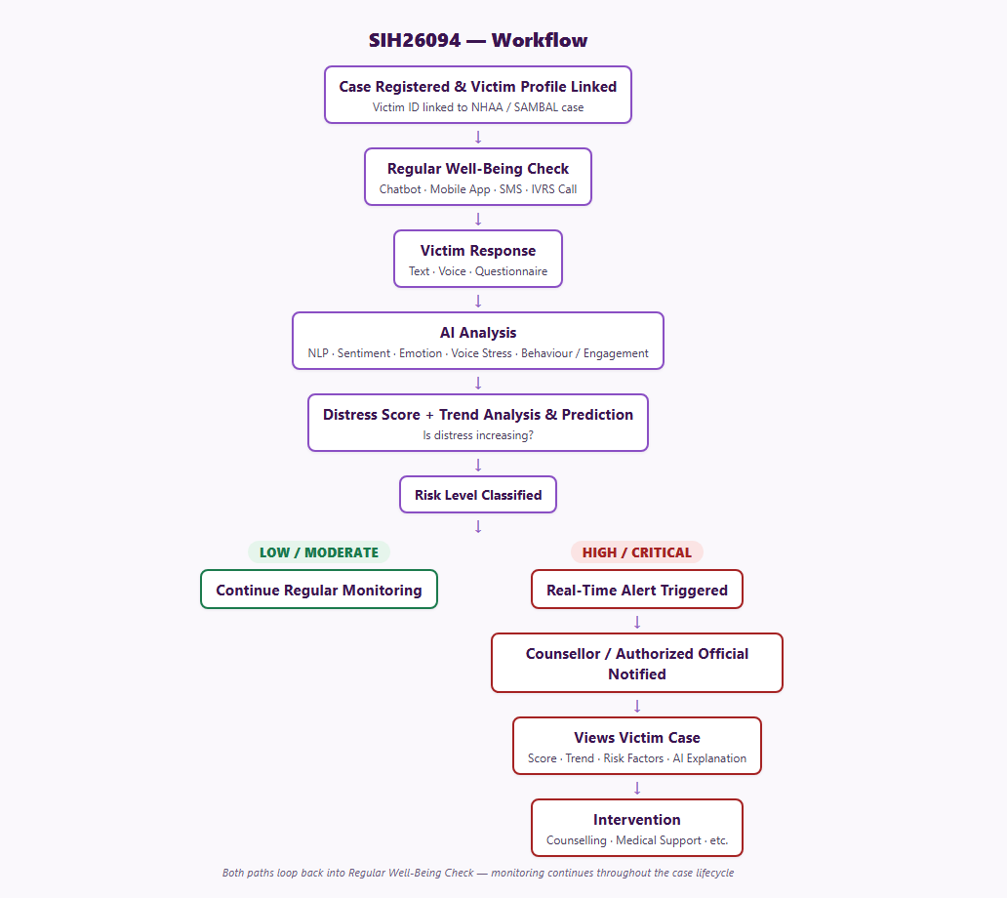
TECHNICAL APPROACH
JAMMERZ
Tech Stack
  Client: React Native - one codebase, Mobile + Web
  Backend: Node.js + Express
  Platform: Supabase - Postgres, Auth, Storage, Realtime
  AI: Gemini (chat/sentiment) + Google Speech/Bhashini (ASR/TTS) + SpeechBrain (voice stress)
Backend AI Features
  AI response analysis → Distress Score Engine → history/trend → prediction → risk classification → automated case prioritisation

Slide 4
FEASIBILITY AND VIABILITY
JAMMERZ
Feasibility
  Mature, well-documented stack - React Native, Node, Supabase
  Pretrained SER models available today - no training needed
  Extends NHAA/SAMBAL + Tele-MANAS - not built from scratch
  One codebase → feature parity by design
Challenges
  No real victim data available (ethically/legally)
  Voice-stress models trained on English - India-language gap
  Highly sensitive data - privacy/security risk
  False positive/negative risk in crisis prediction
Strategies to Overcome
  Validate on public datasets + synthetic personas
  Human-in-the-loop - AI recommends, never auto-acts
  DPDP-compliant architecture from day one

Slide 5
IMPACT AND BENEFITS
JAMMERZ
Impact
  Closes the crisis-detection gap - flags distress weeks earlier
  Strengthens victim trust in the justice system
  Gives policymakers real visibility at scale
  Improves welfare / counselling / law-enforcement coordination
Benefits
  Victims: multilingual, voice-first - reaches rural/semi-literate users
  Counsellors: automated prioritisation + AI case-note copilot
  MoSJE: reuses existing infra - faster, cheaper rollout
  Protects highly sensitive data by design

Slide 6
RESEARCH AND REFERENCES
JAMMERZ
Government Systems Referenced
  PIB - 14566: National Helpline Against Atrocities - pib.gov.in
  NHAA / SAMBAL portal - nhapoa.dosje.gov.in
  Tele-MANAS official portal, MoHFW - telemanas.mohfw.gov.in
  SC/ST (Prevention of Atrocities) Act, 1989 - ncsk.nic.in
  Witness Protection Scheme, 2018 - IJLMH
Research and Case Studies
  India's Tele-MANAS: evolution, early outcomes - BJPsych / Cambridge Core
  Tele-MANAS callers turning to humans after AI falls short - Vision IAS / The Hindu
  Speech Emotion Recognition in Mental Health: Systematic Review - JMIR, 2025
  AI-Powered Holistic Mental Health Monitoring - ResearchGate, 2025
  Crisis Text Line - Detecting Crisis: An AI Solution - ~85-90% severe-risk detection from text alone

