Slide 1
VertexArc
PDF Question & Answer Application
Ask questions about any PDF — answered only from the document.
Developer Evaluation Task · June 2026
Retrieval-Augmented Generation · Streamlit · OpenAI

Slide 2
OVERVIEW
What we built
A document-based Q&A web app: upload a PDF, get an instant summary, and ask natural-language questions. Every answer is grounded strictly in the uploaded document using a Retrieval-Augmented Generation (RAG) pipeline.
9
1
functional requirements met
independent session per document
5
2
recent Q&A pairs shown
export formats (TXT, PDF)
VertexArc PDF Q&A
2 / 10

Slide 3
PROBLEM
The problem we solve
Information is buried
1
Key facts live inside long PDFs — contracts, reports, manuals. Reading all of it to find one answer is slow.
Generic chatbots hallucinate
2
They answer from broad training data and may invent facts not present in your document.
No source of truth
3
Users need answers tied to their own document, with a clear signal when the answer simply isn't there.
VertexArc PDF Q&A
3 / 10

Slide 4
OBJECTIVES
What the app must do
✓
Upload a PDF and ask questions via an intuitive chat interface
✓
Answer using only the uploaded document as context
✓
Keep an independent session & index per document
✓
Auto-summarise on upload; show recent history
✓
Handle out-of-document questions gracefully
✓
Export conversations; work on desktop & mobile
VertexArc PDF Q&A
4 / 10

Slide 5
APPROACH
How RAG keeps answers honest
01
02
03
04
Extract & chunk
Embed & index
Retrieve
Answer or decline
→
→
→
PDF text is split into overlapping, page-tagged chunks.
Each chunk becomes a vector in an in-memory index.
The question is matched to top-K chunks by cosine similarity.
The model answers only from those chunks — or says it can't.
If confidence is below a floor, the app returns a clear "not found in this document" message instead of guessing.
VertexArc PDF Q&A
5 / 10

Slide 6
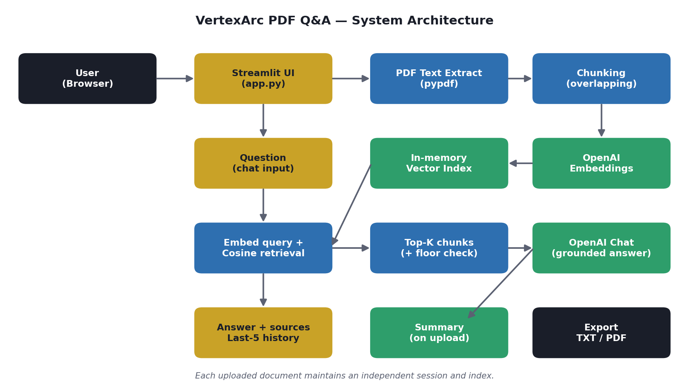
ARCHITECTURE
System architecture
Single Streamlit app · four modules: PDF processing, RAG engine, exporters, configuration.
VertexArc PDF Q&A
6 / 10

Slide 7
STACK
Technology & data model
Technology stack
Data model — stateless, no external DB
UI & backend | Streamlit
PDF parsing | pypdf
Embeddings | text-embedding-3-small
Answering | gpt-4o-mini
Vector math | NumPy
Hosting | Streamlit Cloud
Document session
doc hash, name, page text
Vector index
chunk, page, embedding (in-memory)
Chat history
question, answer, source pages
Summary
generated summary text
All data lives in the user's session — simple to host, nothing sensitive stored server-side.
VertexArc PDF Q&A
7 / 10

Slide 8
PRODUCT
Workflow & key features
User workflow
Key features
Context-only answers (no hallucination)
Independent session per document
Automatic document summary
Graceful "not found" handling
Conversation export (TXT / PDF)
Responsive desktop & mobile UI
1
Upload a PDF
2
Auto-summary appears
3
Ask a question
4
Get a grounded answer + source pages
5
Review last 5 Q&As
6
Export as TXT or PDF
VertexArc PDF Q&A
8 / 10

Slide 9
DEMO
Application screenshots
Home screen
PDF upload
Chat interface
Document summary
Export
Replace placeholders with live screenshots before submission.
VertexArc PDF Q&A
9 / 10

Slide 10
FUTURE & CONCLUSION
Built to extend
OCR for scanned PDFs
Persistent vector store (FAISS / pgvector)
Multi-document querying & in-PDF citations
User accounts & saved chats
Streaming answers & model selection
In summary
A complete, deployable PDF Q&A solution that meets all nine requirements, stays faithful to the source document, and uses a pragmatic, easy-to-host architecture — delivered with responsible AI-assisted development.
Thank you · VertexArc Developer Evaluation

