Slide 1

SMART INDIA HACKATHON 2026
TITLE PAGE
Problem Statement ID – 26167
Problem Statement Title- SatQuery AI: An Interactive Vision-Language Assistant for Multimodal Remote Sensing Image Analysis through Text Queries
Theme- Space Technology
PS Category- Software
Team ID- (as registered on portal)
Team Name (Registered on portal)- Lunar Circle

Slide 2
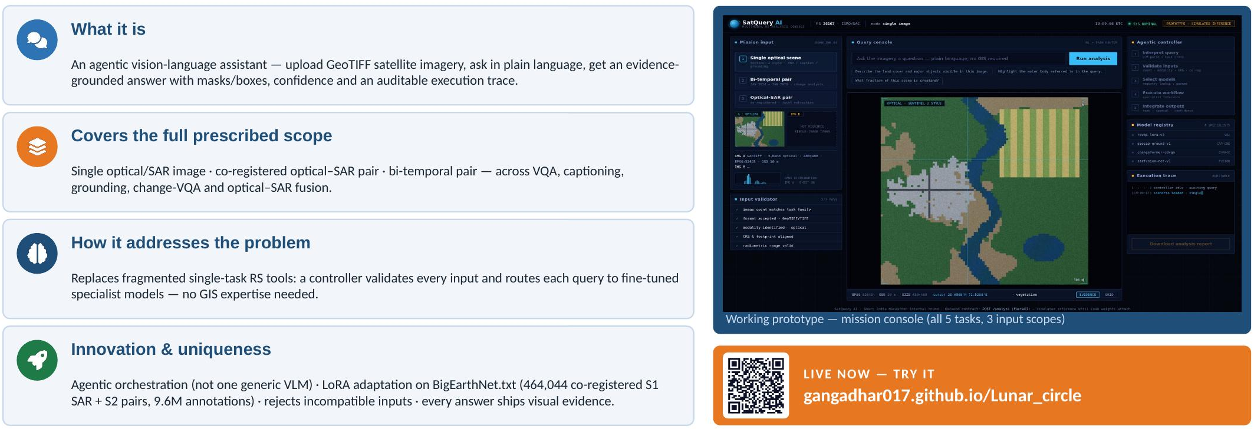
SatQuery AI
Lunar Circle
Proposed Solution (Describe your Idea/Solution/Prototype)

Slide 3
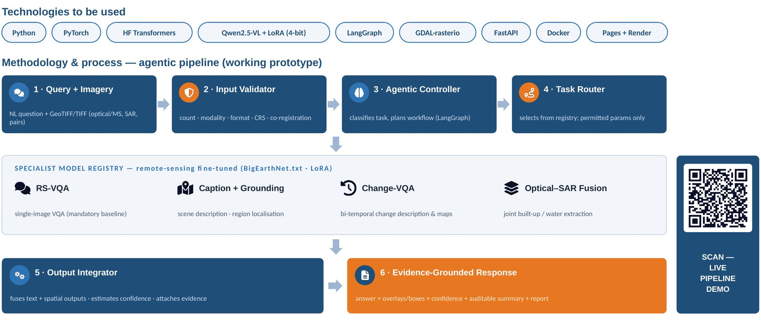
TECHNICAL APPROACH
Lunar Circle

Slide 4
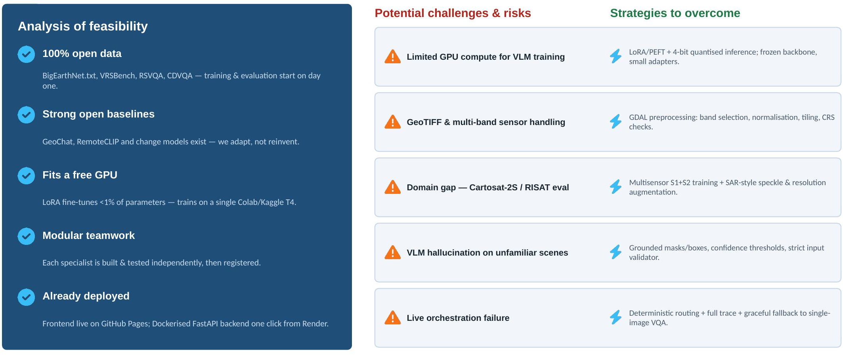
FEASIBILITY AND VIABILITY
Lunar Circle

Slide 5
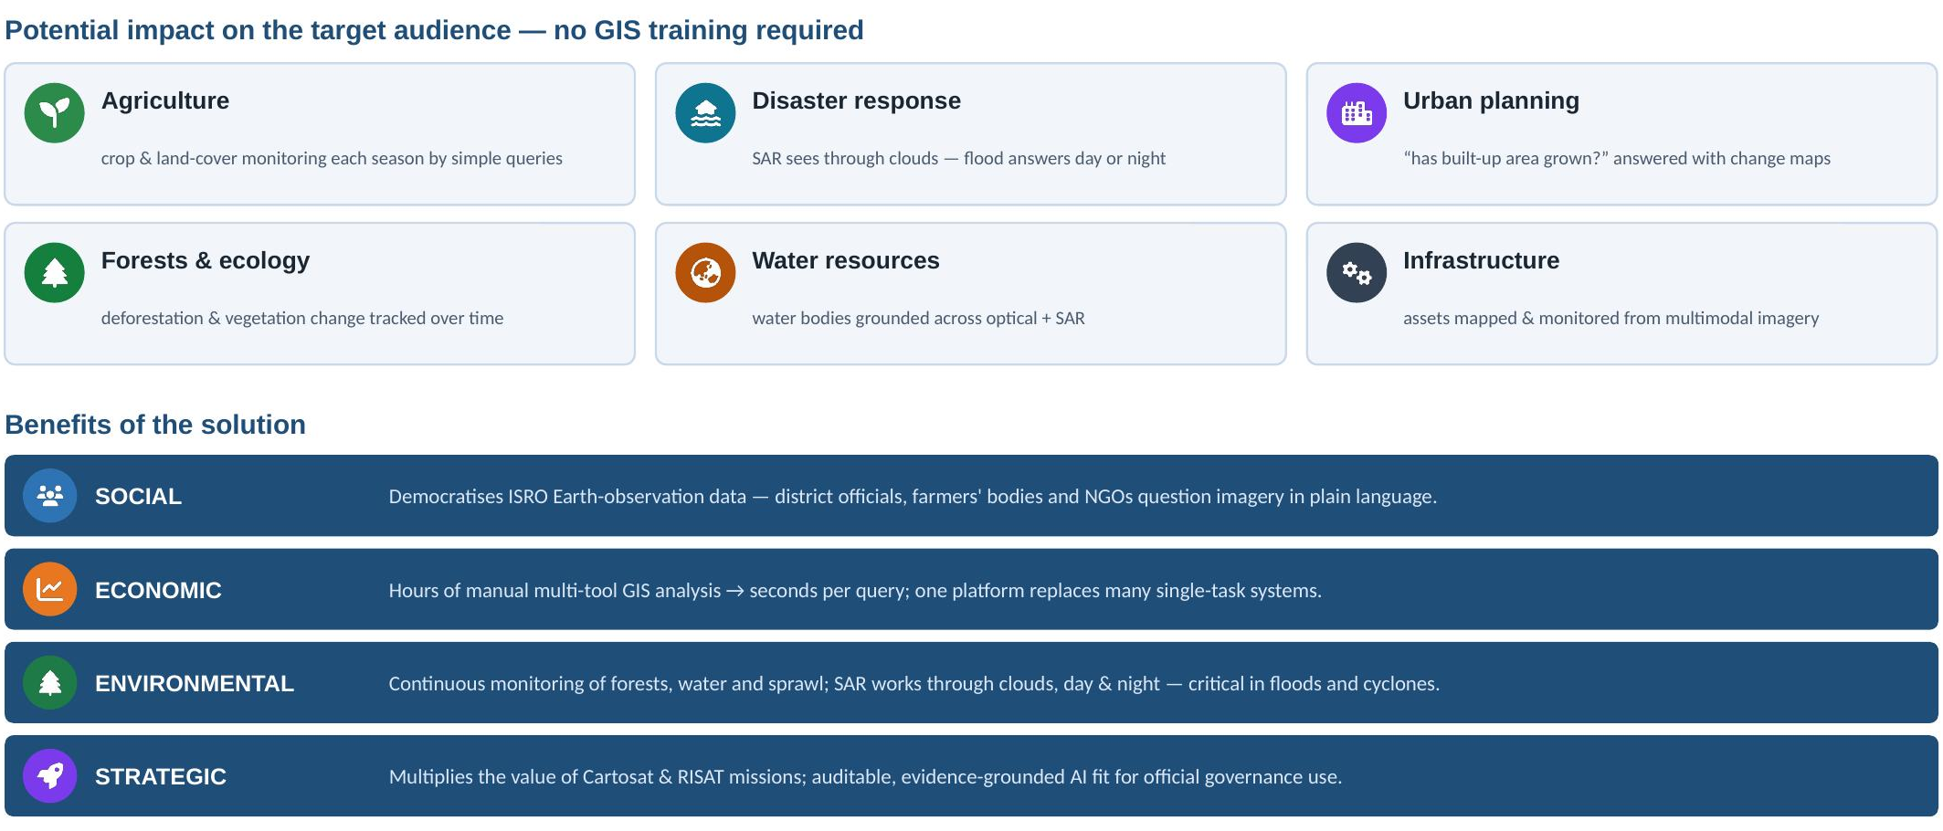
IMPACT AND BENEFITS
Lunar Circle

Slide 6
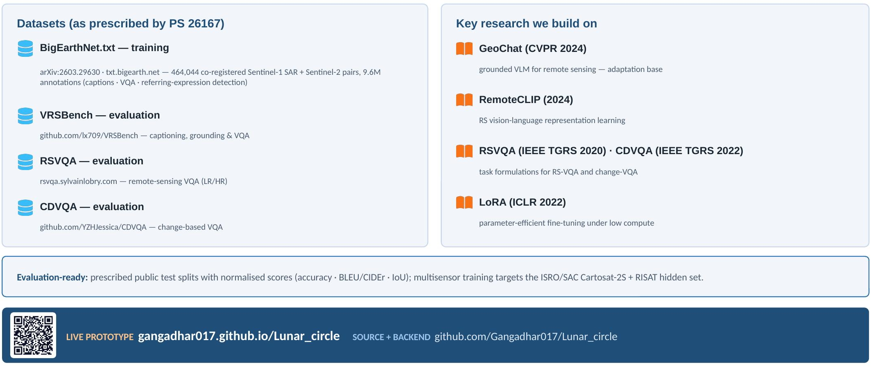
RESEARCH AND REFERENCES
Lunar Circle

