Slide 1



SMART INDIA HACKATHON 2026 — INTERNAL ROUND
SatQuery AI
An Interactive Vision-Language Assistant for Multimodal
Remote Sensing Image Analysis through Text Queries
Ask satellites questions in plain language. An agentic AI routes each query to fine-tuned remote-sensing specialist models across optical, SAR and multi-temporal imagery — and answers with visual evidence.
PS ID
ORGANIZATION
THEME
CATEGORY
26167
ISRO / SAC
Space Technology
Software
Team LUNAR CIRCLE
LIVE DEMO — SCAN OR VISIT
gangadhar017.github.io/Lunar_circle

Slide 2




The Problem
Satellite imagery is everywhere — the expertise to question it is not
Fragmented single-task tools
WHAT PS 26167 DEMANDS
Today's RS AI ships as isolated apps — one for classification, one for detection, one for change. Users must know sensors, GIS workflows and model selection just to ask a question.
Single-image VQA + one more task (caption or grounding)
Bi-temporal change description / change-VQA
Answers live across images
Co-registered optical–SAR joint extraction
Operational questions often need more than one optical image: SAR sees structure through clouds day & night; change needs two dates; optical + SAR together beat either alone.
Agentic model & tool orchestration
RS fine-tuning (BigEarthNet.txt)
Generic VLMs fall short
GeoTIFF I/O + input compatibility checks
Off-the-shelf LLMs/VLMs aren't adapted to RS imagery, sensor physics or domain terminology — the PS explicitly rules out an unadapted generic model.
Evidence, confidence & auditable trace
SatQuery AI answers all of it through one natural-language console — already live in prototype.
SatQuery AI · PS 26167 · Smart India Hackathon — Internal Round
02

Slide 3







Proposed Solution
One assistant, every satellite question — no GIS expertise required
INNOVATION & UNIQUENESS
THE PROBLEM WE SOLVE
Remote-sensing AI today is fragmented into single-task tools that demand expertise in sensors, GIS workflows and model selection. Real questions often need multiple images — optical + SAR, or two dates — which generic VLMs cannot reason over reliably.
Agentic, not generic
True RS adaptation
A controller selects, sequences and executes fine-tuned RS specialist models per query — instead of one generic VLM guessing at everything.
Vision-language backbone fine-tuned (LoRA) on BigEarthNet's co-registered Sentinel-1 SAR + Sentinel-2 multispectral imagery.
OUR IDEA
Natural-language front end — upload GeoTIFF/TIFF imagery, ask a question, get an evidence-grounded answer.
Agentic controller interprets the query, validates inputs and routes to the right specialist model automatically.
Multi-image reasoning
Trustworthy by design
Handles all three prescribed scopes: single image, co-registered optical–SAR pair, bi-temporal pair.
Change description & change-VQA over bi-temporal pairs, plus optical–SAR fusion that extracts complementary information.
Grounded masks/boxes as proof, confidence estimates, and an auditable trace of task, models and parameters — as the PS demands.
Every answer ships with visual evidence, confidence and an auditable execution trace.
SatQuery AI · PS 26167 · Smart India Hackathon — Internal Round
03

Slide 4
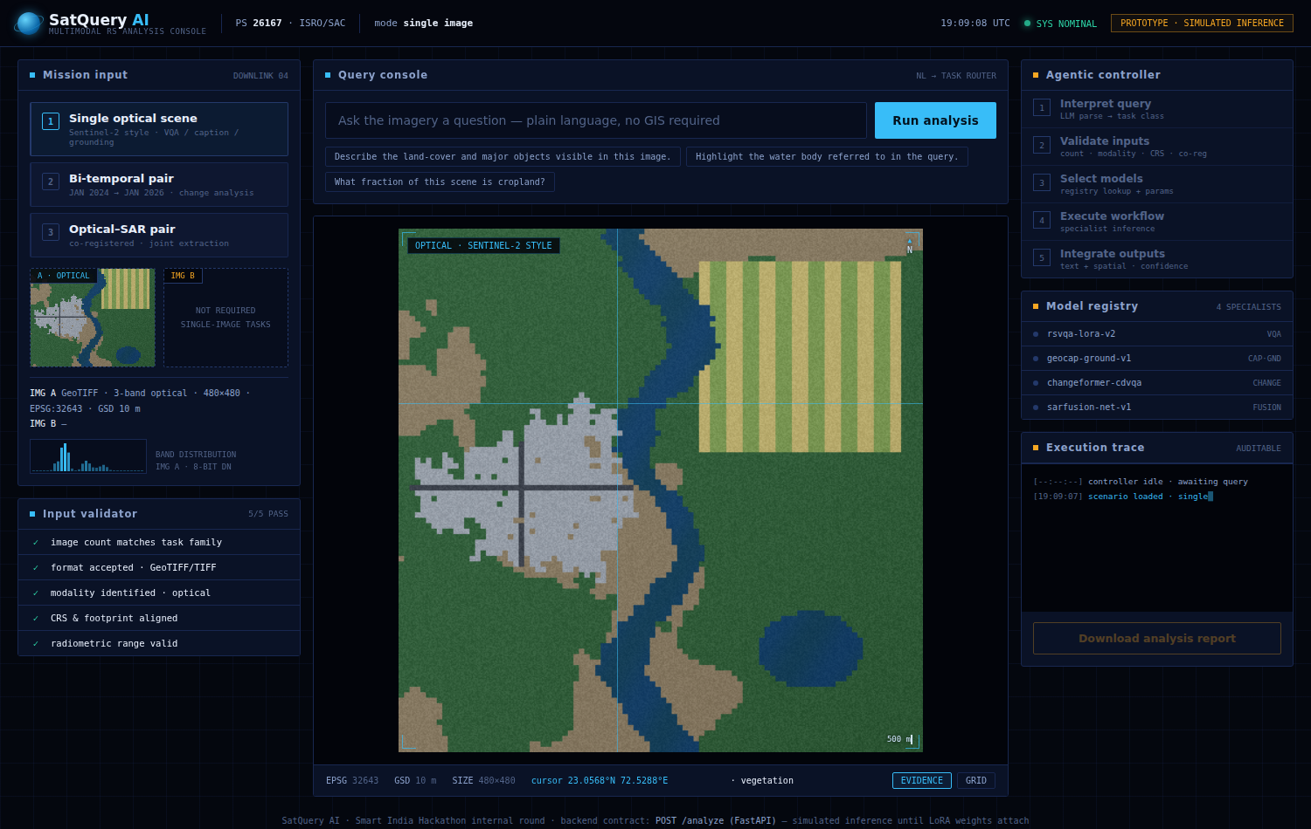
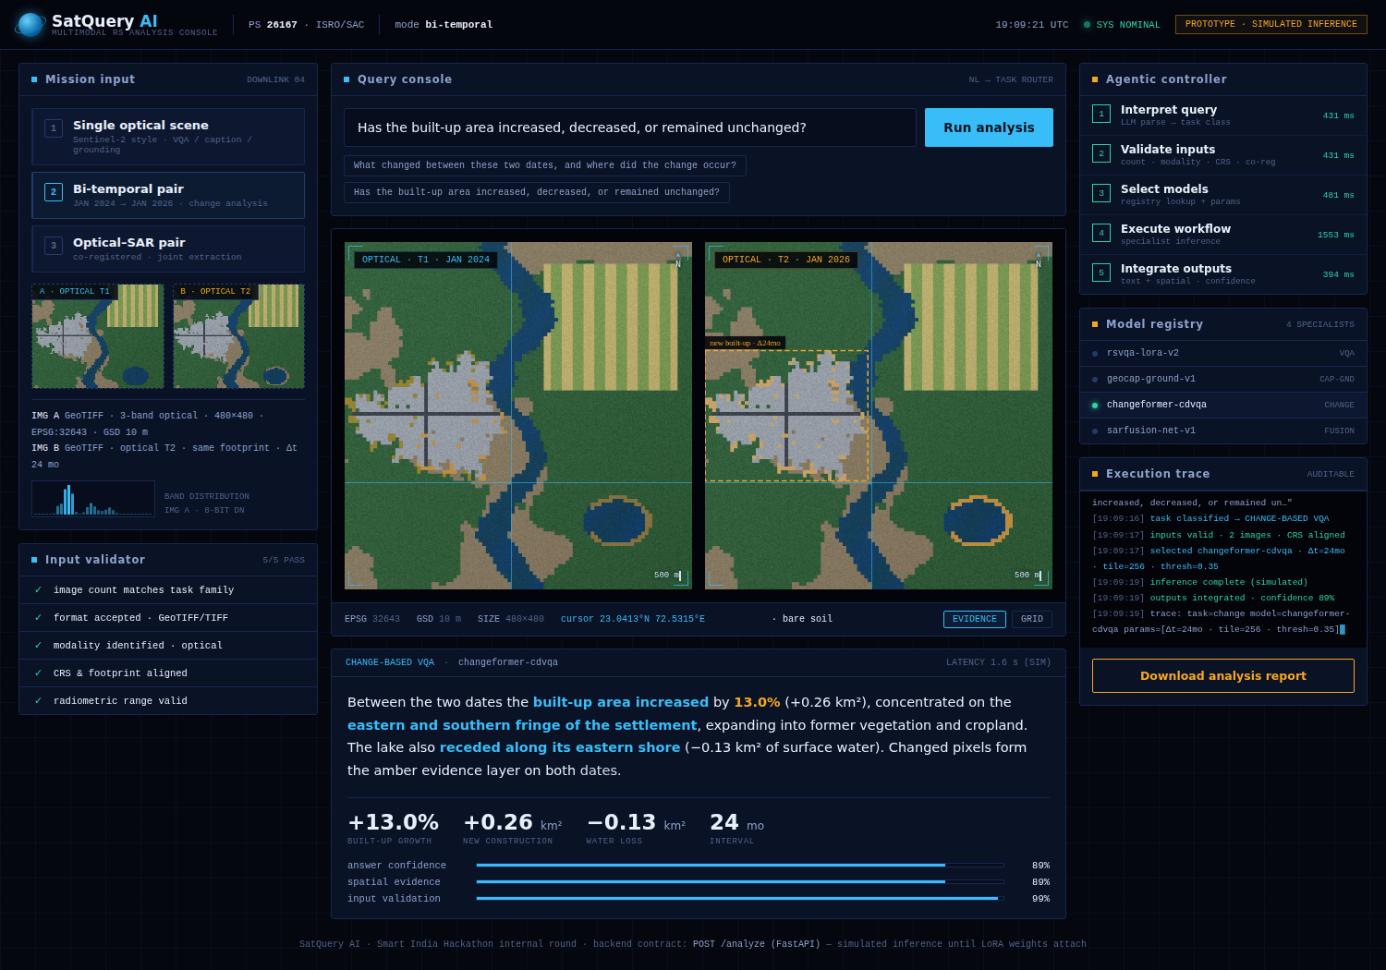
Live Prototype — Deployed Today
Not a mockup: the mission console is public, and the agentic FastAPI backend is Dockerised & API-ready
Single-image console · live cursor georeferencing
Bi-temporal change analysis · evidence + execution trace
TRY IT NOW gangadhar017.github.io/Lunar_circle CODE github.com/Gangadhar017/Lunar_circle
SatQuery AI · PS 26167 · Smart India Hackathon — Internal Round
04

Slide 5







Technical Approach
Query in — evidence-grounded answer out, through an agentic pipeline
1 · Query + Imagery
2 · Input Validator
3 · Agentic Controller
4 · Task Router
NL question with GeoTIFF/TIFF — optical/MS, SAR, or image pairs
Checks count, modality, format, metadata & co-registration
Classifies the task and plans the tool workflow (LangGraph)
Selects models from registry; sets only permitted parameters
SPECIALIST MODEL REGISTRY — remote-sensing fine-tuned (BigEarthNet · LoRA/PEFT)
RS-VQA
Caption + Grounding
Change-VQA
Optical–SAR Fusion
Single-image visual question answering (mandatory baseline)
Scene description & text-guided region localisation
Bi-temporal change description, change QA & change maps
Joint extraction: built-up, water & structure from both sensors
5 · Output Integrator
6 · Evidence-Grounded Response
Fuses textual + spatial outputs, estimates confidence, attaches evidence
Answer + overlays/boxes + confidence + auditable execution summary + downloadable report
STACK
PyTorch
HF Transformers
Qwen2.5-VL / GeoChat
LoRA / PEFT
LangGraph
GDAL · rasterio
FastAPI
React
Docker
SatQuery AI · PS 26167 · Smart India Hackathon — Internal Round
05

Slide 6
Agentic Orchestration
Every response is auditable: task, models, permitted parameters and outputs — exactly what the PS evaluates
1 · Interpret
2 · Validate
3 · Select
4 · Execute
5 · Audit
Query parsed; task classified into VQA / caption / grounding / change / fusion
Count, modality, format, CRS & co-registration checked before anything runs
Specialist chosen from registry; only permitted parameters configured
Workflow runs; spatial + textual outputs collected with confidence
Execution summary logged: task · models · params · trace
EXECUTION TRACE — CAPTURED FROM THE LIVE PROTOTYPE
It refuses when it should
[19:09:16] query: "Has the built-up area increased…"
[19:09:16] task classified -> CHANGE-BASED VQA
[19:09:17] inputs valid · 2 images · CRS aligned
[19:09:17] selected changeformer-cdvqa · Δt=24mo · tile=256 · thresh=0.35
[19:09:19] inference complete · outputs integrated · confidence 89%
[19:09:19] trace: task=change model=changeformer-cdvqa params=[Δt=24mo · tile=256]
Ask a change question with only one image and the validator rejects execution before any model runs — then tells the user what input is missing. Compatibility checking isn't a checkbox for us; it's demonstrable behaviour in the live demo.
VALIDATION FAILED · requires a bi-temporal pair
SatQuery AI · PS 26167 · Smart India Hackathon — Internal Round
06

Slide 7

Remote-Sensing Adaptation
BigEarthNet.txt (arXiv:2603.29630) — the prescribed dataset, and a perfect match for the ISRO/SAC evaluation
464,044
9.6M
3
CC-BY
CO-REGISTERED S1 + S2 PAIRS
TEXT ANNOTATIONS
ANNOTATION TYPES
OPEN LICENSE
EACH ANNOTATION STREAM TRAINS ONE OF OUR SPECIALISTS
Geographically anchored captions
LULC classes, spatial relations, environmental context
geocap-ground-v1 · captioning
VQA pairs across task types
Question–answer supervision on real S1/S2 patches
rsvqa-lora-v2 · single-image VQA
Referring-expression detection
Text instructions with bounding-box targets
geocap-ground-v1 · grounding head
TRAINING PLAN Qwen2.5-VL-7B backbone · 4-bit NF4 quantisation · LoRA r=16 (<1% trainable params) · one adapter per specialist · fits a single free T4 GPU — script already in the repo (src/train/finetune_lora.py)
SatQuery AI · PS 26167 · Smart India Hackathon — Internal Round
07

Slide 8
Evaluation Plan
Built for the judging protocol: prescribed test splits, normalised scores, and the ISRO/SAC hidden set
BENCHMARK
TASK EVALUATED
METRICS
OUR SPECIALIST
VRSBench
Captioning · grounding · VQA
BLEU-4 / CIDEr · IoU@0.5 · accuracy
geocap-ground-v1 · rsvqa-lora-v2
RSVQA (LR/HR)
Single-image VQA
Answer accuracy
rsvqa-lora-v2
CDVQA
Change-based VQA (bi-temporal)
Answer accuracy
changeformer-cdvqa
BigEarthNet.txt bench
Manually verified in-domain split
Task-native metrics
all four
READY FOR THE ISRO/SAC HIDDEN SET
The final evaluation uses pre-georeferenced, co-registered Cartosat-2S optical + RISAT SAR pairs with undisclosed annotations. Our transfer strategy: multisensor S1+S2 adaptation (same optical+SAR pairing), SAR-style speckle & resolution augmentation, strict GDAL input validation, and normalised per-task scoring identical to the published protocol — no surprises on judging day.
SatQuery AI · PS 26167 · Smart India Hackathon — Internal Round
08

Slide 9


Feasibility & Viability
Buildable in hackathon time — every risk has a concrete mitigation
CHALLENGES → MITIGATIONS
WHY IT'S FEASIBLE
100% open data
Limited GPU compute for VLM training
LoRA/PEFT + 4-bit quantised inference; frozen backbone, small adapters per task.
BigEarthNet, VRSBench, RSVQA and CDVQA are all public — training and evaluation can start on day one.
GeoTIFF & multi-band sensor handling
GDAL/rasterio preprocessing layer: band selection, normalisation, tiling, CRS checks before models.
Strong open baselines
RS-tuned VLMs (GeoChat, RemoteCLIP) and change models exist; we adapt, not reinvent.
Domain gap — Cartosat-2S / RISAT eval data
Multisensor BigEarthNet adaptation + SAR-style augmentation & resolution jitter for transfer.
Parameter-efficient tuning
LoRA fine-tunes <1% of weights — trains on a single free/college GPU (Colab/Kaggle T4).
VLM hallucination on unfamiliar scenes
Grounded outputs (masks/boxes), confidence thresholds, validator rejects incompatible inputs.
Modular agentic design
Each specialist tool is built and tested independently, then registered — parallel teamwork.
Complex orchestration failing live
Deterministic task-routing rules + full execution trace; graceful fallback to single-image VQA.
SatQuery AI · PS 26167 · Smart India Hackathon — Internal Round
09

Slide 10








Impact & Benefits
Democratising India's satellite data — from expert-only pipelines to a question anyone can ask
Agriculture
Disaster Response
Urban Planning
Crop & land-cover monitoring by simple queries each season
SAR sees through clouds — flood & damage answers day or night
“Has built-up area increased?” answered with change maps
Forest & Ecology
Water Resources
Infrastructure
Deforestation and vegetation change tracked over time
Water bodies grounded & monitored across optical + SAR
Mapping & monitoring assets from multimodal imagery
SOCIAL
Non-experts — district officials, farmers' bodies, NGOs — extract insight from satellite imagery without GIS training, in natural language.
ECONOMIC
Cuts hours of manual multi-tool GIS analysis to seconds per query; one platform replaces many single-task systems — lower cost per insight.
STRATEGIC
Multiplies the value of ISRO's Cartosat & RISAT missions and EO archives; auditable, evidence-grounded AI fit for governance use.
SatQuery AI · PS 26167 · Smart India Hackathon — Internal Round
10

Slide 11
Roadmap to Finals
Half the system is already public — the rest has scripts waiting for GPU hours
SHIPPED — PUBLIC TODAY
FINALS SPRINT — 4 WEEKS
Mission console deployed on GitHub Pages (all 5 tasks, 3 input scopes, evidence overlays)
W1
LoRA fine-tune VQA + caption adapters on BigEarthNet.txt (Colab/Kaggle T4)
Agentic controller + GDAL validator + model registry — tested Python package in the repo
W2
Train grounding & change heads; wire adapters into the registry
FastAPI /analyze backend, Dockerised, Render blueprint, one-click deploy
W3
Benchmark on VRSBench / RSVQA / CDVQA prescribed splits; tune thresholds
Auditable execution trace + downloadable analysis reports
W4
Cartosat/RISAT domain hardening · load-test API · dry-run the full demo
LoRA fine-tuning & benchmark evaluation scripts (BigEarthNet.txt ready)
De-risked by design: the frontend, orchestration, validation and API contract are already proven — finals work is training weights and plugging them into an interface that exists.
SatQuery AI · PS 26167 · Smart India Hackathon — Internal Round
11

Slide 12


Research & References
Built on the exact datasets and evaluation plan prescribed by the problem statement
DATASETS (as prescribed)
KEY RESEARCH WE BUILD ON
BigEarthNet
GeoChat (CVPR 2024)
Primary fine-tuning — co-registered Sentinel-1 SAR + Sentinel-2 multispectral with text annotations (arxiv.org/abs/2603.29630)
Grounded VLM for remote sensing — base for adaptation
VRSBench
RemoteCLIP (2024)
Evaluation — single-image captioning, grounding & VQA
RS vision-language representation learning
RSVQA
RSVQA (TGRS 2020) & CDVQA (TGRS 2022)
Evaluation — remote-sensing visual question answering
Task formulations for RS-VQA and change-VQA
CDVQA
LoRA (ICLR 2022)
Evaluation — multitemporal change-based VQA
Parameter-efficient fine-tuning under low compute
LIVE DEMO gangadhar017.github.io/Lunar_circle SOURCE + DECK + BACKEND github.com/Gangadhar017/Lunar_circle
Team LUNAR CIRCLE
SatQuery AI · PS 26167 · Smart India Hackathon — Internal Round
12

