Slide 1

STARDUST Online Retail Management System
Chagganti Kiran Kumar Reddy
Suresh Jammu
Veldoj Sai Prakash
Gowlikar Rohith
Robbi Sai Yogesh
Koduru Gangadhar

Slide 2


Abstract of the project:
The Online Retail Management system lets the customers register and shop by searching the product based on category, brand, etc. In order to buy the product the customer should login to the system, search the product, add to cart and make the payment. On successful payment, customer receives the confirmation message of product.
· Manage Category
· Add, View and Delete category.
· Manage Sub Category
· Add, View and Delete sub category.
· Search a Product
· Add product to shopping cart
· Make payment
· Provide comments for a product.

Slide 3
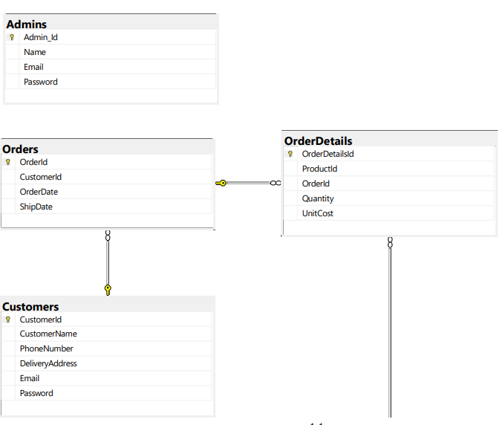
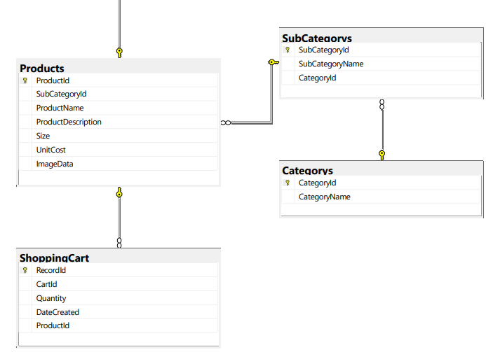
ER DIAGRAM

