Slide 1
Banking & Financial Data Analysis Project
SQL Commands & Syntax

Slide 2
Introduction
Analyzed customer, account, and transaction data to identify usage patterns, transaction trends, and operational insights.
Designed SQL queries to extract, join, and aggregate data from multiple tables for reporting and analysis.

Slide 3

Database Creation
CREATE DATABASE Banking_bi;
USE banking_bi;

Slide 4

Customer Table – SQL Syntax
CREATE TABLE customer_1 ( customer_id INT PRIMARY KEY,customer_name VARCHAR(100),gender VARCHAR(10),city VARCHAR(50),join_date DATE);

Slide 5
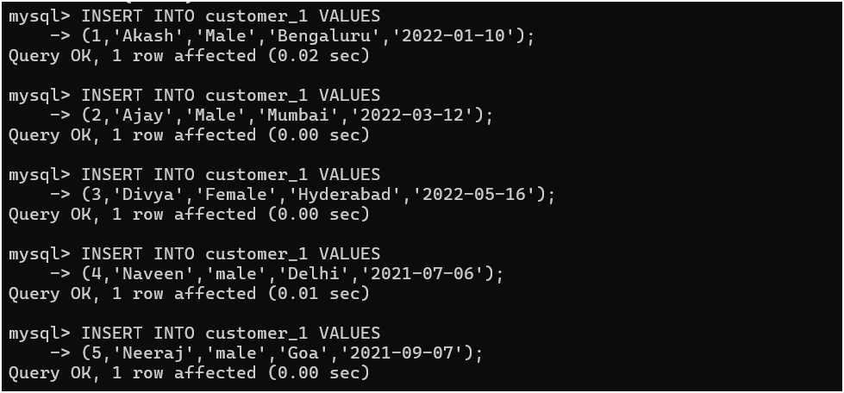
Insert Customer Data (DML)
INSERTINTOcustomer_1VALUES(1,'Akash','Male','Bengaluru','2022-01-10’);

Slide 6
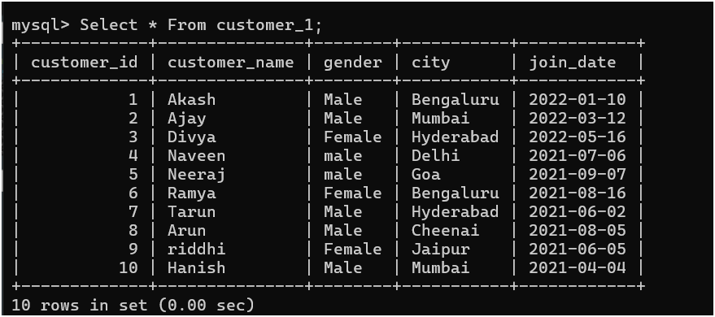
SELECT QUERIES
SELECT * FROM customer_1;

Slide 7
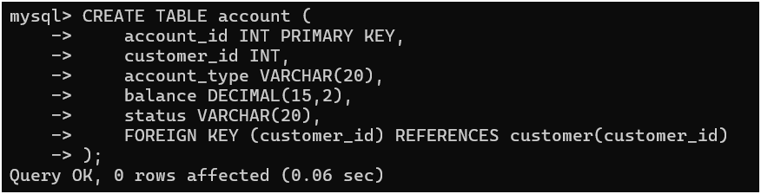
ACCOUNT TABLE
Syntax: CREATE TABLE account (account_id INT PRIMARY KEY,customer_id INT, account_type VARCHAR(20),balance DECIMAL(15,2),
status VARCHAR(20), FOREIGN KEY (customer_id) REFERENCES customer(customer_id));

Slide 8
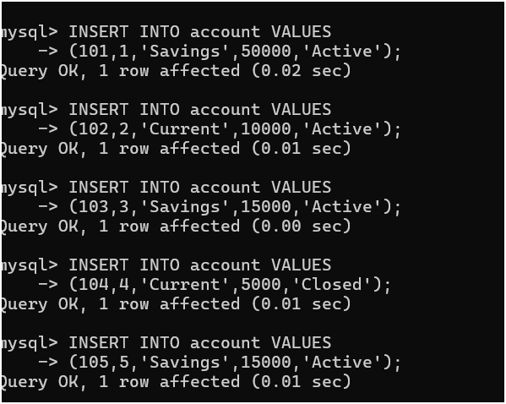
Insert AccountData
Syntax:INSERTINTOaccountVALUES101,1,'Savings',50000,'Active’);

Slide 9
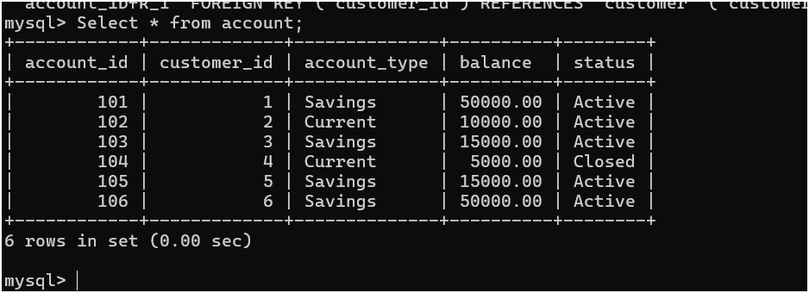
Select Queries
Syntax: Select * from account;

Slide 10
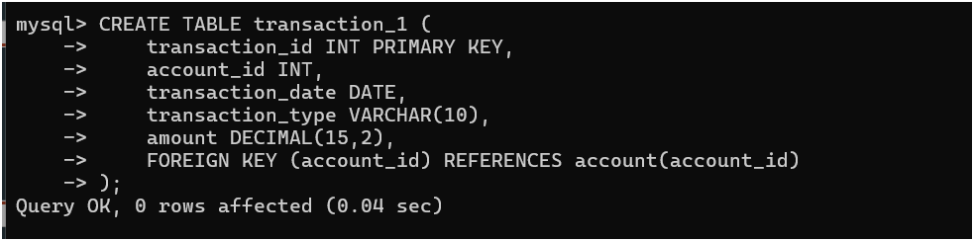
TRANSACTION TABLE
Syntax: CREATE TABLE transaction_1 (transaction_id INT PRIMARY KEY, account_id INT,transaction_date DATE, transaction_type VARCHAR(10), amount DECIMAL(15,2), FOREIGN KEY (account_id) REFERENCES account(account_id));

Slide 11
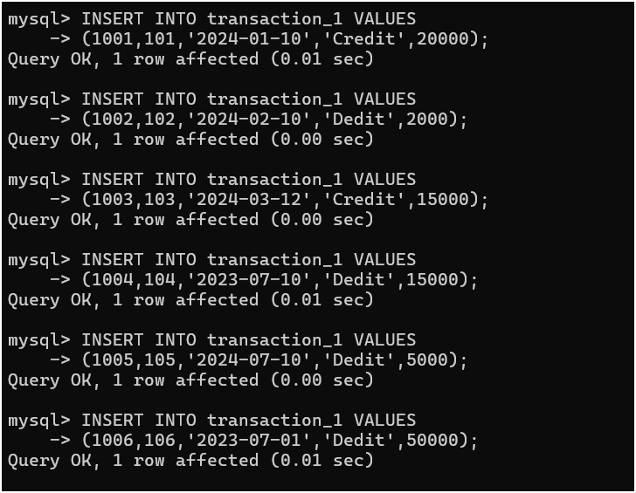
Insert Data
Syntax: INSERT INTO transaction_1VALUES(1001,101,'2024-01-10','Credit',20000);

Slide 12
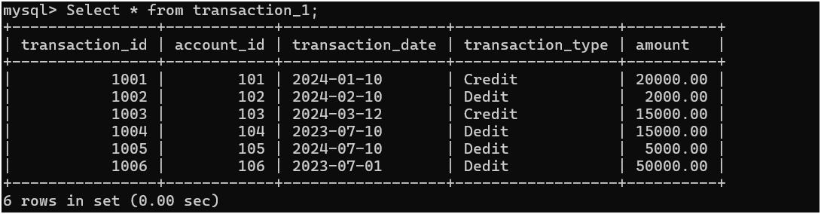
Select Queries
Select * from transaction_1;

Slide 13
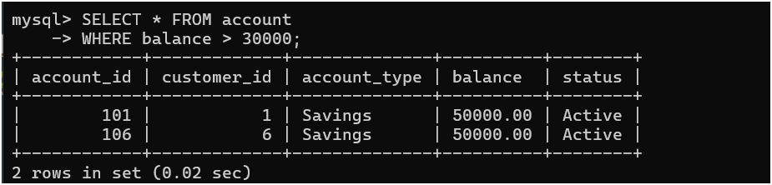
Filtering(Where Condition from Account )
Syntax:SELECT * FROM account WHERE balance > 30000;

Slide 14
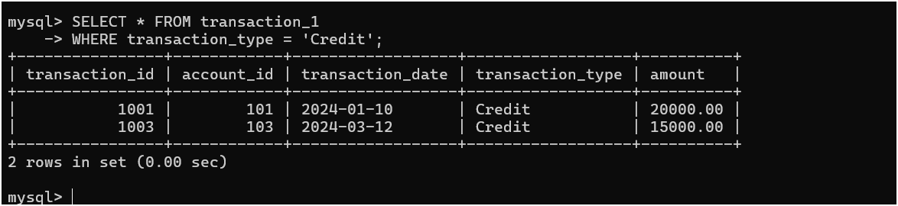
Filtering(Where Condition from transaction_1 )
Syntax: SELECT * FROM transaction_1WHERE transaction_type =‘Credit';

Slide 15
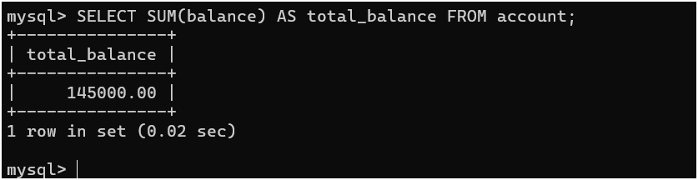
AGGREGATE FUNCTIONS
Syntax:SELECT SUM(balance) AS total_balance FROM account;

Slide 16
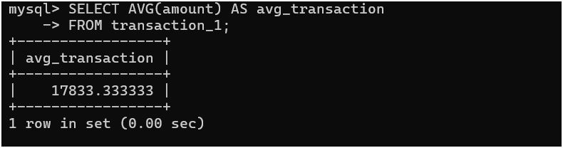
AGGREGATE FUNCTIONS
Syntax : SELECT AVG(amount) AS avg_transactionFROM transaction_1;

Slide 17
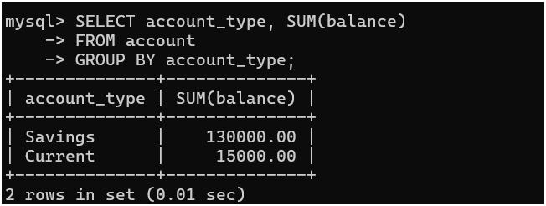
GROUP BY
SELECT account_type, SUM(balance)FROM account GROUP BY account_type;

Slide 18
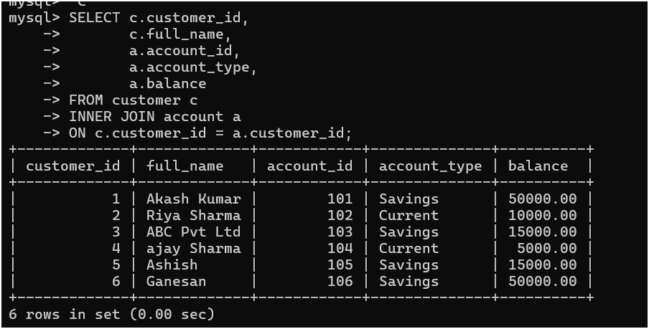
JOINS INNER JOINS
Syntax: SELECT customer_id, c.full_name,a.account_id,a.account_type,a.balanceFROM customer c
INNER JOIN account a ON C. customer_id = a. customer _id;

Slide 19
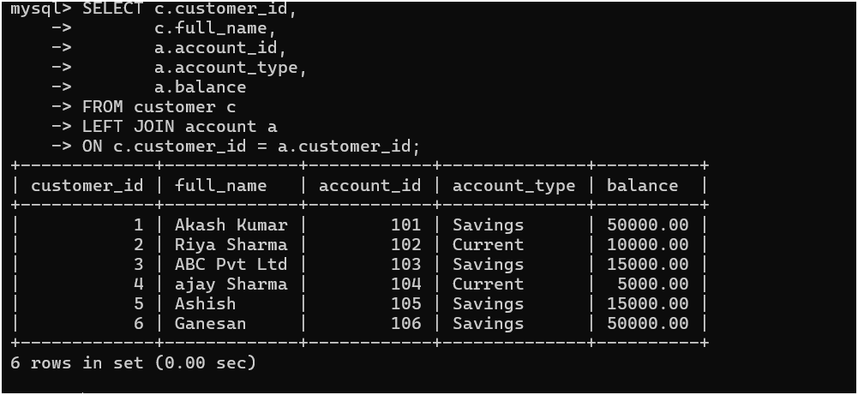
LEFT JOIN
SYNTAX : SELECT customer_id, c.full_name,a.account_id,a.account_type,a.balanceFROM customer c
LEFT JOIN account a ON customer_id = a.customer_id;

Slide 20
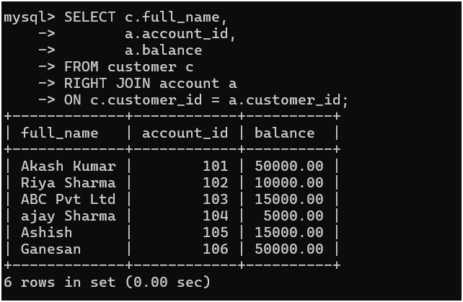
RIGHT JOINS
Syntax:SELECT c.full_name, a.account_id,a.balance FROM customer c RIGHT JOIN account a ON customer_id = a.customer_id;

Slide 21
FULL OUTER JOINS
SELECT c.customer_id,
c.full_name,
a.account_id,
a.account_type,
a.balance
FROM customer c
LEFT JOIN account a
ON c.customer_id = a.customer_id
UNION
SELECT c.customer_id,
c.full_name,
a.account_id,
a.account_type,
a.balance
FROM customer c
RIGHT JOIN account a
ON c.customer_id = a.customer_id;

Slide 22
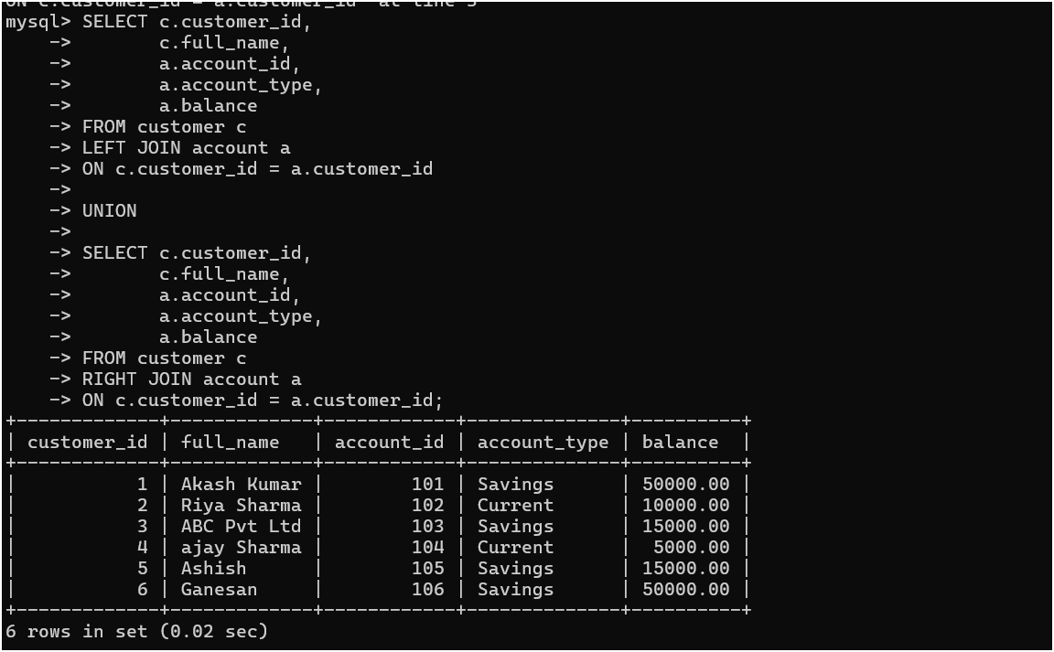

Slide 23
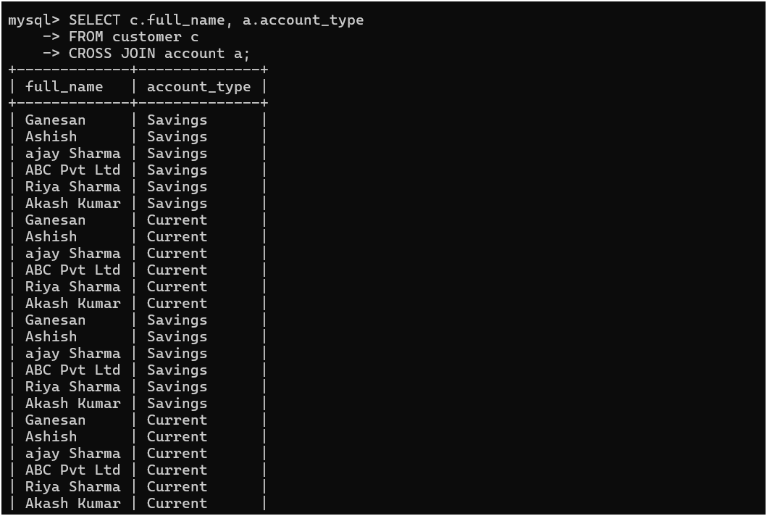
CROSS JOINS
SELECT c.full_name, a.account_type
-> FROM customer c
-> CROSS JOIN account a;

Slide 24
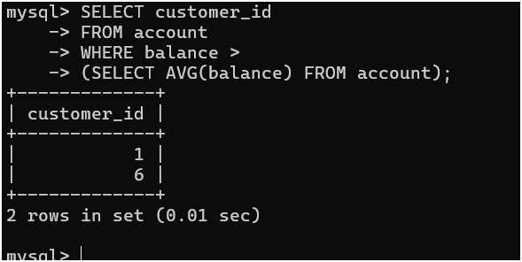
SUBQUERY
SELECT customer_id FROM account WHERE balance >(SELECT AVG(balance) FROM account);

Slide 25
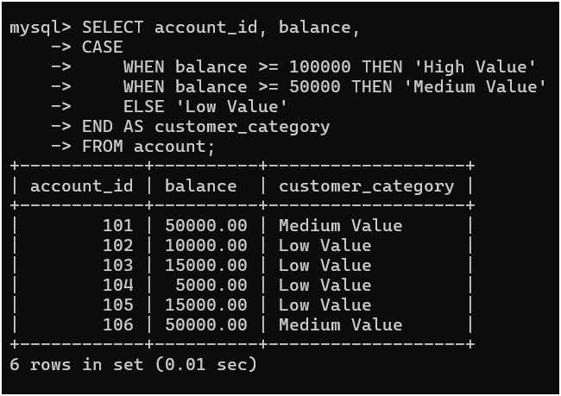
CASE STATEMENT
SELECT account_id, balance, CASE WHEN balance >= 100000 THEN 'High Value’ WHEN balance >= 50000 THEN 'Medium Value’ ELSE 'Low Value’ END AS customer_categoryFROM account;

Slide 26
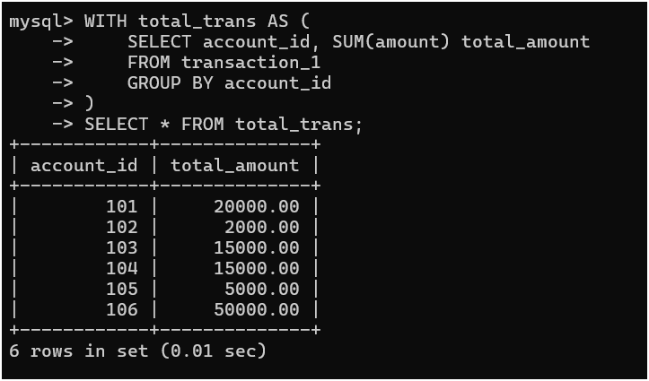
CTE (WITH CLAUSE)
WITH total_trans AS ( SELECT account_id, SUM(amount) total_amountFROM transaction_1GROUP BY account_id)
SELECT * FROM total_trans;

Slide 27
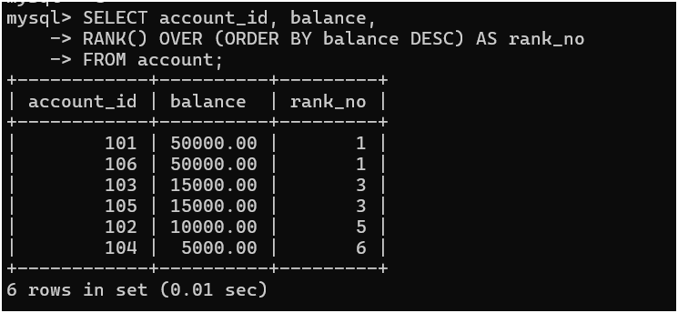
WINDOW FUNCTION
SELECT account_id, balance,
RANK() OVER (ORDER BY balance DESC) AS rank_no
FROM account;

Slide 28
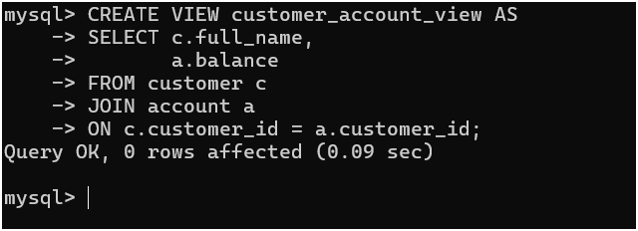
VIEW
CREATE VIEW customer_account_view ASSELECT c.customer_name, a.balance
FROM customer c JOIN account a ON c.customer_id = a.customer_id;

Slide 29
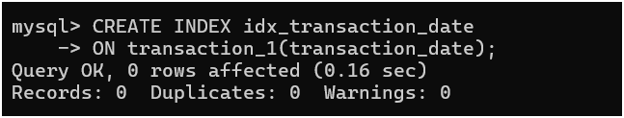
INDEX (PERFORMANCE)
CREATE INDEX idx_transaction_date
ON transaction_1(transaction_date);

Slide 30
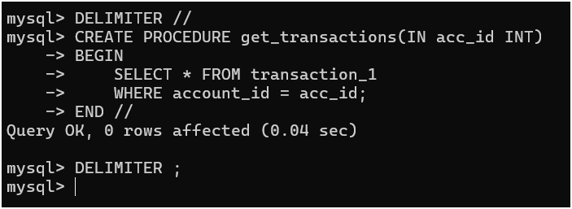
STORED PROCEDURE
DELIMITER //
CREATE PROCEDURE get_transactions(IN acc_id INT)
BEGIN
SELECT * FROM transaction_1
WHERE account_id = acc_id;
END //
DELIMITER ;

Slide 31
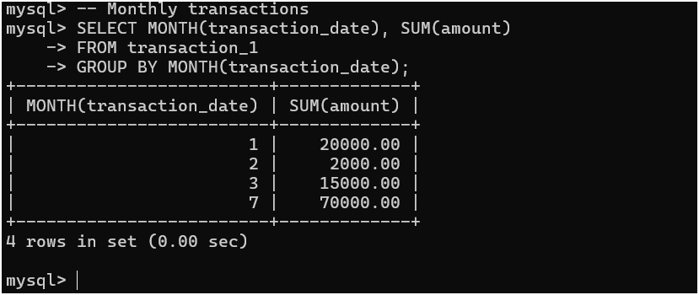
BUSINESS INSIGHTS
-- Monthly transactionsSELECT MONTH(transaction_date), SUM(amount)
FROM transaction_1GROUP BY MONTH(transaction_date);

Slide 32
Key SQL Concepts Covered
• DDL & DML
• Joins & Subqueries
• CTEs & Window Functions
• Views & Procedures

