Slide 1


Introduction to MLOps: Bridging ML and DevOps
Building Scalable and Efficient ML Pipelines
GANGADHAR S
Machine Learning Engineer
@Tiger Analytics, Bengaluru

Slide 2

Agenda:
Introduction to MLOps
What is MLOps
Why it is essential
MLOps Lifecycle
Data pipelines
ML pipelines
CI-CD pipelines
Deployment
Mini project

Slide 3
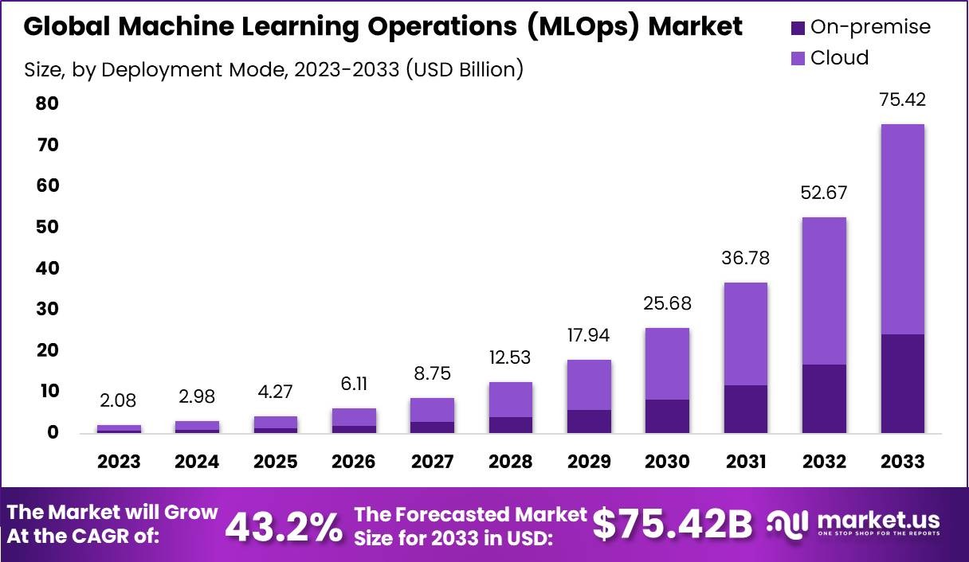

Slide 4
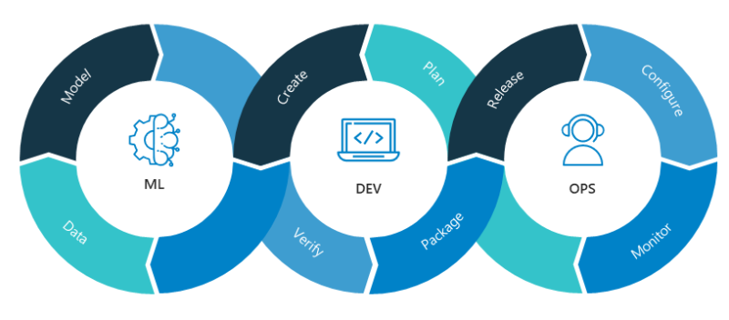
Unlocking the power of MLOps?
What is MLOps?
Bridging the gap between Machine Learning and Operational Excellence
85% of AI projects never make it to production. Let's explore how MLOps changes that.
What’s the point of building a great model if it never gets deployed?

Slide 5
Why do we need MLOps?
Challenges in Traditional Machine Learning Workflows
Manual deployment processes are time-consuming and error-prone.
Difficulties in collaboration between data scientists, engineers, and IT teams.
Lack of version control for data, code, and models.
Scalability Issues
Models work in experiments but fail to handle real-world production loads.
Monitoring and Maintenance Challenges
Deployed models degrade over time without proper monitoring.
Bridging the Gap
MLOps provides automation, scalability, and continuous integration/delivery (CI/CD) for ML projects.

Slide 6
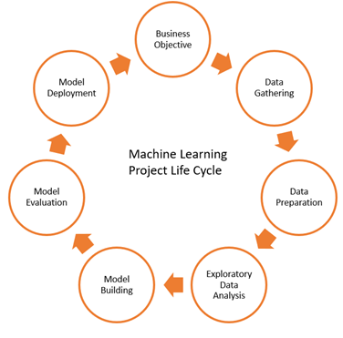
ML Lifecyle:

Slide 7
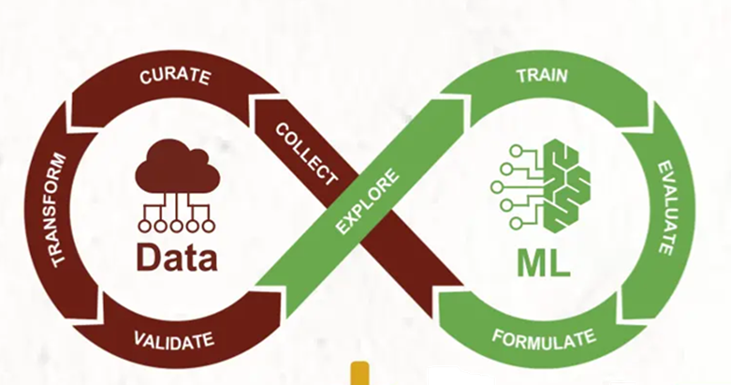
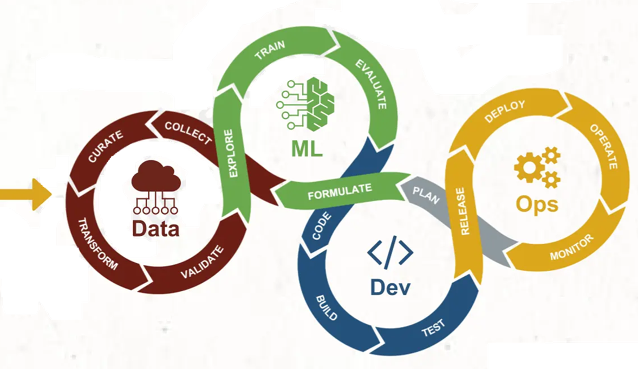
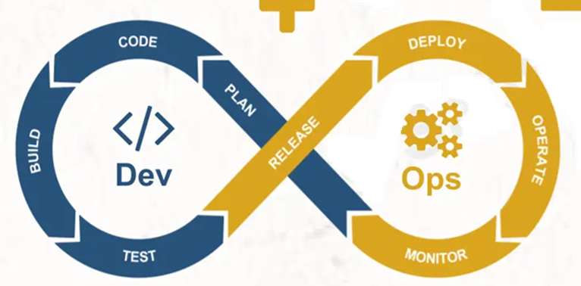
MLOps Lifecyle:
MLOps = DataML + DevOps

Slide 8
What Makes Up MLOps?
Data Management:
Versioning, cleaning, and pre-processing data.
Ensuring data quality and consistency across environments.
Model Development:
Collaborative experimentation with version control for models and code.
Tools like Git, MLFlow, or DVC for tracking changes.
CI/CD Pipelines:
Automating model training, validation, and deployment.
Integration of testing stages to ensure quality.
Monitoring and Logging:
Observing model performance in production.
Detecting drift in data or predictions.
Infrastructure Automation:
Managing resources like cloud storage, compute, and orchestration tools.
Tools like Kubernetes, Terraform, and Docker for scalability and reproducibility.

Slide 9
Essential Tools and Platforms for MLOps
Version Control and Collaboration:
Git: For source code and model versioning.
GitHub/GitLab/Bitbucket: Platforms for collaborative development and repository management.
Experiment Tracking:
MLflow: Tracks experiments, models, and metrics.
Weights & Biases: Provides experiment tracking, visualization, and collaboration features.

Slide 10
Essential Tools and Platforms for MLOps
Pipeline Orchestration:
Kubeflow: Kubernetes-native platform for deploying, monitoring, and managing ML models.
Apache Airflow: Manages complex workflows and data pipelines.
Azure Pipelines: Integrates with Azure DevOps for CI/CD automation.
Model Serving:
TensorFlow Serving: Serves TensorFlow models in production environments.
FastAPI/Flask: Lightweight frameworks to deploy custom APIs for model inference.
Seldon Core: Open-source platform for deploying and scaling machine learning models on Kubernetes.

Slide 11
Essential Tools and Platforms for MLOps
Containerization and Deployment:
Docker: Containers for packaging applications and dependencies.
Kubernetes: Orchestrates containerized applications for scalability and reliability.
Monitoring and Logging:
Prometheus: Collects and stores metrics for monitoring.
Grafana: Visualizes metrics and creates dashboards.
ELK Stack (Elasticsearch, Logstash, Kibana): Centralizes and analyzes logs.
Infrastructure as Code (IaC):
Terraform: Manages infrastructure through code for reproducibility.
Ansible: Automates configuration management and application deployment.

