Slide 1
Retail Sales Analytics Dashboard
From messy operational data to trusted business insight
Databricks → Microsoft Fabric → Power BI
Analysis of sales, products, stores and customers, with recommendations for the retailer
Notes:
Opening: this deck walks through the dashboard we built, what the data says, what problem it solves, and what a retailer could do next.

Slide 2
The problem: numbers nobody could trust
A retailer sells through stores, a website and a mobile app. Its data arrives in different formats and is dirty: duplicates, missing values, broken references and invalid amounts. Any report built straight on it would be wrong.
1
Six messy sources
Customers, products, stores, orders, order items and payments, in CSV and Parquet.
Questions the business needs answered
2
Known defects
How much are we selling, and how profitable is it?
Which products, stores and regions perform best?
Who are our customers and how much do they spend?
How healthy are operations: cancellations, returns, payment failures?
Duplicates, missing values, broken keys and negative amounts in 0.5% to 3% of rows.
3
No single view
No shared model, so sales, product, store and customer views cannot be compared.
Defect rates come from the documented data generator used to simulate a realistic retail feed.
Notes:
The core problem is trust. Before any dashboard is useful, the data underneath has to be cleaned and modelled so that everyone gets the same answer.

Slide 3
What we built: raw data to dashboard
Raw data
Bronze
Silver
Gold
Fabric
Power BI
6 tables, CSV and Parquet
Stored as received, with lineage
Cleaned; bad rows quarantined
Star schema for analysis
Lakehouse and semantic model
4 pages, 7 measures
94,277
49,697
0
raw rows processed
clean sales lines in the fact table
failed quality checks after cleaning
Built and run on Databricks Free Edition and a Microsoft Fabric trial; Power BI report built in Fabric.
Notes:
Bronze keeps data as received, Silver cleans and validates, Gold is the analysis-ready star schema. Fabric and Power BI sit on top.

Slide 4
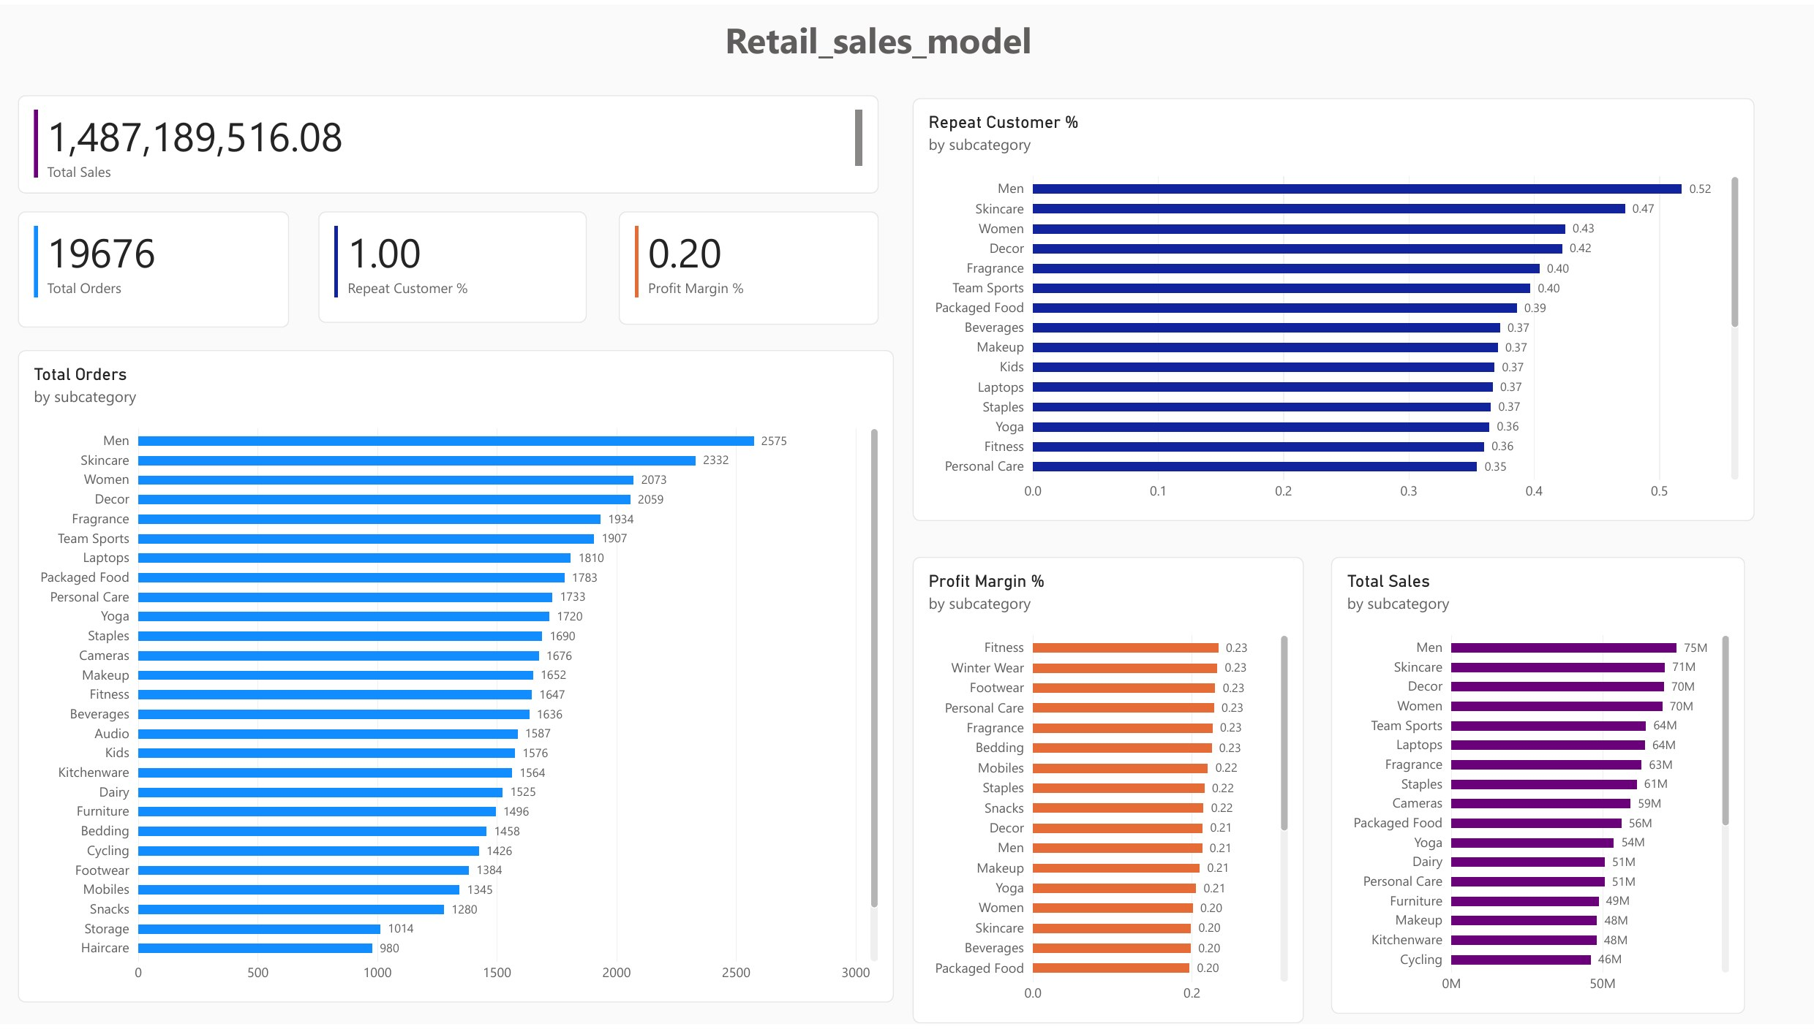
Executive Overview: $1.49B at a 20% margin
What the page shows
1
Total sales of $1,487M from 19,676 orders, at a 20% profit margin.
2
Subcategories are close: Men leads with $75M, then Skincare $71M and Decor $70M.
3
Repeat Customer % reads 1.00 because each customer placed about 10 orders in this dataset.
Real report page exported from the Power BI dashboard
Data: synthetic retail dataset (dev scale, 49,697 sales lines). Figures illustrate the pipeline, not a real retailer.
Notes:
Headline KPIs. The repeat-customer figure is an artefact of the data volume: 2,000 customers and about 19,800 orders.

Slide 5
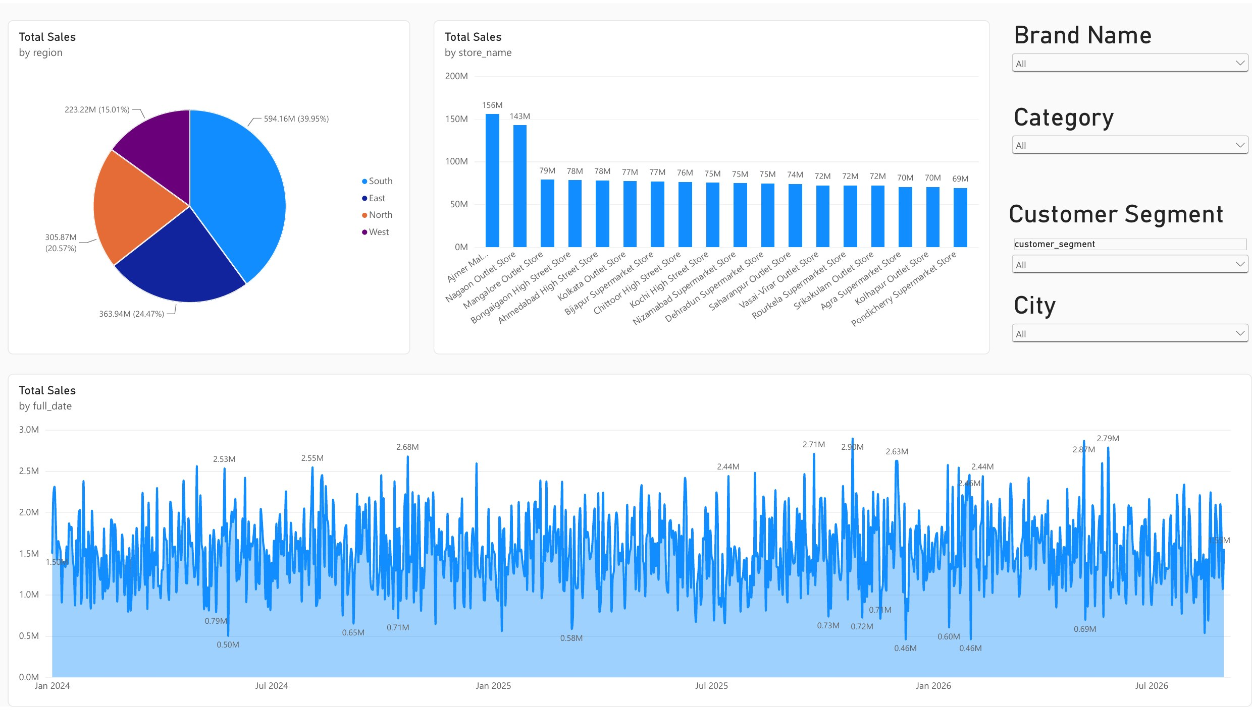
Sales Analysis: revenue follows store count
What the page shows
1
South earns 40% of sales ($594M) because it has 8 of the 20 stores. Per store, all regions earn $73M to $77M.
2
Daily sales swing between about $0.5M and $2.9M with no clear trend or seasonality.
3
Two bars look double size: Ajmer Mall and Nagaon Outlet are each two stores sharing one name.
Real report page exported from the Power BI dashboard
Data: synthetic retail dataset (dev scale, 49,697 sales lines). Figures illustrate the pipeline, not a real retailer.
Notes:
Region and store-type differences come from how many stores each has, not from stronger stores. The double-height bars are a dashboard flaw: store_name is not unique, so two store IDs were merged.

Slide 6
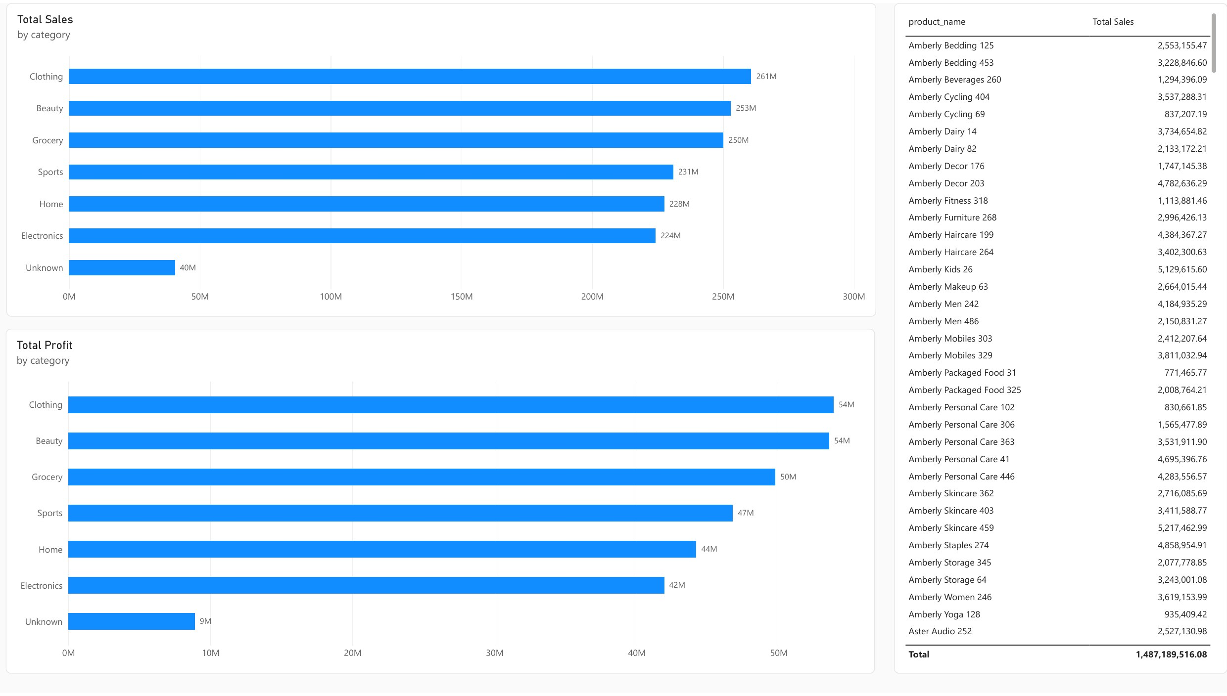
Product Analysis: Electronics earns least
What the page shows
1
Clothing, Beauty and Grocery each bring in about $250M to $261M.
2
Profit margin: Beauty 21.2% is best, Electronics 18.7% is lowest.
3
$40M (2.7% of sales) sits under "Unknown" because the source category was missing.
Real report page exported from the Power BI dashboard
Data: synthetic retail dataset (dev scale, 49,697 sales lines). Figures illustrate the pipeline, not a real retailer.
Notes:
Category margins are computed from Total Profit divided by Total Sales per category. The Unknown bar is a data-quality signal, not a lost sale.

Slide 7
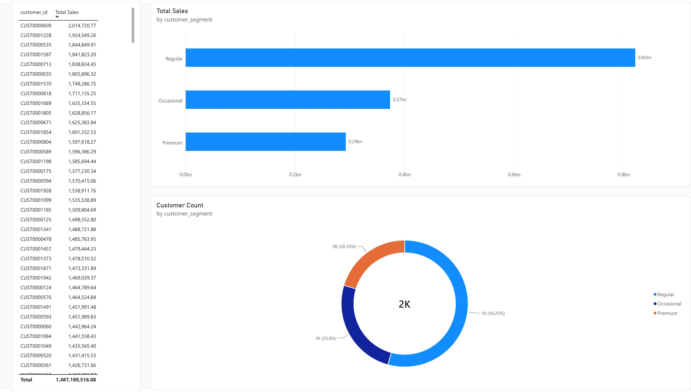
Customer Analysis: segments spend alike
What the page shows
1
Regular customers are 54% of the base (1,085) and 55% of sales ($821M).
2
Spend per customer is almost equal: Regular $757K, Occasional $735K, Premium $719K.
3
Premium customers do not spend more than the other segments, so the label is not adding value.
Real report page exported from the Power BI dashboard
Data: synthetic retail dataset (dev scale, 49,697 sales lines). Figures illustrate the pipeline, not a real retailer.
Notes:
Segment mix and spend per customer. Premium spending slightly less than Regular suggests the segment is not tied to spend in this data.

Slide 8
Two findings that stand out
Discounts cut the margin by 10 points
17% of reported sales did not complete
57% of sales lines carry a discount. Those lines make $792M of sales at a 15.1% margin, against 25.8% on full-price lines.
$251M of the $1,487M headline sales comes from cancelled or returned orders, and another $77M is still pending. Total Sales currently counts all of it.
Source: Gold fact_sales joined to Silver orders in Databricks. Discount split by sales line; status split by revenue share.
Notes:
These are the two clearest signals in the data. Most other differences between regions, categories and segments are small because the dataset is synthetic and evenly distributed.

Slide 9
Fixing the data before analysing it
Data problem | In raw data | After cleaning
Duplicate customers | 20 | 0
Customers missing a city | 40 | 0
Order lines pointing at unknown products | 514 | 0
Order lines with negative quantity | 257 | 0
Payments with an invalid amount | 202 | 0
Duplicate payments | 200 | 0
Bad rows are kept, not deleted
Every rejected row goes to a quarantine table with a reason, so nothing disappears silently and each fix can be traced.
The checks also caught 198 orphaned payments linked to orders that had been removed. That gap was fixed and re-verified.
Same checks, run on raw and cleaned data: every raw check failed as expected and every cleaned check passed.
Source: Databricks data-quality results table (dev-scale run).
Notes:
This is the foundation of the dashboard. Without it, the duplicates and broken keys would flow straight into the totals.

Slide 10
What this solved
Before
After
✕
Duplicates, blanks and broken keys inside the numbers
✓
Cleaned data passes every quality check
✕
No proof the totals were right
✓
Total Sales and Total Profit match exactly between Databricks and Power BI
✕
Bad rows silently dropped or ignored
✓
Rejected rows quarantined with reasons
✕
No shared view of sales, product, store and customer
✓
One star schema drives all four report pages
Cross-platform check: Total Sales 1,487,189,516.08 and Total Profit 298,982,105.59 in both Databricks and Power BI.
Notes:
The strongest evidence is the exact match of totals across two independent platforms.

Slide 11
What the retailer can do next
1
Cut cancellations and returns
2
Discipline discounting
3
Review Electronics pricing
17% of orders (about $251M of sales) do not complete. Each point recovered is worth roughly $15M. Fix stock accuracy and delivery promises, and record return reasons.
Discounted lines earn a 15.1% margin against 25.8% at full price. Cap discount depth and test whether discounts truly lift volume.
Electronics has the lowest margin (18.7%) against Beauty (21.2%). Renegotiate supplier cost or adjust price, and lean the mix toward Beauty and Clothing.
4
Reduce payment failures
5
Make Premium mean something
6
Grow the website
About 5% of payments fail, highest on debit cards (5.5%). Add retry flows and nudge customers toward UPI and wallets.
Premium customers spend $719K each, below Regular at $757K. Tie the tier to spend and add benefits that earn higher value.
Website carries 45% of orders at an order value similar to stores. Invest in conversion, and lift the mobile app, which lags at 20%.
Recommendations are tied to figures in this dataset. Effects of actions (for example discount lift) would need real transaction history to confirm.
Notes:
Recommendations are grounded in numbers from the dashboard. The size of each prize would need validation on real data.

Slide 12
Next steps and how to read this
Improve the dashboard
Read the numbers carefully
Chart stores by store ID, so shared names are not merged
Report completed-order sales ($1,159M) beside the current total
Add cancellation, return and payment-failure cards
Mark the date table to enable year-on-year and month-on-month growth
Add Top 10 and Bottom 10 products, and tidy the layout
The data is synthetic and evenly spread, so most differences between regions, categories and segments are small.
The clear signals are the discount margin gap and the share of orders that never complete.
Repeat Customer % is 100% here only because customers average about 10 orders each.
On real data, re-run the same pipeline and refresh the dashboard.
Project repository: github.com/Gangarajukonimeti2012/retail-data-engineering-databricks-fabric
Notes:
Close on honesty: which findings are strong, which are artefacts of synthetic data, and the concrete dashboard fixes.

