Slide 1
Automating Building Energy Modeling from Natural Language
Gang Jiang, University of Utah, gang.jiang@uta.edu

Slide 2
Learning Objectives
Understand how automated building energy modeling enabled through natural language
Learn prompt engineering and fine-tuning (with performance-efficient) techniques for large language models

Slide 3
Outline/Agenda
Motivation
Current challenges
Solution 1: Prompting to inform
- Case study
Solution 2: Fine-tuning
- Case study with video demo
Future work

Slide 4
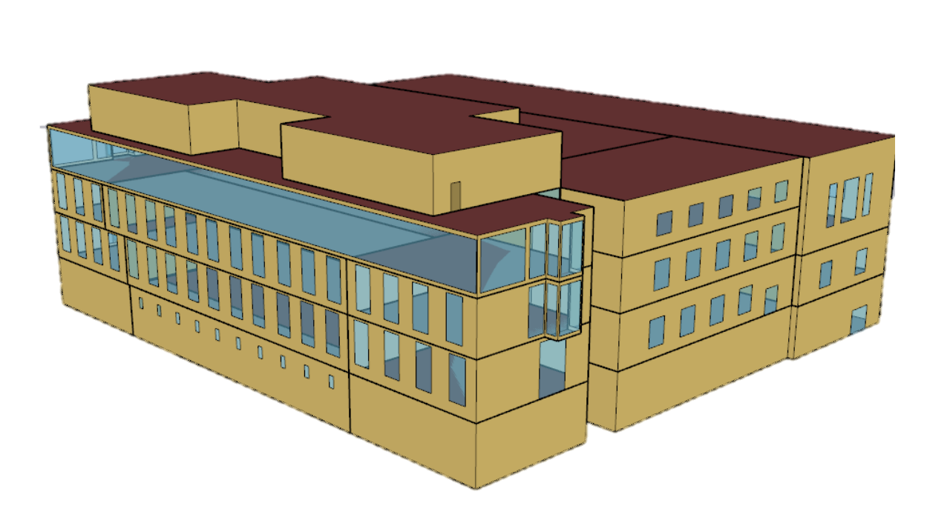


Motivation
Domain knowledge
Technical Proficiency
Config setting
GUIs
Programming skill
Specific learning
Limited functionality
Poor scalability
Repos
Building Energy Modeling (BEM)
Building energy modeling is time-consuming and labor intensive!!
Notes:
We all know that bem is not a trivial thing.

Slide 5


Motivation
❓
Natural language
Building Energy Models
Customize a large language model for building modeling (e.g., EnergyPlus)
A Platform: User friendly, intuitive, and scalable
Notes:
Is that possible to directly map user’s language descriptions to building energy models?

Slide 6

Current Challenges
Current general LLMs lacking building science, especially for building modeling knowledge
LLM & Task Knowledge
Inherent complexity of LLM application, including model architecture selecting, training efficiency, deployment
High computing dependency - GPUs
Requiring domain understanding and specific task customizing

Slide 7

Current Challenges
BEM & User demanding
Uniqueness and complexity of building parameterization
Accuracy and diversity required in user queries
Modeling precision, consistency, and alignment
Needing LLMs fully understanding users’ modeling intent; generating 100% accurate and 0 human intervention

Slide 8


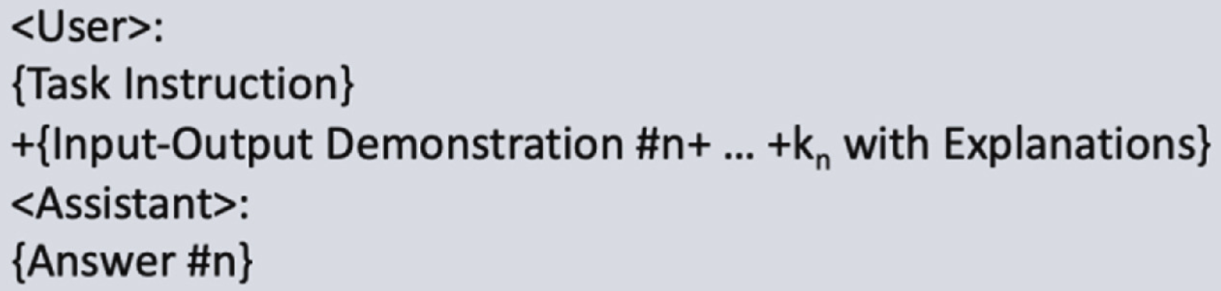
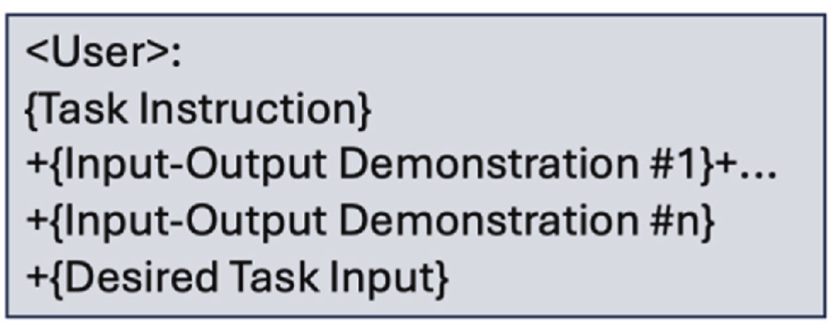

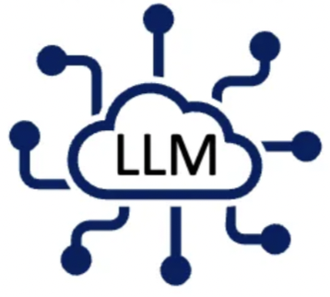

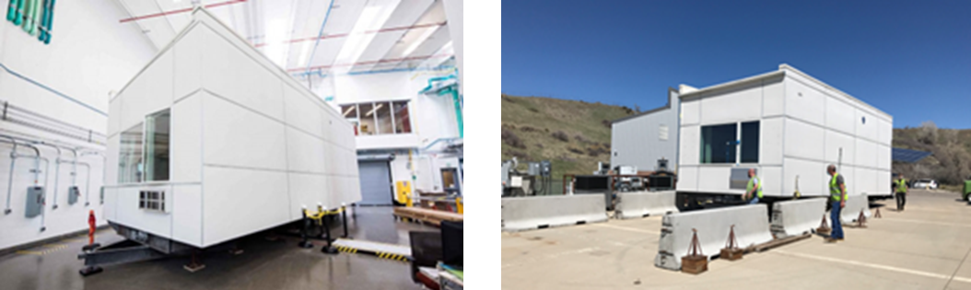


Solution 1: Prompting to inform
Prompt Engineering Framework
Reasoning
Logic of BEM
Self-learning
Corresponding BEMs
User Natural Language
Foundation
Domain Knowledge
Open-source SOTA LLMs
e.g., Llama, Qwen, etc.
Or ChatGPT, etc.
Large Language Model
Knowledge Informed
Few shots
Division
Explanation
NREL, iUnit building
BEM Examples
Prompting Strategies
Jiang G, Ma Z, Zhang L, Chen J. (2025) Prompt engineering to inform large language model in automated building energy modeling. Energy
Notes:
We’ve mentioned that llms lack domain knowledge, like building modeling and energyplus knowledge. But how about we directly give this specific knowledge to llms. This way called prompt engineering.

Slide 9
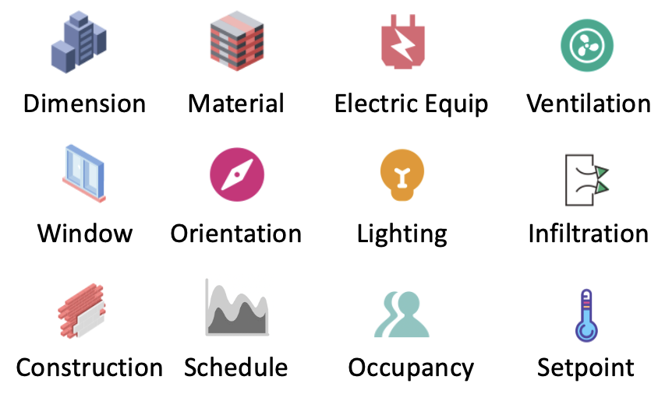
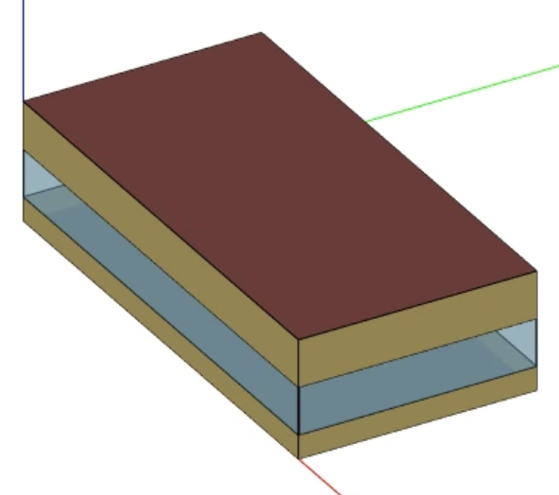
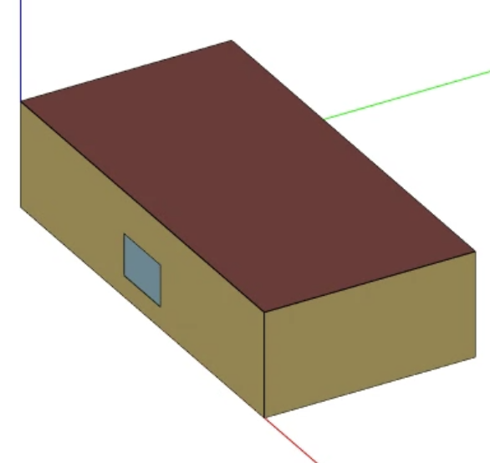
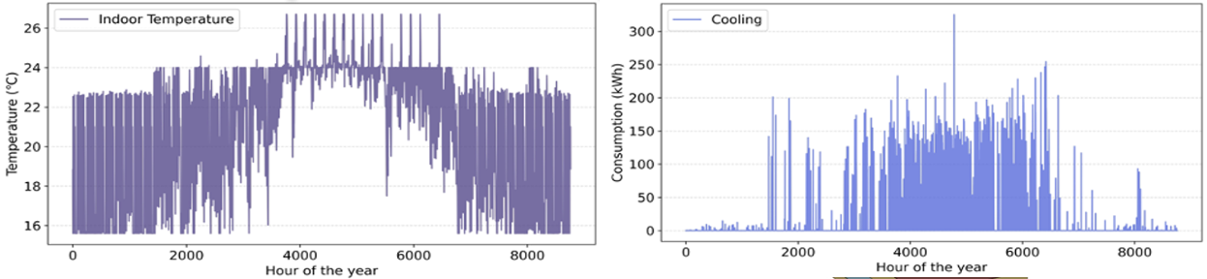
Case Study
Modeling Scenario: Building Energy Analysis & Retrofit
One-shot Learning
Building Modeling Instruction
(Reasoning)
Auto-generated Model
Modeling Example
Energy Consumption & Indoor Environment
All codes can find in the paper
Jiang G, Ma Z, Zhang L, Chen J. (2025) Prompt engineering to inform large language model in automated building energy modeling. Energy
Notes:
One shot learning example

Slide 10
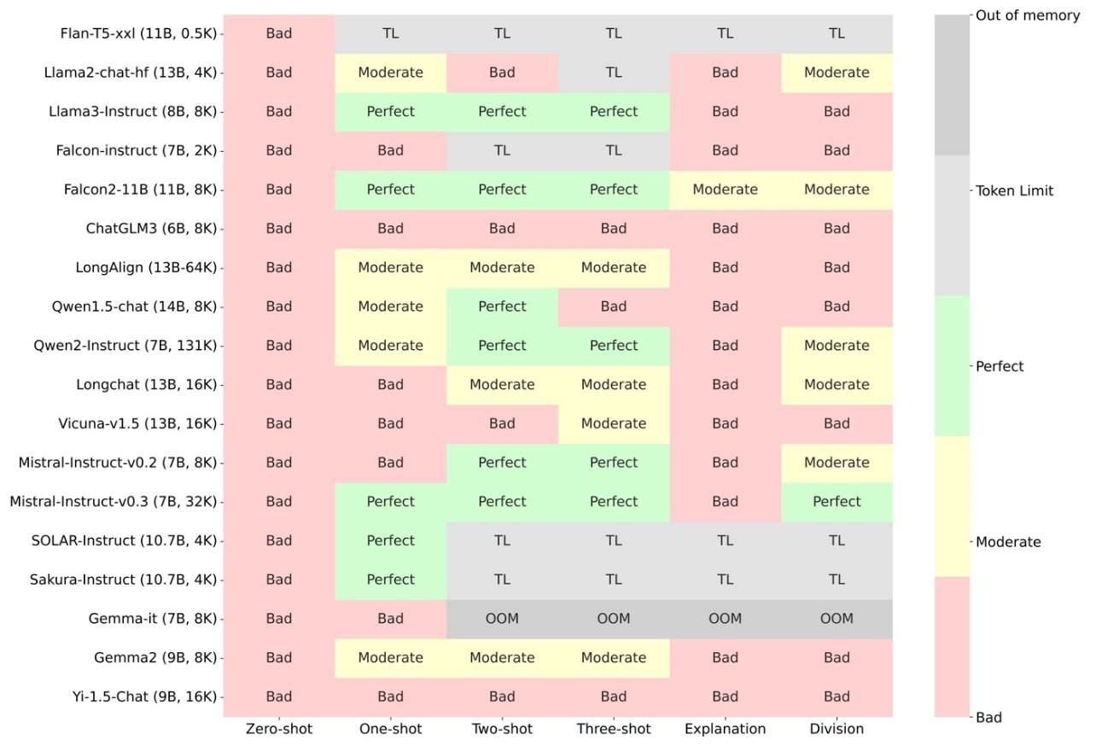
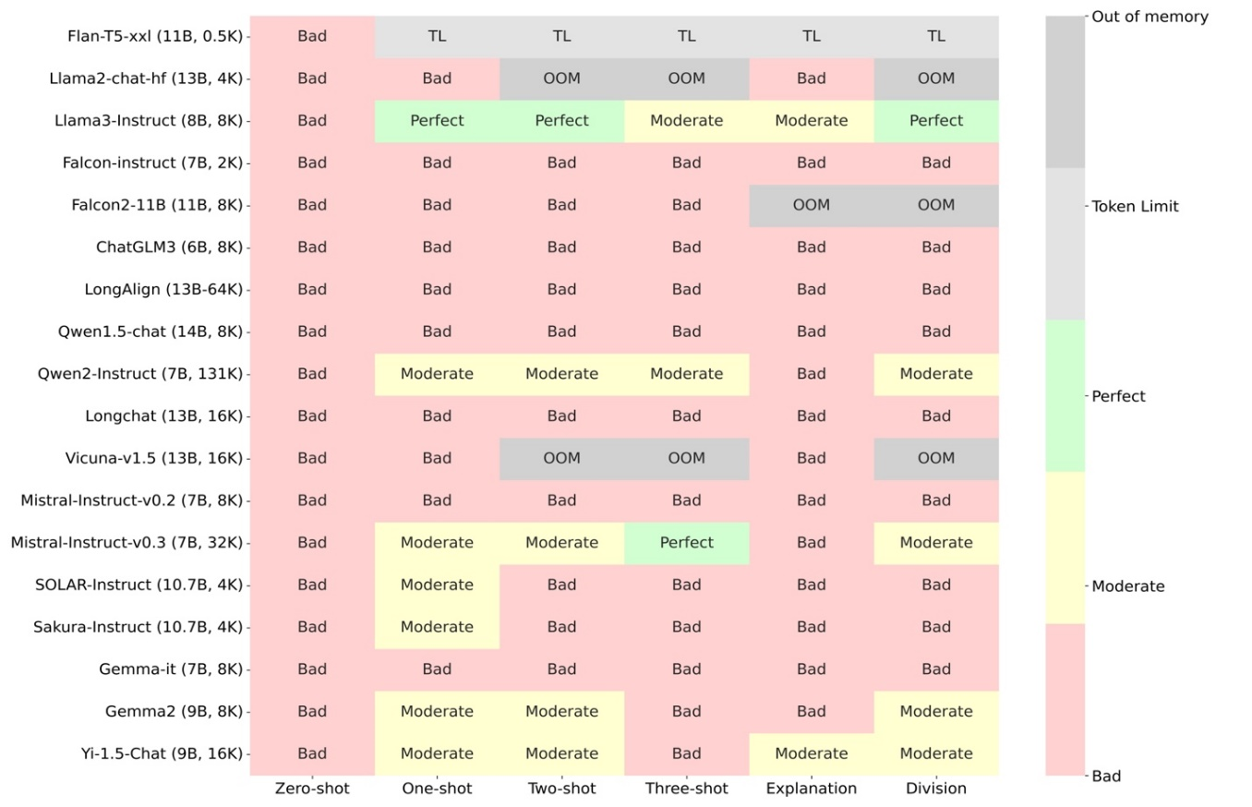
Case Study
Typical modeling task
Real-world modeling task
For those scenarios, just one example (one-shot learning) is workable!!
Over-design may yield deficient performance.
Chain-of-thought (Division or Explanation) can improve modeling accuracy and success rate.
Compact open-source LLMs perform well.
However, for complex building scenarios, relying solely on prompt engineering is not sufficient for automated modeling!
Notes:
So actually, prompt engineering is not that robustness, and for complex scenarios, it is not sufficient. We want to make something different to develop more robustness, more automation platform. fine-tuning is that approach.

Slide 11
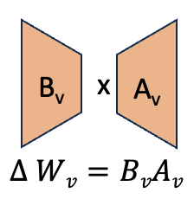
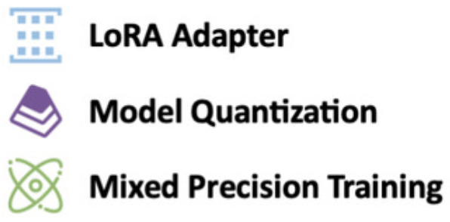
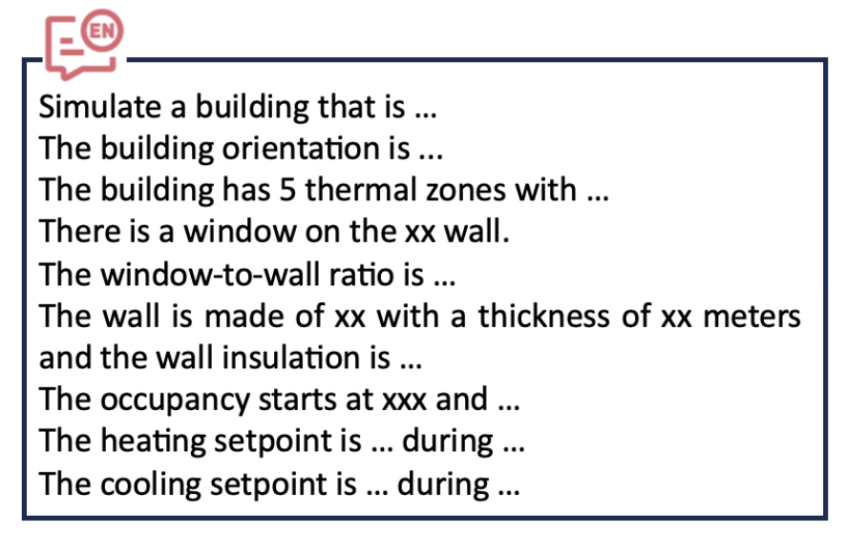

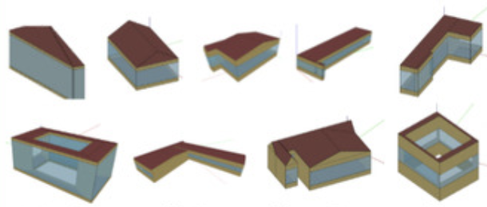

Solution 2: Fine-tuning to learn
Fine-tuning Framework
Param W
Full-parameter
Efficient fine-tuning
Corresponding BEMs
Supervised Learning
Foundation
User Natural Language
Sampling & Modeling
Pair Constructing
Language Mapping
Large Language Model
Knowledge Informed
Jiang G, Chen J. (2025) Efficient fine-tuning of large language models for automated building energy modeling in complex cases. Automation in Construction
Jiang G, Ma Z, Zhang L, Chen J. (2024) EPlus-LLM: A large language model-based computing platform for automated building energy modeling. Applied Energy
A large amount of BEMs across various scenarios
Data preparation
Training
Models and quick start codes can find in the paper/Hugginface: https://huggingface.co/EPlus-LLM/EPlus-LLMv2
Notes:
Prompt engineering is to inform LLMs with extra knowledge or information or examples. Fine-tuning is letting LLMs to learn with dataset

Slide 12
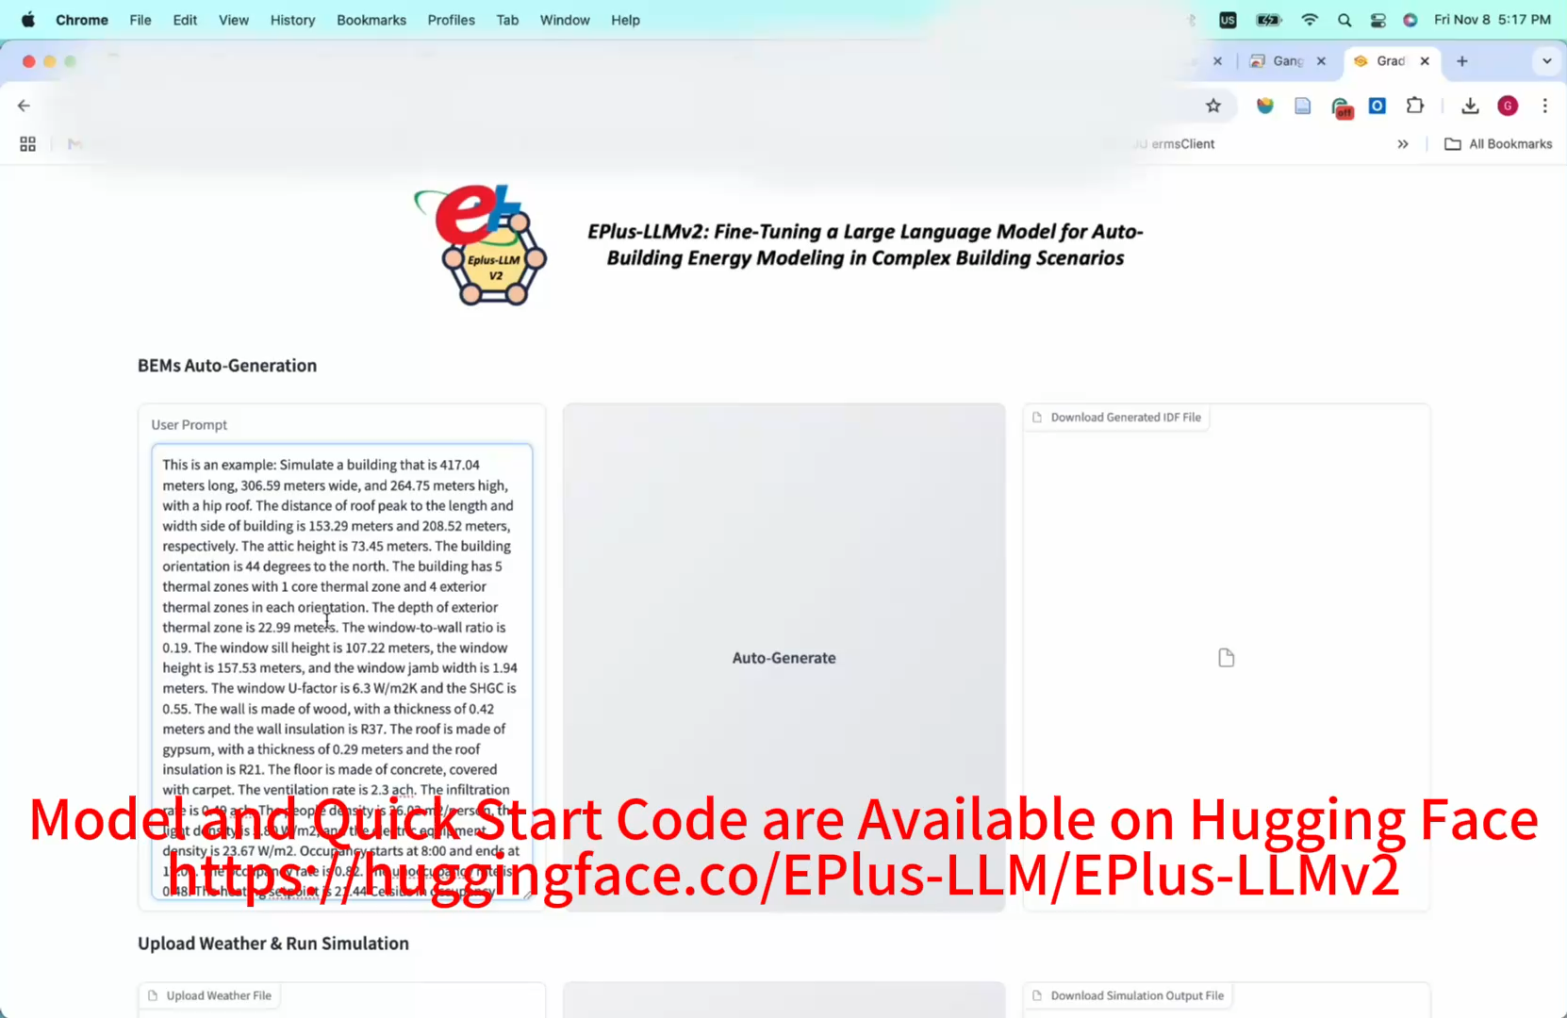
Case Study
Video Demo

Slide 13
Conclusion
 | Advantages | Disadvantages
Prompt Engineering | No training required, Easy to deploy (API) Flexible and quick to iterate/update | Well-designed prompt templates Unstable and sensitive Wide testing
Fine-Tuning | High task-specific accuracy (often 100%) Robust and consistent performance | Training data preparation High computational burden and cost Technical complexity
Efficient Fine-Tuning | Computational efficiency Enable task adaptation (LoRA) | Hyperparameter Tuning Slow inference speed Hard to deploy

Slide 14
Future Work
Enhance the ability of LLMs to incorporate domain-specific knowledge, improving their adaptability to the building domain.
Apply efficient techniques to reduce the computational burden during the customization process.
More complex and diverse scenarios to support the practical application of diversified building energy modeling.
Applied to other tasks/directions suitable with LLMs

Slide 15
Bibliography
Jiang G, Ma Z, Zhang L, Chen J. (2025) Prompt engineering to inform large language model in automated building energy modeling. Energy
Jiang G, Chen J. (2025) Efficient fine-tuning of large language models for automated building energy modeling in complex cases. Automation in Construction
Jiang G, Ma Z, Zhang L, Chen J. (2024) EPlus-LLM: A large language model-based computing platform for automated building energy modeling. Applied Energy

Slide 16
Questions
❓
gang.jiang@utah.edu

