Slide 1
ConvXAI:
Delivering Heterogeneous AI Explanations via Conversations to Support Human-AI Scientific Writing
Presenter: Gang Jiang

Slide 2
Introduction
Current AI explanations (XAI)
Gaps
"Why X not Y?” to build trust in AI.
Only provides one type of explanation.
Unable to incorporate user feed back into
producing AI explanations.
“If and how” to improve performance in human-AI collaborative tasks.
Enable users to choose counterfactual prediction foil.
Produce personalized explanations for users’ individual needs.
Our proposed ConvXAI (Conversation AI explanation) :
improvement of user’s task rather than merely gain an understanding of the AI predictions (on scientific writing).
we identify four design principles and incorporate them into the empirical system design for further evaluation with human tasks.

Slide 3
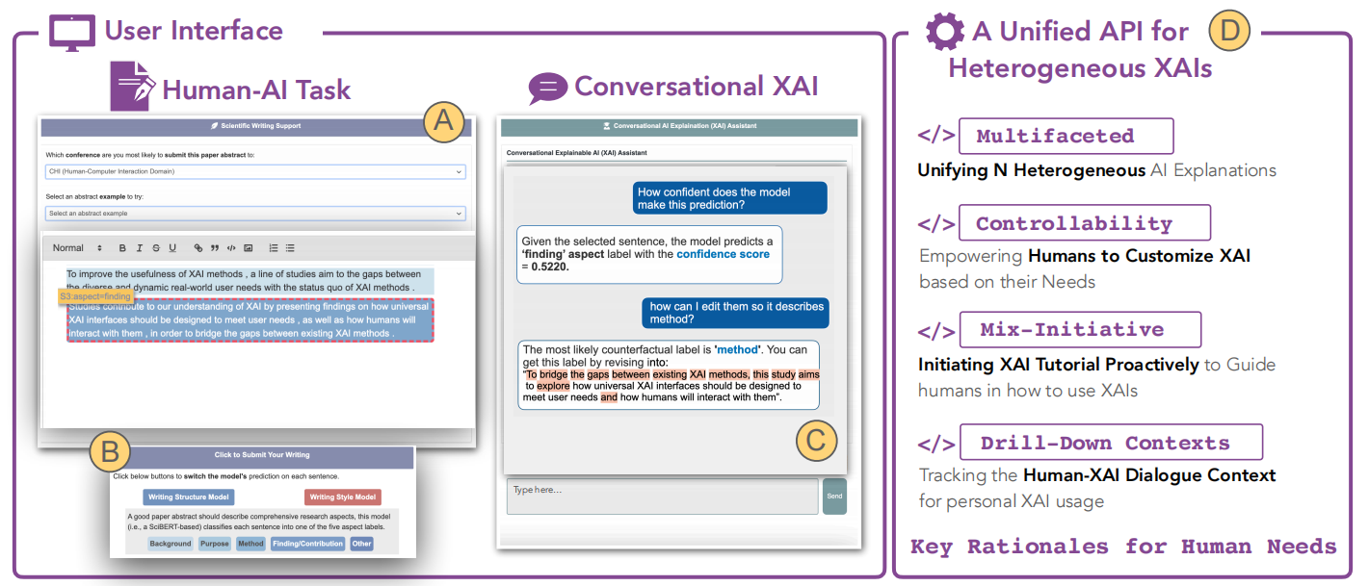
Fig. 1. Overview of ConvXAI.

Slide 4
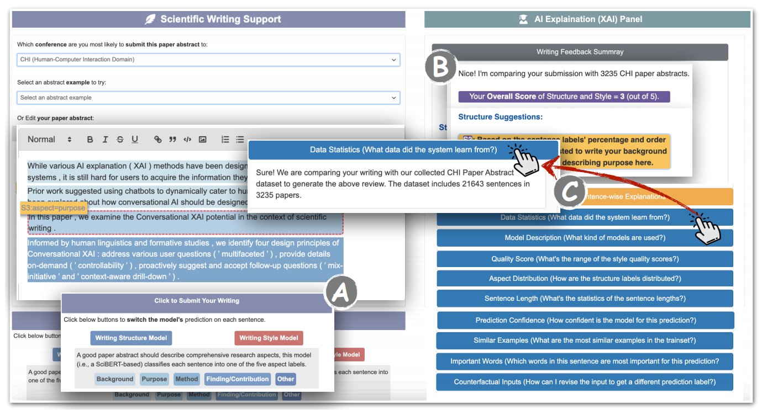
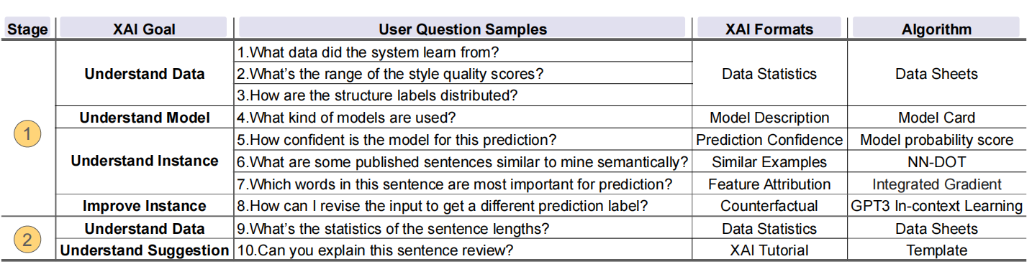
Model comparation
Baseline model: Select XAI
GUI based
Statically displays all the XAI formats
Have same 10 users question samples
Notes:
The select XAI only can provide static buttons to show the explanations.

Slide 5
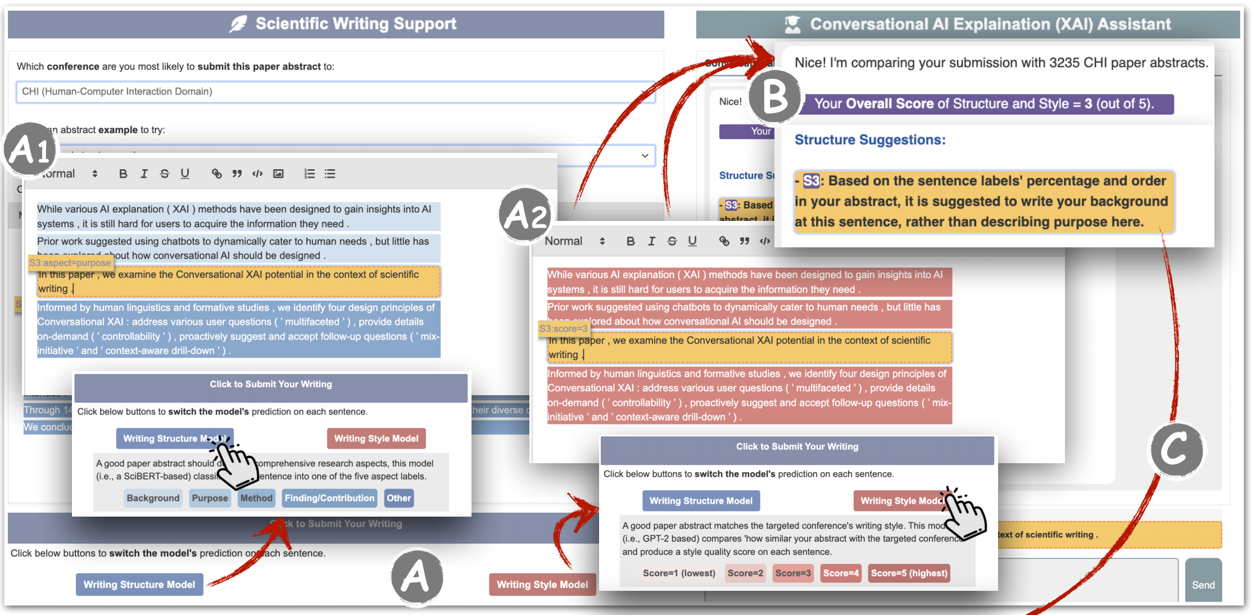
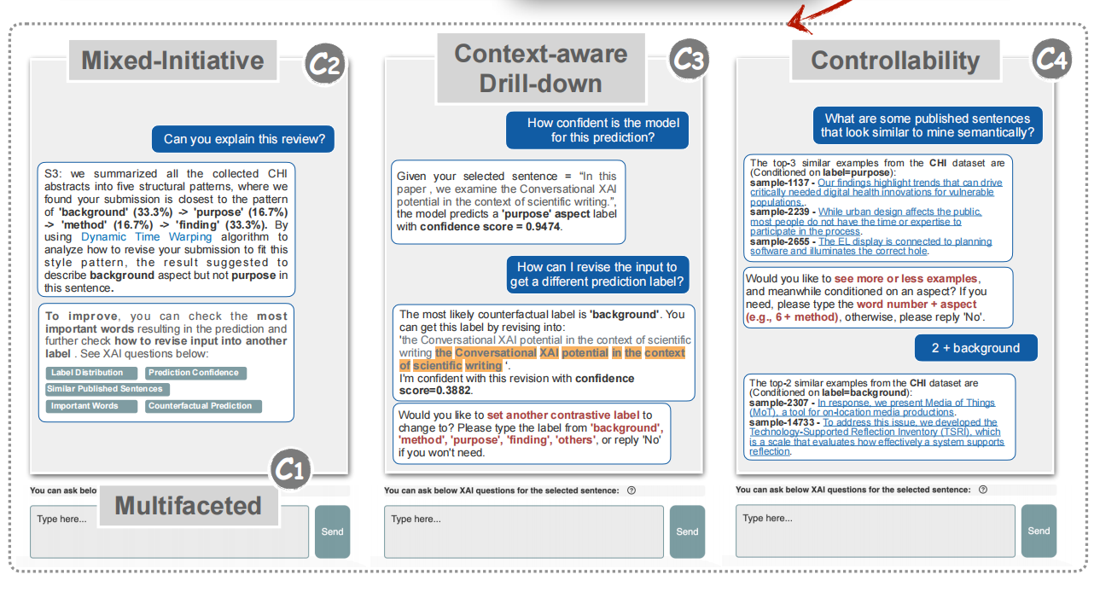
Model comparation
ConvXAI XAI
Dynamic dialogs for human-ai interaction

Slide 6
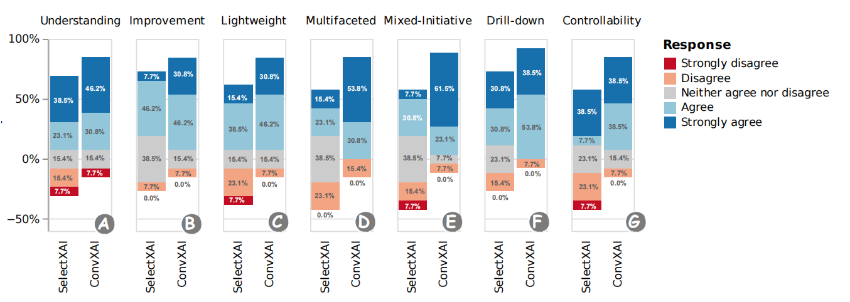
User studies
Task1: Open-ended writing (user-orientation: effectiveness and self-rating)
13 participants to self-rating their using experience
Fig. 4. Analyses on users’ self-ratings on their experiences.
ConvXAI: Improving writing and better to understand explanations

Slide 7
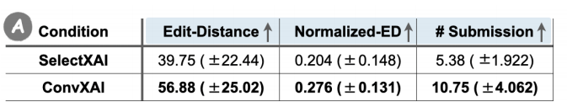
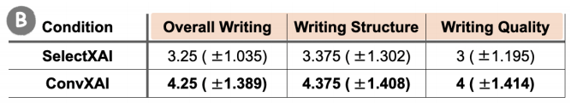
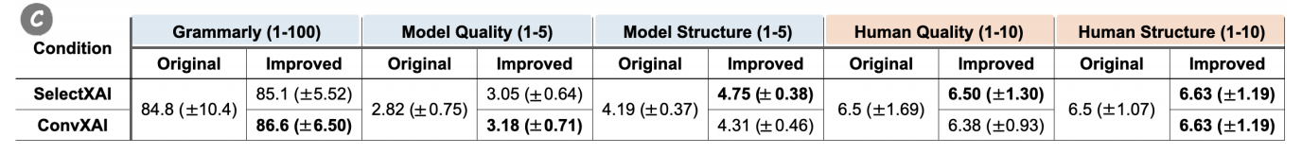
User studies
Task2: Well-defined Tasks (Evaluation: productivity, and performance)
Measurement A: Productivity
8 users and divide into 4 pair of groups, each group have a writing topics, like NLP, AI and so on.
Measurement B: Usefulness (Rated by users)
Measurement C: Performance (Grammarly, built in models, and human rating)
ConvXAI: More modifications, more re-submission times, and more usefulness and performance
Notes:
Use this three measurements to assess users’ writing performance in Task2.
ConvXAI and SelectXAI can both improve the writing Structure evaluations, but not in the Quality metric. To probe the inconsistency between human and
auto-metric evaluations, we further compute the Pearson correlation between the model scores and the human ratings and find
that both quality and structure are negatively correlated or not correlated (quality: -0.0311 and structure: -0.1150), showing that there is a misalignment between humans and models.

Slide 8
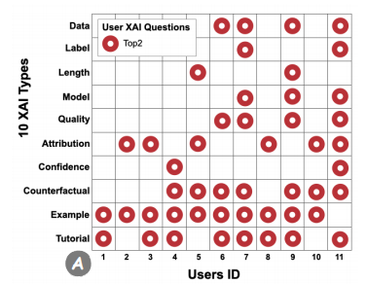
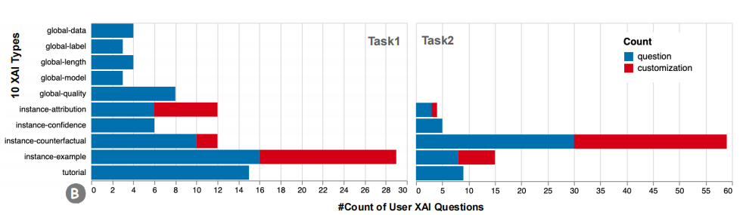
Users demands analysis
Analysis A: Users top2 questions
Different users have different questions and asking orders for their needs, although Examples question is the most popular question
User demands are changing over time.
Customized question for users’ needs is crucial in practice.
Proactive XAI tutorials on how to use XAI is crucial.
Analysis B: Users cumulative questions
Notes:
accommodate different users’ backgrounds and practical demands.

Slide 9
Conclusion
a unified XAI interface with conversations.
incorporate practical user demands
representing four design principles for XAI evaluation.
multi-faceted, mixed-initiated, context-aware, proactive tutorials and customized explanations are better for achieving tasks
Future Directions
Contextualize for the right user group.
Considering different groups and providing customized explanations
Characterize the paths and connections between XAI methods
Tracking which words are helpful for understanding
Incorporate multi-modality
Identifying users’ emotions to certain explanations

