Slide 1

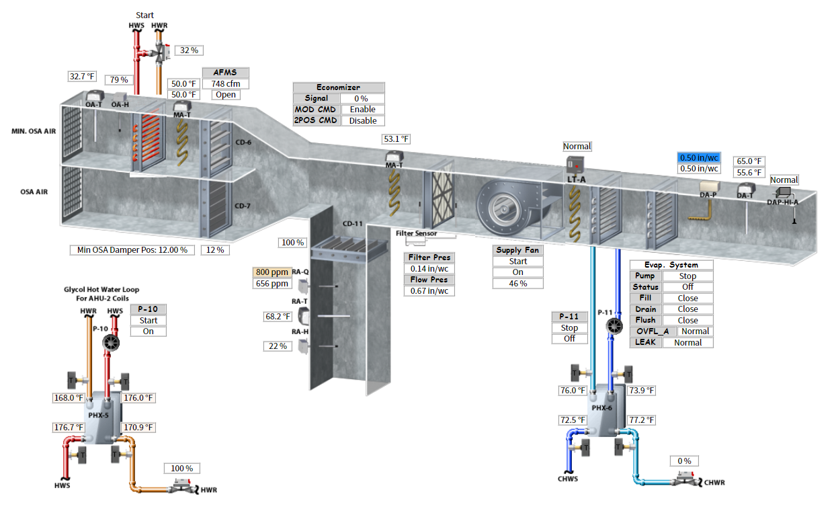
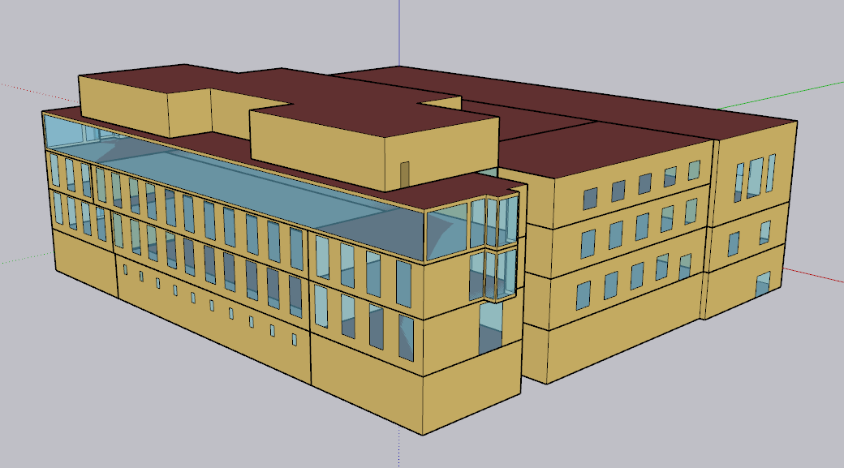
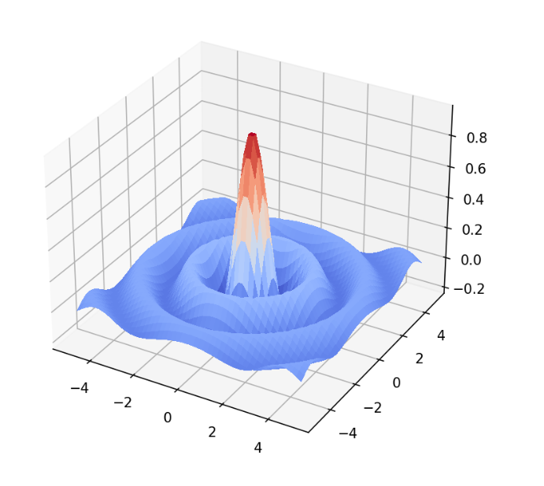
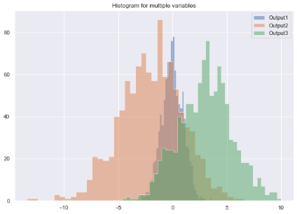
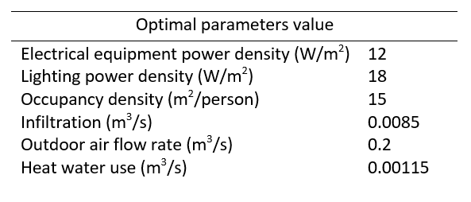
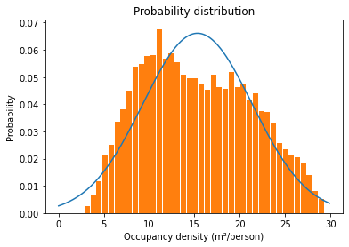
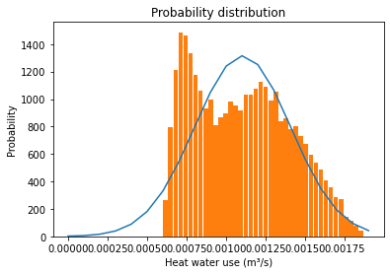
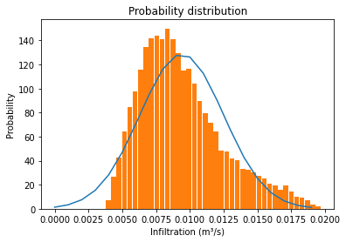

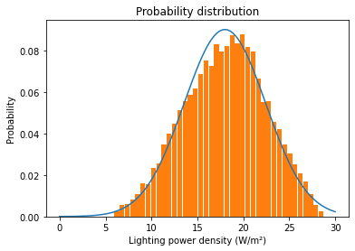
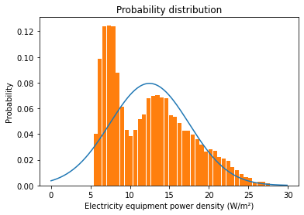
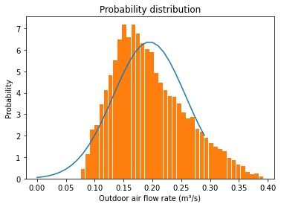
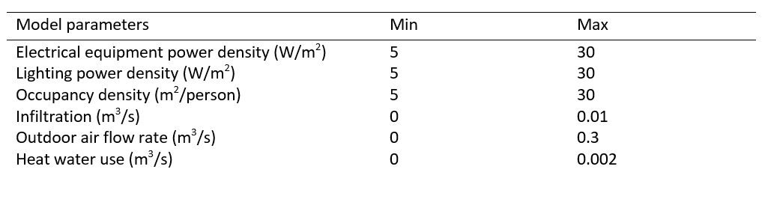
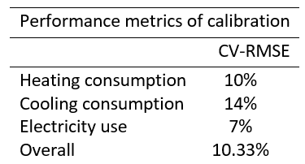

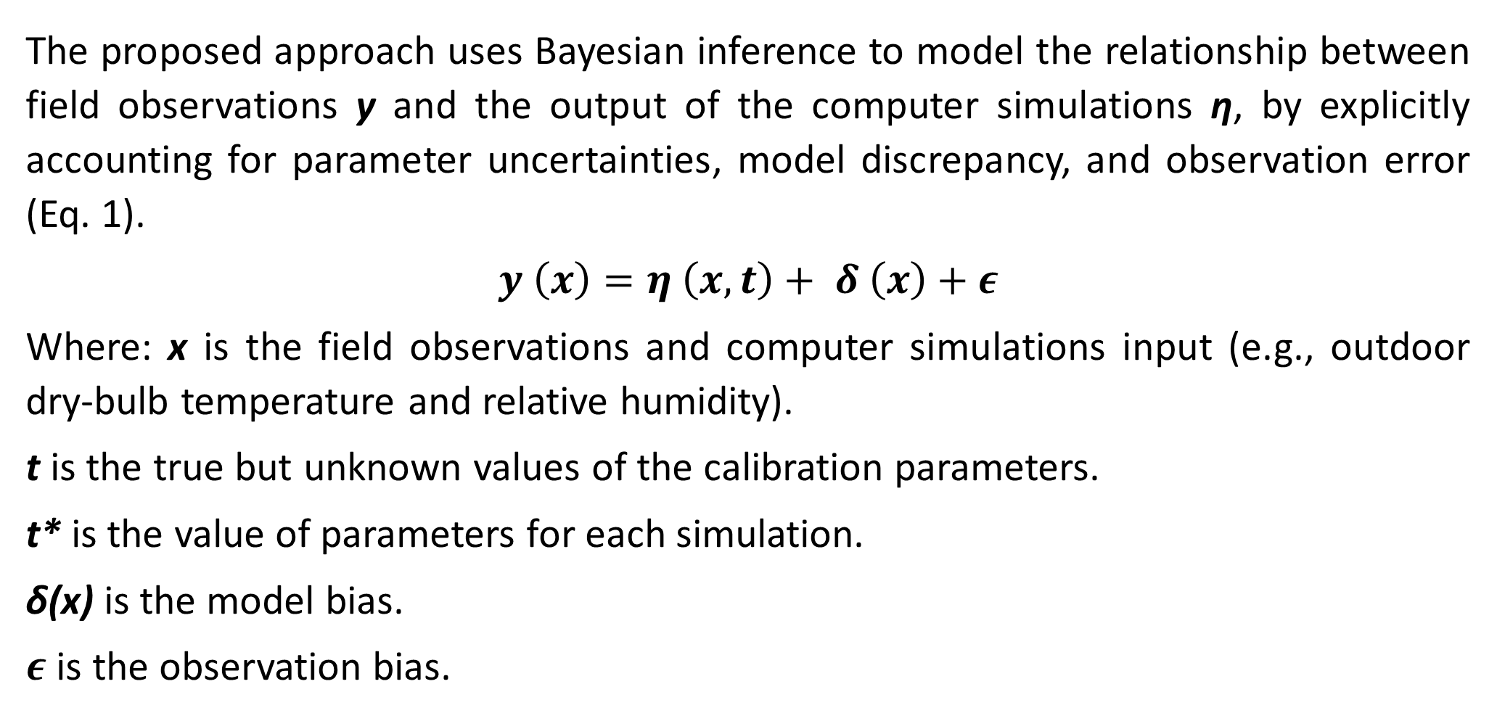

Bayesian calibration of campus building energy model
Gang Jiang, Jianli Chen* (jianli.chen@utah.edu)
Department of Civil and Environmental Engineering, University of Utah, Salt Lake City, UT 84112
Introduction/application scenirial
The first step to calibrating a BEM is to combine field and simulation data in surrogate (Gaussian process) model.
Rapid data generation using the surrogate model for Bayesian inference.
Posterior distributions are obtained by Markov chain Monte Carlo(MCMC) sampling.
Using optimal parameter calibrate BEM model.
Checking the calibrated model result and access accuracy.
Buildings account for 36% of global energy consumption and 19% of greenhouse gas emissions. To achieve and predict building energy use, it is critical to obtain an accurate building energy model (BEM).
The proposed method is applied to calibrate a BEM which is developed to simulate a comprehensive office building (including office, class, auditorium, and lab) located in University of Utah.
We demonstrate effectiveness of the proposed calibration by simultaneously calibrating 6 parameters (including equipment use, heat water use, lighting density, occupants, infiltration, and outdoor air) of a BEM, with 9 months building operation data (other data are missing) by 3 domains (cooling, heating, and electricity use).
The calibration results are well below the threshold value (15%) recommended by the ASHRAE standard for monthly energy data. This indicates that using the proposed method for building energy model calibration is accurate and efficient.
Collect field data from BMS
A bunch of simulation runs
y (x)
$η$ (x, t*)
Combine field and computer
simulation data in GP model
Distribution of t*
Explore posterior distributions
using MCMC
Optimal t
Initial building energy model
The initial computer simulation model was constructed by Energy Plus software in conjunction with the building design information.
The model input are weather information, building information, and building system information.
Weather
Building
System
Table 2. Optimal parameters value
Check and assess accuracy
Posterior parameter distributions
Figure 2. Bayesian calibration workflow
Heating
Cooling
Electricity
The model output are heating consumption, cooling consumption and electricity use. (+indoor environment)
Figure 1. Initial building energy model
Data collect & Parameter selection
The building operation data come from building management system. we used 9 months of data from 2021; the other three months were missing.
We use Latin hypercube sampling (LHS) to sample the parameter range and obtain 200 sets of simulation runs with different parameter combinations as the computer simulation data preparation for conducting model calibration.
A critical step before calibrating a BEM is to conduct a sensitivity analysis and uncertainty quantification to identify the most influential uncertain model parameters and their ranges. The uncertain parameters in the model and their ranges are listed in Table 1.
Figure 3. Posterior parameter distributions
We use the MCMC algorithm for sampling to obtain the posterior distribution of the parameters and obtain the optimal BEM parameters. The posterior parameters distribution are listed in Figure 3.
Results & Conclusion
The 3 output results all below the threshold (15%) by the ASHRAE standard for monthly energy data. (Table. 3)
Bayesian calibration quantifies the impact of uncertainty on parameter calibration based on posterior distributions, which can provide more reliable parameter selection
A multi-output model calibration approach will yield somewhat poorer results than a single output, but due to the coupling between building systems, a multi-output calibration model will yield a more robust baseline model and more reflective calibration results.
Heating Consumption (kW/h)
Field data
Simulation data
Month
Field data
Cooling Consumption (kW/h)
Simulation data
Table 1. Parameters and their ranges
Bayesian calibration approach
The proposed approach uses Bayesian inference to model the relationship between field observations y and the output of the computer simulations η, by explicitly accounting for parameter uncertainties, model discrepancy, and observation error (Eq. 1).
$$y \left(x\right)=η \left(x,t\right)+ δ \left(x\right)+ε$$
Where: x is the field observations and computer simulations input (e.g., outdoor dry-bulb temperature and relative humidity).
t is the true but unknown values of the calibration parameters.
t* is the value of parameters for each simulation.
δ(x) is the model bias.
$ε$ is the observation bias.
Month
(1)
Electricity Consumption (kW/h)
Table 3. Calibration performance
Month
Figure 4. Calibrated model results and field data
Acknowledgement
Acknowledge SEED2SOIL and GCSC support in any publications or presentations with the statement “Funding has been provided by the University of Utah’s SEED2SOIL program with the support the Global Change and Sustainability Center.”
Notes:
Hight level+ Steps
Calibration 目的

