Slide 1
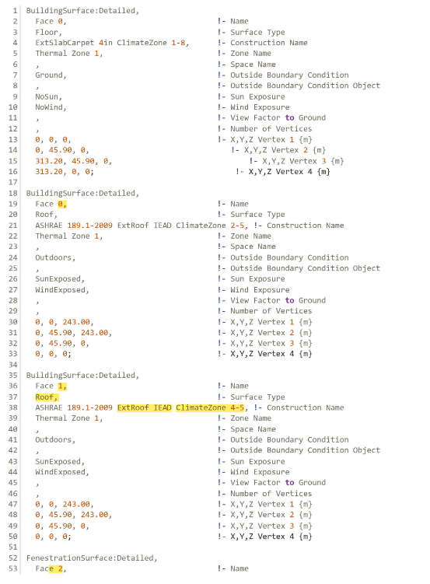
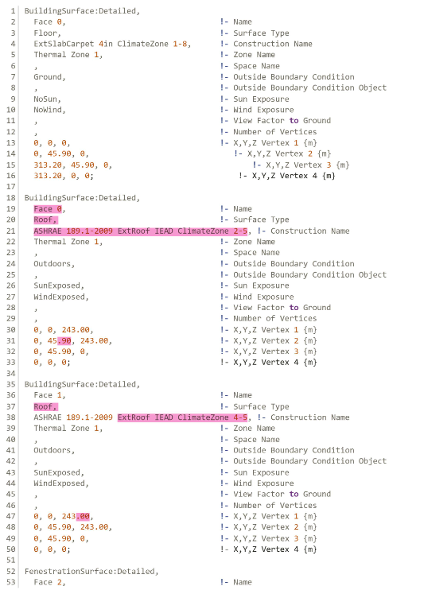
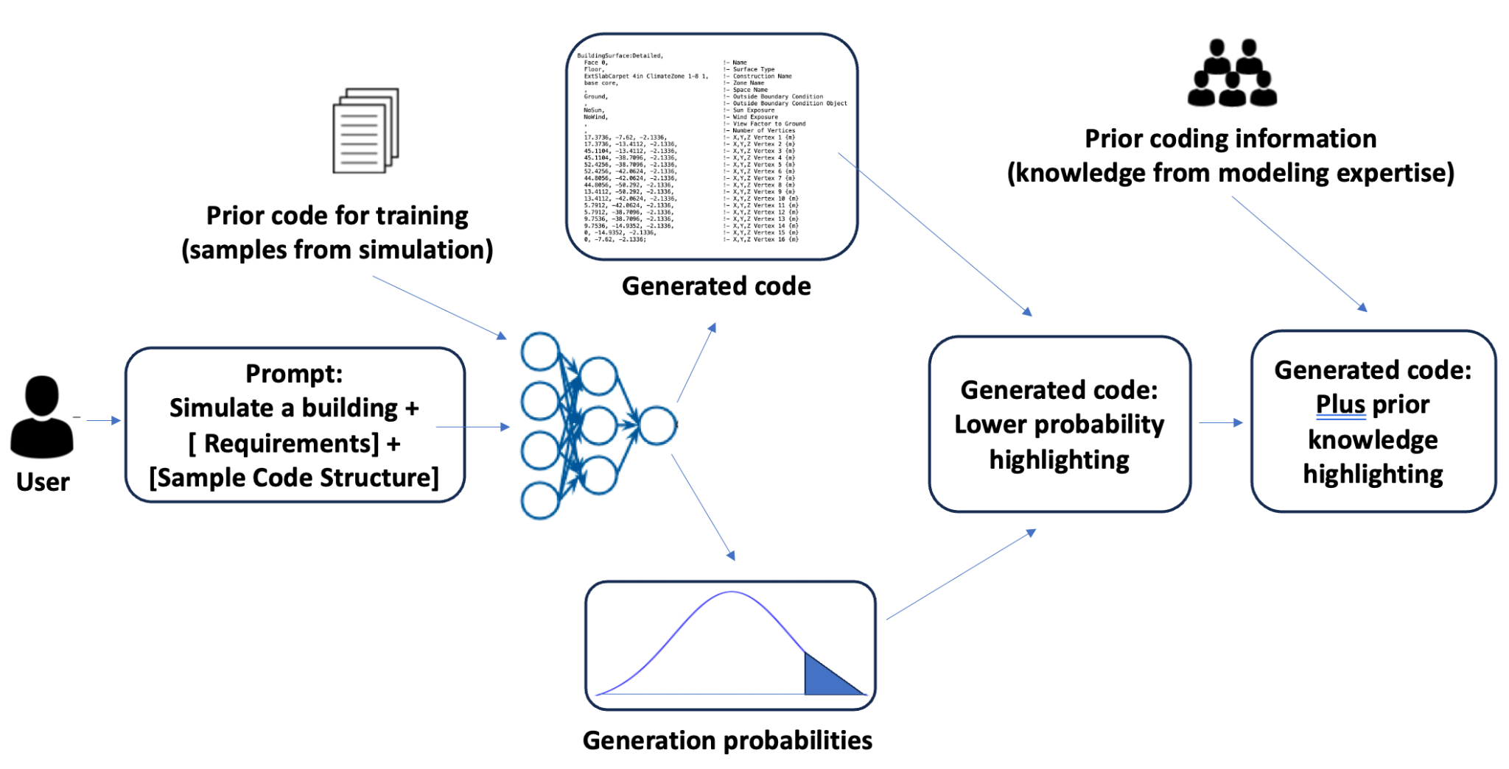
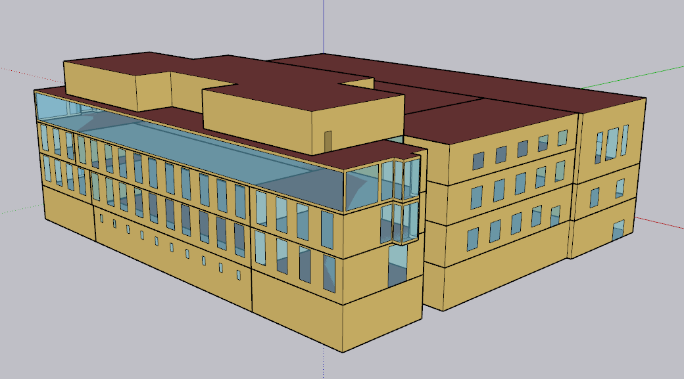
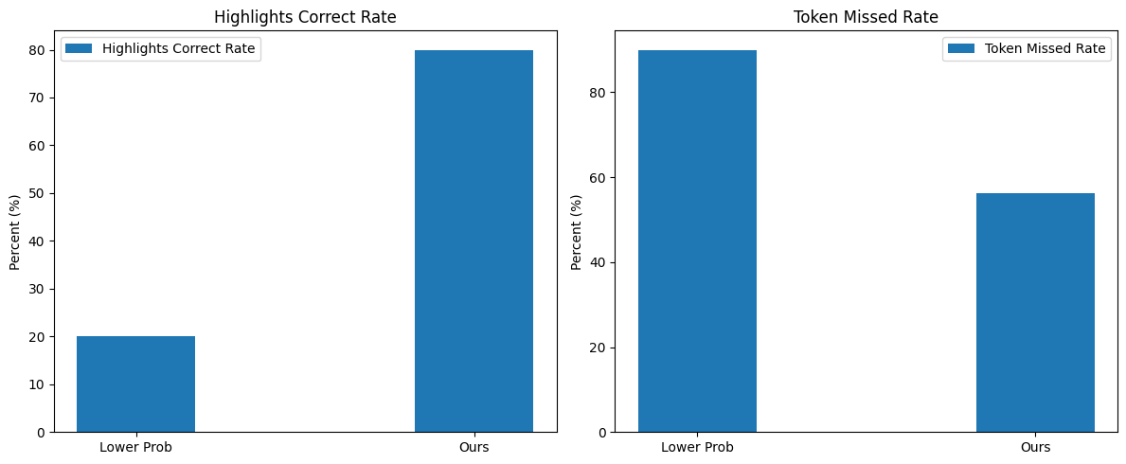

Inline Highlighting to Support Generated Building Simulation Code Debugging
Gang Jiang, Zhou Zhang
Introduction
Diversifying Applications for Sustainable, Resilient Construction.
Addressing Building Simulation Challenges: Time, Computation, Expertise.
Fine-tuning LLM model to generate simulation scripts. Provide explanation for debugging.
Datasets: Real Data of Crocker Science Center and modified data with random number.
Fig. 1. Overview of the method.
Explanation based on the probability of generated tokens
Code Testing & Bug Identification: Token Probability Analysis.
Output: Generated Results + Token Probabilities.
Bug Correlation: Lower Probability Tokens.
Caution: High Probability Tokens Can Still Have Bugs.
Fig. 2. Lower Prob + Prior Info Tokens
Fig. 3. Bug Tokens.
Prior information to support explanation
Conclusion
Solution: Inline Highlights + Prior Knowledge to Indicate Uncertainty.
Comparison: Tokens with lower probability and prior information (Figure 2), Tokens where the bugs are (Figure 3).
Analysis: Highlights Correct rate and Token Missed Rate based on 5 samples (Figure 4).
We fine-tuned a large language model to realize auto-simulation and provide a user-friendly human-Ai interaction.
Find Generation Probabilities Insufficient for Debugging Explanation.
Introduce inline highlighting (probability plus prior information) to support user’s debugging.
Fig. 4. Analysis: Correct Rate (left); Missed Rate (right)

