Slide 1
McDonald's : A Diagnostic Analysis
Diagnostic analysis of the fast-food dataset
Prepared by: Gangothri M C
Batch / Team: PTID-CDA-SEP-26-11268
Date: 14-10-2026
Project GitHub Link https://github.com/Gangothri521/Fast_Food_Analysis_project.git
Notes:
Introduce yourself and the project. I analysed McDonald's from the fast-food nutrition dataset and built a dashboard to explain why its numbers look the way they do.

Slide 2
The project at a glance
512
8
57
records in the dataset
restaurant chains
McDonald's menu items
GOAL
LIMITATION
Explain why McDonald's calories, sodium and protein look the way they do, and recommend evidence-based improvements.
The dataset has no price column, so nutrition measures replace the average price named in the project brief.
Notes:
The dataset has 512 records across 8 chains. McDonald's has 57 items. The brief mentions average price, but there is no price column, so nutrition measures were used instead.

Slide 3
Dataset and limitations
The dataset
Limitations
MySQL table: 512 records, 8 restaurants
McDonald's subset: 57 menu items
Calories, fats, cholesterol, sodium, carbs, fiber, sugar and protein per item
Vitamins and calcium as % of daily value
No price column, so no average price analysis
Missing fiber and vitamin values for some chains
Salad column holds "Other" in every row
No portion weights or sales figures
Correlation, not proof of cause
Notes:
Describe the dataset and be upfront about the limitations. The data cannot tell us what customers actually buy, and the results show relationships rather than proof of cause.

Slide 4
Cleaning the data
1
Removed useless columns
satish (empty), age (all zeros) and salad (no information)
2
Removed duplicates
1 duplicate Taco Bell record removed (512 to 511 rows)
3
Fixed missing values
"NA" replaced with null and numeric types set; blanks kept, not zero
4
Created new columns
Calorie Category, Is Salad and Protein per 100 Cal
Notes:
Four cleaning steps. Blanks were kept as blanks rather than replaced with zero, and three derived columns support the later analysis.

Slide 5
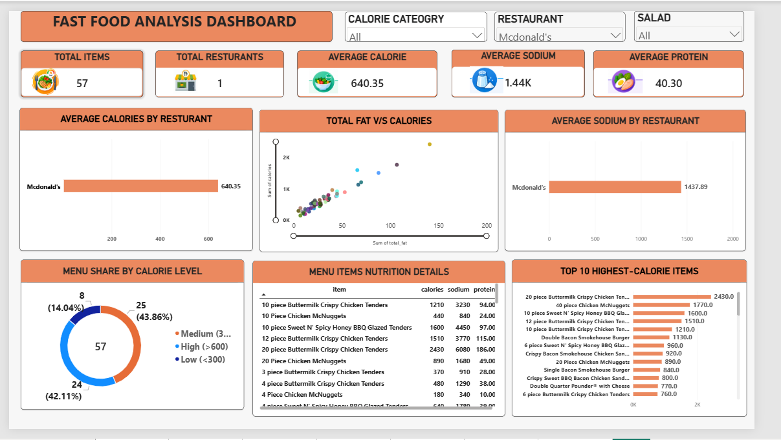
The dashboard
640.35
average calories
1,437.89
average sodium (mg)
40.30
average protein (g)
Notes:
Walk through the dashboard: five KPI cards, the charts and the three slicers (Calorie Category, Restaurant and Salad). Selecting a slicer updates every visual. McDonald's averages: 640.35 calories, 1,437.89 mg sodium and 40.30 g protein.

Slide 6
Big portions drive calories
140 to 2,430
calories per item
Why
Multi-piece sharing portions, breaded and fried.
Meaning
Single items are far lower: Hamburger 250, Cheeseburger 300.
Notes:
Calories range from 140 to 2,430. The top five are all large chicken portions, listed as single items, which pulls the average up to 640.

Slide 7
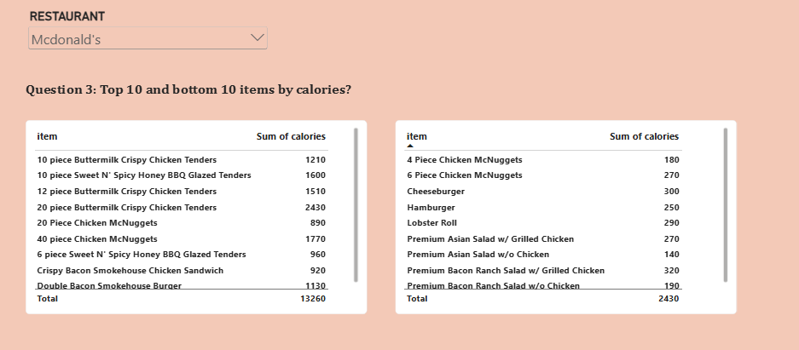
Top 10 and bottom 10 items by calories
Left: highest-calorie items. Right: lightest items. Together they show the full range of the menu.
Notes:
The left table lists the highest-calorie items and the right table lists the lightest, such as the Premium Asian Salad without chicken at 140 calories.

Slide 8
Sodium runs very high
19 of 57
items above 1,500 mg
Why
Breading, sauces, cheese and processed meat add salt.
Meaning
Six items exceed 2,300 mg, the commonly cited daily limit.
Notes:
The same fried chicken items lead on sodium. The 20-piece tenders have 6,080 mg, more than double the commonly cited daily limit of 2,300 mg.

Slide 9
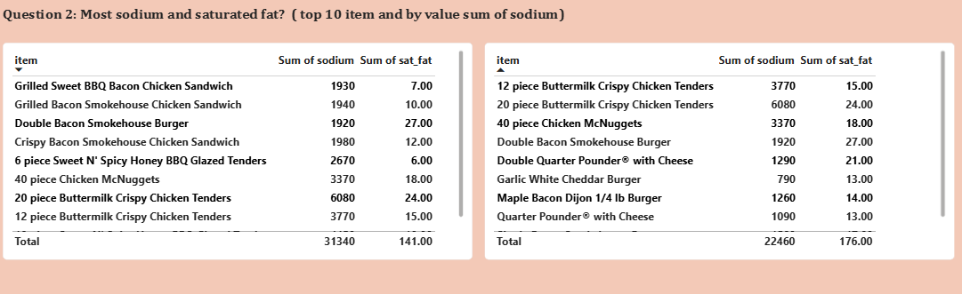
Sodium and saturated fat by item
6,080 mg sodium in the 20-piece tenders, the highest on the menu
27 g saturated fat in the Double Bacon Smokehouse Burger
Notes:
Both tables show sodium and saturated fat on the same row, so you can compare the two measures for each item.

Slide 10
Saturated fat peaks in burgers and big tenders
Why: double patties, bacon and cheese are rich in saturated fat.
Meaning: judge calories, sodium and saturated fat separately.
Notes:
Multi-layer burgers rank at the top for saturated fat even when their calories are lower than the 20-piece tenders. An item can be high risk for one measure without being highest in another.

Slide 11
Salads are far lighter
Salads (9 items)
Non-salads (48 items)
332
698
calories on average
calories on average
Sodium: 824 mg Protein: 26 g
Sodium: 1,553 mg Protein: 43 g
Why: salads replace buns, fries, fried coatings and cheese with vegetables, so calories and sodium are roughly halved. Protein is lower because there is less meat.
Notes:
Salads average 332 calories against 698 for other items, and sodium is about half. Protein is also lower because there is less meat. Toppings and dressings still matter.

Slide 12
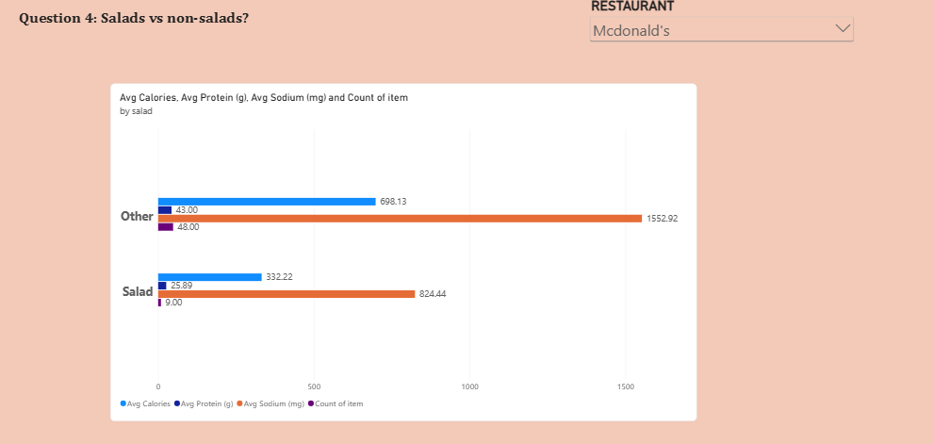
Salads vs non-salads: four measures
Calories, protein, sodium and item count by group. Sodium dominates the scale, so read the data labels.
Notes:
The non-salad bars are roughly twice as long for calories and sodium. The count bars show the groups differ in size: 48 non-salad items against 9 salads.

Slide 13
Best protein per calorie
13.13
g protein per 100 calories
Why
Grilled chicken is lean protein, with no breading or frying.
Meaning
The Bacon Ranch Salad gives 42 g protein for 320 calories.
Notes:
This ratio shows the best nutritional value. Grilled chicken salads and sandwiches lead because they give a lot of protein for few calories.

Slide 14
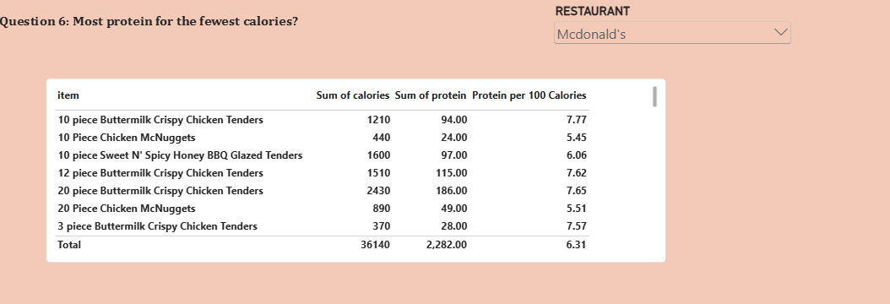
Most protein for the fewest calories
Reading the table: fried tenders give high total protein but few grams per calorie (7.77 per 100 calories for the 10-piece, at 1,210 calories).
Notes:
The Protein per 100 Calories column ranks items by protein efficiency instead of total protein. Large fried tender portions deliver high absolute protein but at a high calorie cost.

Slide 15
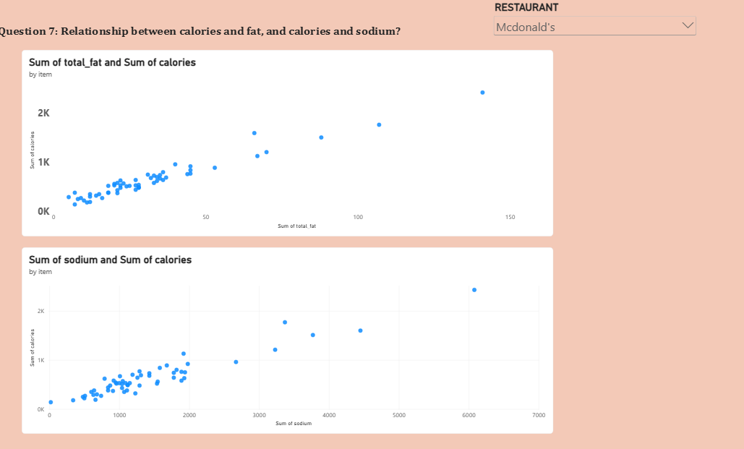
Fat drives calories
0.97
calories and total fat
0.95
calories and sodium
0.95
calories and protein
Why: fat has 9 calories per gram versus 4 for carbs and protein.
Notes:
Both scatter charts rise tightly along a linear trend. Correlation of calories with fat is about 0.97, and with sodium and protein about 0.95. This shows a relationship, not proof of cause.

Slide 16
Almost half the menu is high calorie
Low (under 300)
8 items, 14.04%
Medium (300 to 600)
25 items, 43.86%
57
menu items
High (over 600)
24 items, 42.11%
Meaning: low-calorie choices are limited; nearly one item in two exceeds 600 calories.
Notes:
Of 57 items, 8 are low calorie, 25 are medium and 24 are high. The menu is built around burgers, sandwiches and fried chicken, with few light options.

Slide 17
Diagnostic summary
Insight | Evidence
Large portions drive extremes | Calories reach 2,430 and sodium 6,080 mg in multi-piece fried sharing items
Frying, breading, cheese, bacon | 19 of 57 items exceed 1,500 mg sodium; saturated fat peaks at 27 g
Fat is the main calorie driver | Calories and fat correlate at about 0.97; fat has 9 calories per gram vs 4
Salads and grilled chicken lead | Salads average 332 vs 698 calories; grilled chicken gives up to 13.13 g protein per 100 calories
The menu is calorie-heavy | 42.11% of items exceed 600 calories; only 8 of 57 are under 300
Notes:
Summarise the five main insights and the evidence behind each.

Slide 18
Recommendations
1
Separate sharing portions
2
Add sodium warnings
3
Promote grilled options
List sharing items apart from single servings so averages are not distorted
Flag items above 1,500 mg (19 of 57 items)
Best protein per calorie on the menu
4
Add lighter items
5
Cut fat in multi-patty burgers
6
Collect price and sales data
Only 8 of 57 items are under 300 calories
Lighter cheese or sauce lowers calories and saturated fat
Link nutrition to what customers buy and pay
Notes:
Six recommendations, each tied to a finding. The last is about data: price and sales data would let us link nutrition to real customer choices.

Slide 19
Conclusion
McDonald's ranges from a 140-calorie salad to a 2,430-calorie sharing platter. The extremes come from large, fried, breaded portions, while salads and grilled chicken are the lightest, highest-value choices. Better labelling and more light options would help customers choose well.
Thank you.
Notes:
Close with the main takeaway and mention the limitation: no price or sales data. Then thank the audience.

