Slide 1
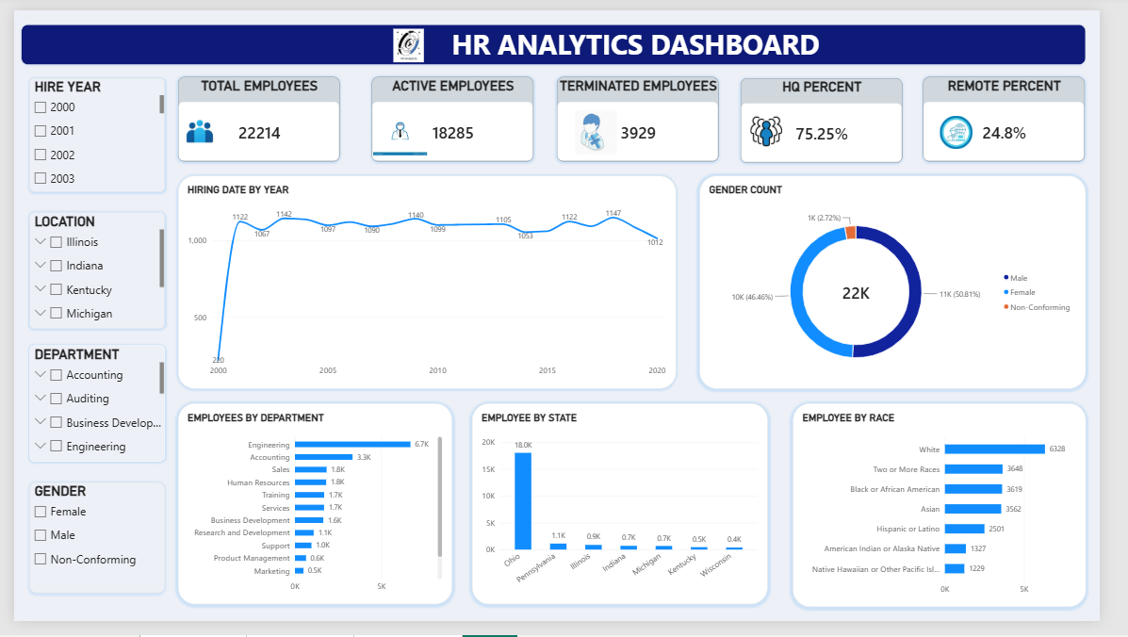
PRDA-03 · CAPSTONE PROJECT ANALYSIS REPORT
HR Analytics
Workforce composition, diversity, hiring trends and attrition: a data-driven view for HR leadership
Prepared by: Gangothri M C
Batch / Team: PTID-CDA-SEP-26-11268
Date: 01-10-2026

Slide 2



INTRODUCTION
Objective & Dataset
Objective
Dataset Overview
Tools Used
This report examines the organisation’s HR dataset to assess workforce composition, diversity, hiring patterns and employee attrition.
22,214
MySQL – data extraction, querying and KPI calculation
Power BI – interactive dashboard and chart visualisation
Word / PDF – report documentation
employee records
Source: MySQL database (project_hr_analytics), table HR
Its purpose is to give HR leadership clear, evidence-based findings and practical recommendations.
Key attributes: employee ID, name, birthdate, age, gender, race, department, job title, work location (remote/HQ), hire date, termination date, city and state
HR Analytics — PRDA-03 Capstone | Gangothri M C
2

Slide 3
POWER BI DASHBOARD
Dashboard Overview
HR Analytics — PRDA-03 Capstone | Gangothri M C
3

Slide 4
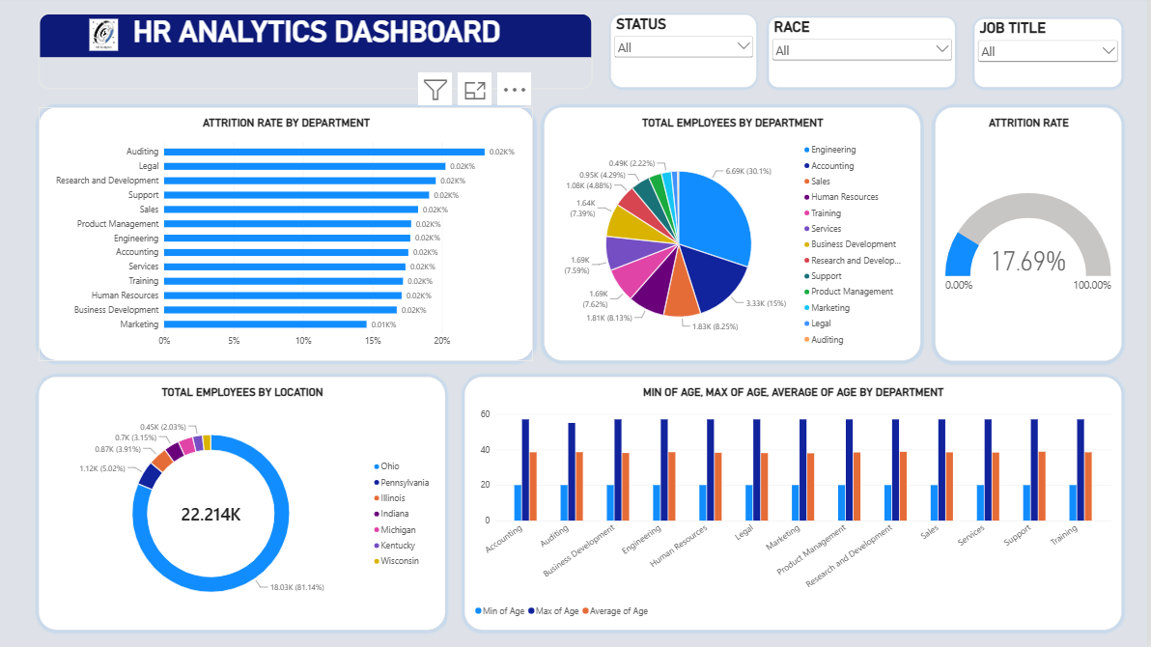
POWER BI DASHBOARD
Attrition & Location View
HR Analytics — PRDA-03 Capstone | Gangothri M C
4

Slide 5
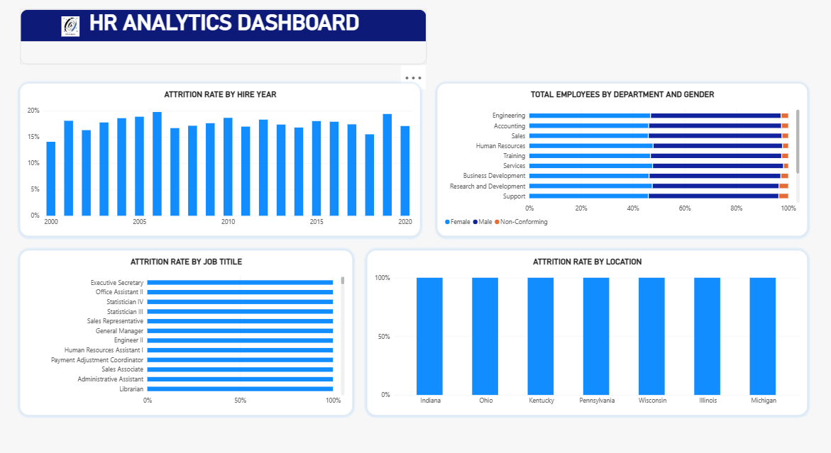
POWER BI DASHBOARD
Hiring & Job Title View
HR Analytics — PRDA-03 Capstone | Gangothri M C
5

Slide 6
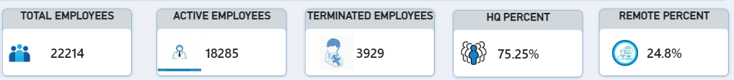
KPIS
Key Performance Indicators
82.3%
17.69%
75.25%
Active workforce
Overall attrition
HQ-based
18,285 of 22,214 employees are currently active
3,929 employees have left the company
24.8% of employees work remotely
Total Employees counts every record in the HR table; Active Employees excludes anyone with a termination date on file. All splits are calculated across the full employee base.
HR Analytics — PRDA-03 Capstone | Gangothri M C
6

Slide 7
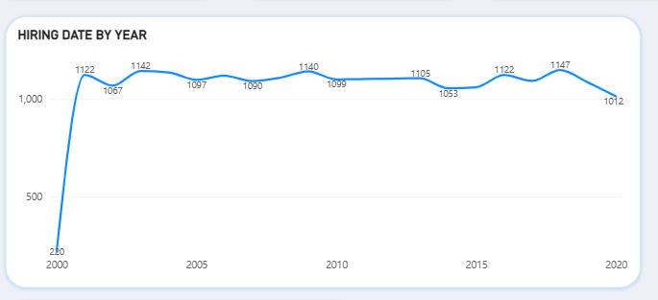
CHART 1 · LINE CHART
Hiring Rate by Year
INSIGHT
1,147
peak hires, in 2018
Steady hiring for two decades
Hiring started low in 2000 (220 hires, a partial first year), then held at roughly 1,050–1,150 per year from 2001 to 2019. The 2020 dip to 1,012 may be a slowdown or incomplete data.
HR Analytics — PRDA-03 Capstone | Gangothri M C
7

Slide 8
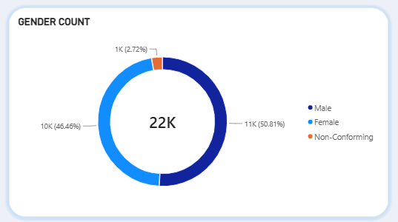
CHART 2 · DONUT CHART
Gender Split
INSIGHT
50.8%
Male employees (11,288)
Gender mix is well balanced
Female employees are 46.5% (10,321) and Non-Conforming employees 2.7% (605). There is no significant gender imbalance company-wide.
HR Analytics — PRDA-03 Capstone | Gangothri M C
8

Slide 9
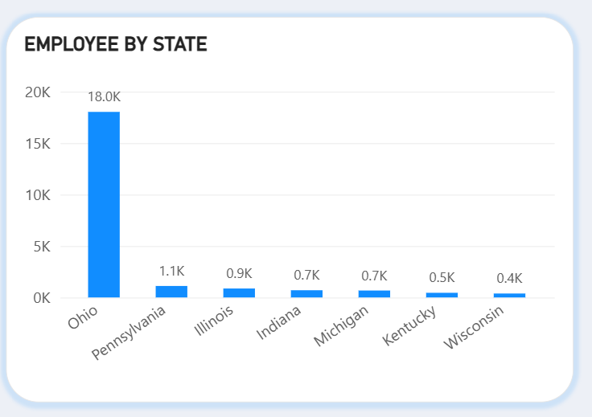
CHART 3 · BAR CHART
Headcount by State
INSIGHT
81%
of staff in Ohio (18,025)
Heavy dependence on one state
Pennsylvania (1,115), Illinois (868), Indiana (700), Michigan (673), Kentucky (451) and Wisconsin (382) are all minor by comparison.
HR Analytics — PRDA-03 Capstone | Gangothri M C
9

Slide 10
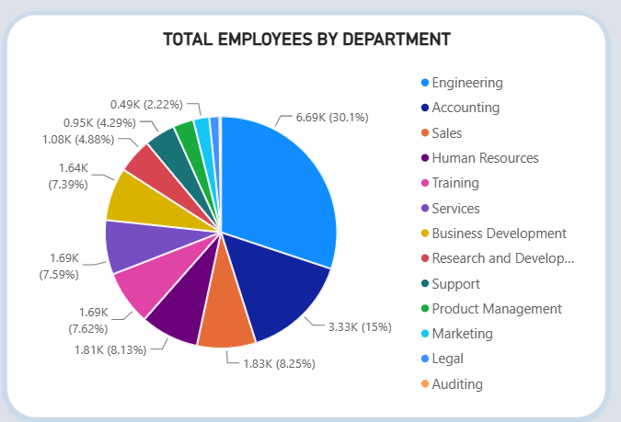
CHART 4 · PIE CHART
Total Employees by Department
INSIGHT
45%
in Engineering + Accounting
Headcount sits in two departments
Engineering has 6.69K employees (30.1%), about twice Accounting at 3.33K (15%). Sales, HR, Training, Services and Business Development hold roughly 7–8% each.
HR Analytics — PRDA-03 Capstone | Gangothri M C
10

Slide 11
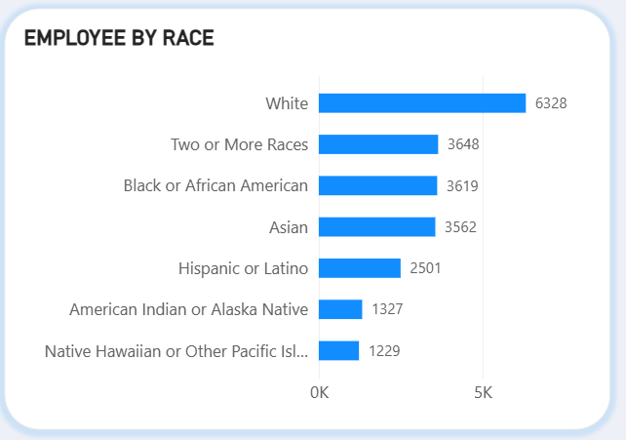
CHART 5 · BAR CHART
Employees by Race
INSIGHT
28.5%
White, the largest group (6,328)
Reasonably diverse company-wide
Two or More Races (3,648), Black or African American (3,619) and Asian (3,562) follow closely. No group holds an overwhelming majority.
HR Analytics — PRDA-03 Capstone | Gangothri M C
11

Slide 12
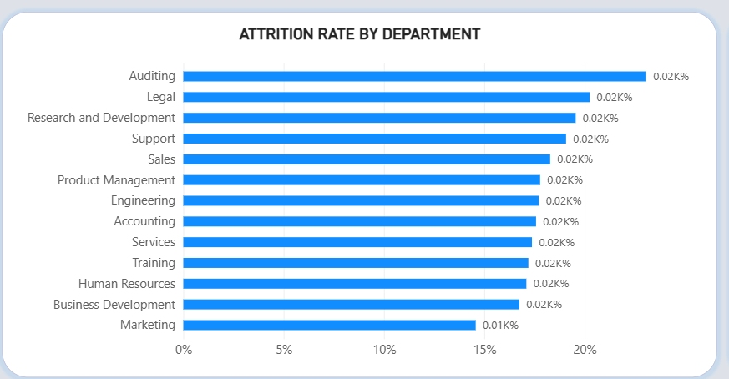
CHART 6 · BAR CHART
Attrition Rate by Department
INSIGHT
23.1%
Auditing, highest rate*
Legal and R&D need attention
Legal is at 20.3% and R&D at 19.6%; Marketing is lowest at 14.6%. *Auditing has only 52 employees, so a few exits swing its rate sharply.
HR Analytics — PRDA-03 Capstone | Gangothri M C
12

Slide 13
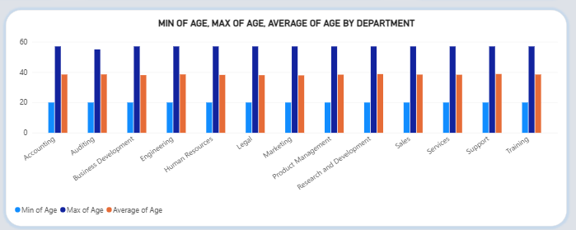
CHART 7 · BAR CHART
Average, Minimum & Maximum Age
INSIGHT
38–39
average age in every department
Age is evenly spread
Minimum (20) and maximum (57) ages are consistent across departments, so no single team carries a disproportionate retirement risk.
HR Analytics — PRDA-03 Capstone | Gangothri M C
13

Slide 14
FINDINGS
Insights Summary
Workforce
Age Mix
Hiring
Gender
82.3% active and 17.7% have left; 75.25% HQ-based vs 24.75% remote.
Average age is 38 (38–39 in every department), with a 20–57 range.
Stable at 1,050–1,150 hires a year since 2001, with no growth spurt or freeze.
Balanced: 50.8% Male, 46.5% Female, 2.7% Non-Conforming.
Geography
Departments
Diversity
Attrition
81% of staff are based in Ohio, a significant single-location concentration.
Engineering and Accounting hold 45% of headcount; Auditing is smallest (0.2%).
No racial group exceeds 29% of the workforce.
17.69% overall; Auditing, Legal and R&D run highest.
HR Analytics — PRDA-03 Capstone | Gangothri M C
14

Slide 15
ACTION PLAN
Recommendations
1
Strengthen retention in Auditing, Legal and R&D
All run well above the 17.69% average (23.1%, 20.3%, 19.6%). Start with exit interviews and a workload and compensation review; Auditing’s rate reflects a small team of 52.
2
Reduce geographic concentration risk
81% of staff are in Ohio. Consider broader remote hiring or a second regional hub.
3
Broaden remote work options
Only 24.75% work remotely; a pilot with wider eligibility would widen the talent pool beyond Ohio.
4
Review Engineering and Accounting headcount
Together they hold 45% of employees; confirm this matches strategic staffing plans.
5
Keep monitoring diversity metrics
Add department-level slicers for gender and race to confirm balance within each team, especially Engineering and Accounting.
HR Analytics — PRDA-03 Capstone | Gangothri M C
15

Slide 16
CONCLUSION
A large, balanced workforce of 22,214 employees, with steady hiring and 17.69% attrition.
The two most significant findings are the heavy geographic concentration in Ohio (81% of staff) and elevated attrition in Legal and Research & Development, alongside Auditing’s high rate on a small base. Reducing geographic risk and introducing targeted retention measures should be HR leadership’s highest-priority actions.
Thank you
Gangothri M C · PTID-CDA-SEP-26-11268

