Slide 1
APPLE Stock Price Prediction
PRESENTED BY:
2103A52022 – K. Ganesh
2103A52025 – N. Shiva Teja
2103A52026-P. Jayavardhan

Slide 2
INTRODUCTION
Apple Stock Price prediction is the act of trying to determine the future value of an Apple stock or other financial instrument traded on an exchange.
The successful prediction of a stock's future price could yield significant profit.
Apple Stock Price prediction refers to the process of understanding various aspects of the Apple stock that can influence the price of a stock and based on these potential factors building a model to predict the price of the stock.
The Stock-Forecasting software predicts stock prices, generates trading "Buy-Hold-Sell" signals, computes the most profitable company to invest in and analyzes the accuracy of predictions.

Slide 3
Prediction and analysis of the stock market are some of the most complicated tasks to do. There are several reasons for this, such as the market volatility and so many other dependent and independent factors for deciding the value of a particular stock in the market. These factors make it very difficult for any stock market analyst to predict the rise and fall with high accuracy degrees.
Stock market prediction is the act of trying to determine the future value of a company stock or other financial instrument traded on an exchange.

Slide 4
ADVANTAGES
Platform for stock value prediction using multiple algorithms at a time.
Develops the habit of complete analysis.
Minimize the losses.
Assures Consistency.
Gives a better idea about entry and exit points.
User friendly and simply to use.

Slide 5
About DATASET
It is Supervised Machine Learning.
Supervised learning, also known as supervised machine learning, is a subcategory of machine learning and artificial intelligence.
It is defined by its use of labeled datasets to train algorithms that to classify data or predict outcomes accurately.
This dataset contains 2519 number of rows and 7 number of columns.
As this dataset considered as Supervised because it is labeled dataset to train algorithms that to classify data or predict outcomes accurately.

Slide 6
target
Before going forward, let’s quickly clarify what we are trying to predict here.
The stock market (or also called an exchange) is simply like any other market, but here stocks, i.e., shares of a company, are bought and sold.
In its simplest form, people buy a stock at a lower price, and as the company grows and its share value, aka stock price, increases, and the stockholder sells it at the market for a profit.
What the model needs to do is predict what will be the price of the stock in upcoming days.

Slide 7
Features/Independent values
Date
Close
High
Low
Open
Volume
Adj Close

Slide 8
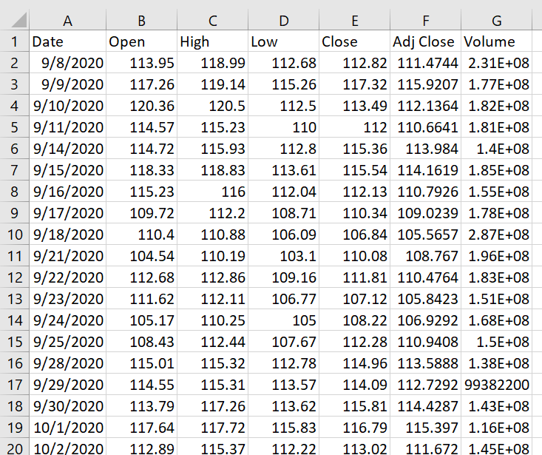
DATASET

Slide 9
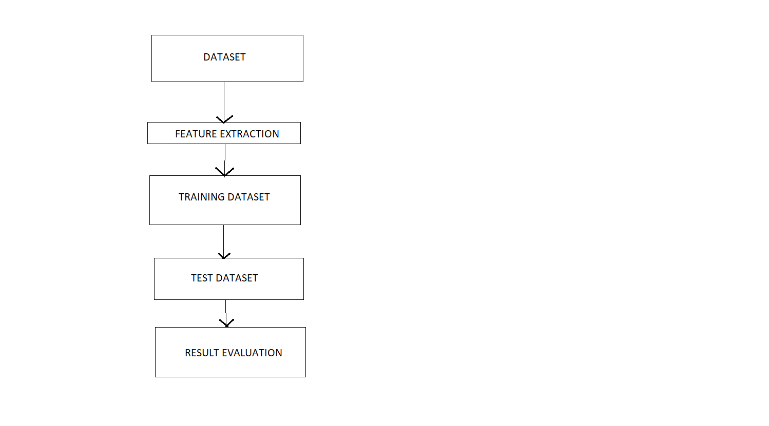
Flowchart

Slide 10
Linear Regression
One of the most straightforward techniques, Linear Regression, can be used to predict any continuous values, including the predictions of the stock price.
Linear Regression, as the name suggests, is a linear technique, i.e., it finds the linear combination of the X variables that are used to predict the Y variable (the stock price in this case).
The major advantage of this method is that it is high in interpretability as the user can know which factor influences the price of stock more and by how much.
Machine Learning-based packages such as sci-kit learn to allow the user to use Linear Regression in a Machine Learning framework. Some libraries in R also allow the same, but the disadvantage persists.

Slide 11
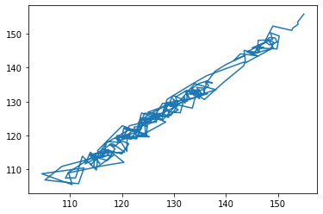
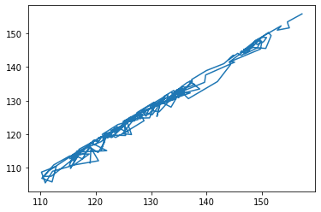
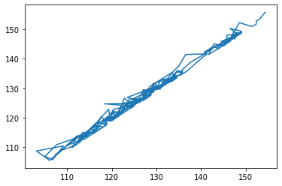
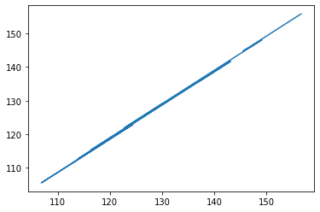
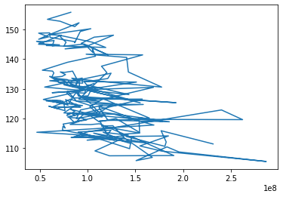
GRAPHS
X=Open ,Y =Adj close
X=High ,Y =Adj close
X=Low ,Y =Adj close
X=Close ,Y =Adj close
X=Volume ,Y =Adj close

Slide 12
Conclusion
However, with the introduction of Machine Learning and its strong algorithms, the most recent market research and Stock Market Prediction advancements have begun to include such approaches in analyzing stock market data. The Opening Value of the stock, the Highest and Lowest values of that stock on the same days, as well as the Closing Value at the end of the day, are all indicated for each date.
Predicting the stock market was a time-consuming and laborious procedure a few years or even a decade ago. However, with the application of machine learning for stock market forecasts, the procedure has become much simpler. Machine learning not only saves time and resources but also outperforms people in terms of performance. it will always prefer to use a trained computer algorithm since it will advise you based only on facts, numbers, and data and will not factor in emotions or prejudice.

Slide 13
THANK YOU

