Slide 1
Brain imaging data (fMRI)
pattern recognition
Ganijon Rahimov

Slide 2

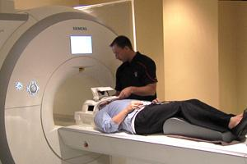
fMRI Machine

Slide 3
Functional Magnetic Resonance Imaging (fMRI)
FMRI is a technique for obtaining 3D images related to neural activity in the brain through time.
fMRI is Blood oxygen level dependent(BOLD) used to detect brain activity.
It works by detecting the changes in blood oxygenation and flow that occurs in response to neural activity
fMRI is used to produce activation maps showing which parts of the brain are involved in a particular mental process.

Slide 4
fMRI Process
The sensitivity of fMRI in detecting neural activation is dependent on the relative level of signal and noise in the time-series data.
the whole brain is represented/divided into a number of unit volumes called Voxels.
This will helps in production of high dimensional data
An fMRI scanner measure the value of fMRI signals at all the points in a three dimensional grid every few seconds(4-6)

Slide 5
Project Objective and Method
Our project is targeted on to make predictions whether an individual is reading a sentence or perceiving(seeing) a picture at a given time..
Neural network is trained with a picture and sentence data received from fMRI machine and able to predict for future problems(inputs).
Neural network classifier is used for classification of the data collected.
MATLAB is used for implementation.

Slide 6
The Experiment
The experiment consists of a set of trials, and data is partitioned into trials.
The subject was shown a picture and sentence.
The subject instructed to press a button to indicate whether the sentence correctly described the picture

Slide 7
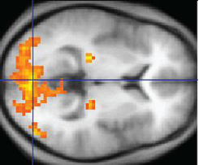
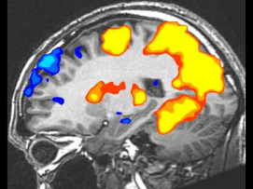
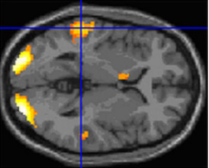
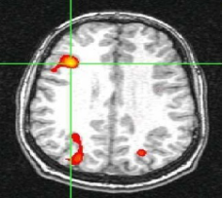
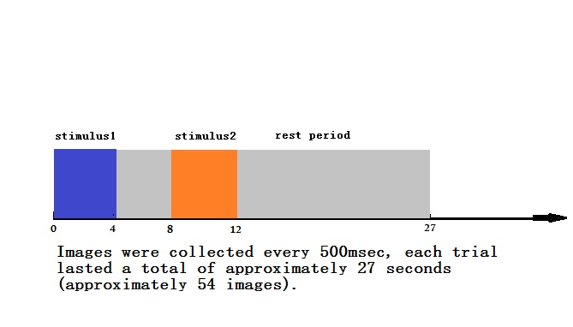

Slide 8
Timing within each such trial
The first stimulus (sentence or picture) was presented
Four seconds later the stimulus was removed.
Four seconds later the second stimulus was presented.
A rest period of 15 seconds was added after the second stimulus was removed from the screen.

Slide 9
Data structure
meta
provides information about the data set, e.g.: subject: '05710', ntrials: 54, nvoxels: 4634, dimx: 64, dimy: 64, dimz: 8
info
This variable defines the experiment in terms of a sequence of 'trials'. Relevant fields are: cond: 2, firstStimulus: 'P'
data
This variable contains the raw observed data. The fMRI data is a sequence of images collected over time, one image each 500 msec.

Slide 10
Feature Selection and Preprocessing
Data from data set is loaded
Collect the non-noise and non-fixation trials
Creates examples for a fixation learning task
Returns a copy of info, data, meta containing only the specified trials
Gets the data based on the condition specified in the cond of info dataset
turns a trial (#voxels over a time interval corresponding to performance of the task in a given condition) into example.

Slide 11
Regions of Interest (ROI)
A copy of info, data, and meta, selecting voxels that belong to ROIs found on ROI list.
Seven ROIs are selected since they are enough to classify picture and sentence.
IDM where the data contains just the voxels belonging to the seven regions are returned.

Slide 12
Separate Pictures and Sentences
First, picture and sentence are selected from the trail.
To read picture and sentence separately: slice time correction is applied.
Each voxel is acquired at different time point in one Time of repetition (picture in first 16 seconds and sentence in next 16 seconds or vice versa)
Convert IDM structure to examples
combine examples, labels structure, which can be used in training and applying a classifier.

Slide 13
Network Architecture
NetLab Toolbox (Matlab)
Network type: 3-layer feed-forward multi-layer perceptron network
number of hidden neurons: 2 = number of classes
number of output neurons: 2 = number of classes
Output activation function: softmax
common for classification problems, uses 1-of-N encoding
scales output of each neuron down, so the total output is 1
clear winner is neuron with output closer to 1
Optimization method: scaled conjugate gradient
converges generally faster than gradient descent optimization on mlp with backpropagation
search is performed along conjugate gradient directions to determine the step size

Slide 14
Classification process
Prepare training data
Normalize data points to mean 0 stdv 1
Convert targets into 1-of-N encoding
Training network using 'scg' optimizer
net = netopt(net, options, x, t, 'scg')
Cross-validation using 'leave-one-out' method
k-fold method extended, by k = N (# of input vectors)
Testing using test subject data flipped in order
Performance measurement using confusion matrix

Slide 15
Demo
Dataset
Code
Results

Slide 16
References
Keller, T. A., Just, M. A., & Stenger, V. A. (2001). Reading span and the time-course of cortical activation in sentence-picture verification. Annual Convention of the Psychonomic Society, Orlando, FL.
Wang, X., Mitchell, T., Detecting cognitive states using machine learning. Iterim working paper, October 2002.
Ramish, J., Learning common features from fMRI data of multiple subjects. Summer project report, August 2004.
"Learning to Identify Overlapping and Hidden Cognitive Processes from fMRI Data,"R. Hutchinson, T.M. Mitchell, I. Rustandi, submitted to HBM 2005.
"Learning to Decode Cognitive States from Brain Images,"T.M. Mitchell, R. Hutchinson, R.S. Niculescu, F.Pereira, X. Wang, M. Just, and S. Newman, Machine Learning, Vol. 57, Issue 1-2, pp. 145-175. October 2004.
"Training fMRI Classifiers to Detect Cognitive States across Multiple Human Subjects ," X. Wang, R. Hutchinson, and T. M. Mitchell, Neural Information Processing Systems 2003. December 2003.
"Classifying Instantaneous Cognitive States from fMRI Data," T. Mitchell, R. Hutchinson, M. Just, R.S. Niculescu, F. Pereira, X. Wang, American Medical Informatics Association Symposium, October 2003.

