Slide 1
Library Management System
Saifullah Safdar
Ganijon Rahimov

Slide 2
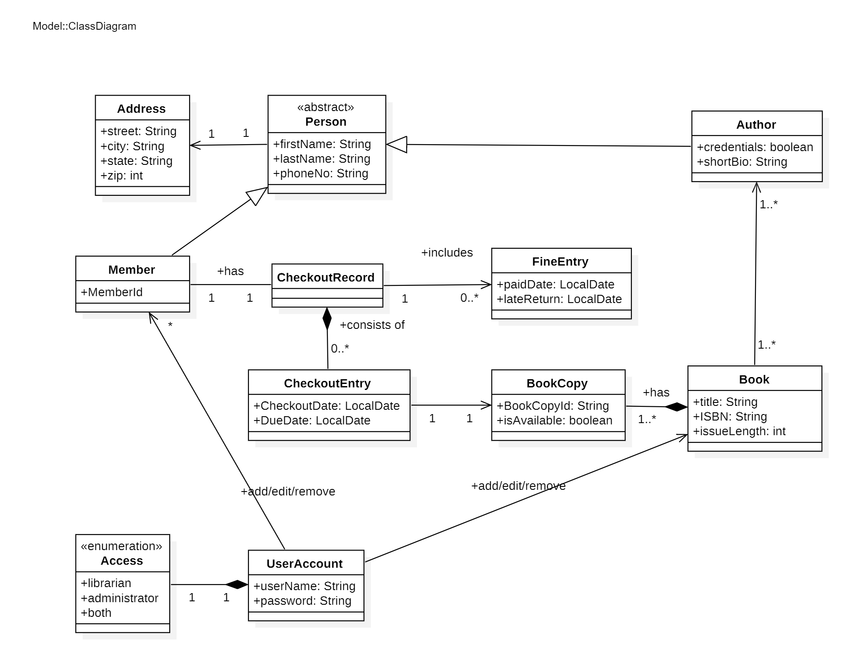

Slide 3
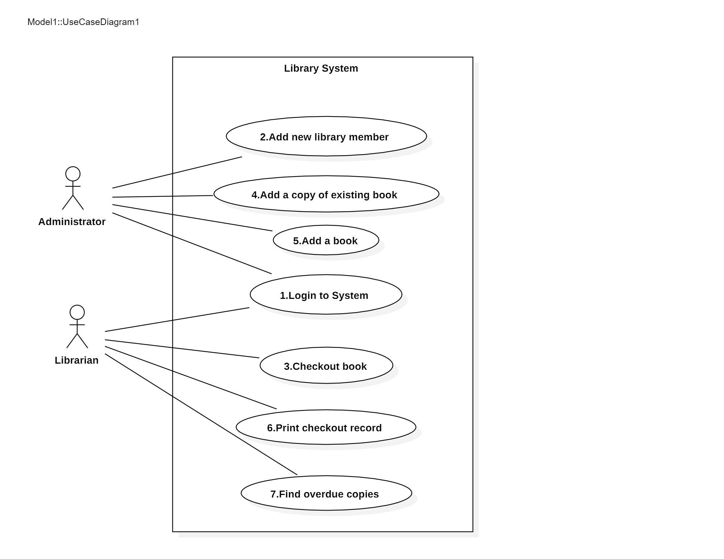

Slide 4
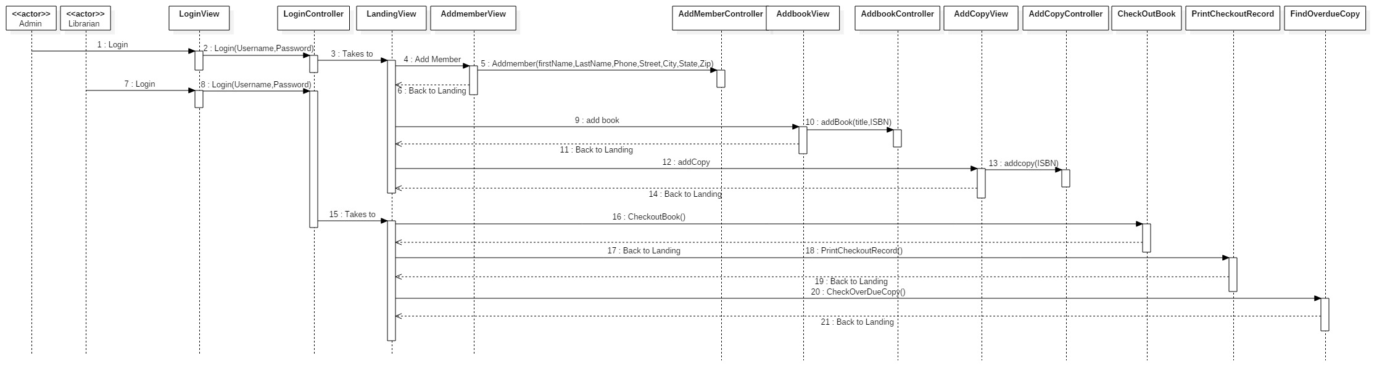

Slide 5
Development Approach

Slide 6
Demo

Slide 7
Quastions

Slide 8
Thankx

