Slide 1
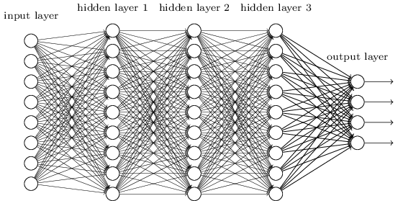
Lecture 5 Smaller Network: CNN
We know it is good to learn a small model.
From this fully connected model, do we really need all the edges?
Can some of these be shared?

Slide 2
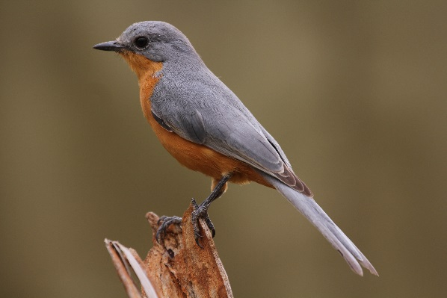
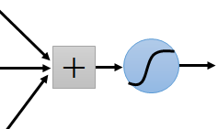
Consider learning an image:
Some patterns are much smaller than the whole image
Can represent a small region with fewer parameters
“beak” detector

Slide 3
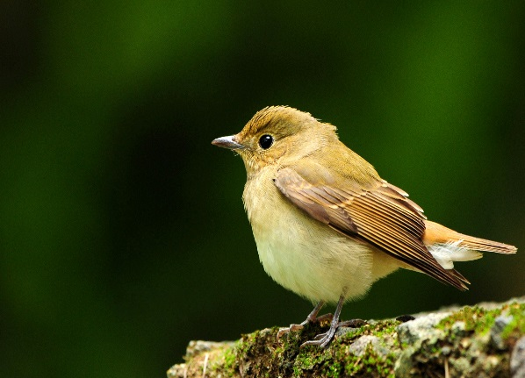
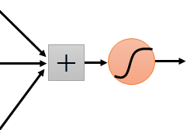

Same pattern appears in different places:
They can be compressed!
What about training a lot of such “small” detectors and each detector must “move around”.
“upper-left beak” detector
They can be compressed
to the same parameters.
“middle beak” detector

Slide 4
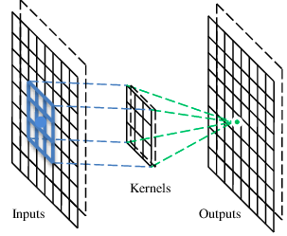
A convolutional layer
A CNN is a neural network with some convolutional layers
(and some other layers). A convolutional layer has a number
of filters that does convolutional operation.
Beak detector
A filter

Slide 5
Convolution
These are the network parameters to be learned.
1 | -1 | -1
-1 | 1 | -1
-1 | -1 | 1
1 | 0 | 0 | 0 | 0 | 1
0 | 1 | 0 | 0 | 1 | 0
0 | 0 | 1 | 1 | 0 | 0
1 | 0 | 0 | 0 | 1 | 0
0 | 1 | 0 | 0 | 1 | 0
0 | 0 | 1 | 0 | 1 | 0
Filter 1
-1 | 1 | -1
-1 | 1 | -1
-1 | 1 | -1
Filter 2
……
6 x 6 image
Each filter detects a small pattern (3 x 3).

Slide 6
Convolution
1 | -1 | -1
-1 | 1 | -1
-1 | -1 | 1
Filter 1
stride=1
1 | 0 | 0 | 0 | 0 | 1
0 | 1 | 0 | 0 | 1 | 0
0 | 0 | 1 | 1 | 0 | 0
1 | 0 | 0 | 0 | 1 | 0
0 | 1 | 0 | 0 | 1 | 0
0 | 0 | 1 | 0 | 1 | 0
Dot
product
3
-1
6 x 6 image

Slide 7
Convolution
1 | -1 | -1
-1 | 1 | -1
-1 | -1 | 1
Filter 1
If stride=2
1 | 0 | 0 | 0 | 0 | 1
0 | 1 | 0 | 0 | 1 | 0
0 | 0 | 1 | 1 | 0 | 0
1 | 0 | 0 | 0 | 1 | 0
0 | 1 | 0 | 0 | 1 | 0
0 | 0 | 1 | 0 | 1 | 0
3
-3
6 x 6 image

Slide 8
Convolution
1 | -1 | -1
-1 | 1 | -1
-1 | -1 | 1
Filter 1
stride=1
1 | 0 | 0 | 0 | 0 | 1
0 | 1 | 0 | 0 | 1 | 0
0 | 0 | 1 | 1 | 0 | 0
1 | 0 | 0 | 0 | 1 | 0
0 | 1 | 0 | 0 | 1 | 0
0 | 0 | 1 | 0 | 1 | 0
3
-1
-3
-1
-3
1
0
-3
-3
-3
0
1
3
-2
-2
-1
6 x 6 image

Slide 9
Convolution
-1 | 1 | -1
-1 | 1 | -1
-1 | 1 | -1
Filter 2
stride=1
Repeat this for each filter
1 | 0 | 0 | 0 | 0 | 1
0 | 1 | 0 | 0 | 1 | 0
0 | 0 | 1 | 1 | 0 | 0
1 | 0 | 0 | 0 | 1 | 0
0 | 1 | 0 | 0 | 1 | 0
0 | 0 | 1 | 0 | 1 | 0
3
-1
-3
-1
-1
-1
-1
-1
-3
1
0
-3
-1
-1
-2
1
Feature
Map
-3
-3
0
1
-1
-1
-2
1
3
-2
-2
-1
6 x 6 image
-1
0
-4
3
Two 4 x 4 images
Forming 2 x 4 x 4 matrix

Slide 10
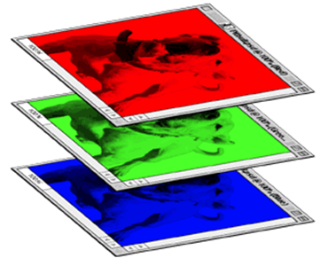
Color image: RGB 3 channels
1 | -1 | -1
-1 | 1 | -1
-1 | -1 | 1
-1 | 1 | -1
-1 | 1 | -1
-1 | 1 | -1
1 | -1 | -1
-1 | 1 | -1
-1 | -1 | 1
-1 | 1 | -1
-1 | 1 | -1
-1 | 1 | -1
1 | -1 | -1
-1 | 1 | -1
-1 | -1 | 1
-1 | 1 | -1
-1 | 1 | -1
-1 | 1 | -1
Filter 1
Filter 2
Color image
1 | 0 | 0 | 0 | 0 | 1
0 | 1 | 0 | 0 | 1 | 0
0 | 0 | 1 | 1 | 0 | 0
1 | 0 | 0 | 0 | 1 | 0
0 | 1 | 0 | 0 | 1 | 0
0 | 0 | 1 | 0 | 1 | 0
1 | 0 | 0 | 0 | 0 | 1
0 | 1 | 0 | 0 | 1 | 0
0 | 0 | 1 | 1 | 0 | 0
1 | 0 | 0 | 0 | 1 | 0
0 | 1 | 0 | 0 | 1 | 0
0 | 0 | 1 | 0 | 1 | 0
1 | 0 | 0 | 0 | 0 | 1
0 | 1 | 0 | 0 | 1 | 0
0 | 0 | 1 | 1 | 0 | 0
1 | 0 | 0 | 0 | 1 | 0
0 | 1 | 0 | 0 | 1 | 0
0 | 0 | 1 | 0 | 1 | 0

Slide 11
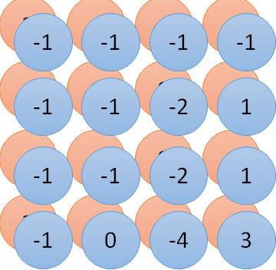



Convolution v.s. Fully Connected
1 | 0 | 0 | 0 | 0 | 1
0 | 1 | 0 | 0 | 1 | 0
0 | 0 | 1 | 1 | 0 | 0
1 | 0 | 0 | 0 | 1 | 0
0 | 1 | 0 | 0 | 1 | 0
0 | 0 | 1 | 0 | 1 | 0
1 | -1 | -1
-1 | 1 | -1
-1 | -1 | 1
-1 | 1 | -1
-1 | 1 | -1
-1 | 1 | -1
convolution
image
1 | 0 | 0 | 0 | 0 | 1
0 | 1 | 0 | 0 | 1 | 0
0 | 0 | 1 | 1 | 0 | 0
1 | 0 | 0 | 0 | 1 | 0
0 | 1 | 0 | 0 | 1 | 0
0 | 0 | 1 | 0 | 1 | 0
Fully-connected
……
……

Slide 12
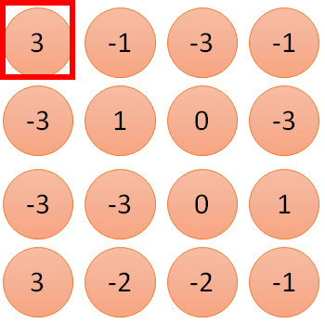

1 | -1 | -1
-1 | 1 | -1
-1 | -1 | 1
1
1
Filter 1
2
0
3
0
3
4:
0
1 | 0 | 0 | 0 | 0 | 1
0 | 1 | 0 | 0 | 1 | 0
0 | 0 | 1 | 1 | 0 | 0
1 | 0 | 0 | 0 | 1 | 0
0 | 1 | 0 | 0 | 1 | 0
0 | 0 | 1 | 0 | 1 | 0
…
0
8
1
9
0
10:
0
…
13
0
6 x 6 image
14
0
fewer parameters!
15
Only connect to 9 inputs, not fully connected
1
16
1
…

Slide 13
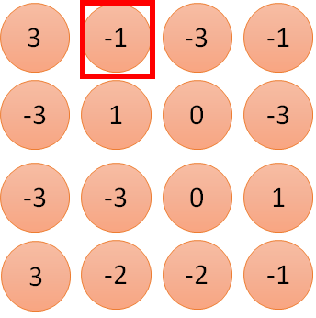


1 | -1 | -1
-1 | 1 | -1
-1 | -1 | 1
1:
1
Filter 1
2:
0
3:
0
3
4:
0
1 | 0 | 0 | 0 | 0 | 1
0 | 1 | 0 | 0 | 1 | 0
0 | 0 | 1 | 1 | 0 | 0
1 | 0 | 0 | 0 | 1 | 0
0 | 1 | 0 | 0 | 1 | 0
0 | 0 | 1 | 0 | 1 | 0
…
7:
0
8:
1
-1
9:
0
10:
0
…
13:
0
6 x 6 image
14:
0
Fewer parameters
15:
1
16:
1
Shared weights
Even fewer parameters
…

Slide 14
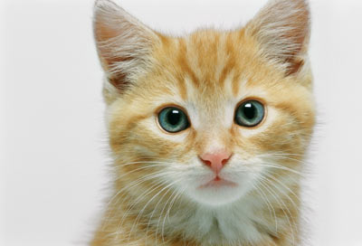

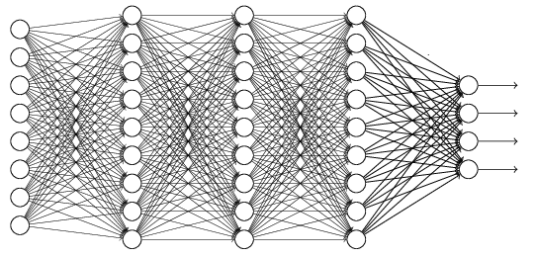

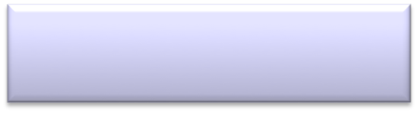



The whole CNN
cat dog ……
Convolution
Max Pooling
Can repeat many times
Fully Connected Feedforward network
Convolution
Max Pooling
Flattened

Slide 15
Max Pooling
1 | -1 | -1
-1 | 1 | -1
-1 | -1 | 1
-1 | 1 | -1
-1 | 1 | -1
-1 | 1 | -1
Filter 1
Filter 2
3
-1
-3
-1
-1
-1
-1
-1
-3
1
0
-3
-1
-1
-2
1
-3
-3
0
1
-1
-1
-2
1
3
-2
-2
-1
-1
0
-4
3

Slide 16
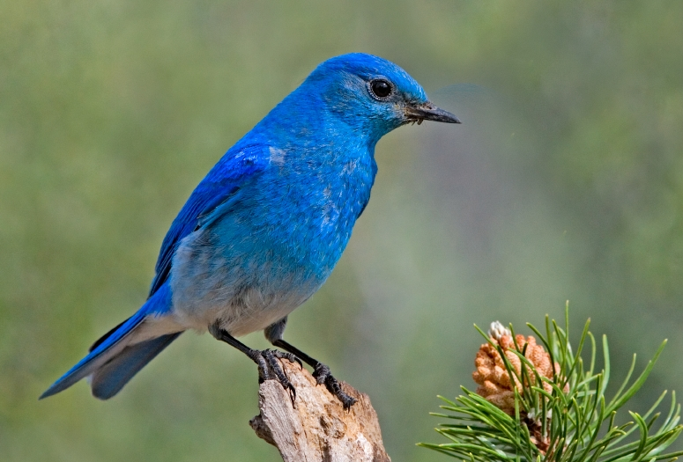

Why Pooling
Subsampling pixels will not change the object
bird
bird
Subsampling
We can subsample the pixels to make image smaller
fewer parameters to characterize the image

Slide 17
A CNN compresses a fully connected network in two ways:
Reducing number of connections
Shared weights on the edges
Max pooling further reduces the complexity

Slide 18
Max Pooling
New image
but smaller
1 | 0 | 0 | 0 | 0 | 1
0 | 1 | 0 | 0 | 1 | 0
0 | 0 | 1 | 1 | 0 | 0
1 | 0 | 0 | 0 | 1 | 0
0 | 1 | 0 | 0 | 1 | 0
0 | 0 | 1 | 0 | 1 | 0
Conv
3
0
-1
1
Max
Pooling
3
1
0
3
2 x 2 image
6 x 6 image
Each filter
is a channel

Slide 19

The whole CNN
3
0
-1
1
Convolution
3
1
0
3
Max Pooling
Can repeat many times
A new image
Convolution
Smaller than the original image
The number of channels is the number of filters
Max Pooling

Slide 20


The whole CNN
cat dog ……
Convolution
Max Pooling
Fully Connected Feedforward network
A new image
Convolution
Max Pooling
Flattened
A new image

Slide 21

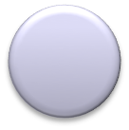


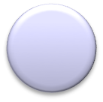
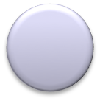


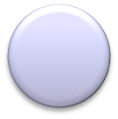
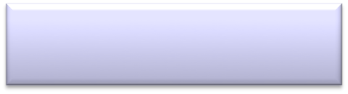
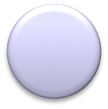
Flattening
3
0
1
3
0
-1
1
3
3
1
-1
0
3
Flattened
1
Fully Connected Feedforward network
0
3

Slide 22
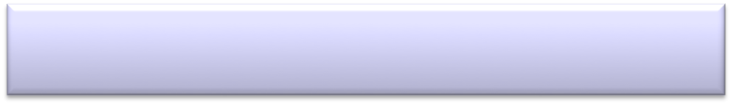


CNN in Keras
Only modified the network structure and input format (vector -> 3-D tensor)
input
Convolution
1 | -1 | -1
-1 | 1 | -1
-1 | -1 | 1
-1 | 1 | -1
-1 | 1 | -1
-1 | 1 | -1
There are 25 3x3 filters.
……
Max Pooling
Input_shape = ( 28 , 28 , 1)
28 x 28 pixels
1: black/white, 3: RGB
Convolution
3
-1
3
Max Pooling
-3
1

Slide 23



CNN in Keras
Only modified the network structure and input format (vector -> 3-D array)
Input
1 x 28 x 28
Convolution
How many parameters for each filter?
9
25 x 26 x 26
Max Pooling
25 x 13 x 13
Convolution
How many parameters
for each filter?
225=
25x9
50 x 11 x 11
Max Pooling
50 x 5 x 5

Slide 24

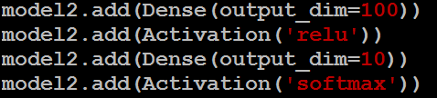

CNN in Keras
Only modified the network structure and input format (vector -> 3-D array)
Input
1 x 28 x 28
Output
Convolution
25 x 26 x 26
Fully connected feedforward network
Max Pooling
25 x 13 x 13
Convolution
50 x 11 x 11
Max Pooling
1250
50 x 5 x 5
Flattened

Slide 25
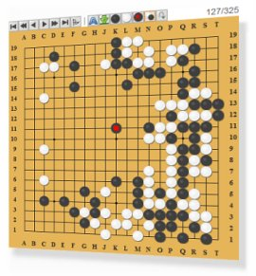


AlphaGo
Neural
Network
Next move
(19 x 19 positions)
19 x 19 matrix
Fully-connected feedforward network can be used
Black: 1
white: -1
none: 0
But CNN performs much better

Slide 26
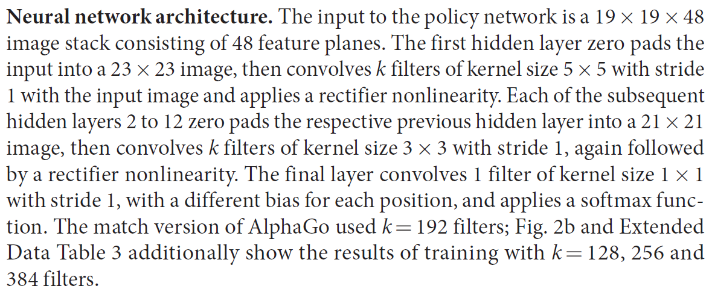
AlphaGo’s policy network
The following is quotation from their Nature article:
Note: AlphaGo does not use Max Pooling.

Slide 27
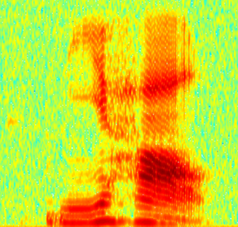
CNN in speech recognition
The filters move in the frequency direction.
CNN
Frequency
Image
Time
Spectrogram

Slide 28
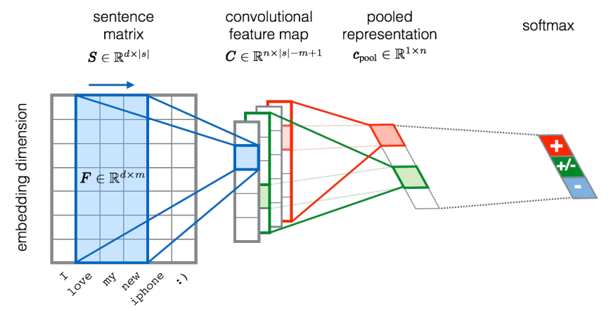
CNN in text classification
?
Source of image: http://citeseerx.ist.psu.edu/viewdoc/download?doi=10.1.1.703.6858&rep=rep1&type=pdf

