Slide 1
Introduction to Deep Learning
Ismini Lourentzou
11-30-2017

Slide 2
Outline
Machine Learning basics
Introduction to Deep Learning
what is Deep Learning
why is it useful
Main components/hyper-parameters:
activation functions
optimizers, cost functions and training
regularization methods
tuning
classification vs. regression tasks
DNN basic architectures:
convolutional
recurrent
attention mechanism
Application example: Relation Extraction
x
Backpropagation
GANs & Adversarial training
Bayesian Deep Learning
Generative models
Unsupervised / Pretraining
Most material from CS224 NLP with DL course at Stanford

Slide 3
Machine Learning Basics
Machine learning is a field of computer science that gives computers the ability to learn without being explicitly programmed
Labeled Data
Machine Learning algorithm
Training
Prediction
Labeled Data
Learned model
Prediction
Methods that can learn from and make predictions on data

Slide 4

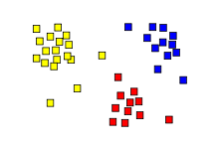
Types of Learning
Supervised: Learning with a labeled training set
Example: email classification with already labeled emails
Unsupervised: Discover patterns in unlabeled data
Example: cluster similar documents based on text
Reinforcement learning: learn to act based on feedback/reward
Example: learn to play Go, reward: win or lose
class A
class A
Classification
Regression
Clustering
Anomaly Detection
Sequence labeling
…
http://mbjoseph.github.io/2013/11/27/measure.html

Slide 5
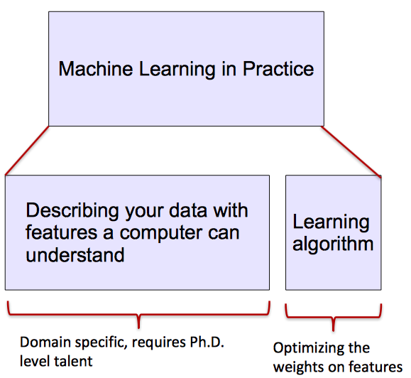
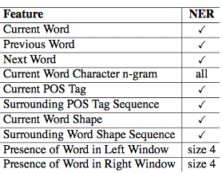
ML vs. Deep Learning
Most machine learning methods work well because of human-designed representations and input features
ML becomes just optimizing weights to best make a final prediction

Slide 6
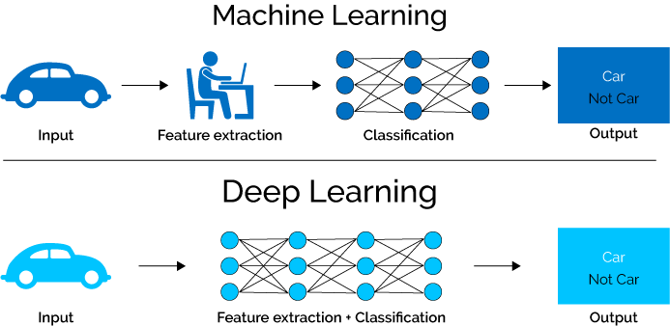
What is Deep Learning (DL) ?
A machine learning subfield of learning representations of data. Exceptional effective at learning patterns.
Deep learning algorithms attempt to learn (multiple levels of) representation by using a hierarchy of multiple layers
If you provide the system tons of information, it begins to understand it and respond in useful ways.
https://www.xenonstack.com/blog/static/public/uploads/media/machine-learning-vs-deep-learning.png

Slide 7
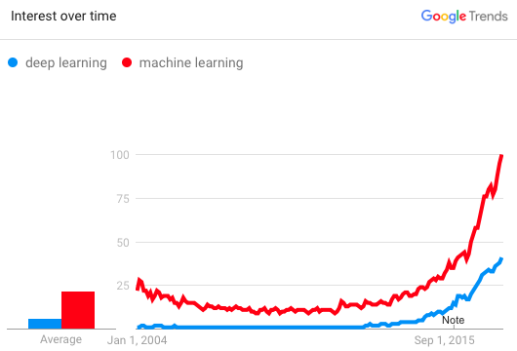
Why is DL useful?
Manually designed features are often over-specified, incomplete and take a long time to design and validate
Learned Features are easy to adapt, fast to learn
Deep learning provides a very flexible, (almost?) universal, learnable framework for representing world, visual and linguistic information.
Can learn both unsupervised and supervised
Effective end-to-end joint system learning
Utilize large amounts of training data
In ~2010 DL started outperforming other ML techniques
first in speech and vision, then NLP

Slide 8
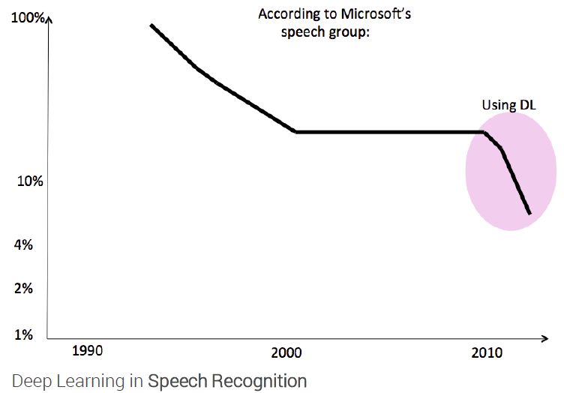
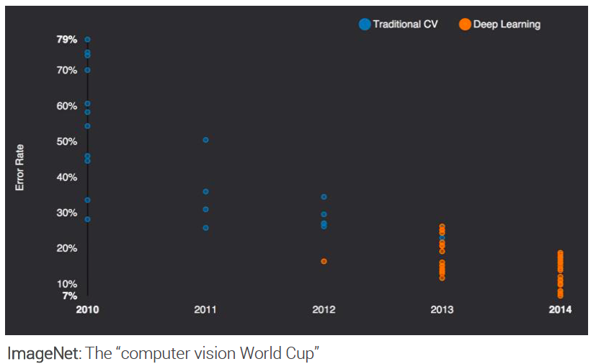
State of the art in …
Several big improvements in recent years in NLP
Machine Translation
Sentiment Analysis
Dialogue Agents
Question Answering
Text Classification …
Leverage different levels of representation
words & characters
syntax & semantics

Slide 9
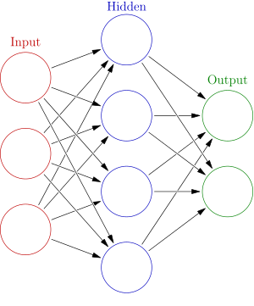



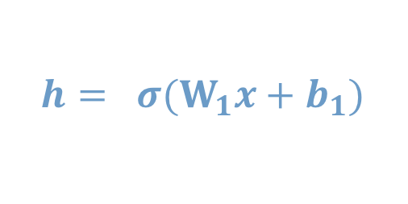

Neural Network Intro
Weights
$$h= σ(W_{1}x+b_{1})$$
$$y=σ(W_{2}h+b_{2})$$
Activation functions
How do we train?
$$y$$
$$x$$
4 + 2 = 6 neurons (not counting inputs)
[3 x 4] + [4 x 2] = 20 weights
4 + 2 = 6 biases
26 learnable parameters
$$h$$
Demo
Notes:
Hyper-parameters

Slide 10
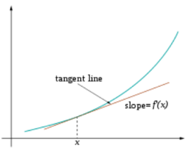
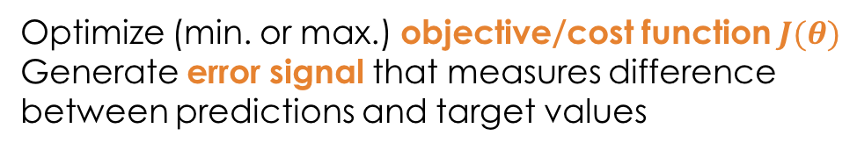
Training
Sample labeled data
(batch)
Forward it through the network, get predictions
Back-propagate the errors
Update the network weights
Optimize (min. or max.) objective/cost function $J(θ)$
Generate error signal that measures difference between predictions and target values
Use error signal to change the weights and get more accurate predictions
Subtracting a fraction of the gradient moves you towards the (local) minimum of the cost function
https://medium.com/@ramrajchandradevan/the-evolution-of-gradient-descend-optimization-algorithm-4106a6702d39

Slide 11
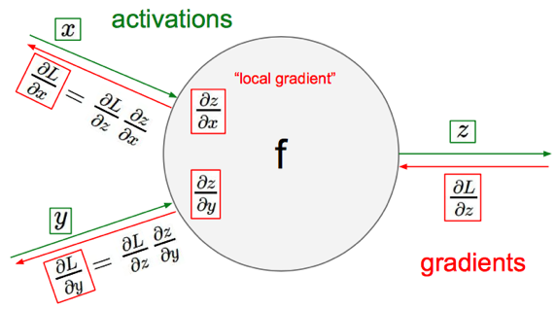

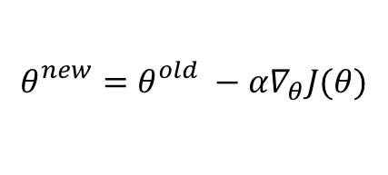
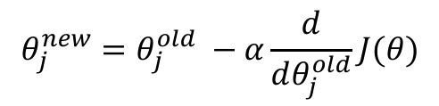
Gradient Descent
objective/cost function $J(θ)$
Review of backpropagation
$$θ_{j}^{new}=θ_{j}^{old} −α\frac{ⅆ}{ⅆθ_{j}^{old}}J(θ)$$
Update each element of θ
$$θ_{}^{new}=θ_{}^{old} −α∇_{θ}J(θ)$$
Matrix notation for all parameters
learning rate
Recursively apply chain rule though each node
Notes:
Adaptive Gradient Algorithm (AdaGrad) that maintains a per-parameter learning rate that improves performance on problems with sparse gradients (e.g. natural language and computer vision problems).
Root Mean Square Propagation (RMSProp) that also maintains per-parameter learning rates that are adapted based on the average of recent magnitudes of the gradients for the weight (e.g. how quickly it is changing). This means the algorithm does well on online and non-stationary problems (e.g. noisy).
Adam realizes the benefits of both AdaGrad and RMSProp.
Instead of adapting the parameter learning rates based on the average first moment (the mean) as in RMSProp, Adam also makes use of the average of the second moments of the gradients (the uncentered variance).
Specifically, the algorithm calculates an exponential moving average of the gradient and the squared gradient, and the parameters beta1 and beta2 control the decay rates of these moving averages.
The initial value of the moving averages and beta1 and beta2 values close to 1.0 (recommended) result in a bias of moment estimates towards zero. This bias is overcome by first calculating the biased estimates before then calculating bias-corrected estimates.

Slide 12




One forward pass
Text (input) representation
TFIDF
Word embeddings
….
0.2 | -0.5 | 0.1
2.0 | 1.5 | 1.3
0.5 | 0.0 | 0.25
-0.3 | 2.0 | 0.0
0.1
0.2
0.3
1.0
3.0
0.025
0.0
0.95
3.89
0.15
0.37
very positive
positive
negative
very negative
$$W$$
$$x_{i}$$
$$b$$
$$σ(x_{i};W, b)$$

Slide 13
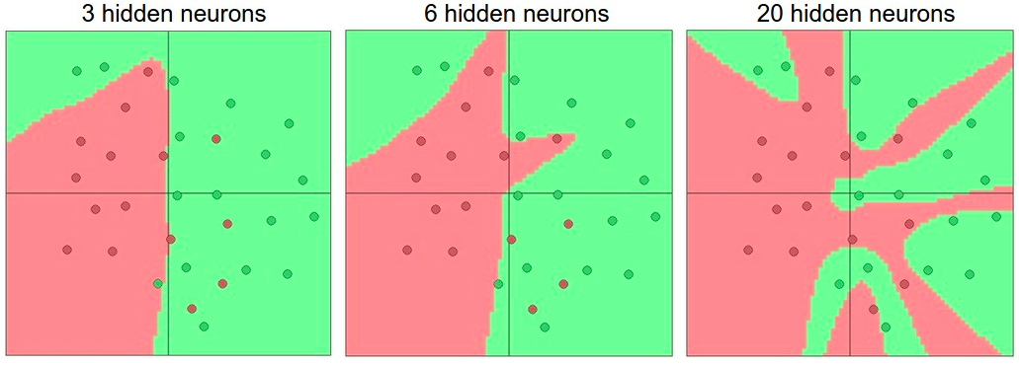

Activation functions
Non-linearities needed to learn complex (non-linear) representations of data, otherwise the NN would be just a linear function
More layers and neurons can approximate more complex functions
$W_{1}W_{2}x=Wx$
http://cs231n.github.io/assets/nn1/layer_sizes.jpeg
Full list: https://en.wikipedia.org/wiki/Activation_function

Slide 14
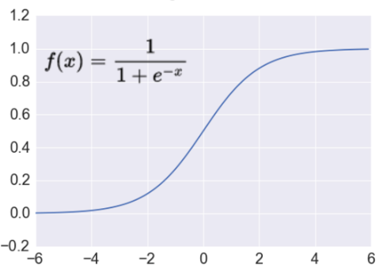

Activation: Sigmoid
Takes a real-valued number and “squashes” it into range between 0 and 1.
$$R^{n}→\left[0,1\right]$$
http://adilmoujahid.com/images/activation.png
Nice interpretation as the firing rate of a neuron
0 = not firing at all
1 = fully firing
Sigmoid neurons saturate and kill gradients, thus NN will barely learn
when the neuron’s activation are 0 or 1 (saturate)
gradient at these regions almost zero
almost no signal will flow to its weights
if initial weights are too large then most neurons would saturate

Slide 15
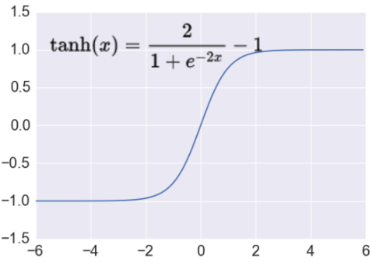
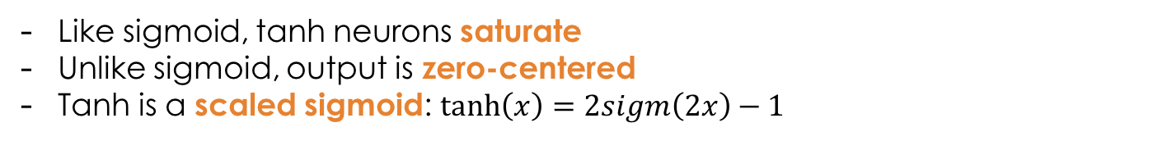

Activation: Tanh
Takes a real-valued number and “squashes” it into range between -1 and 1.
$$R^{n}→\left[−1,1\right]$$
http://adilmoujahid.com/images/activation.png
Like sigmoid, tanh neurons saturate
Unlike sigmoid, output is zero-centered
Tanh is a scaled sigmoid: $\tanh\left(x\right)=2sigm\left(2x\right)−1$
Notes:
not zero-centered: later layers of processing would be receiving data that is not zero-centered.
if data coming into a neuron is always positive then the gradient on the weights will be either all be positive, or all negative (depending on the gradient of the whole expression). Could introduce undesirable zig-zagging dynamics in the gradient weight updates. However, once these gradients are added up across a data batch the final weight update can have variable signs, somewhat mitigating this issue.

Slide 16
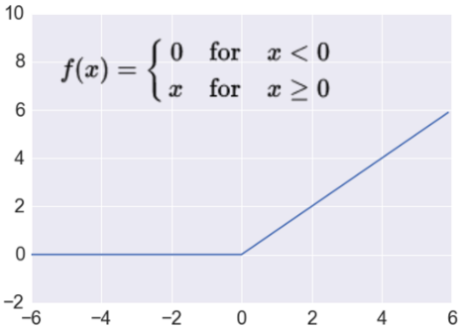

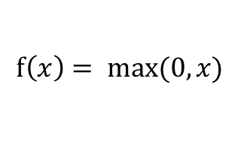
Activation: ReLU
Takes a real-valued number and thresholds it at zero
$$f\left(x\right)= max⁡(0,x)$$
$$R^{n}→R_{+}^{n}$$
http://adilmoujahid.com/images/activation.png
Most Deep Networks use ReLU nowadays
Trains much faster
accelerates the convergence of SGD
due to linear, non-saturating form
Less expensive operations
compared to sigmoid/tanh (exponentials etc.)
implemented by simply thresholding a matrix at zero
More expressive
Prevents the gradient vanishing problem
Notes:
ReLU units can “die”
large gradient flowing through a ReLU could cause weights to update in such a way that the neuron will never activate on any datapoint again
gradient flowing through the unit will forever be zero from that point on
With a proper setting of the learning rate this is less frequently an issue

Slide 17
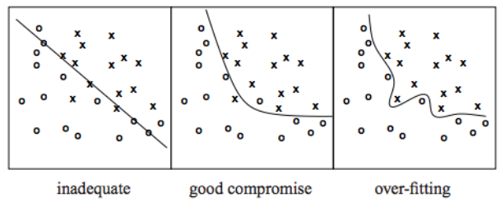
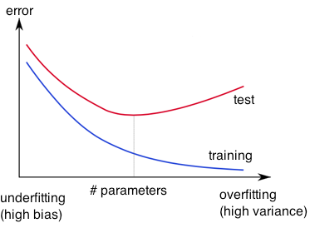
Overfitting
http://wiki.bethanycrane.com/overfitting-of-data
Learned hypothesis may fit the training data very well, even outliers (noise) but fail to generalize to new examples (test data)
https://www.neuraldesigner.com/images/learning/selection_error.svg

Slide 18
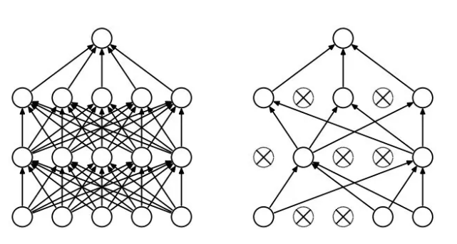
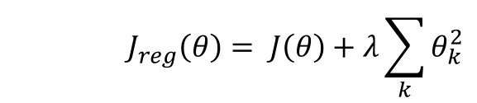
Regularization
Dropout
Randomly drop units (along with their connections) during training
Each unit retained with fixed probability p, independent of other units
Hyper-parameter p to be chosen (tuned)
Srivastava, Nitish, et al. "Dropout: a simple way to prevent neural networks from overfitting." Journal of machine learning research (2014)
L2 = weight decay
Regularization term that penalizes big weights, added to the objective
Weight decay value determines how dominant regularization is during gradient computation
Big weight decay coefficient → big penalty for big weights
$$J_{reg}\left(θ\right)= J\left(θ\right)+λ\sum_{k}{θ_{k}^{2}}$$
Early-stopping
Use validation error to decide when to stop training
Stop when monitored quantity has not improved after n subsequent epochs
n is called patience

Slide 19
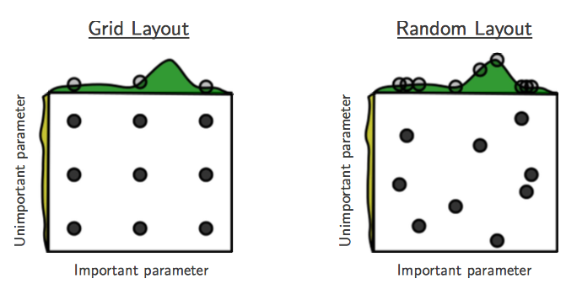
Tuning hyper-parameters
g(x) ≈ g(x) + h(y)
g(x) shown in green
h(y) is shown in yellow
Bergstra, James, and Yoshua Bengio. "Random search for hyper-parameter optimization." Journal of Machine Learning Research, Feb (2012)
“Grid and random search of 9 trials for optimizing function g(x) ≈ g(x) + h(y)
With grid search, nine trials only test g(x) in three distinct places.
With random search, all nine trials explore distinct values of g. ”
Both try configurations randomly and blindly
Next trial is independent to all the trials done before
Bayesian optimization for hyper-parameter tuning:
Make smarter choice for the next trial, minimize the number of trials
Collect the performance at several configurations
Make inference and decide what configuration to try next
Library available!

Slide 20




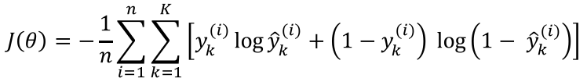
Loss functions and output
Classification
Regression
Training
examples
R^{n} x {class_1, ..., class_n}
(one-hot encoding)
R^{n} x R^{m}
Output
Layer
Soft-max
[map R^{n} to a probability distribution]
Linear (Identity)
or Sigmoid
f(x)=x
Cost (loss)
function
Cross-entropy
Mean Squared Error
$$J\left(θ\right)= \frac{1}{n}\sum_{i=1}^{n}{{\left(y^{(i)}−{\hat{y}}^{(i)}\right)}^{2}}$$
$$J\left(θ\right)=−\frac{1}{n}\sum_{i=1}^{n}{\sum_{k=1}^{K}{\left[y_{k}^{(i)}\log{{\hat{y}}_{k}^{(i)}+\left(1−y_{k}^{(i)}\right) }\log\left(1− {\hat{y}}_{k}^{\left(i\right)}\right)\right]}}$$
Mean Absolute Error
$$J\left(θ\right)= \frac{1}{n}\sum_{i=1}^{n}{\left|y^{(i)}−{\hat{y}}^{(i)}\right|}$$
List of loss functions
Notes:
Exponentiate to make it positive
MSE has nice mathematical properties which makes it easier to compute the gradient
Because of the square, large errors have relatively greater influence on MSE.
Therefore, MAE is more robust to outliers since it does not make use of square.

Slide 21
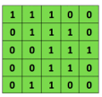

Convolutional Neural Networks (CNNs)
Main CNN idea for text:
Compute vectors for n-grams and group them afterwards
Example: “this takes too long” compute vectors for:
This takes, takes too, too long, this takes too, takes too long, this takes too long
Convolutional
3x3 filter
Input matrix
http://deeplearning.stanford.edu/wiki/index.php/Feature_extraction_using_convolution
Notes:
http://www.asimovinstitute.org/neural-network-zoo/

Slide 22
Convolutional Neural Networks (CNNs)
Main CNN idea for text:
Compute vectors for n-grams and group them afterwards
max pool
2x2 filters
and stride 2
https://shafeentejani.github.io/assets/images/pooling.gif

Slide 23
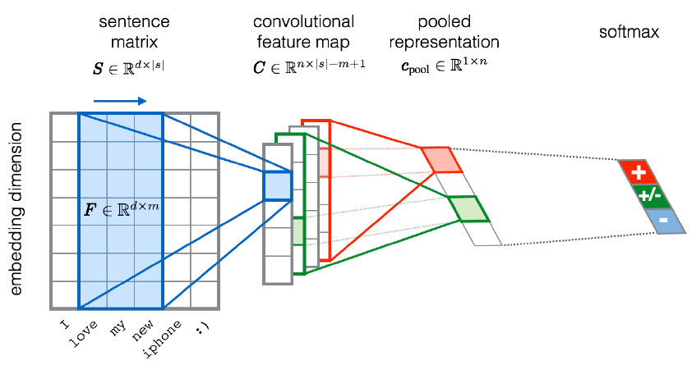
CNN for text classification
Severyn, Aliaksei, and Alessandro Moschitti. "UNITN: Training Deep Convolutional Neural Network for Twitter Sentiment Classification." SemEval@ NAACL-HLT. 2015.
Notes:
the width m of the convolution filters is set to 5
n = 300 feature maps
first layer embeds words into low-dimensional vectors.

Slide 24
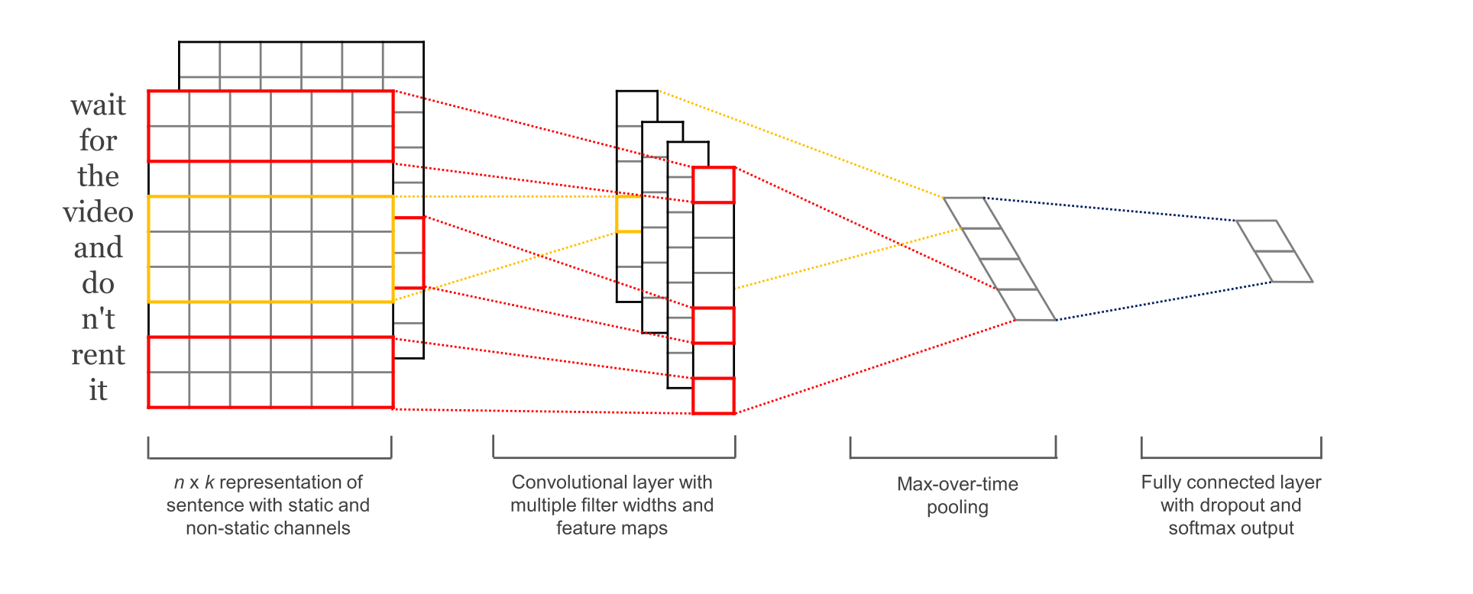
CNN with multiple filters
Kim, Y. “Convolutional Neural Networks for Sentence Classification”, EMNLP (2014)
sliding over 3, 4 or 5 words at a time

Slide 25
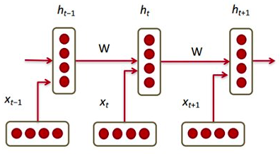
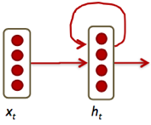
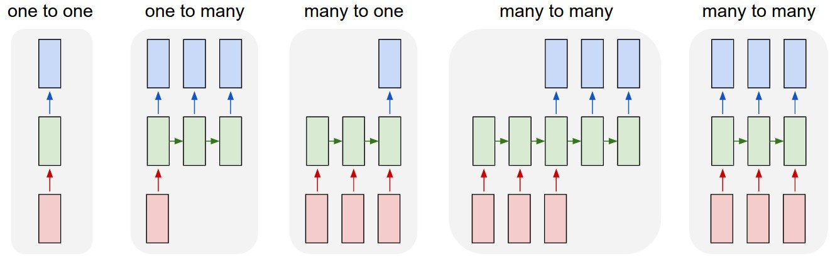
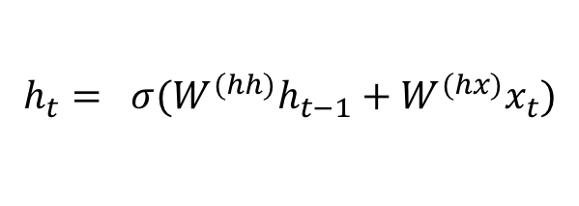

Recurrent Neural Networks (RNNs)
Main RNN idea for text:
Condition on all previous words
Use same set of weights at all time steps
$$h_{t}= σ(W^{(hh)}h_{t−1}+W^{(hx)}x_{t})$$
$$≜$$
https://pbs.twimg.com/media/C2j-8j5UsAACgEK.jpg
Stack them up, Lego fun!
Vanishing gradient problem
https://discuss.pytorch.org/uploads/default/original/1X/6415da0424dd66f2f5b134709b92baa59e604c55.jpg
Notes:
https://pbs.twimg.com/media/C2j-8j5UsAACgEK.jpg

Slide 26
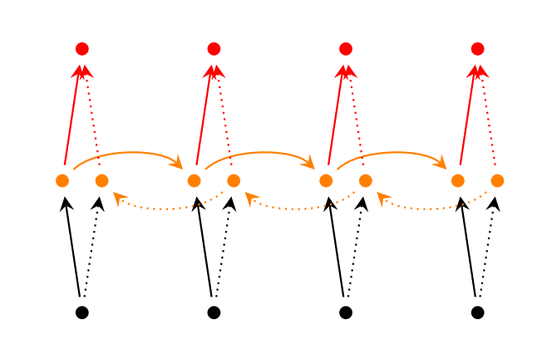
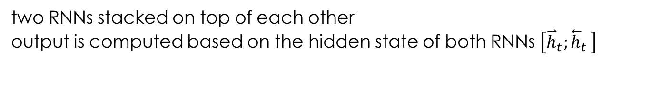
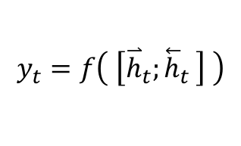
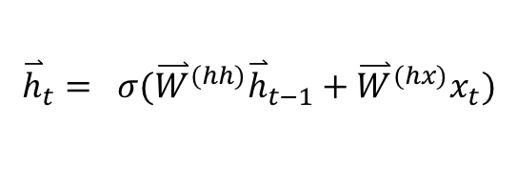
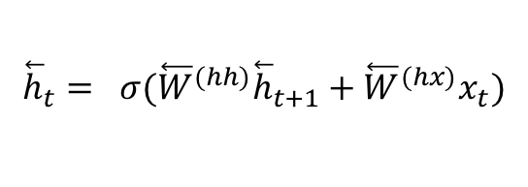
Bidirectional RNNs
Main idea: incorporate both left and right context
output may not only depend on the previous elements in the sequence, but also future elements.
$${\overset{⃑}{h}}_{t}= σ({\overset{⃑}{W}}^{(hh)}{\overset{⃑}{h}}_{t−1}+{\overset{⃑}{W}}^{(hx)}x_{t})$$
$${\overset{⃖}{h}}_{t}= σ({\overset{⃖}{W}}^{(hh)}{\overset{⃖}{h}}_{t+1}+{\overset{⃖}{W}}^{(hx)}x_{t})$$
$$y_{t}=f\left( \left[{\overset{⃑}{h}}_{t}{;\overset{⃖}{h}}_{t}\right] \right)$$
past and future around a single token
http://www.wildml.com/2015/09/recurrent-neural-networks-tutorial-part-1-introduction-to-rnns/
two RNNs stacked on top of each other
output is computed based on the hidden state of both RNNs $\left[{\overset{⃑}{h}}_{t}{;\overset{⃖}{h}}_{t}\right]$

Slide 27
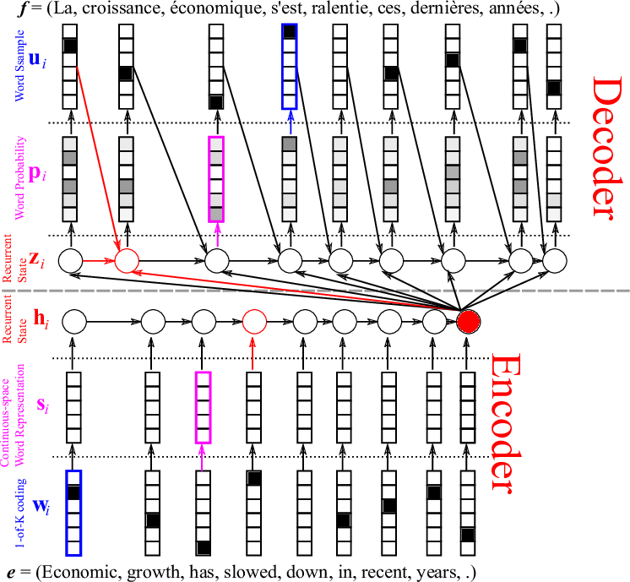
Sequence 2 Sequence or Encoder Decoder model
Try many other models for MT
Cho, Kyunghyun, et al. "Learning phrase representations using RNN encoder-decoder for statistical machine translation." EMNLP 2014

Slide 28
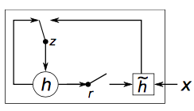
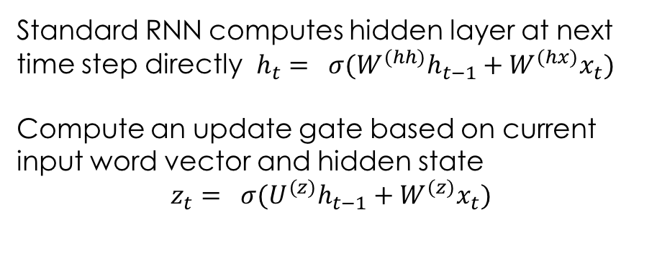
Gated Recurrent Units (GRUs)
Main idea:
keep around memory to capture long dependencies
Allow error messages to flow at different strengths depending on the inputs
Standard RNN computes hidden layer at next time step directly $h_{t}= σ(W^{(hh)}h_{t−1}+W^{(hx)}x_{t})$
Compute an update gate based on current input word vector and hidden state
$$z_{t}= σ(U^{(z)}h_{t−1}+W^{(z)}x_{t})$$
http://www.wildml.com/2015/10/recurrent-neural-network-tutorial-part-4-implementing-a-grulstm-rnn-with-python-and-theano/
Controls how much of past state should matter now
If z close to 1, then we can copy information in that unit through many steps!
Notes:
http://colah.github.io/posts/2015-08-Understanding-LSTMs/

Slide 29
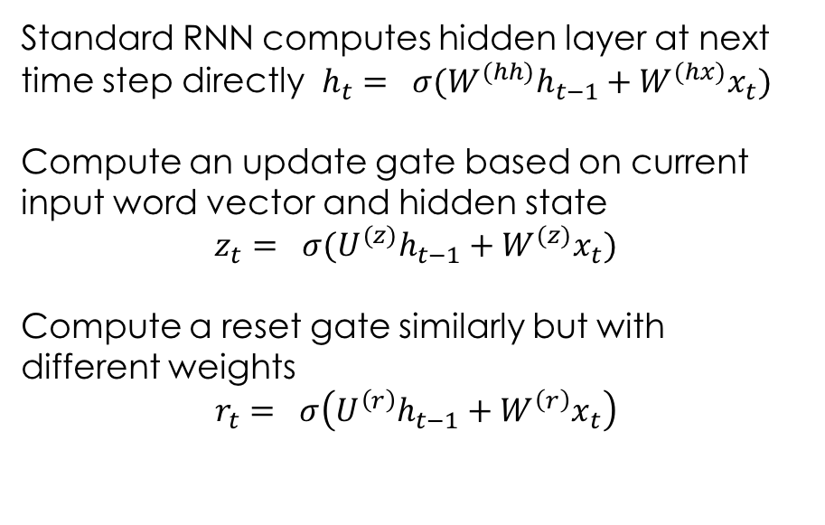
Gated Recurrent Units (GRUs)
Main idea:
keep around memory to capture long dependencies
Allow error messages to flow at different strengths depending on the inputs
Standard RNN computes hidden layer at next time step directly $h_{t}= σ(W^{(hh)}h_{t−1}+W^{(hx)}x_{t})$
Compute an update gate based on current input word vector and hidden state
$$z_{t}= σ(U^{(z)}h_{t−1}+W^{(z)}x_{t})$$
Compute a reset gate similarly but with different weights
$$r_{t}= σ\left(U^{\left(r\right)}h_{t−1}+W^{\left(r\right)}x_{t}\right)$$
http://www.wildml.com/2015/10/recurrent-neural-network-tutorial-part-4-implementing-a-grulstm-rnn-with-python-and-theano/
If reset close to 0, ignore previous hidden state (allows model to drop information that is irrelevant in the future)
Units with short-term dependencies often have reset gates very active
Units with long-term dependencies have active update gates z
Notes:
http://colah.github.io/posts/2015-08-Understanding-LSTMs/

Slide 30
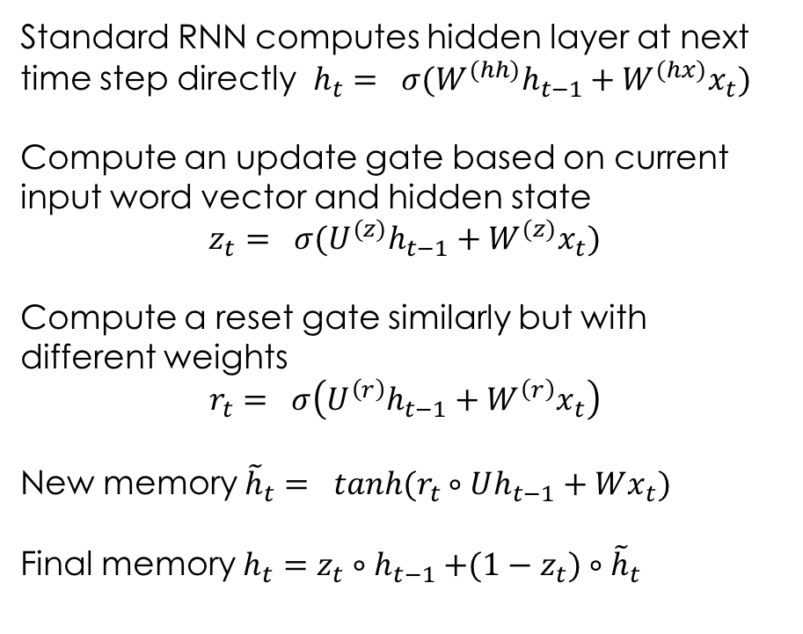
Gated Recurrent Units (GRUs)
Main idea:
keep around memory to capture long dependencies
Allow error messages to flow at different strengths depending on the inputs
Standard RNN computes hidden layer at next time step directly $h_{t}= σ(W^{(hh)}h_{t−1}+W^{(hx)}x_{t})$
Compute an update gate based on current input word vector and hidden state
$$z_{t}= σ(U^{(z)}h_{t−1}+W^{(z)}x_{t})$$
Compute a reset gate similarly but with different weights
$$r_{t}= σ\left(U^{\left(r\right)}h_{t−1}+W^{\left(r\right)}x_{t}\right)$$
New memory ${\tilde{h}}_{t}= tanh(r_{t}∘Uh_{t−1}+Wx_{t})$
Final memory $h_{t}=z_{t}{∘h}_{t−1}+(1−z_{t})∘{\tilde{h}}_{t}$
http://www.wildml.com/2015/10/recurrent-neural-network-tutorial-part-4-implementing-a-grulstm-rnn-with-python-and-theano/
LSTMs are a more complex form, but basically same intuition
GRUs are often more preferred than LSTMs
combines current & previous time steps
Notes:
http://colah.github.io/posts/2015-08-Understanding-LSTMs/

Slide 31
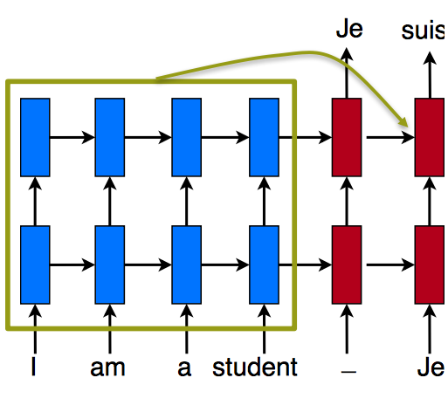
Attention Mechanism
Pool of source states
Bahdanau D. et al. "Neural machine translation by jointly learning to align and translate." ICLR (2015)
Main idea: retrieve as needed

Slide 32
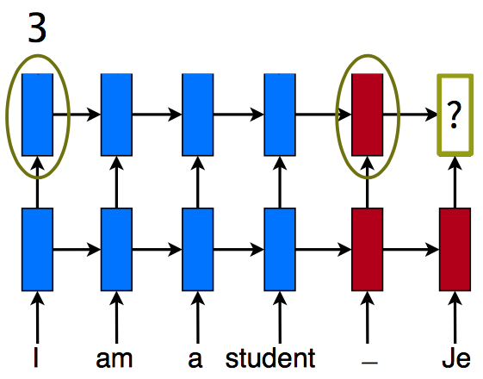
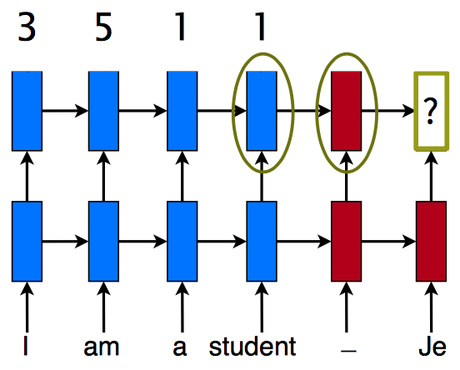
Attention - Scoring
$$score\left(h_{t−1},{\overline{h}}_{s}\right)={{h_{t}}^{T}\overline{h}}_{s}$$
Compare target and source hidden states

Slide 33
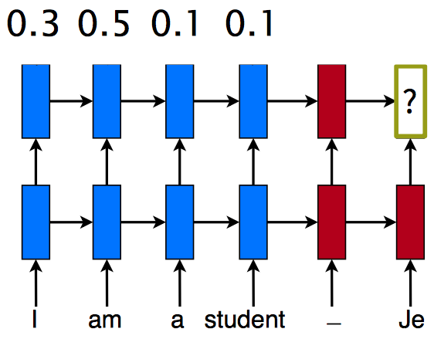
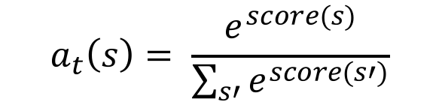
Attention - Normalization
$$a_{t}\left(s\right)= \frac{e^{score(s)}}{\sum_{s′}{e^{score(s′)}}}$$
Convert into alignment weights

Slide 34
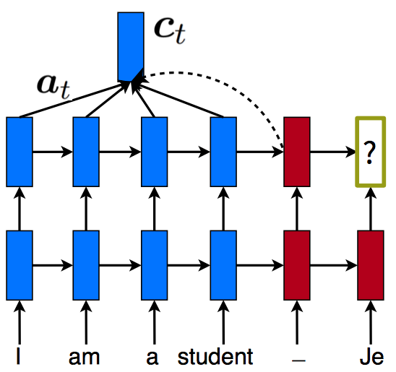
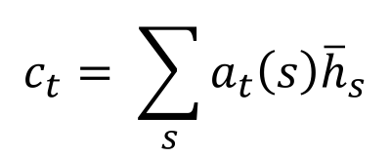
Attention - Context
$$c_{t}= \sum_{s}{a_{t}\left(s\right){\overline{h}}_{s}}$$
Build context vector: weighted average

Slide 35



Attention - Context
$$e_{t}$$
$$h_{t}=f(h_{t−1},c_{t},e_{t})$$
Compute next hidden state

Slide 36
Application Example:
IMDB Movie reviews sentiment classification
https://uofi.box.com/v/cs510DL
Binary Classification
Dataset of 25,000 movies reviews from IMDB, labeled by sentiment (positive/negative)

Slide 37

Application Example: Relation Extraction from text
Useful for:
knowledge base completion
social media analysis
question answering
…
http://www.mathcs.emory.edu/~dsavenk/slides/relation_extraction/img/distant.png

Slide 38
Task: binary (or multi-class) classification
sentence S = w₁ w₂ .. e₁ .. w_{j} .. e₂ .. w_{n} e₁ and e₂ entities
“The new iPhone 7 Plus includes an improved camera to take amazing pictures”
Component-Whole(e₁ , e₂ ) ?
YES / NO
It is also possible to include more than two entities as well: “At codons 12, the occurrence of point mutations from G to T were observed” → point mutation(codon, 12, G, T)

Slide 39
Features / Input representation
context-wise split of the sentence
Embeddings Left
Embeddings Middle
Embeddings Right
The new iPhone 7 Plus includes an improved camera that takes amazing pictures
2) word sequences concatenated with positional features
Word indices
[5, 7, 12, 6, 90 …]
Position indices e₁
[-1, 0, 1, 2, 3 …]
Position indices e₂
[-4, -3, -2 -1, 0]
Word Embeddings
Positional emb. e₁
Positional emb. e₂
3) concatenating embeddings of two entities with average of word embeddings for rest of the words
Embeddings e₁
Embeddings e₂
context embeddings
The new iPhone 7 Plus includes an improved camera that takes amazing pictures

Slide 40
Models: MLP
Component-Whole(e₁ , e₂ ) ?
YES / NO
Sigmoid
Dense Layer n
…
Dense Layer 1
Embeddings e₁
context embeddings
Embeddings e₂
The new iPhone 7 Plus includes an improved camera that takes …
Simple fully-connected multi-layer perceptron

Slide 41
Models: CNN
Sigmoid
Component-Whole(e₁ , e₂ ) ?
YES / NO
Max Pooling
Max Pooling
Max Pooling
Convolutional Layer
Convolutional Layer
Convolutional Layer
Embeddings Left
Embeddings Middle
Embeddings Right
The new iPhone 7 Plus includes an improved camera that takes …
OR
Word indices
[5, 7, 12, 6, 90 …]
Position indices e₁
[-1, 0, 1, 2, 3 …]
Position indices e₂
[-4, -3, -2 -1, 0]
Word Embeddings
Positional emb. e₁
Positional emb. e₂
Zeng, D.et al. “Relation classication via convolutional deep neural network”.COLING (2014)

Slide 42
Models: CNN (2)
Sigmoid
Component-Whole(e₁ , e₂ ) ?
YES / NO
Max Pooling
Max Pooling
Max Pooling
Convolution
filter=2
Convolution
filter=3
Convolution
filter=k
CNN with multiple filter sizes
CNN with multiple filter sizes
Embeddings Left
Embeddings Middle
Embeddings Right
The new iPhone 7 Plus includes an improved camera that takes …
OR
Word indices
[5, 7, 12, 6, 90 …]
Position indices e₁
[-1, 0, 1, 2, 3 …]
Position indices e₂
[-4, -3, -2 -1, 0]
Word Embeddings
Positional emb. e₁
Positional emb. e₂
Nguyen, T.H., Grishman, R. “Relation extraction: Perspective from convolutional neural networks.” VS@ HLT-NAACL. (2015)

Slide 43
Models: Bi-GRU
Sigmoid
Component-Whole(e₁ , e₂ ) ?
YES / NO
Attention or
Max Pooling
Bi-GRU
Embeddings Left
Embeddings Middle
Embeddings Right
The new iPhone 7 Plus includes an improved camera that takes …
OR
Word indices
[5, 7, 12, 6, 90 …]
Position indices e₁
[-1, 0, 1, 2, 3 …]
Position indices e₂
[-4, -3, -2 -1, 0]
Word Embeddings
Positional emb. e₁
Positional emb. e₂
Zhang, D., Wang, D. “Relation classication via recurrent neural network.” -arXiv preprint arXiv:1508.01006 (2015)
Zhou, P. et al. “Attention-based bidirectional LSTM networks for relation classication. ACL (2016)

Slide 44
Distant Supervision
Circumvent the annotation problem – create large dataset
Exploit large knowledge bases to automatically label entities and their relations in text
Assumption:
when two entities co-occur in a sentence, a certain relation is expressed
knowledge base
Relation | Entity 1 | Entity 2
place of birth | Michael Jackson | Gary
place of birth | Barack Obama | Hawaii
… | … | …
text
Barack Obama moved from Gary ….
Michael Jackson met … in Hawaii
place of birth
For many ambiguous relations, mere co-occurrence does not guarantee the existence of the relation → Distant supervision produces false positives

Slide 45

Attention over Instances
s representation of the sentence set
a_{i} weight given by sentence-level attention
x_{i} sentence vector representation
x_{i} sentence for an entity pair (e₁,e₂)
n sentences for relation r(e₁,e₂)
Lin et al. “Neural Relation Extraction with Selective Attention over Instances” ACL (2016) [code]
Notes:
employ convolutional neural networks to embed the semantics of sentences.
sentence-level attention over multiple instances, which is expected to dynamically reduce the weights of those noisy instances.
softmax final layer

Slide 46

Sentence-level ATT results
NYT10 Dataset
Align Freebase relations with New York Times corpus (NYT)
53 possible relationships
+NA (no relation between entities)
Data | sentences | entity pairs
Training | 522,611 | 281,270
Test | 172,448 | 96,678
Lin et al. “Neural Relation Extraction with Selective Attention over Instances” ACL (2016) [code]
Notes:
follows the assumption that at least one mention of the entity pair will reflect their relation, and only uses the sentence with the highest probability in each set for training.

Slide 47
References
Srivastava, Nitish, et al. "Dropout: a simple way to prevent neural networks from overfitting." Journal of machine learning research (2014)
Bergstra, James, and Yoshua Bengio. "Random search for hyper-parameter optimization." Journal of Machine Learning Research, Feb (2012)
Kim, Y. “Convolutional Neural Networks for Sentence Classification”, EMNLP (2014)
Severyn, Aliaksei, and Alessandro Moschitti. "UNITN: Training Deep Convolutional Neural Network for Twitter Sentiment Classification." SemEval@ NAACL-HLT (2015)
Cho, Kyunghyun, et al. "Learning phrase representations using RNN encoder-decoder for statistical machine translation." EMNLP (2014)
Ilya Sutskever et al. “Sequence to sequence learning with neural networks.” NIPS (2014)
Bahdanau et al. "Neural machine translation by jointly learning to align and translate." ICLR (2015)
Gal, Y., Islam, R., Ghahramani, Z. “Deep Bayesian Active Learning with Image Data.” ICML (2017)
Nair, V., Hinton, G.E. “Rectified linear units improve restricted boltzmann machines.” ICML (2010)
Ronan Collobert, et al. “Natural language processing (almost) from scratch.” JMLR (2011)
Kumar, Shantanu. "A Survey of Deep Learning Methods for Relation Extraction." arXiv preprint arXiv:1705.03645 (2017)
Lin et al. “Neural Relation Extraction with Selective Attention over Instances” ACL (2016) [code]
Zeng, D.et al. “Relation classification via convolutional deep neural network”. COLING (2014)
Nguyen, T.H., Grishman, R. “Relation extraction: Perspective from CNNs.” VS@ HLT-NAACL. (2015)
Zhang, D., Wang, D. “Relation classification via recurrent NN.” -arXiv preprint arXiv:1508.01006 (2015)
Zhou, P. et al. “Attention-based bidirectional LSTM networks for relation classification . ACL (2016)
Mike Mintz et al. “Distant supervision for relation extraction without labeled data.” ACL- IJCNLP (2009)

Slide 48
References & Resources
http://web.stanford.edu/class/cs224n
https://www.coursera.org/specializations/deep-learning
https://chrisalbon.com/#Deep-Learning
http://www.asimovinstitute.org/neural-network-zoo
http://cs231n.github.io/optimization-2
https://medium.com/@ramrajchandradevan/the-evolution-of-gradient-descend-optimization-algorithm-4106a6702d39
https://arimo.com/data-science/2016/bayesian-optimization-hyperparameter-tuning
http://www.wildml.com/2015/12/implementing-a-cnn-for-text-classification-in-tensorflow
http://www.wildml.com/2015/11/understanding-convolutional-neural-networks-for-nlp
https://medium.com/technologymadeeasy/the-best-explanation-of-convolutional-neural-networks-on-the-internet-fbb8b1ad5df8
http://www.wildml.com/2015/09/recurrent-neural-networks-tutorial-part-1-introduction-to-rnns/
http://www.wildml.com/2015/10/recurrent-neural-network-tutorial-part-4-implementing-a-grulstm-rnn-with-python-and-theano/
http://colah.github.io/posts/2015-08-Understanding-LSTMs
https://github.com/hyperopt/hyperopt
https://github.com/tensorflow/nmt

Slide 49
https://giphy.com/gifs/thanks-thank-you-thnx-3o6ozuHcxTtVWJJn32/download

