Slide 1
GraphQL a query language for your API
Student： Wanyi Liu
NetID： wl49
Professor：Scott
Notes:
a query language GraphQL.

Slide 2
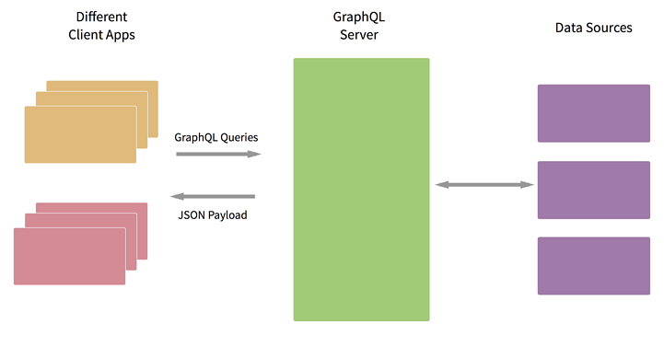
GraphQL
https://segmentfault.com/a/1190000005766732
Notes:
In this course, we use RESTful API to implement the data queries. However, using REST, a large number of concurrent requests may cause a lot of trouble for mobile application, especially on the response time.
Facebook created graphQL to solve this problem. It is a data abstraction layer, including data format, data association, query definition and implementation. It communicates with the client and data sources.

Slide 3
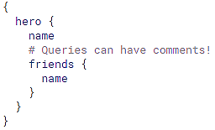
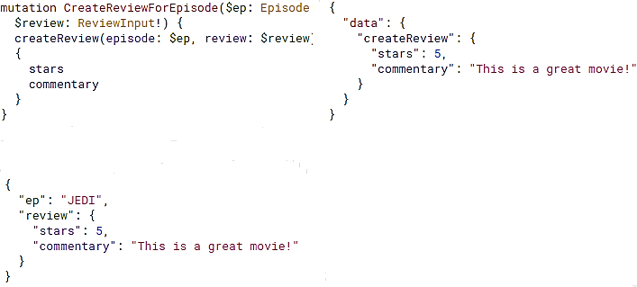
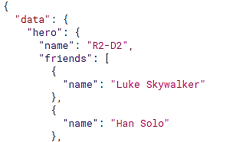
Query
Query
Mutation
http://graphql.org/
Notes:
This is an query in GraphQL and the result we get. The query has exactly the same shape as the result.
In this query hero, we can get the name, and the friend list of the hero.
In RESTful APIs, we use POST and PUT to update data. And here, we use mutation instead. This example will create a review for an episode, which contains the fields of starts and commentary.

Slide 4
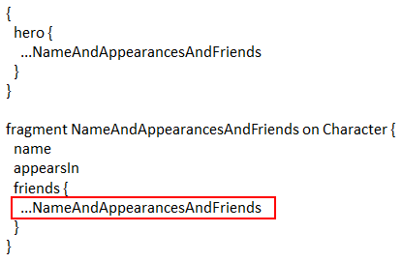


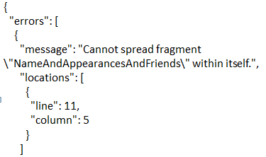
Type system
Schemas and Types
Validation
validationErrors(query)
Notes:
Unlike Rest, graphQL has a type system.
Every service should define a set of types which describe the data you can query on that service.
For example, we can define a type called starship, and it has three fields, whose types are ID, String and Float.
By using the type system, it can be predetermined whether a query is valid or not, without having runtime checks. We can call the validation function, if the query is invalid, it will return errors.

Slide 5
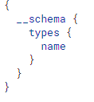
Introspection
Ask GraphQL for available types
Types that we defined in our type system
Built-in scalar types that the type system provided
String, Boolean
Types in the introspection system
Notes:
If we don’t know what types are available, we can use Introspection to access the documentation about the type system, we can query the __schema field, and it will return all types in the server, including types we defined, scalar types, and the types to support the introspection system.

Slide 6
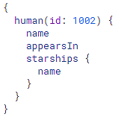
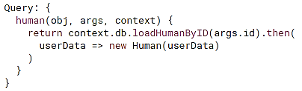
Execution
Root type / Query type :
a type that represents all of the possible entry points into the GraphQL API
Notes:
When we execute a query, each field on each type is backed by a function called the resolver.
If a field produces a scalar value, then the execution completes. However if a field produces an object then the query continues fetch the fields in the object until scalar values are reached.
In the server, there will be a Root type that represents all possible entry points into the API.
In this example, our Root type provides a field called human, it will return a human object.

Slide 7
GraphQL vs REST
Pros
Ask and get what exactly you need
Get many resources in a single request
Check type document quickly and validation
GraphQL Devolves Power to Clients
Cons
Security issues
Need new cache strategy
https://philsturgeon.uk/api/2017/01/24/graphql-vs-rest-overview/
Notes:
Compared to REST,
A GraphQL query can get exactly what you need. this makes apps fast and stable.
And the queries can fetch lots of related data in one request, instead of making several roundtrips, like what we usually do in REST architecture.
And we can check type document quickly.
Using grapgQL, the clients can write queries in their language of choice, instead of bugging the API team to write it in a different language.
However, GraphQL may have some secure problems due to its powerful query capability.
And REST uses cache to solve a lot of performance problems. But a GraphQL service may need to load data from the databases repeatedly.

Slide 8

Q&A
Student： Wanyi Liu
NetID： wl49
Notes:
Are there any questions?

