Slide 1
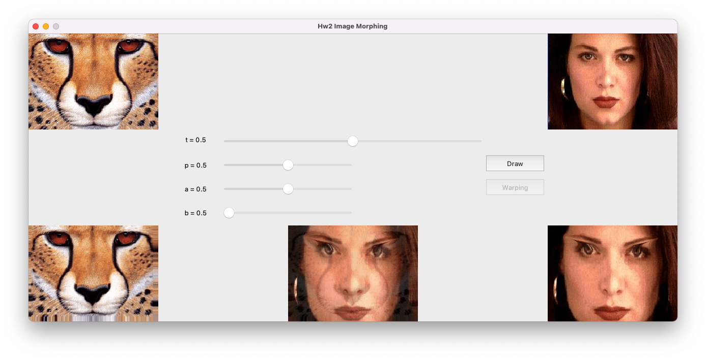
1. source image
2. morphed image display section
5. animation section
3. warped section
4. configuration section

Slide 2
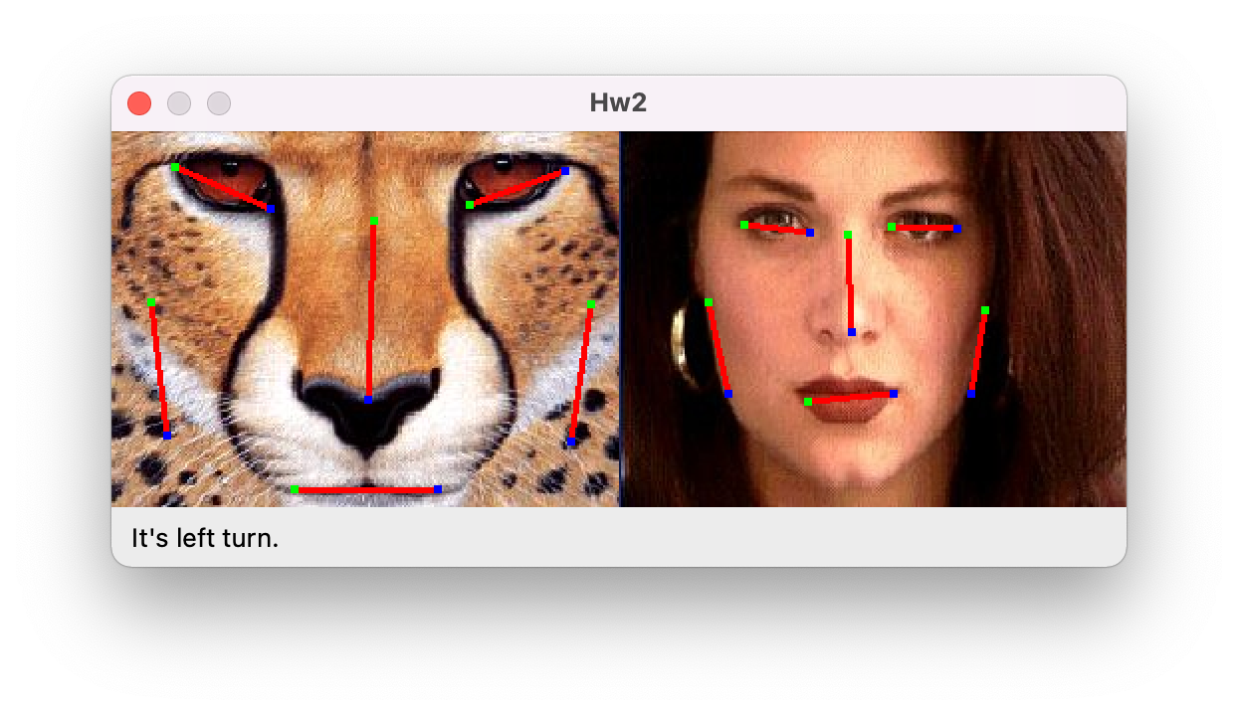
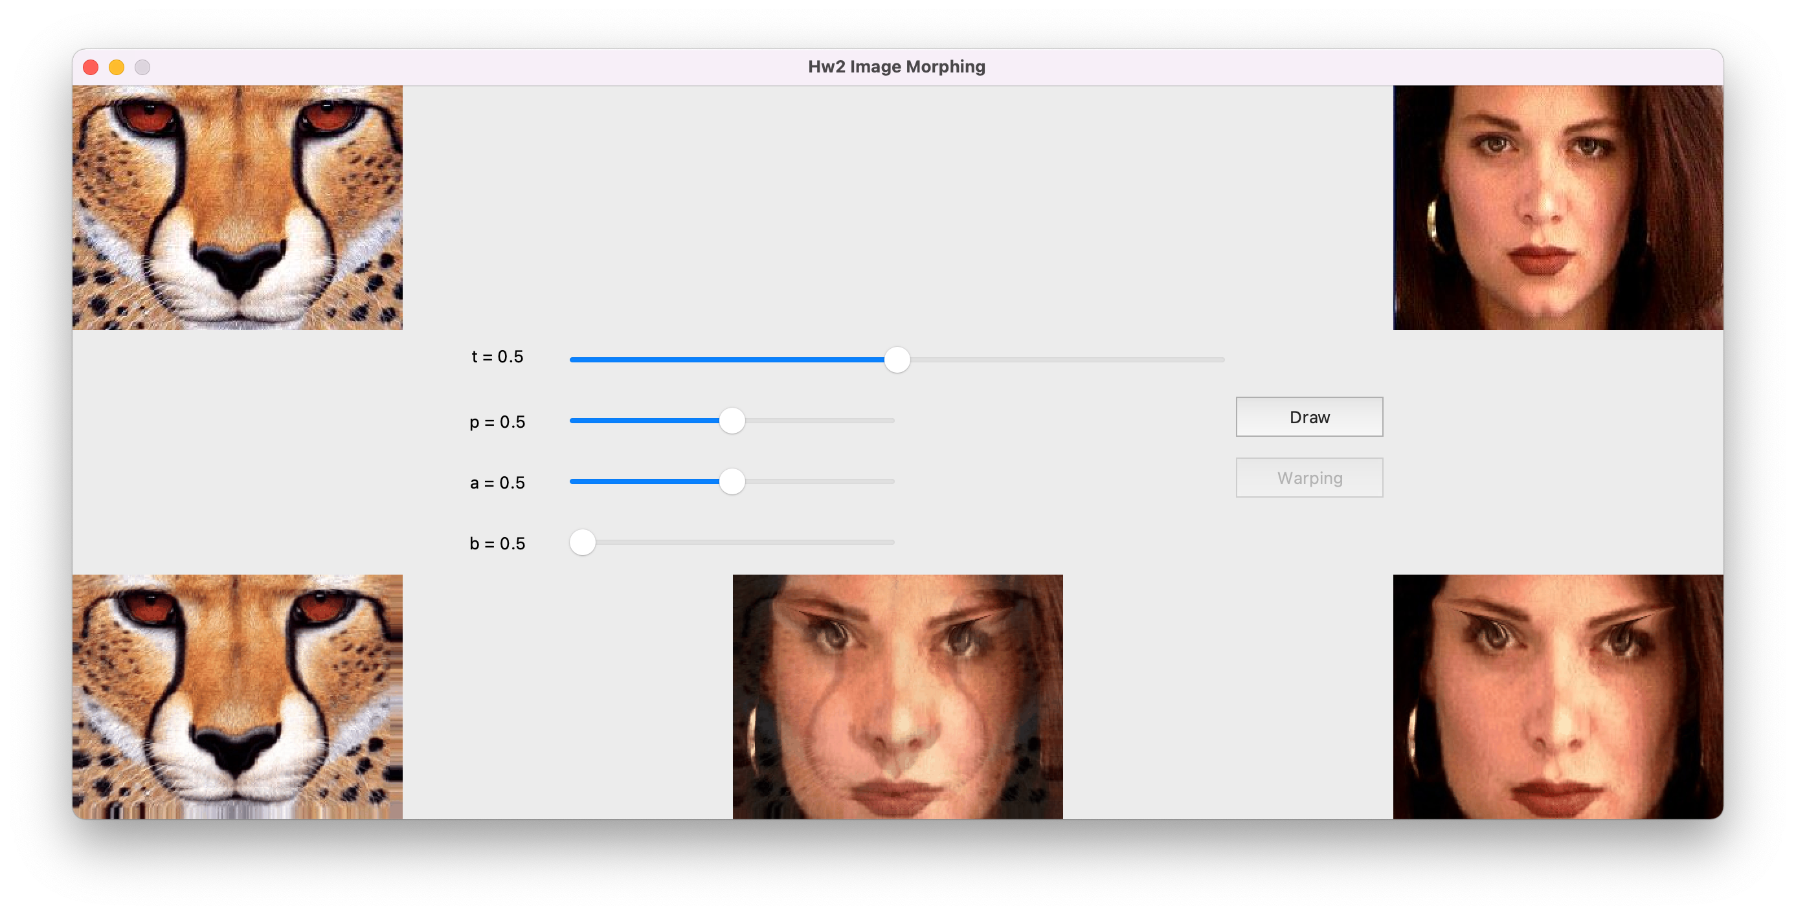

Slide 3
