Slide 1
ターン前壁切れ参考資料

Slide 2
ターン前壁切れ(直進)
-------- TurnPreCalculation test --------
-- turn_l_90 --
0.1, 0.025486, 0.024903, 0.07, 1.083
0.2, 0.024844, 0.024944, 0.29, 0.542
0.3, 0.024367, 0.025267, 0.64, 0.362
0.4, 0.023752, 0.025618, 1.14, 0.272
0.5, 0.022849, 0.026096, 1.79, 0.218
0.6, 0.022106, 0.026995, 2.57, 0.181
0.7, 0.021123, 0.027611, 3.50, 0.156
0.8, 0.019906, 0.028638, 4.57, 0.137
0.9, 0.018890, 0.028719, 5.79, 0.123
1.0, 0.017187, 0.026697, 7.14, 0.114
1.1, 0.015761, 0.023816, 8.62, 0.107
1.2, 0.013569, 0.020517, 10.23, 0.102
1.3, 0.011746, 0.016345, 11.96, 0.099
1.4, 0.009755, 0.012242, 13.79, 0.096
1.5, 0.007564, 0.006555, 15.72, 0.094
-- turn_180 --
0.1, 0.027000, 0.025842, 0.09, 1.779
0.2, 0.027000, 0.026574, 0.36, 0.892
0.3, 0.027000, 0.027424, 0.80, 0.595
0.4, 0.027000, 0.028541, 1.43, 0.446
0.5, 0.027000, 0.029824, 2.23, 0.357
0.6, 0.027000, 0.031572, 3.21, 0.298
0.7, 0.027000, 0.033514, 4.38, 0.255
0.8, 0.027000, 0.035319, 5.74, 0.223
0.9, 0.027000, 0.037584, 7.27, 0.198
1.0, 0.027000, 0.038835, 9.02, 0.179
1.1, 0.027000, 0.038188, 10.95, 0.165
1.2, 0.027000, 0.036015, 13.10, 0.155
1.3, 0.027000, 0.033856, 15.49, 0.146
1.4, 0.027000, 0.030553, 18.12, 0.139
1.5, 0.027000, 0.027369, 21.06, 0.134
-- turn_s2d_45 --
0.1, 0.024865, 0.043472, 0.10, 0.394
0.2, 0.024474, 0.043613, 0.39, 0.198
0.3, 0.023998, 0.044036, 0.88, 0.132
0.4, 0.023490, 0.044388, 1.57, 0.100
0.5, 0.022758, 0.045110, 2.46, 0.080
0.6, 0.022110, 0.045742, 3.53, 0.067
0.7, 0.020959, 0.044907, 4.79, 0.060
0.8, 0.019960, 0.043200, 6.22, 0.056
0.9, 0.018836, 0.041499, 7.78, 0.053
1.0, 0.017551, 0.038528, 9.45, 0.052
1.1, 0.016132, 0.035316, 11.17, 0.051
1.2, 0.014573, 0.031717, 12.93, 0.051
1.3, 0.012227, 0.027578, 14.68, 0.052
1.4, 0.010330, 0.022761, 16.39, 0.053
1.5, 0.008300, 0.017851, 18.05, 0.054
-- turn_s2d_135 --
0.1, 0.036254, 0.028051, 0.11, 1.084
0.2, 0.035712, 0.028091, 0.43, 0.543
0.3, 0.035178, 0.028357, 0.96, 0.362
0.4, 0.034496, 0.028841, 1.72, 0.272
0.5, 0.033757, 0.029284, 2.68, 0.218
0.6, 0.032954, 0.030124, 3.86, 0.181
0.7, 0.031878, 0.030650, 5.25, 0.156
0.8, 0.030522, 0.031149, 6.86, 0.137
0.9, 0.028802, 0.029152, 8.68, 0.125
1.0, 0.027222, 0.026053, 10.70, 0.117
1.1, 0.025379, 0.022437, 12.93, 0.110
1.2, 0.022653, 0.018280, 15.35, 0.105
1.3, 0.020145, 0.012436, 17.94, 0.102
1.4, 0.017329, 0.006410, 20.69, 0.100
1.5, 0.014165, -0.000732, 23.57, 0.098
180
135
90
45

Slide 3
ターン前壁切れ(斜め)
-- turn_d_90 --
0.1, 0.022391, 0.022158, 0.11, 0.690
0.2, 0.021949, 0.022349, 0.45, 0.345
0.3, 0.021470, 0.022570, 1.01, 0.231
0.4, 0.020953, 0.023018, 1.80, 0.173
0.5, 0.020096, 0.023587, 2.81, 0.139
0.6, 0.019201, 0.024272, 4.04, 0.116
0.7, 0.018418, 0.024764, 5.50, 0.100
0.8, 0.017056, 0.023355, 7.18, 0.091
0.9, 0.015874, 0.021236, 9.06, 0.084
1.0, 0.014520, 0.018498, 11.15, 0.080
1.1, 0.012427, 0.014532, 13.40, 0.077
1.2, 0.010663, 0.010532, 15.80, 0.075
1.3, 0.008708, 0.005692, 18.31, 0.074
1.4, 0.006555, -0.000291, 20.90, 0.074
1.5, 0.004223, -0.006221, 23.54, 0.074
-- turn_d2s_45 --
0.1, 0.043505, 0.024832, 0.10, 0.394
0.2, 0.043113, 0.024974, 0.39, 0.198
0.3, 0.042638, 0.025397, 0.88, 0.132
0.4, 0.042129, 0.025749, 1.57, 0.100
0.5, 0.041397, 0.026470, 2.46, 0.080
0.6, 0.040750, 0.027102, 3.53, 0.067
0.7, 0.039599, 0.026268, 4.79, 0.060
0.8, 0.038600, 0.024560, 6.22, 0.056
0.9, 0.037475, 0.022859, 7.78, 0.053
1.0, 0.036190, 0.019888, 9.45, 0.052
1.1, 0.034771, 0.016677, 11.17, 0.051
1.2, 0.033213, 0.013077, 12.93, 0.051
1.3, 0.030867, 0.008938, 14.68, 0.052
1.4, 0.028969, 0.004121, 16.39, 0.053
1.5, 0.026939, -0.000789, 18.05, 0.054
-- turn_d2s_135 --
0.1, 0.028534, 0.035772, 0.11, 1.084
0.2, 0.027991, 0.035812, 0.43, 0.543
0.3, 0.027457, 0.036078, 0.96, 0.362
0.4, 0.026775, 0.036562, 1.72, 0.272
0.5, 0.026036, 0.037004, 2.68, 0.218
0.6, 0.025233, 0.037845, 3.86, 0.181
0.7, 0.024157, 0.038371, 5.25, 0.156
0.8, 0.022802, 0.038870, 6.86, 0.137
0.9, 0.021081, 0.036873, 8.68, 0.125
1.0, 0.019501, 0.033774, 10.70, 0.117
1.1, 0.017658, 0.030158, 12.93, 0.110
1.2, 0.014932, 0.026001, 15.35, 0.105
1.3, 0.012424, 0.020156, 17.94, 0.102
1.4, 0.009608, 0.014131, 20.69, 0.100
1.5, 0.006444, 0.006989, 23.57, 0.098
d2sのターン
d2s135
d90
d2s45
0.065

Slide 4
ターン前壁切れ(斜め連続)
-- turn_d_90 --
0.1, 0.022391, 0.022158, 0.11, 0.690
0.2, 0.021949, 0.022349, 0.45, 0.345
0.3, 0.021470, 0.022570, 1.01, 0.231
0.4, 0.020953, 0.023018, 1.80, 0.173
0.5, 0.020096, 0.023587, 2.81, 0.139
0.6, 0.019201, 0.024272, 4.04, 0.116
0.7, 0.018418, 0.024764, 5.50, 0.100
0.8, 0.017056, 0.023355, 7.18, 0.091
0.9, 0.015874, 0.021236, 9.06, 0.084
1.0, 0.014520, 0.018498, 11.15, 0.080
1.1, 0.012427, 0.014532, 13.40, 0.077
1.2, 0.010663, 0.010532, 15.80, 0.075
1.3, 0.008708, 0.005692, 18.31, 0.074
1.4, 0.006555, -0.000291, 20.90, 0.074
1.5, 0.004223, -0.006221, 23.54, 0.074
-- turn_d2s_45 --
0.1, 0.043505, 0.024832, 0.10, 0.394
0.2, 0.043113, 0.024974, 0.39, 0.198
0.3, 0.042638, 0.025397, 0.88, 0.132
0.4, 0.042129, 0.025749, 1.57, 0.100
0.5, 0.041397, 0.026470, 2.46, 0.080
0.6, 0.040750, 0.027102, 3.53, 0.067
0.7, 0.039599, 0.026268, 4.79, 0.060
0.8, 0.038600, 0.024560, 6.22, 0.056
0.9, 0.037475, 0.022859, 7.78, 0.053
1.0, 0.036190, 0.019888, 9.45, 0.052
1.1, 0.034771, 0.016677, 11.17, 0.051
1.2, 0.033213, 0.013077, 12.93, 0.051
1.3, 0.030867, 0.008938, 14.68, 0.052
1.4, 0.028969, 0.004121, 16.39, 0.053
1.5, 0.026939, -0.000789, 18.05, 0.054
-- turn_d2s_135 --
0.1, 0.028534, 0.035772, 0.11, 1.084
0.2, 0.027991, 0.035812, 0.43, 0.543
0.3, 0.027457, 0.036078, 0.96, 0.362
0.4, 0.026775, 0.036562, 1.72, 0.272
0.5, 0.026036, 0.037004, 2.68, 0.218
0.6, 0.025233, 0.037845, 3.86, 0.181
0.7, 0.024157, 0.038371, 5.25, 0.156
0.8, 0.022802, 0.038870, 6.86, 0.137
0.9, 0.021081, 0.036873, 8.68, 0.125
1.0, 0.019501, 0.033774, 10.70, 0.117
1.1, 0.017658, 0.030158, 12.93, 0.110
1.2, 0.014932, 0.026001, 15.35, 0.105
1.3, 0.012424, 0.020156, 17.94, 0.102
1.4, 0.009608, 0.014131, 20.69, 0.100
1.5, 0.006444, 0.006989, 23.57, 0.098
d2sのターン
d2s135
d90
d2s45
0.065

Slide 5
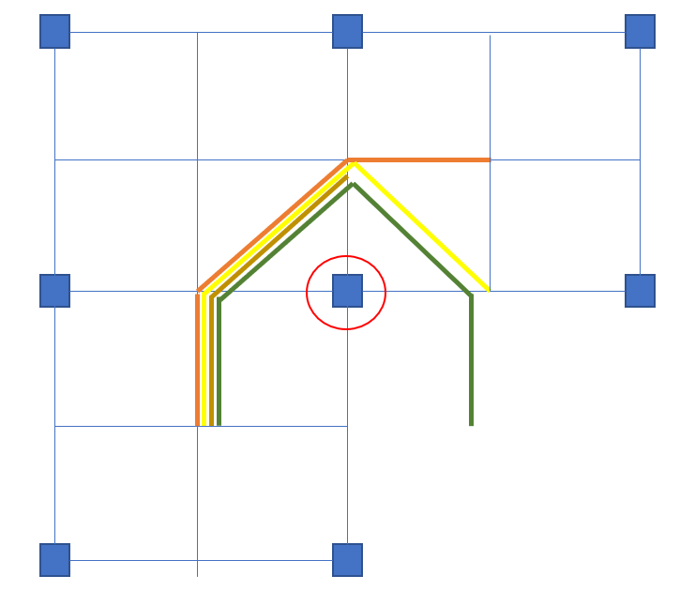
ターン前壁切れパターン(直進)
90deg CW
0deg CW
180deg CW
270deg CW
90deg CCW
0deg CCW
180deg CCW
270deg CCW

Slide 6
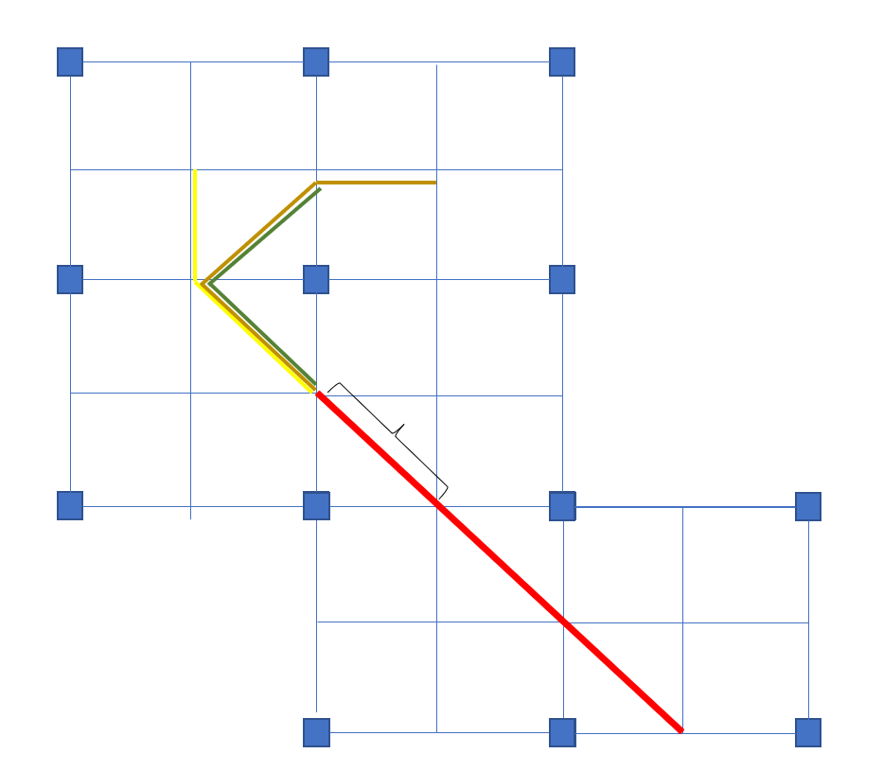
ターン前壁切れパターン(斜め)
x_pillar = 0.09f*(float)((uint8_t)( (x_end + 0.045f )/ 0.09f))
y_pillar = 0.09f*(float)((uint8_t)( (y_end + 0.045f)/ 0.09f))
x = x_pillar + cos(yaw -dir *3/4Pi) *0.045f + r * cos(yaw+Pi)
y = y_pillar + sin(yaw -dir *3/4Pi) * 0.045f + r * sin(yaw+Pi)
d2s135
d90
d2s45
45deg CW
135deg CW
315deg CW
225deg CW
45deg CCW
135deg CCW
315deg CCW
225deg CCW

