Slide 1
JOBHOOK
By –
Jeril Jhonson
Roll Number: 64 Contact Number: 740010466 Email: jariljohnson136@gmail.com
and
Aaryan Deshpande
Roll Number: 18 Contact Number: 9819593324 Email: Aaryandeshpande2@gmail.com

Slide 2
Existing System:
Current job application methods are scattered across multiple platforms, lacking centralized control, customization, and communication features. Existing portals often have:
Poor user interface and navigation issues.
Lack of real-time resume building and modification.
Inadequate profile visibility and matching algorithms.
Manual communication and hiring processes.
No resume optimization or live updates.
Limited customization options for both job seekers and employers.

Slide 3
Drawbacks of the Existing System:
Time-consuming job application process..
Difficulty tracking multiple applications.
Inconsistent communication between employer and candidate.
Lack of smart matching features based on profile skills.
Employers struggle to filter and find ideal candidates efficiently.

Slide 4
Proposed System – JOBHOOK:
JOBHOOK is an integrated job portal platform designed for both job seekers and employers. It includes profile creation, resume builder, job posting, resume screening, application tracking, and candidate hiring. The system emphasizes:
An intelligent matching system.
A user-friendly and responsive design.
Real-time resume creation and editing.
Secure communication between users.
Employer dashboards for job and applicant management.

Slide 5
Needs of the Proposed System:
Simplify the job application and hiring process.
Provide a unified platform for both applicants and recruiters.
Enable on-the-fly resume editing and customization..
Ensure security, privacy, and user data protection.

Slide 6
Scope of the Proposed System:
Job Seeker Module:
Profile registration and verification.
Search and apply for jobs.
Notifications for job openings and application status.
Employer Module:
Employer registration and job posting.
search and filtering.
Interview scheduling and communication.
Application status management.
Admin Module:
Approve/reject users.
Monitor job posts.
Generate reports on portal activity

Slide 7
Objectives of the Proposed System:
Offer a comprehensive job portal for both applicants and employers.
Streamline resume building with real-time editing.
Allow employers to filter, shortlist, and communicate with candidates.
Provide a secure and responsive platform accessible across devices..

Slide 8
Key Features:
User Registration and Login
Separate accounts for job seekers and employers
Secure login with email/password or social login options
Job Posting and Management
Employers can post job vacancies, edit or delete listings
Option to add job details like title, description, location, salary, and required qualifications
Job Search and Filters
Job seekers can search for jobs by keywords, location, category, company, or salary range
Advanced filters to narrow down search results
Resume Upload and Profile Creation
Job seekers can upload resumes, fill out professional profiles
Profile includes skills, experience, education, and preferences
Application Tracking
Job seekers can apply for jobs and track their application status
Employers can view applicants, shortlist candidates, and manage applications

Slide 9
Expected GUI Screens:
Home Screen: Options to Register/Login as Employer or Job Seeker.
User Dashboard: Resume builder, job listings, and application history.
Employer Dashboard: Job posting form, applicant list, filtering options.
Profile Editor: Resume builder interface with live preview and export.
Admin Panel: Overview of all users, job postings, and reports.

Slide 10
Technology Description:
Front End: react,
Back End: JAVA , Springboot
Database: mongoDB
IDE: Visual Studio Code,Eclipse,compass
Language: Java (JDK 17+)

Slide 11
Hardware & Software Requirements:
Hardware:
Dual-core processor or higher
4GB RAM minimum
20GB free storage
Software:
OS: Windows 10 or above
Java Development Kit (JDK 17+)
MySQL Database
Visual Studio Code , Eclipse
Spring Boot with compass

Slide 12
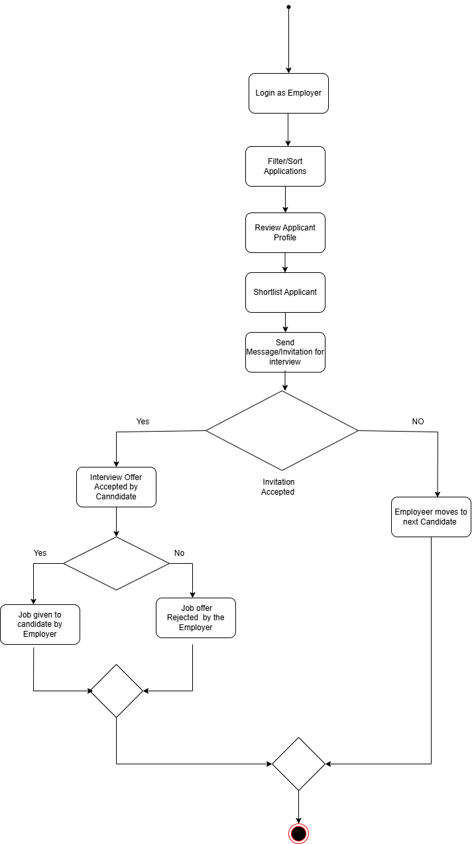
1)Activity diagram Employer perspective

Slide 13
2)Activity Diagram employee perspective

Slide 14
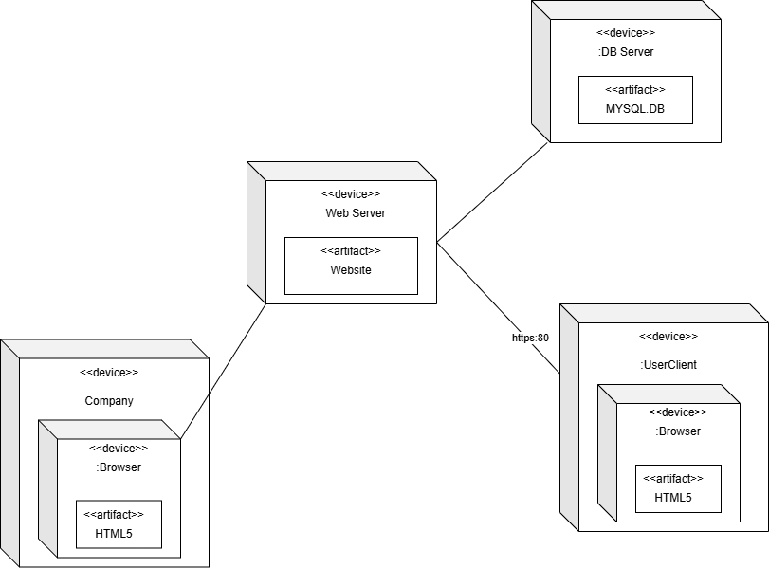
3) Deployment diagram

Slide 15
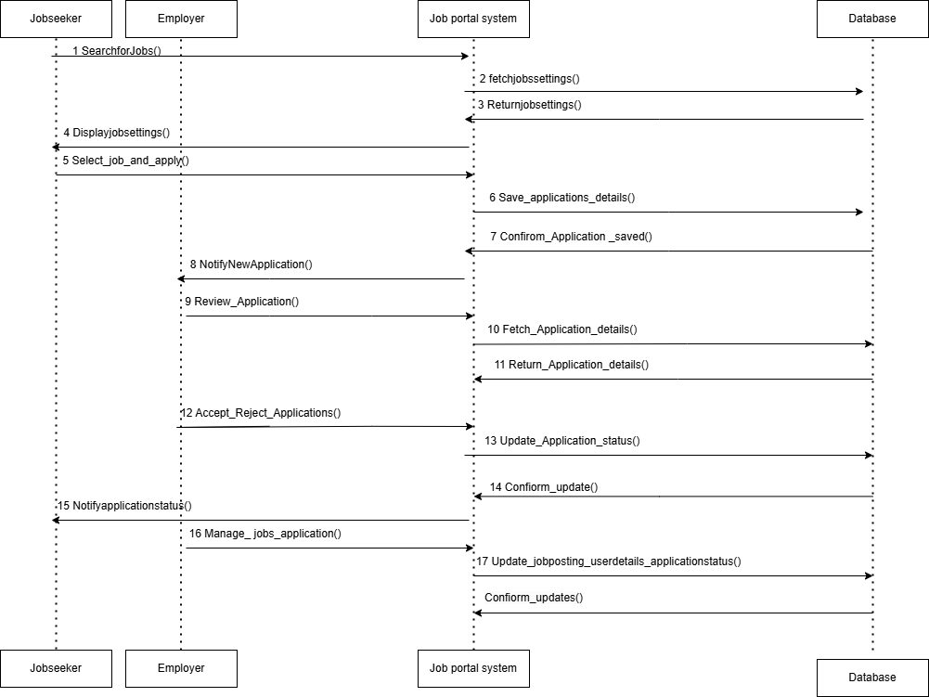
4 Sequence diagram

Slide 16
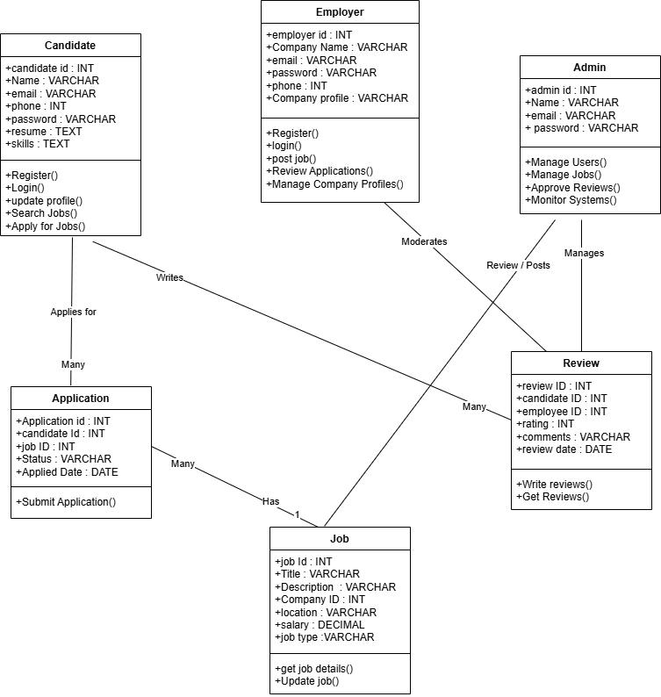
5) Class diagram

Slide 17
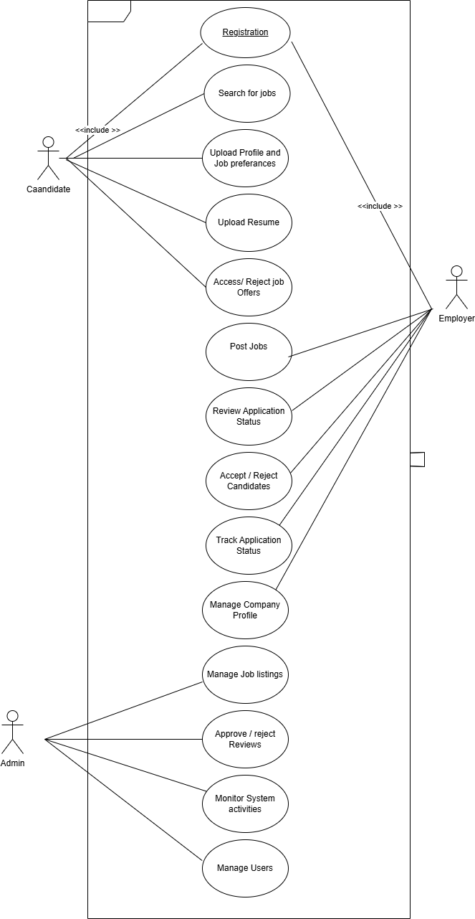
6)Use case diagram

Slide 18
THANK YOU

