Slide 1
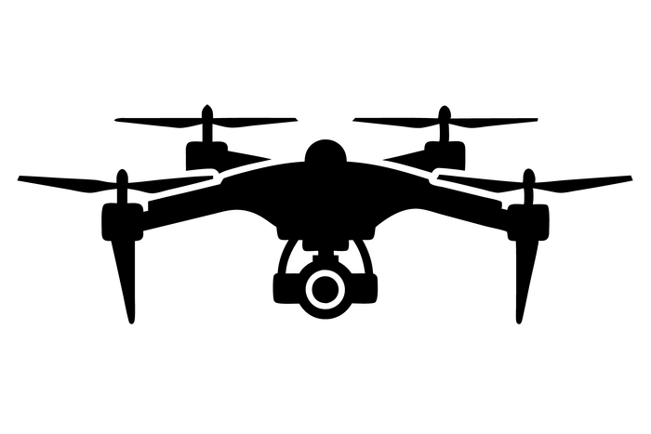
PX4 SITL with Gazebo Failsafe
A Project on GPS Failure Failsafe Mechanism for Quadrotors
G Hemanth Kumar

Slide 2
Introduction & Objectives
Overview of the Project
Importance of GPS Failsafe for Quadrotors
Goals of the Project
Expected Outcomes

Slide 3
Feasibility & Resource Estimation
Availability of Simulation Tools
Justification for Using PX4 SITL and Gazebo Classic
Software Requirements
Hardware Specifications

Slide 4
Timeline & Task Breakdown
Week 1: Research and study of necessary tools
Week 2: Setup of PX4 SITL and Gazebo Classic
Week 3: Implementation of GPS failsafe mechanism
Week 4: Testing, analysis, and refinement

Slide 5
Implementation Steps
Installation of Required Tools (PX4, ROS 2, Gazebo Classic, MAVLink, QGroundControl)
Setting Up the Simulation Environment
Executing GPS Failure Scenarios
Data Logging and Analysis

Slide 6
Simulation Execution & Testing
Running the PX4 Quadrotor in Gazebo
Inducing and Recovering from GPS Failure
Logging Data Using QGroundControl

Slide 7
Failsafe Analysis & Comparison
Drone Behavior Before and After GPS Failure
Position and Altitude Changes
Velocity and Attitude Variations
3D Trajectory Analysis
Comparison Between Normal and GPS Failure Scenarios

