Slide 1

COACHING MATE API PROJECT
Presented by Team Redback
Notes:
Sirui

Slide 2
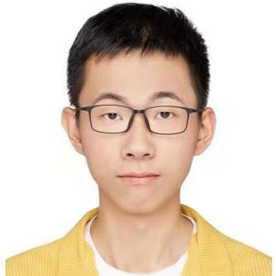


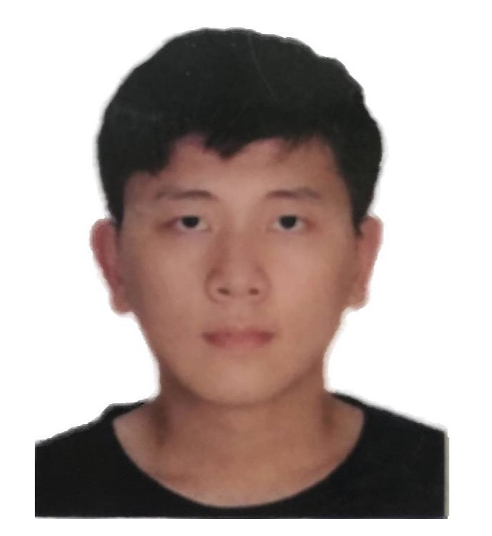

Our Team
Li Qi
Lee Guo Yi
Backend Lead
Product Owner
Sirui Liang
Quality Control
Felix Wu
Scrum Master
Gary Zhang
Frontend Lead
Notes:
Sirui

Slide 3
01
Intro of this project
02
Table of
Contents
Development
Backend structure
Frontend structure
Optimization Solutions
03
Demo Time
Notes:
Sirui

Slide 4
Introduction
Notes:
Sirui

Slide 5


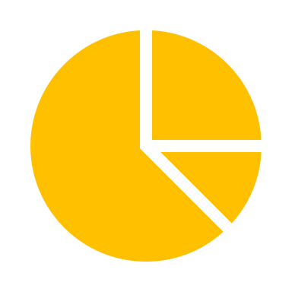









What is this project about ?
Sustainable
Dashboard
CoachingMate
Garmin API
Connect
…
Flexible
Scalable
Notes:
Sirui

Slide 6
Development
Notes:
The development section will consist of three parts

Slide 7
Overall structure
5
Garmin API
<<API>>
Frontend
(React)
<<Server>>
Provide
User
<<Input>>
1
Require
Backend flow
Push to url portal
Frontend flow
1
4
Portal
Mapping
2
Require
1
2
3
1
2
3
4
5
3
url/activity
url/activityDetails
url/epochs
Save/Require
Backend (Java)
<<Server>>
MongoDB
<<Database>>
2
3
Portal
Mapping
Retrieve
Notes:
???????

Slide 8
Backend flow
1
Garmin API publishes the data to the URL portal.
5
Garmin API
<<API>>
Frontend
(React)
<<Server>>
Provide
User
<<Input>>
1
The Backend Server will then post the data.
Require
2
Push to url portal
1
4
Portal
Mapping
2
Require
3
url/activity
url/activityDetails
url/epochs
Save
Backend (Java)
<<Server>>
MongoDB
<<Database>>
2
Backend Server sends the posted data to the MongoDB database and save it as different API data formats
3
3
Portal
Mapping
Retrieve
Notes:
Felix

Slide 9


Backend structure details
Classes
1
Front controller layer
Framework
Controller
Handle data flow from GarminAPI
2
Data interface access layer
Dao
Read and write to database
3
Service
Data service interface layer
Deploy
Preprocess data and response data
Notes:
Felix

Slide 10
Frontend flow
1
The User request data through the frontend
5
Garmin API
<<API>>
Frontend
(React)
<<Server>>
Provide
User
<<Input>>
2
Frontend server will send the data request to the Backend server
1
Require
3
The Backend server will retrieve the requested data in MongoDB
Push to url portal
1
4
Post
Mapping
2
Require
3
4
The Backend server will post map and send the data to the Frontend
url/activity
url/activityDetails
url/epochs
Require
Backend (Java)
<<Server>>
MongoDB
<<Database>>
2
3
5
The Frontend server gets the requested data back to the user
Portal
Mapping
Retrieve

Slide 11
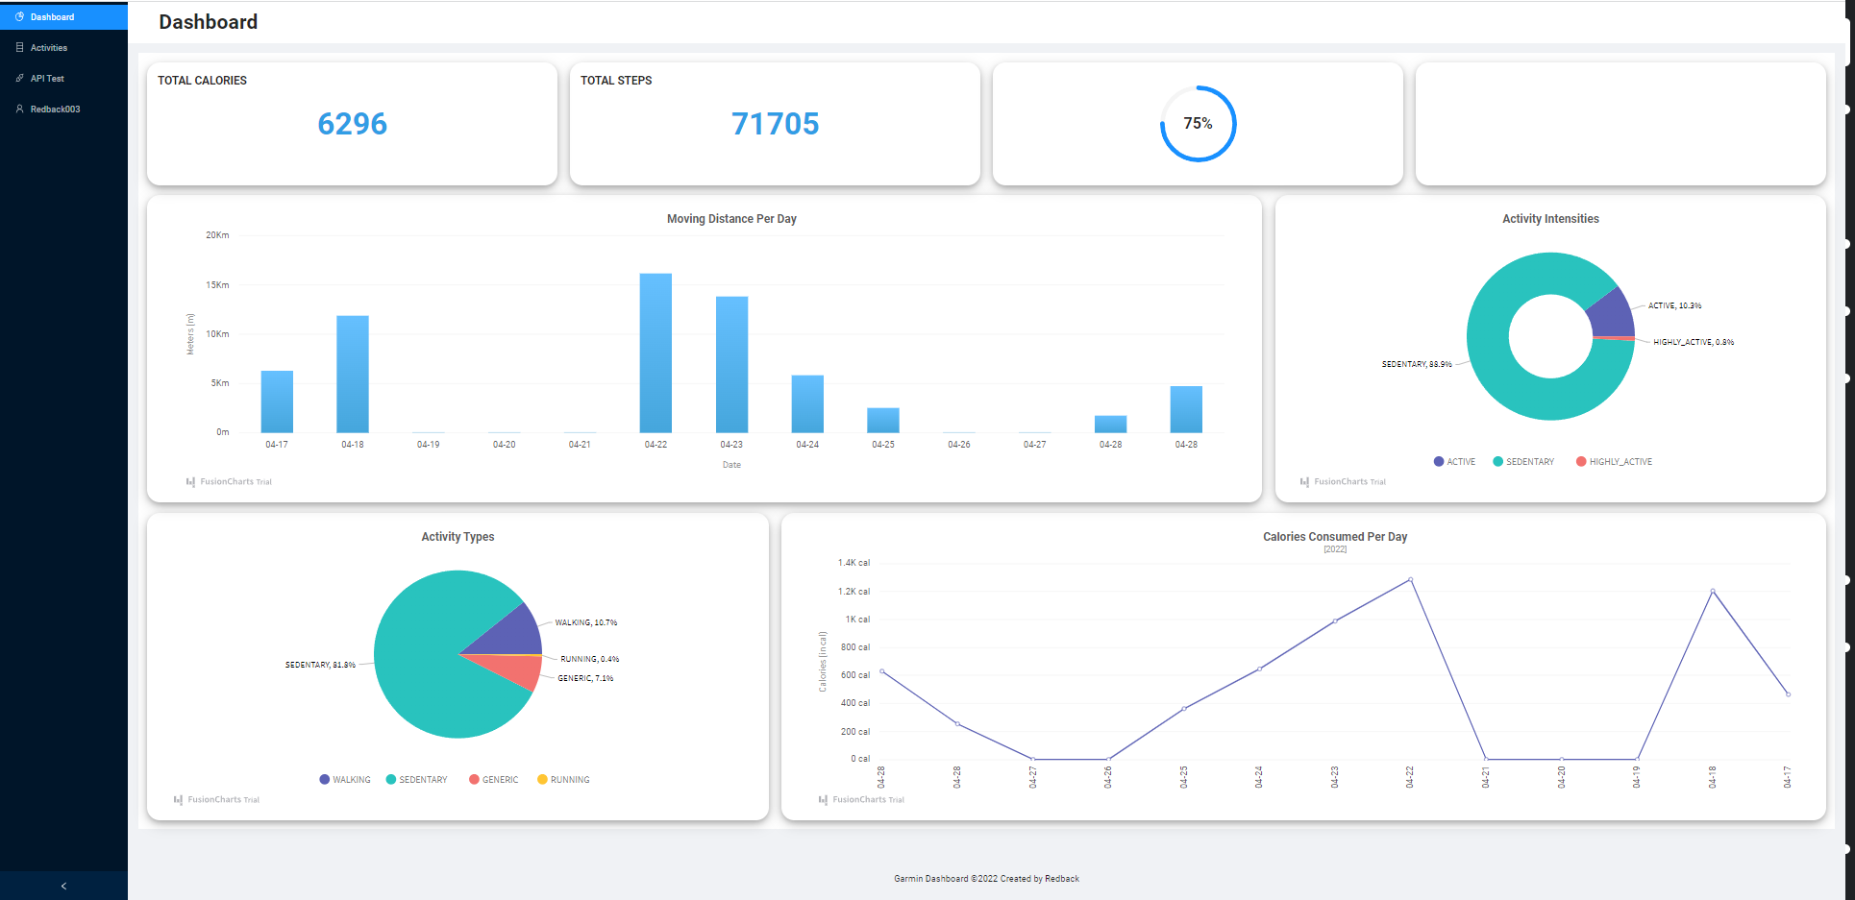
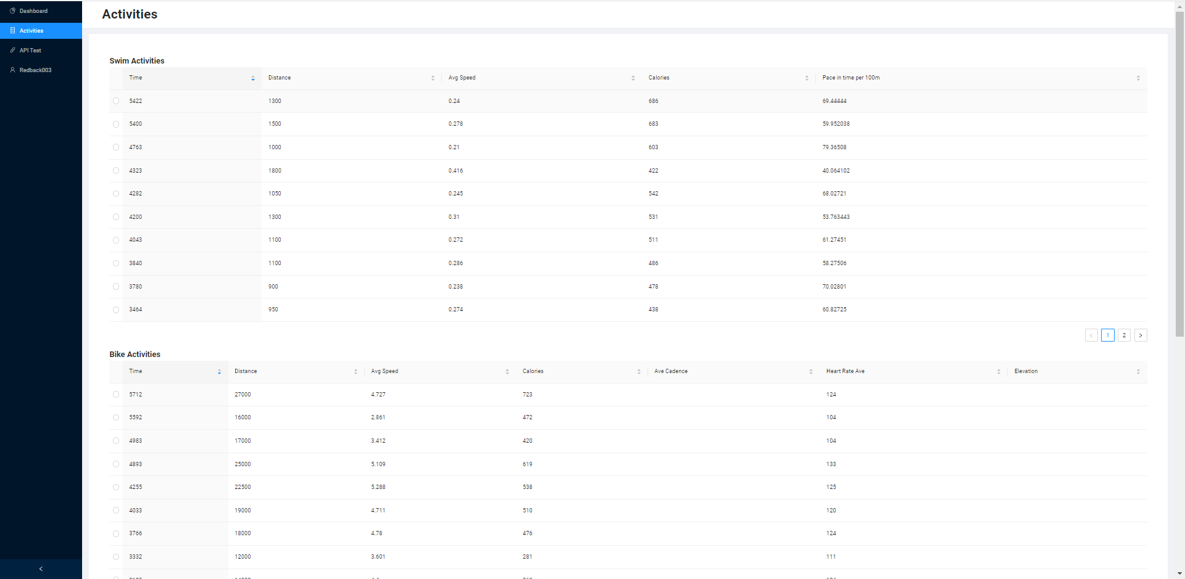
Frontend design structure
Dashboard
The User request data through the frontend.
Shows a summary of their exercises and their statistics.
Activities
Focuses on the main 3 activities:
Run, Bike and Swim
Able to see the key details of each activity logged into the Garmin watch

Slide 12



Frontend data usage
Activities
Time
Distance
Average Speed
Calories
Pace per km
Time
Distance
Average Speed
Calories
Avg Heart Rate
Time
Distance
Average Speed
Calories
Avg Heart Rate
Pace per km

Slide 13
Technical Optimization

Slide 14
Optimization Solutions
Sustainable
Connect
Flexible
Scalable

Slide 15
Optimization Solutions
More scalable
Changed !
5
Problem: Both data format and url portal have changed in Garmin API while older version program is less robust to the changes
Garmin API
<<API>>
Frontend
(React)
<<Server>>
Provide
User
<<Input>>
1
Require
Push to url portal
1
4
Portal
Mapping
2
Require
1
Solution: Rebuilt a more robust saving methods to scale accordingly to the change of Garmin API
url/activity
url/activity
Details
url/epochs
Save/Require
Backend (Java)
<<Server>>
MongoDB
<<Database>>
2
3
Portal
Mapping
Retrieve

Slide 16
Optimization Solutions
More flexible
5
Garmin API
<<API>>
Frontend
(React)
<<Server>>
Provide
User
<<Input>>
Problem: The older version prints data directly in the frontend
1
Require
Push to url portal
1
4
Portal
Mapping
2
Require
Solution: provide methods to retrieve specifications of activity data, specifically focusing on how to make data visualized in the front end
1
url/activity
url/activity
Details
url/epochs
Save/Require
Backend (Java)
<<Server>>
MongoDB
<<Database>>
2
3
Portal
Mapping
Retrieve

Slide 17
Optimization Solutions
More sustainable
Add significant test functions to facilitate error detections in the future
5
Garmin API
<<API>>
Frontend
(React)
<<Server>>
Provide
User
<<Input>>
AuthTest
1
Check whether can connect successfully
Require
Push to url portal
Portal
Mapping
1
4
2
Require
UpComingDataProcess
Test
1
url/activity
url/activityDetails
url/epochs
Save/Require
MongoDB
<<Database>>
2
Backend (Java)
<<Server>>
databaseTest:
Check whether can connect to database
Check whether the data format same from API changed
3
Portal
Mapping
Retrieve
FunctionTest
Check whether the new added function
can work or not

Slide 18
Demo Time
Notes:
The development section will consist of three parts

Slide 19

Thank You !

Slide 20
Questions ?

