Slide 1
value iteration in grid world
Удирдсан багш: Б. Луубаатар
Гүйцэтгэсэн оюутан: Г. Гантулга

Slide 2
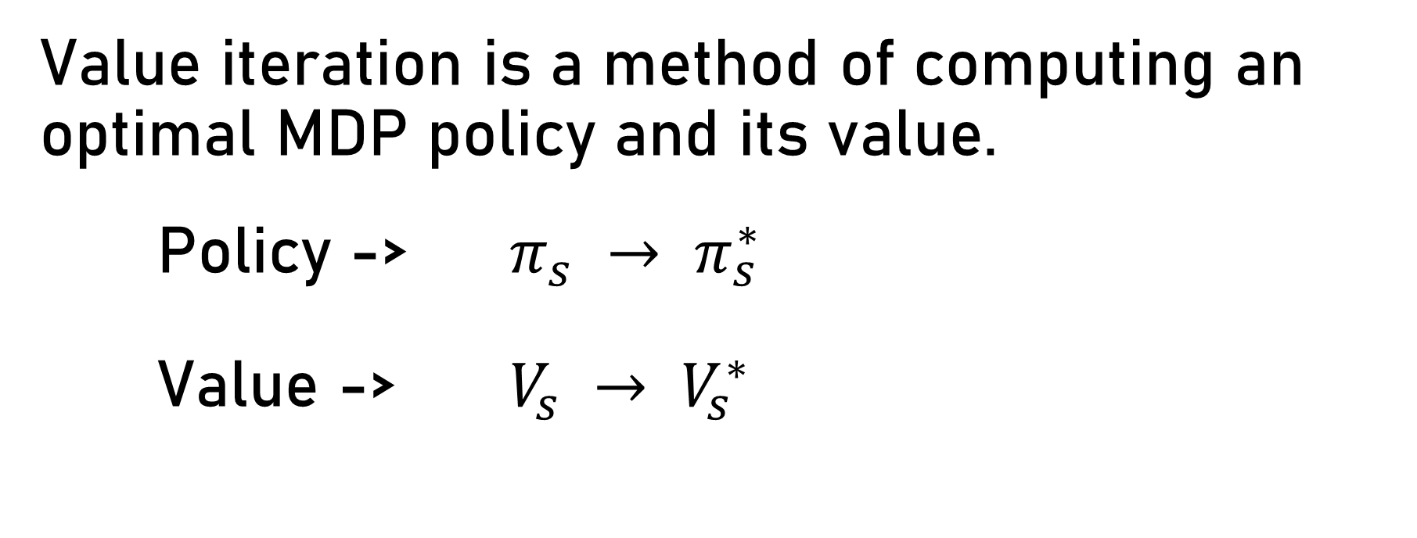
Value iteration
Value iteration is a method of computing an optimal MDP policy and its value.
Policy -> $π_{s} → π_{s}^{∗}$
Value -> $V_{s} → V_{s}^{∗}$

Slide 3
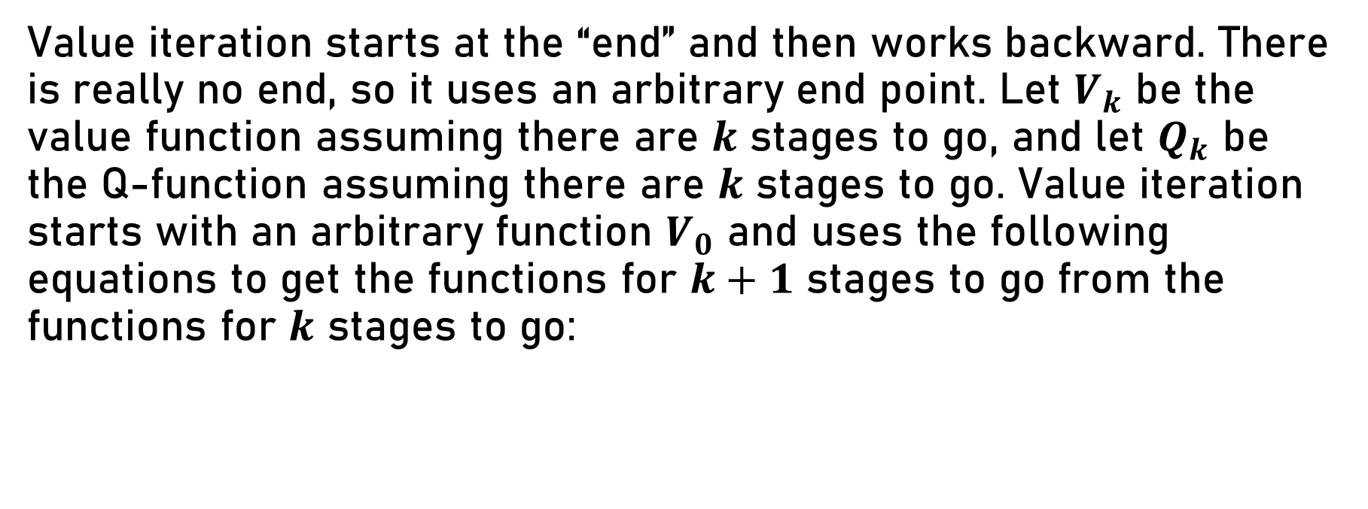
Value iteration
Value iteration starts at the “end” and then works backward. There is really no end, so it uses an arbitrary end point. Let $V_{k}$ be the value function assuming there are $k$ stages to go, and let $Q_{k}$ be the Q-function assuming there are $k$ stages to go. Value iteration starts with an arbitrary function $V_{0}$ and uses the following equations to get the functions for $k+1$ stages to go from the functions for $k$ stages to go:

Slide 4

Value iteration
$$Q_{k+1}(s,a) = \sum_{s′}{P\left(s^{′} | s,a\right)∗(R\left(s,a,s^{′}\right)+γV_{k}(s′)) }$$
$$V_{k+1}(s) =\max_{a}{\sum_{s′}{P\left(s^{′} | s,a\right)∗(R\left(s,a,s^{′}\right)+γV_{k}(s′)) }}$$
$$π_{k+1}(s) =\underset{a}{argmax}{\sum_{s′}{P\left(s^{′} | s,a\right)∗(R\left(s,a,s^{′}\right)+γV_{k}(s′)) }}$$

Slide 5
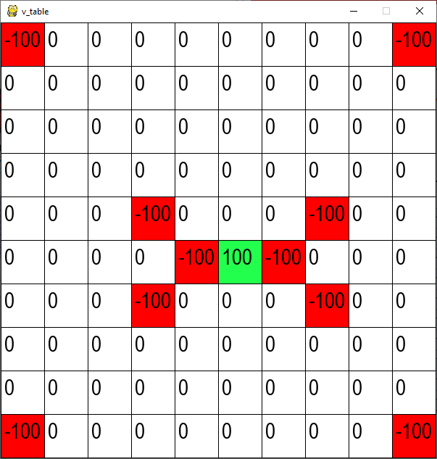
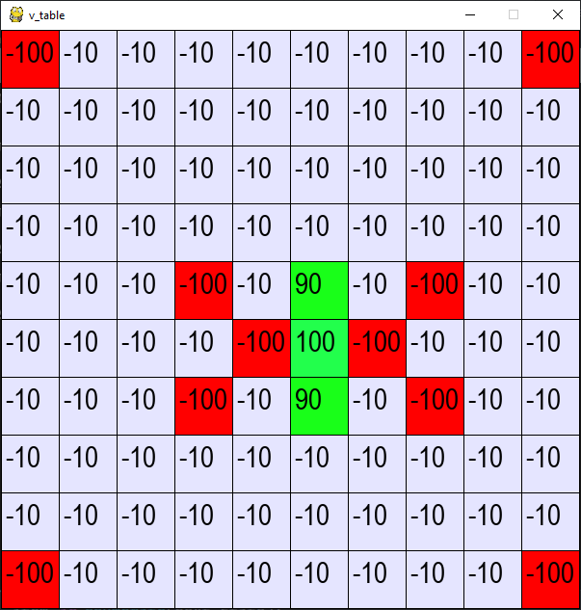
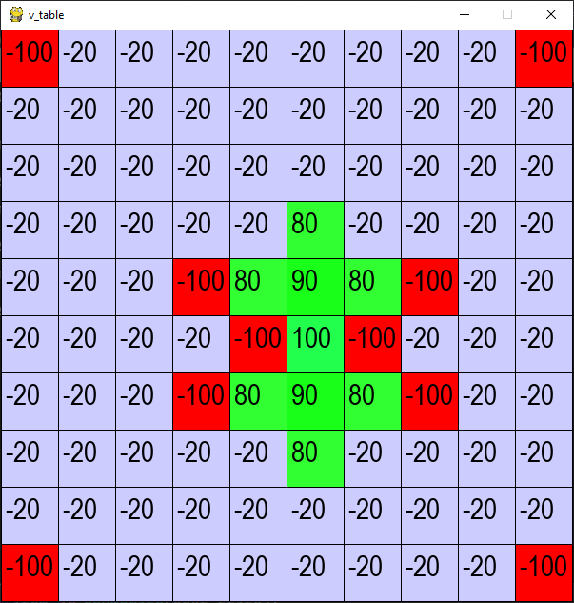
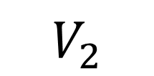
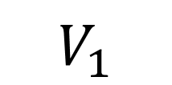
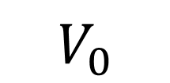
Value iteration
$$V_{0}$$
$$V_{1}$$
$$V_{2}$$

Slide 6
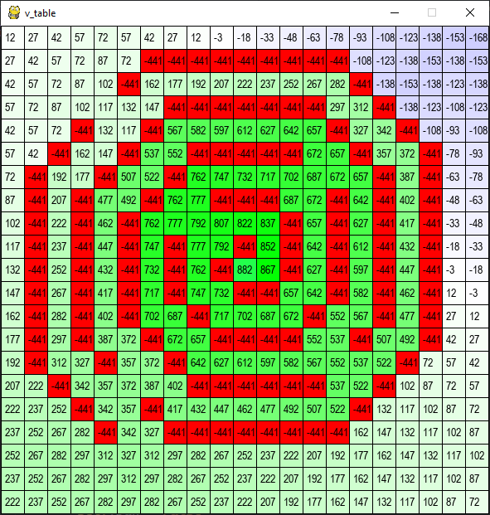
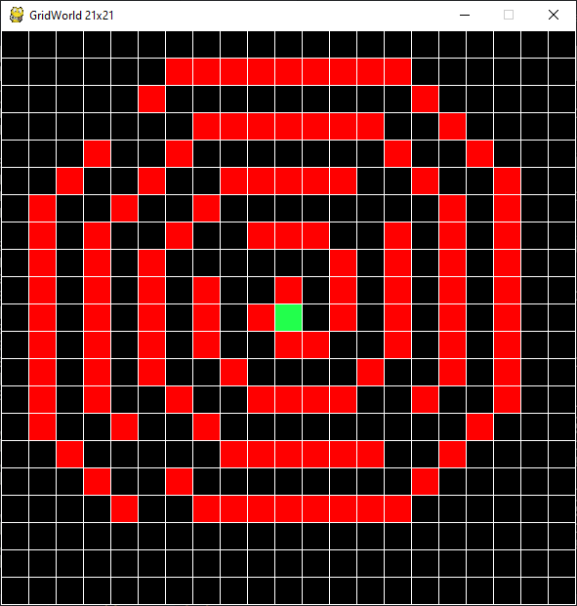
Value iteration

Slide 7
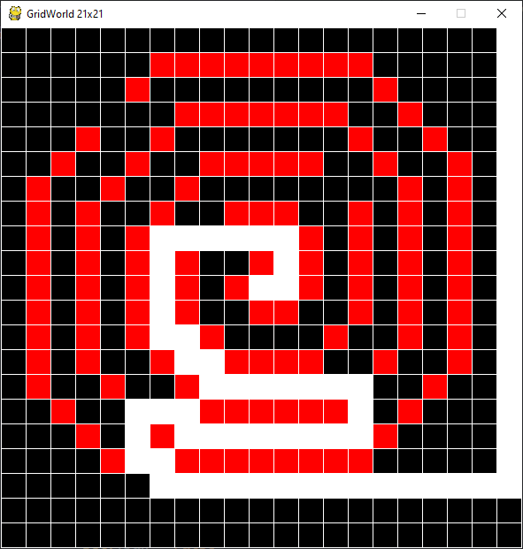
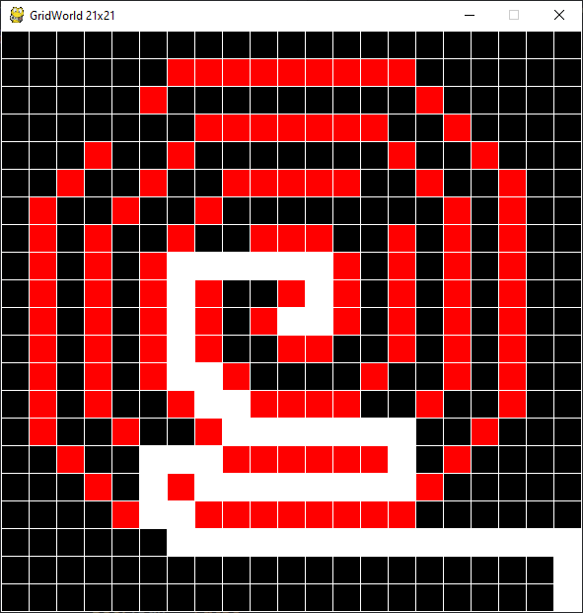
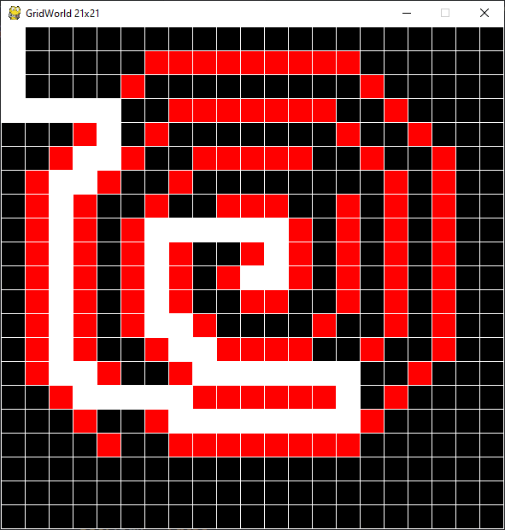
Value iteration

Slide 8
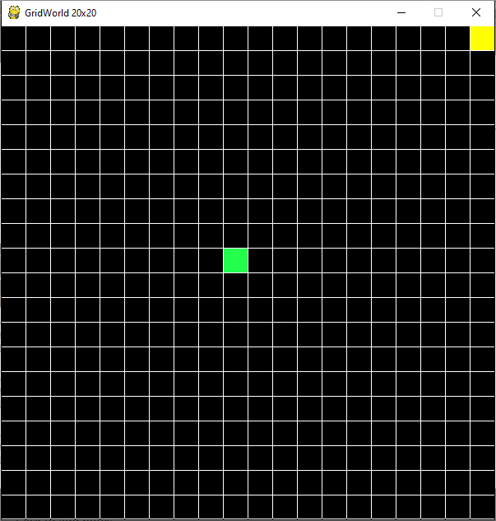
Q-learning vs Value iteration

Slide 9
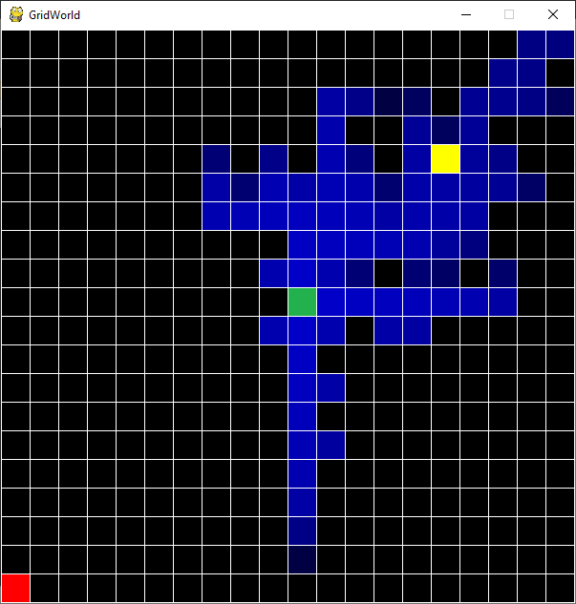
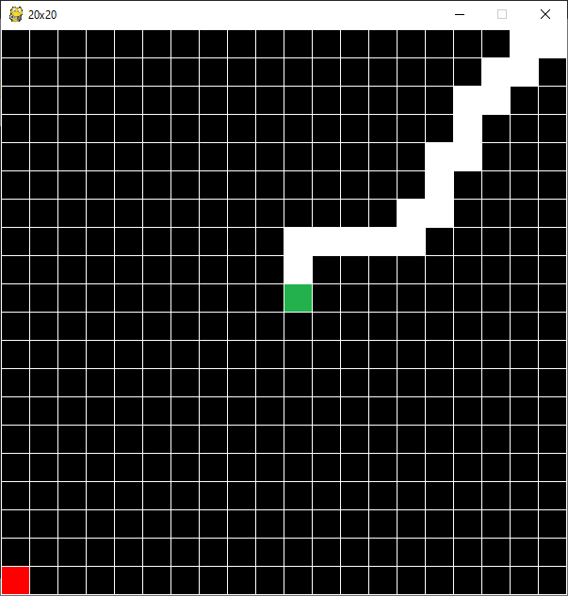
Q-learning vs Value iteration

Slide 10
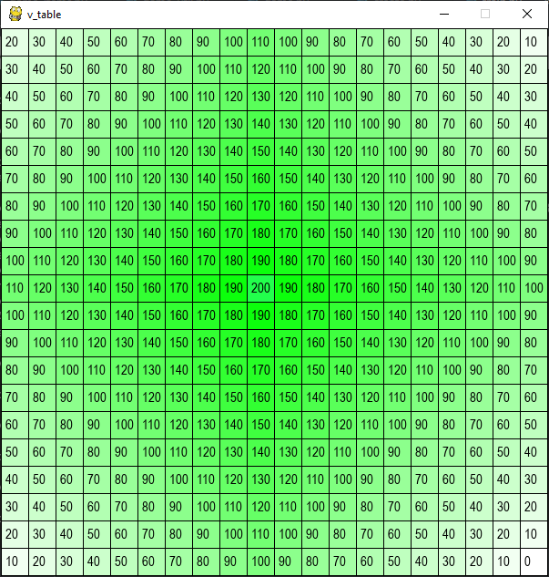
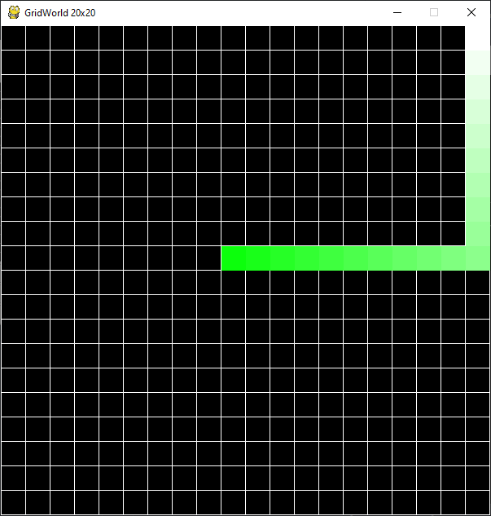
Q-learning vs Value iteration

