Slide 1
Hospital Service Application
Comfortaible service for patients & doctors

Slide 2



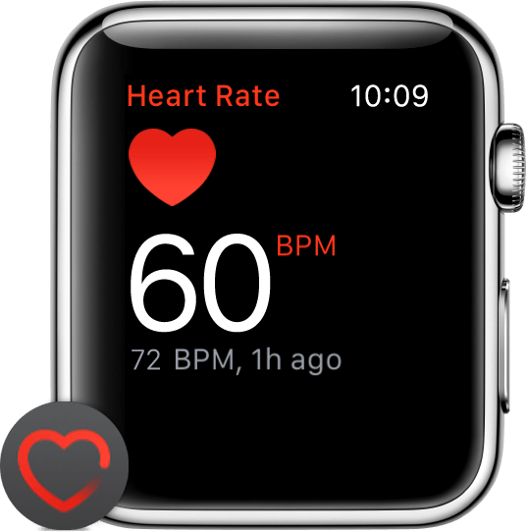
Architecture. Main Parts
Database
Scheduling
HSA Planing & Informing
Health reports
Data
Summary
Alert
HSA Alerting
Pulse

Slide 3
HSA Alerting
Allerting
  Sending alert to doctor
Big Data Technologies:
  Middleware Messages Binder: Apache Kafka
  Rest request: Spring-web
Accumulating data
  Sending heartbeat summary to information system

Slide 4
HSA Alerting. Big Data
Kafka
Source
Sink
Topic: Heart Beating
Group 1: Alerting
Group 2: Accumulating
Rest
Rest
Source
Sink
Source
Sink

Slide 5
HSA. Informing
DMZ (Demilitarize Zone) Architecture
  Internet: Clients (Web, iOS, Android etc)
  Intranet:Web Rest Controller
  TCP Servers (Data Processing)
  UDP Server (Registrator+Load Balancer)
  Database (MySQL, MSSQL, MongoDB etc)

Slide 6
HSA Informing. Architecture
Internet
Intranet
UDP Server
Client
Web Rest
Controller
Database
Client
TCP
Server
TCP
Server
Client
TCP
Server

