Slide 1
Smile guru data
Analysis report
By
Ganugapenta anil

Slide 2
introduction
Objective: analyse website user behaviour using event data.
Tools Used: MYSQL for data cleaning, POWER BI for visualization.

Slide 3
Data Cleaning Overview
page popularity
device & os usage
event distribution
engagement by page
data quality audit
predictive analysis

Slide 4
Initial analysis
The dataset has the information of smile guru website engagement data, there are 1059 rows and 7 columns in given dataset.
Findings of missing values and invalid_timestamp are :
Event_timestamp has 65 invalid_timestamp
Event_date has 103 missing values
Event-name has 91 missing values
User_pseudo_id has 100 missing values
Device_category has 109 and device_os has 91 missing values
Page_location has 109 missing values

Slide 5
Data Cleaning Process (MySQL)
Filtered page_view events.
Filtered page_view events.
Imported data to MySQL with 7columns and 1059 records with datatype as text.
Checked for blank values and replace them with unknown, and removed duplicates from the data.
Converted the datatype from text to required datatypes like date, text, integer, so on.
Created a new column called page by excluding page _location URLs(https://smileguru.com) as home and others based on the URLs.
Counted occurrence of page_view, click, scroll, and form_submit in event_names column.
Created another column called user_id.
The page_location missing values where replace with highest occurrences
Converted event_timestamp to integer
6 duplicates where deleted from the data and empty record where replaced with unknown.

Slide 6
Power bi
power bi is a powerful data visualization tool that allows users to analyse, visualize, and share insights from data in an interactive and user-friendly manner. it helps in making data-driven decisions by transforming raw data into actionable insights through interactive dashboards and reports.

Slide 7
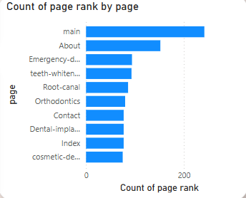
Visualisation in power bi
Bar chart
A Bar Chart in Power BI is used to compare and visualize event occurrences across different categories. In your dataset, bar charts can help identify.

Slide 8
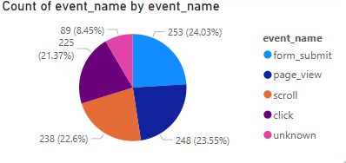
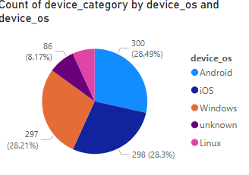
Pie chart
A Pie Chart is a circular visualization that represents data as proportional slices of a whole. Each slice's size is determined by its percentage share of the total dataset.

Slide 9
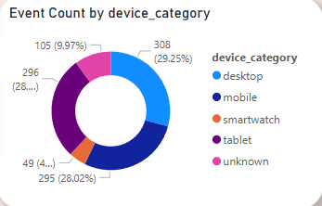
Donut chart
A Donut Chart is a variation of a Pie Chart with a hollow centre, making it visually distinct and easier to read when multiple categories are involved. It represents proportions of a whole, with each slice showing a percentage contribution.

Slide 10
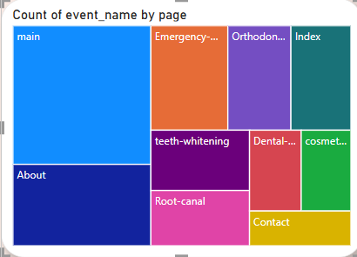
Tree map
A Tree Map is a hierarchical visualization that represents data using nested rectangles, where the size of each rectangle is proportional to its value. It is useful for comparing multiple categories and subcategories in a compact way.

Slide 11
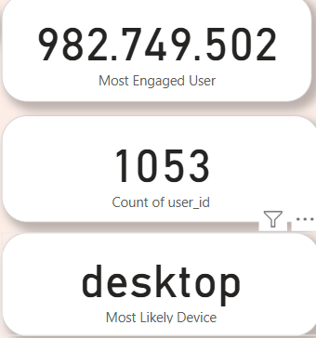

card
A Card Visual in Power BI is used to display a single key metric in a clear and prominent way. It helps in highlighting important KPIs (Key Performance Indicators) for quick insights.

Slide 12
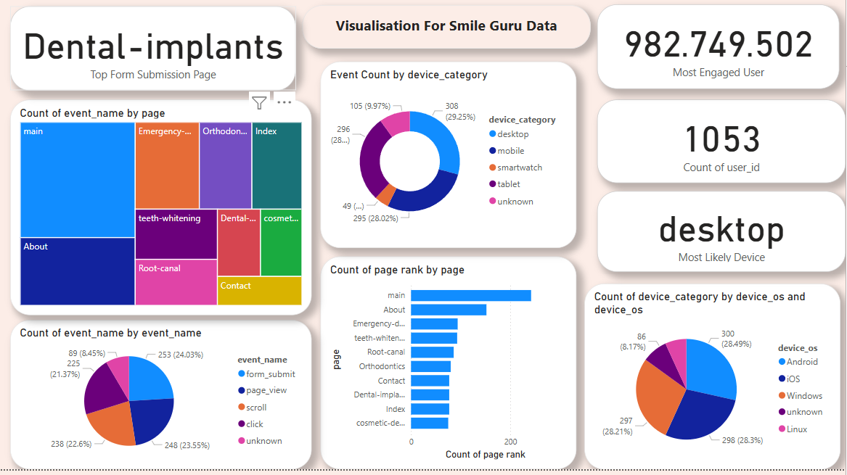

Slide 13
conclusion
The Smile Guru Website Analysis revealed key insights into user engagement, device usage, and event interactions using Power BI. The home page had the highest traffic, and mobile devices dominated user activity. Clicks and scrolls were the most frequent interactions, while form submissions were lower than expected. Data cleaning addressed missing values, duplicates, and invalid timestamps for better accuracy. To improve engagement, optimizing low-performing pages and enhancing call-to-action placements is recommended. A mobile-first approach is essential for better user experience. Regular data audits will ensure continued accuracy and insights.

Slide 14
Thank you

