Slide 1

DB and DBMS
SNU Linguistics & CSE Jeong Daeyong

Slide 2

Table of contents
DB and DBMS
Types of DB
Hierarchical DB
Network DB
Relational DB (SQL)
Non relational DB (NoSQL)
Recent trend of DB
DB Market
Future of DB

Slide 3
1. DB and DBMS
DB (DataBase)
- A set of integrated, systemized data
- to be shared and managed
- ex) A list of employees
DBMS (DataBase Management System)
- A middleware for managing DB
- to resolve data dependency & data redundancy
- minimalized redundancy, easy maintenance, robust security, consistency
- ex) MySQL, MongoDB

Slide 4
1. DB and DBMS
Q) What does it mean by “data dependency and redundancy”?
Q) What is a middleware?
Q) Can we handle DB without DBMS?
Q) Is MS Excel DBMS?

Slide 5
2. Types of DB
Literal meaning of “type of DB” varies.
ex) People, Animal, Products …
The type of DB refers to the methodology of DBMS that chains data.
Hierarchical, Network, Relation, Non-relation

Slide 6
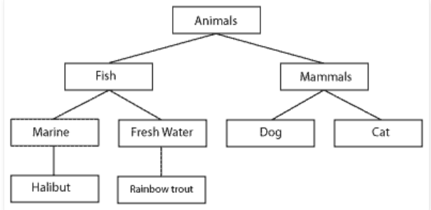
2. Types of DB
1. Hierarchical DB
Data are hierarchical and vertically dependent
Tree structure.
Mid~late 20C
ex) IMS, RDM Moblie
pros)
simple and fast
predictable future data usage
cons)
insertion and amendment
many-to-many relation

Slide 7
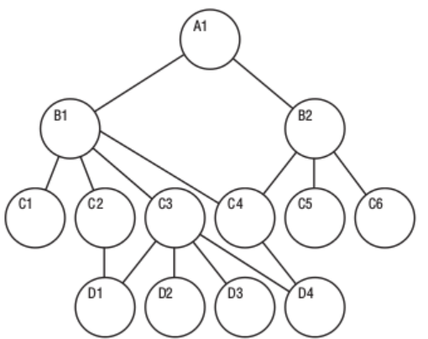
2. Types of DB
2. Network DB
Nodes and paths enable data to be freely connected
Mid~late 20C
ex) IDS, IMAGE, IDMS
pros)
many-to-many relation
solve prob. of hierarchical DB
cons)
complicated composition
data dependency

Slide 8
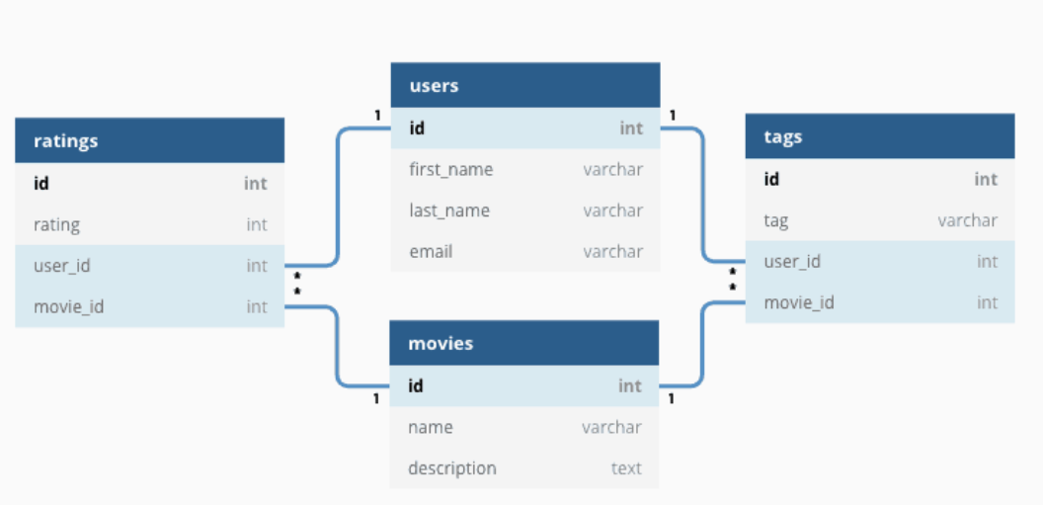
2. Types of DB
3. Relational DB
table, record, field
relation embodied with overlapping field
use Structure Query Language
late 20C ~ / Oracle, MySQL, SQLite
pros)
fast, multiple usage
easy to express relation
stable DB (ACID observation)
cons)
improper for big data
difficult to change the schema
relatively high query cost

Slide 9
2. Types of DB
3. Relational DB
Q. What is transaction?
Q. What is ACID?
Q. Is ACID not observed without relational DB?
Q. Why is relational DB inapproporiate for big data?
Q. So, is relational DB fast?
Q. What is ORM?

Slide 10
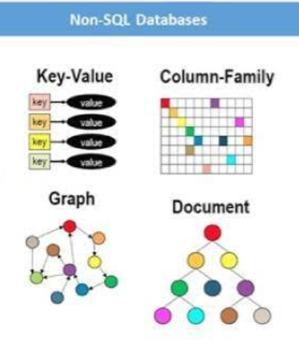
2. Types of DB
4. Non-relational DB or NoSQL
for gigantic, atypical data
no schema, nor relation embodied
table->collection / record->documents
CAP replaces ACID
21C / MongoDB, Redis, Cassandra
pros)
easy to handle atypical data
flexible structure
scalability
cons)
each data not secured
low portability
data dependency

Slide 11
2. Types of DB
4. Non-relational DB or NoSQL
Q. What is CAP?
Q. What is Sharding?
Q. How each types of NoSQL differs?
Q. Why is NoSQL fast?

Slide 12
3. Recent trend of DB
DB Market
Hierarchical & Network DB is not used anymore
Relational DB for Finance, Human-resource, Stock-tracking…
Non-relational DB for Bigdata, SNS…
Worldwide DB market size : 55 billion$
Domestic DB market size : 600 million$
Relational DB much exceeds Non-relational in sales figure.
Non-relational is growing rapidly in occupancy ratio. (6:4)
(sales figure depends on being opensource or not)

Slide 13
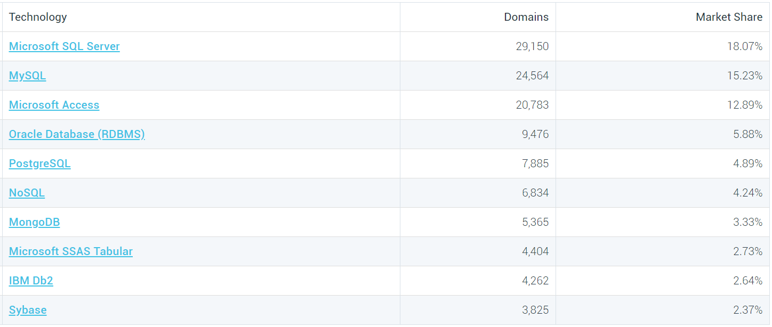
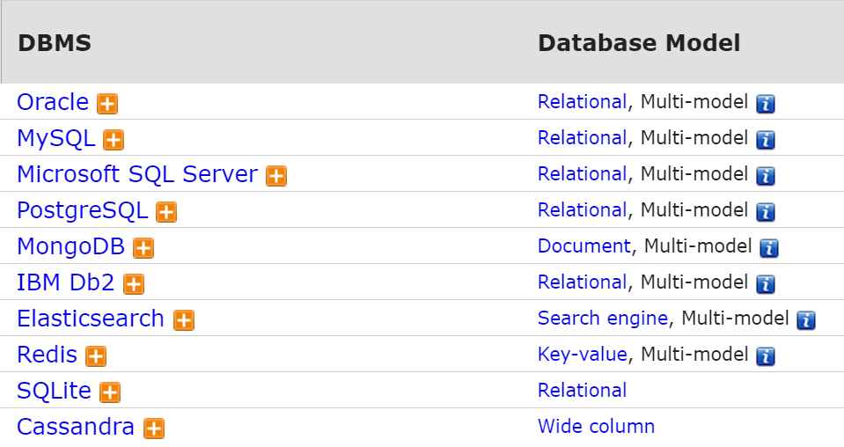
3. Recent trend of DB
Market share score
DB Market
Overall score(sales figure, popularity, market share)

Slide 14
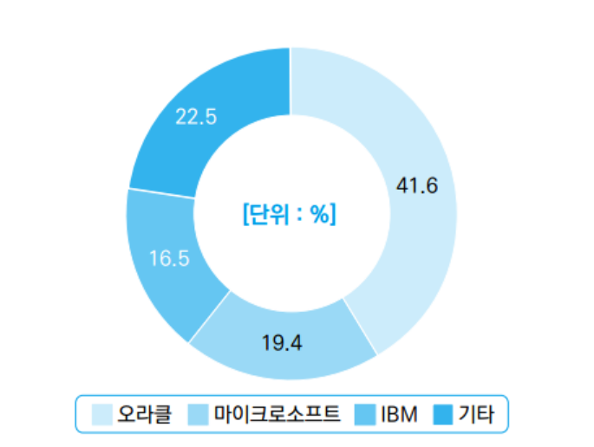
3. Recent trend of DB
DB Market : Domestic
Most of Korean major companies prefer Oracle
Small or Venture business prefer MySQL
More inc. are looking for new DB other than MySQL
b/c of hostile policy of Oracle
PostgreSQL & MariaDB gained popularity instead

Slide 15
3. Recent trend of DB
2. Future of DB
Non-relational DB VS Relational DB
Most of experts expect superiority of Relational DB in future
Relational DB will advance to handle atypical, big data with ease (scale-out)
Brand new DB might appear bridging Relational and Non-relational DB
+) more security issue, full-automatic DB management.. Etc.

Slide 16
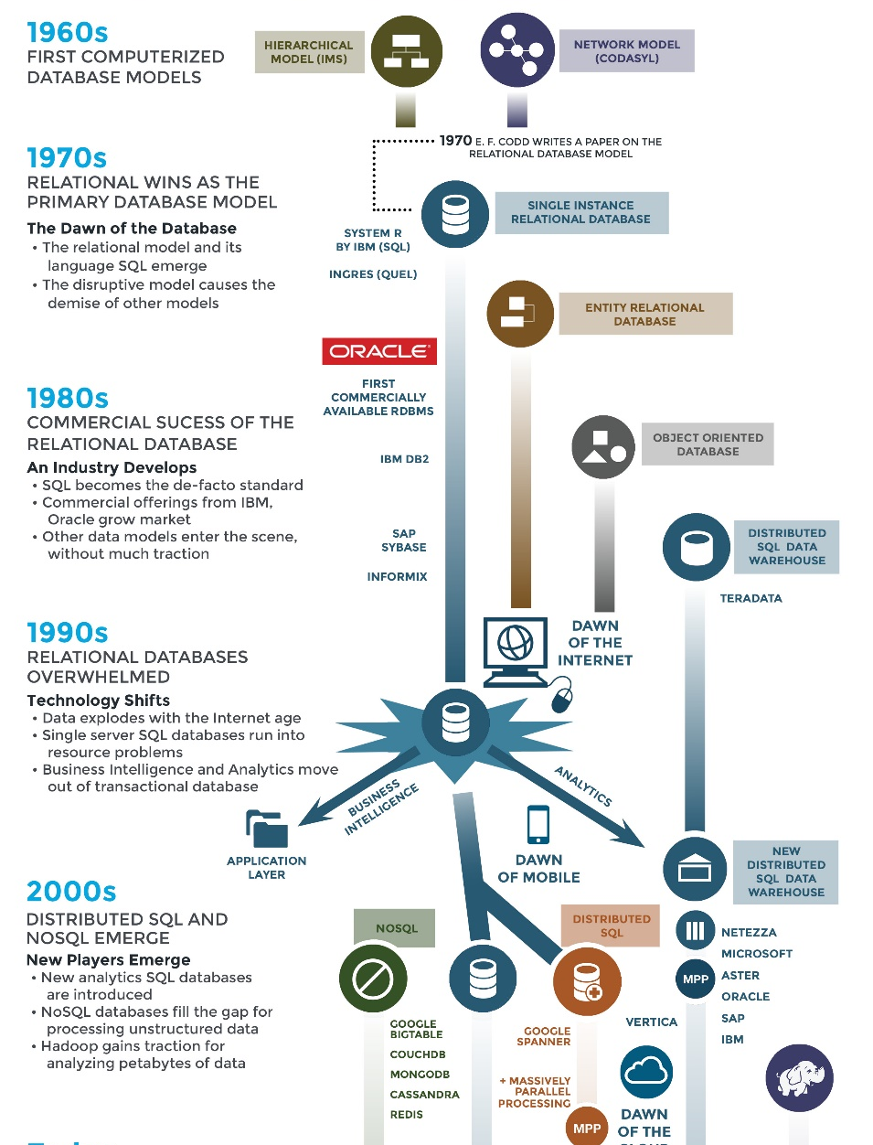
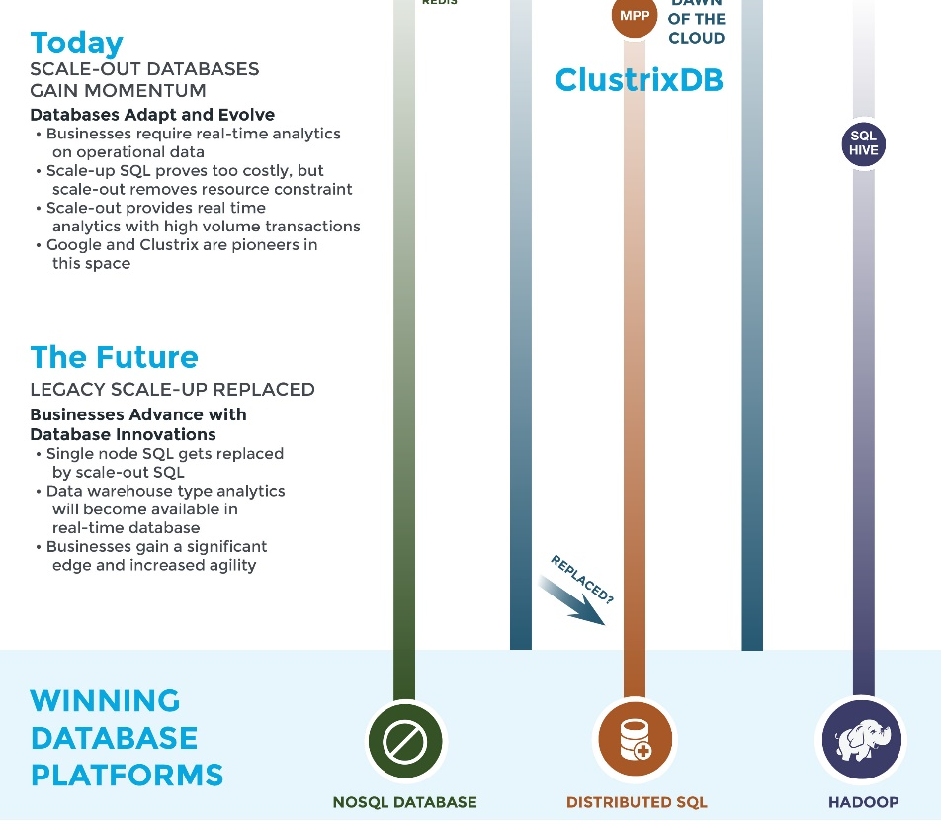

Slide 17
Reference
https://mariadb.com/kb/en/understanding-the-network-database-model/
https://www.omnisci.com/technical-glossary/relational-database
https://www.isaacbigdata.com/from-oracle-db-to-cassandra-nosql/
https://m.blog.naver.com/PostView.nhn?blogId=tomatosoft&logNo=220910427994&proxyReferer=https:%2F%2Fwww.google.com%2F
https://kr.clustrix.com/the-future-of-the-database/
https://poem23.com/2672
http://www.dbguide.net/db.db?cmd=view&boardUid=186825&boardConfigUid=9&categoryUid=216&boardIdx=155&boardStep=1
https://m.blog.naver.com/shakey7/221558533513
https://coding-factory.tistory.com/226
https://www.astera.com/type/blog/database-management-software/
https://velog.io/@dnjscksdn98/Database-%EB%8D%B0%EC%9D%B4%ED%84%B0%EB%B2%A0%EC%9D%B4%EC%8A%A4%EB%9E%80
https://www.oracle.com/kr/database/what-is-database.html
https://www.oracle.com/kr/database/what-is-a-relational-database
http://www.tcpschool.com/mysql/DB
https://ourcstory.tistory.com/30
https://m.blog.naver.com/PostView.nhn?blogId=haideskiller&logNo=221002843370&proxyReferer=https:%2F%2Fwww.google.com%2F
https://www.rfwireless-world.com/Terminology/Advantages-and-Disadvantages-of-RDBMS.html#:~:text=Drawbacks%20or%20disadvantages%20of%20RDBMS,-Following%20are%20the&text=%E2%9E%A8Complex%20software%20refers%20to,to%20recover%20the%20lost%20data.

