Slide 2
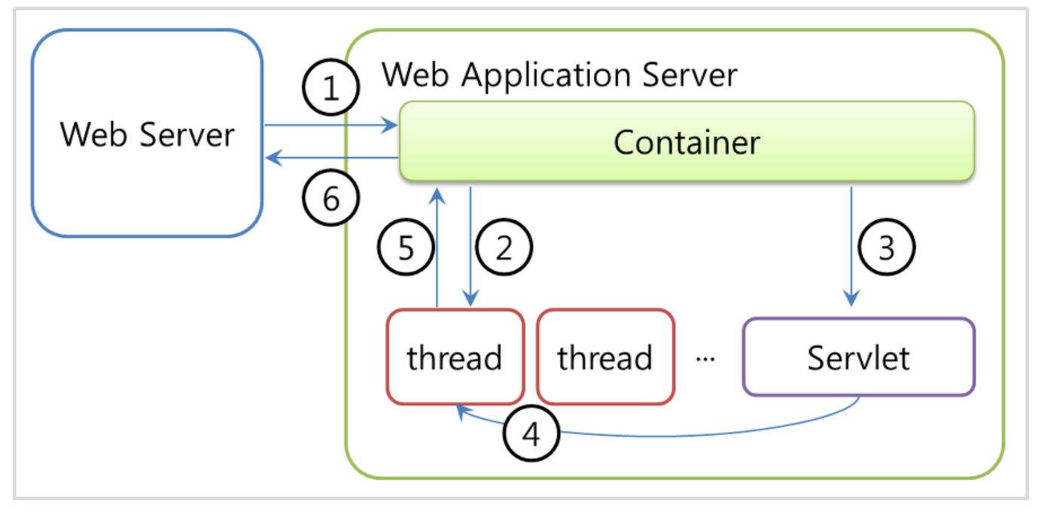
Jsp servlet & WAS

