Slide 1
Server and Server Language
SNU Linguistics & CSE
Jeong Daeyong

Slide 2
Table of Contents
1. Server and its mechanism
1.1. Concept of server
1.2. Server mechanism
1.3. Server and Internet
1.4. Server OS
1.5. Web Application Server
2. Server side script language
2.1. JSP
2.2. ASP
2.3. PHP
2.4. Node.js
2.5. Python
3. Advanced concepts on server
3.1. Servlet and Servlet container
3.2. Thread
3.3. Event loop
3.4. Callback method
3.5. Synchronous, Asynchronous

Slide 3
1. Server and its mechanism - concept of server
Server : computer or device that provides services thru network
Client : be provided with services from server
Client sends “request” to server, server returns “response” to client.
Server-Client is a relative concept
Ex) www : browser – web server
Q) Is server just a computer?

Slide 4
1. Server and its mechanism - mechanism
Client side script implemented : sends a request to server
Server side script receives and executes it.
Server side script organize the result and sends back to client.
Ex) mail website
Send button : client side script sends a request to server
Server executes the request with DB or other servers
Server side script codes are hidden
Q) HTTP source?

Slide 5
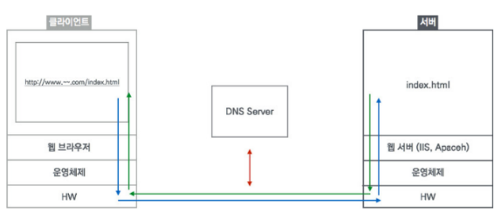
1. Server and its mechanism - mechanism
Q) Frontend? Backend?

Slide 6
1. Server and its mechanism – Internet and server
- Internet : network system connecting world-wide computers
WWW, Telnet, HTTP, FTP
Web is one of a service to achieve Internet’s goal
Web is based on Server-Client system
Internet == City
Web == House
Server-Client system == constructional material of the house

Slide 7
1. Server and its mechanism - Server OS
Most of server uses server OS
Ex) Linux, Solaris, Window Server
Server OS properties are:
No or optional GUI
Advanced backup / networking service
Clear data transmission btw. volumn, devices
Robust security for data, resources

Slide 8
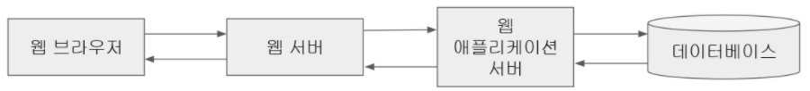
1. Server and its mechanism - Web Application Server
Prob: demand for dynamic web page increased, previous web-container method + CGI burden memory.
Web Application Server : web server + web container
Web Server covers static web page request
WAS takes charge of dynamic web page between Web Server and Database
Ex) Tomcat, uWsgi, APACHE

Slide 9
2. Server side script language
Server-Client system uses script language.
Compile language : Fast, easy debugging, platform dependent
Script language : Platform independent, easy, slow
Server developer’s ease & cost > efficiency of compile language
Q) Why is Java used as Server Language?

Slide 10
2. Server side script language - JSP
Java Server Pages
Based on Java / Servlet
Used for internal system constructions in major companies
Unique mechanism : servlet container checks or creates jsp files
Pro) Platform independency / structural, systematic (OOP-ish) / Java api available
Con) Compile process takes time

Slide 11
2. Server side script language - ASP
Active Server Pages
Based on Window OS
Used for private / small-sized company server, but on downtrend
Unique mechanism : asp.dll executes asp source
Pro) Support from MS / supports multiple languages
Con) High license cost / platform dependency
Q) What is DLL?

Slide 12
2. Server side script language - PHP
Hypertext PreProcessor
Based on C
Most of web servers are developed with PHP
Unique mechanism : PHP parser executes the request
Pro) easy grammar / open source / SQL friendly
Con) old-fashioned / hard to design complex classes (not OOP-ish) / low security
From PHP5, OOP-ish properties are added constantly

Slide 13
2. Server side script language - Node.js
Based on JavaScript
No WAS needed
Asynchronous I/O , Single thread event loop
Unique mechanism : event loop interacts with thread pool
Pro) highly expandable / full-stack development / Json-friendly / potential growth (Chrome V8)
Con) memory inefficiency

Slide 14
2. Server side script language - Python
Multi-purpose language
Not famous in Korea yet
Unique mechanism : Nginx for static page, WSGI for dynamic page
Pro) very easy language / many libraries (productivity up)
Con) slow (property of Python)

Slide 15
3. Advanced concepts on server – Servlet and Servlet container
Servlet : Java’s Multithread, Improved CGI
Dynamic page : WAS / Static page : Web server
Servlet is located btw them and client, check whether the request is dynamic or static
Servlet container : manages Servlets, creates threads for Servlet.
Servlet container Ex) WAS Tomcat, WAS Apachi

Slide 16
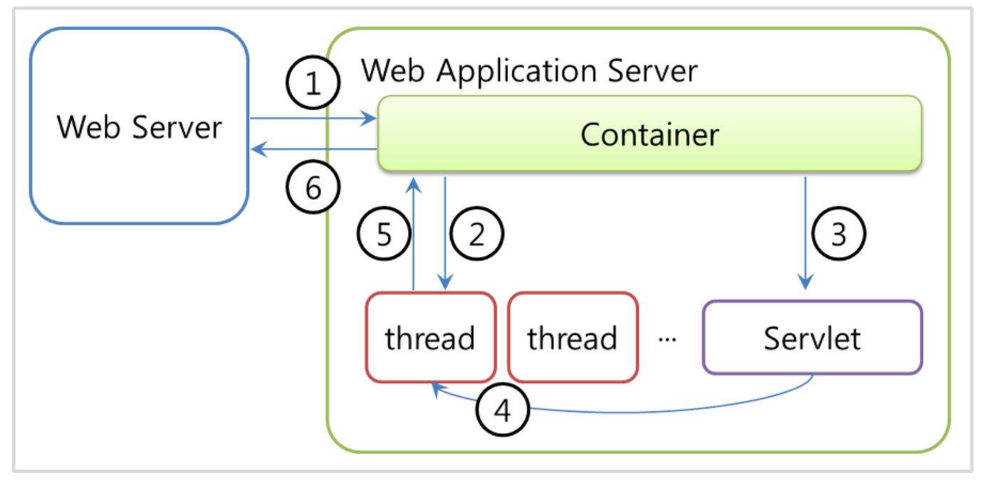
3. Advanced concepts on server – Servlet and Servlet container

Slide 17
3. Advanced concepts on server - Thread
Thread : a unit of work using memory and CPU
Node.js uses Singlethread.
== single call stack: A single thread iterates event loop, executes request itself or calls another thread from threadpool.
Most Web servers including Spring use Multithread (Servlet & Servlet container)
Each of thread execute client’s requests respectively
== multiple call stacks

Slide 18
3. Advanced concepts on server – Event Loop
Node.js
To maximize the efficiency of single thread
Special mechanism of managing Call Stack and Callback Queue.
Operation :
Codes to be executed are stacked in Call Stack. ->
Asynchronous ones are requested to Web API ->
Web API enqueue them to Callback Queue ->
If Call Satck is empty, Event Loop brings them to Call Stack again.

Slide 19
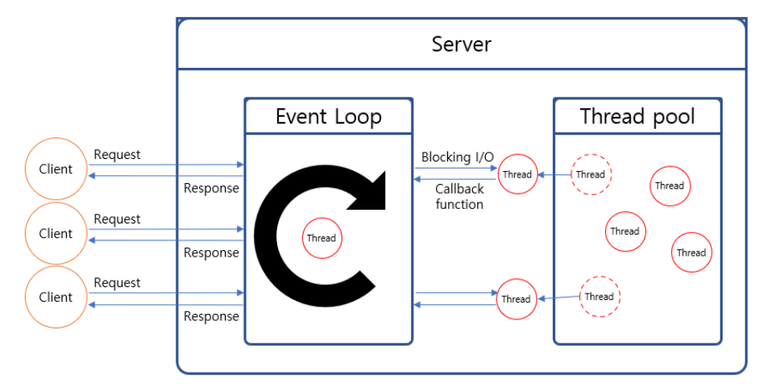
3. Advanced concepts on server – Event Loop

Slide 20
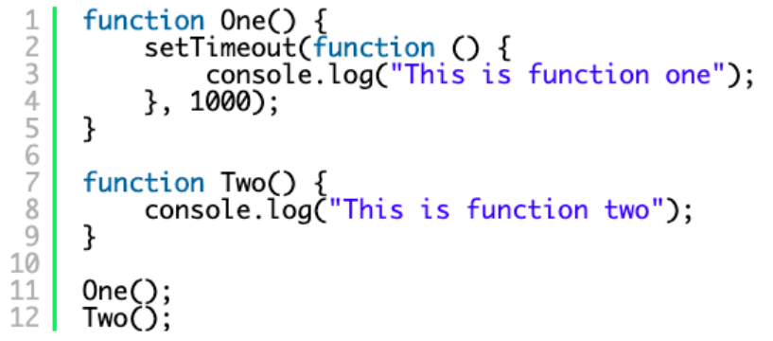
3. Advanced concepts on server – Callback Method
A method that comes in argument position.
Called and executed inside the method(function).
Ex) Collections.sort(~, func)
Asynchronous method’s return values are often omitted b/c asynchronous methods are returned last.

Slide 21
3. Advanced concepts on server – Synchronous / Asynchronous
Synchronous : Executes requests in a linear, serial order.
While a task is being executed, others stay “Blocking”
Ex) Convenient Store
Asynchronous : Executes requests in parallel way.
Each of tasks are under “Non-blocking” condition.
Ex) Subway
Q) Isn’t Asynchronous always better?

Slide 22
References
https://hpitos.tistory.com/7
https://www.fasthosts.co.uk/blog/client-side-vs-server-side-scripting/#:~:text=The%20most%20popular%20server%2Dside,customised%20content%20to%20the%20user.
https://conol.tistory.com/9
https://wikidocs.net/22322#:~:text=%EC%84%9C%EB%B2%84%20%EC%82%AC%EC%9D%B4%EB%93%9C%20%EC%8A%A4%ED%81%AC%EB%A6%BD%ED%8A%B8%EB%8A%94%20%ED%94%84%EB%A1%9C%EA%B7%B8%EB%9E%A8,%EC%9D%B4%EA%B3%A0%2C%20%EC%8B%A4%EC%8B%9C%EA%B0%84%EC%9D%98%20%EC%9D%98%EB%AF%B8%EC%9D%B4%EB%8B%A4.
https://imraccoon-developer.tistory.com/12
https://pathas.tistory.com/176
https://m.blog.naver.com/PostView.nhn?blogId=blogpyh&logNo=220020363988&proxyReferer=https:%2F%2Fwww.google.com%2F
https://includestdio.tistory.com/25#:~:text=%EC%A3%BC%EB%A1%9C%20%EC%A0%95%EC%A0%81%20%EC%9E%90%EC%9B%90%EC%9D%B8%20HTML,%EC%84%9C%EB%B2%84%EC%97%90%20%EC%9A%94%EC%B2%AD%EC%9D%84%20%EB%84%98%EA%B9%81%EB%8B%88%EB%8B%A4.&text=%EC%9B%B9%20%EC%84%9C%EB%B2%84%EB%A1%9C%EB%B6%80%ED%84%B0%20%EC%9A%94%EC%B2%AD%EC%9D%84,%EC%9B%B9%20%EC%84%9C%EB%B2%84%EB%A1%9C%20%EB%B0%98%ED%99%98%ED%95%A9%EB%8B%88%EB%8B%A4.
https://medium.com/@chrisjune_13837/web-%EC%9B%B9%EC%84%9C%EB%B2%84-%EC%95%B1%EC%84%9C%EB%B2%84-was-app%EC%9D%B4%EB%9E%80-692909a0d363
https://jusungpark.tistory.com/15
https://logical-code.tistory.com/30
https://junshock5.tistory.com/118?category=875035
https://dheldh77.tistory.com/entry/%EB%84%A4%ED%8A%B8%EC%9B%8C%ED%81%AC-%EC%8B%B1%EA%B8%80%EC%8A%A4%EB%A0%88%EB%93%9C-%EC%84%9C%EB%B2%84%EC%99%80-%EB%A9%80%ED%8B%B0%EC%8A%A4%EB%A0%88%EB%93%9C-%EC%84%9C%EB%B2%84
https://pro-self-studier.tistory.com/89
https://velog.io/@thms200/Event-Loop-%EC%9D%B4%EB%B2%A4%ED%8A%B8-%EB%A3%A8%ED%94%84
https://poiemaweb.com/js-async
https://medium.com/@AskSnehasish/what-is-a-callback-function-and-how-to-use-it-93e140119859

