Slide 1

Server and Server Language
SNU Linguistics & CSE
Jeong Daeyong

Slide 2
Table of Contents
1. Server and its mechanism
1.1. Concept of server
1.2. Server mechanism
1.3. Server and Internet
1.4. Server OS
1.5. Web Application Server
2. Server side script language
2.1. JSP
2.2. ASP
2.3. PHP
2.4. Node.js
2.5. Python
3. Advanced concepts on server
3.1. Thread
3.2. Event loop
3.3. Callback method
3.4. Synchronous, Asynchronous

Slide 3
1. Server and its mechanism - concept of server
Server : computer or device that provides services thru network
Client : be provided with services from server
Client sends “request” to server, server returns “response” to client.
Server-Client is a relative concept
Ex) www : browser – web server
Q) Is server just a computer?

Slide 4
1. Server and its mechanism - mechanism
Client side script implemented : sends a request to server
Server side script receives and executes it.
Server side script organize the result and sends back to client.
Ex) mail website
Until push “send” button : Client-side script.

Slide 5
2.

Slide 9
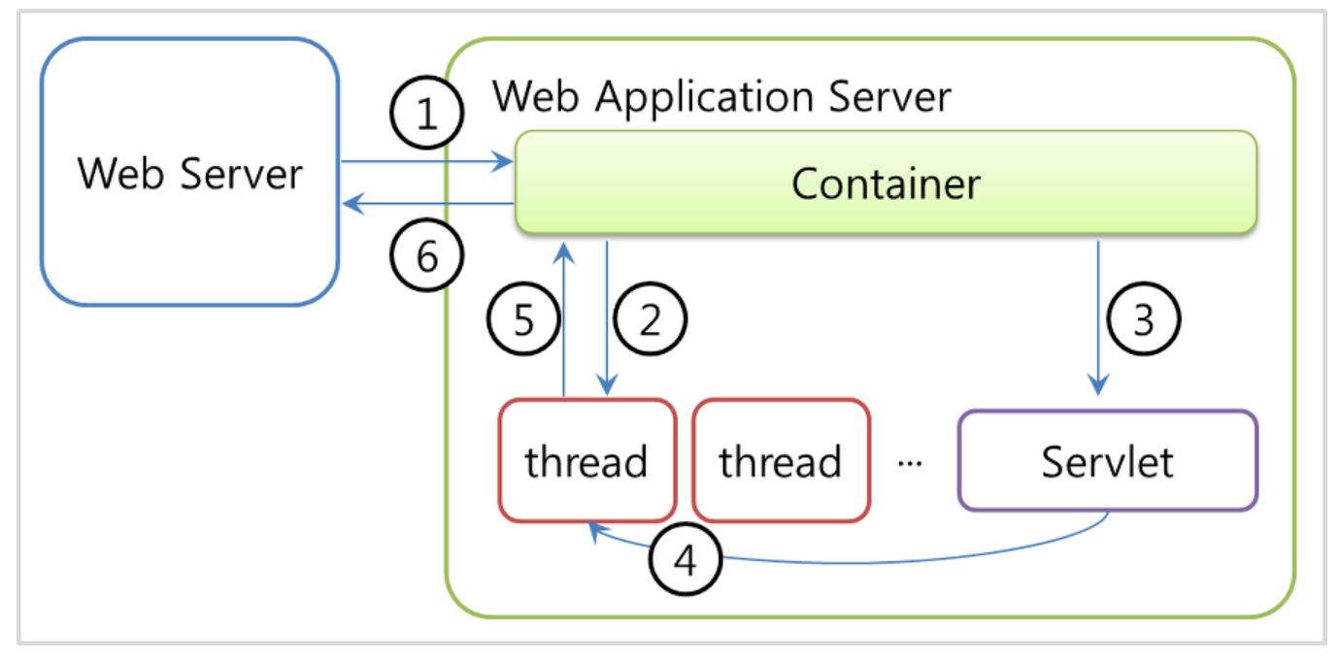
Jsp servlet & WAS

