Slide 1
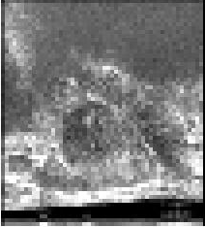
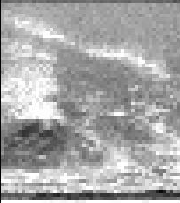
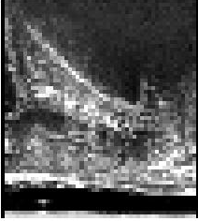
=
+
2n
+
1
n
n
n
n
n
1
4n
2n
2n
2n
2n
+
n
n
+
2n
n
2n
2n
4n
4n
4n
8n
4n
4n
+
+
2n
4n
4n
4n
3*3Cov * 2
Squeeze and Excite
1*1Cov * 1
ASPP
Downsample
Upsample + Attention + Concatenate

Slide 2
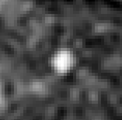
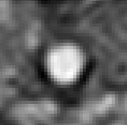
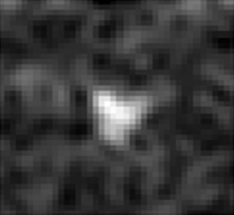
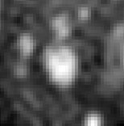
Real Images
prediction
[true/sythetic, cyst/non-cyst]:
DenseNet Discriminator
[0 0]
[1 0]
[0 1]
[1 1]
Fake/Sythetic Images
y: cyst indication
Conditional Generator
z: noise vector
Train

Slide 3
Real/Fake
Discriminator Network
Fake Images
Real Images
Generator Network
z

Slide 4
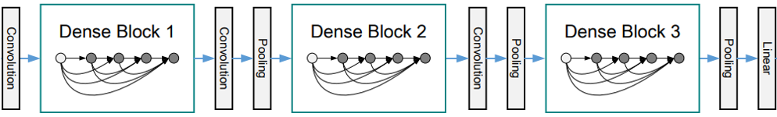
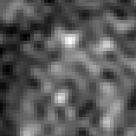
Cyst
Non-Cyst

Slide 5
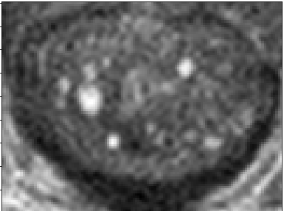
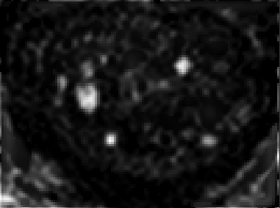
Without Hessian
With Hessian
Encoder Block
Encoder Block
Decoder Block
Encoder Block
Decoder Block
Concat
CNN

Slide 6
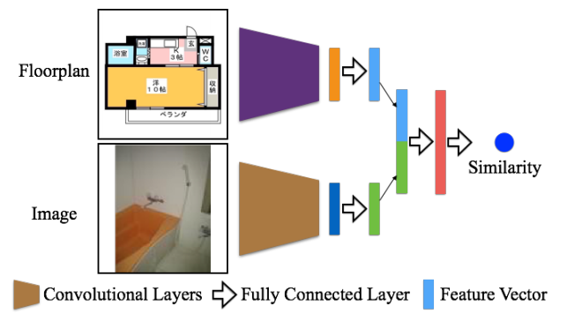


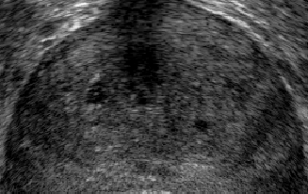

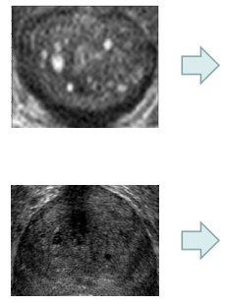


Siamese Net (excluding output layer)
Concat
MLP
Similarity
Extrated Features

Slide 7
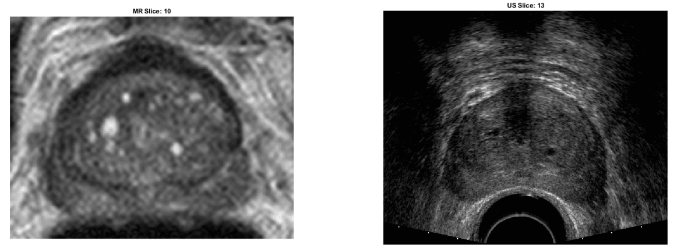
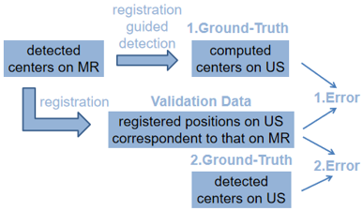
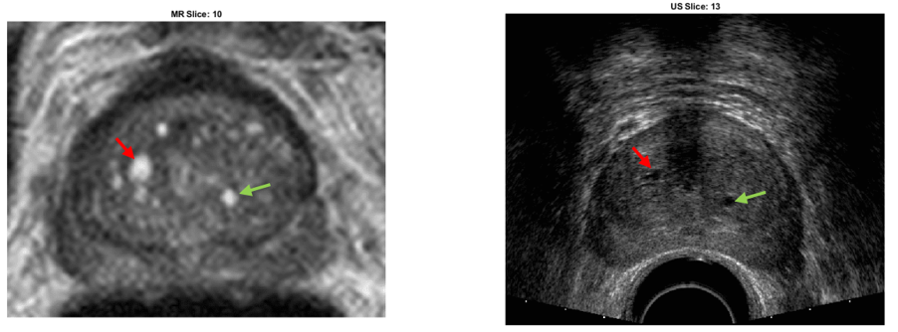
MRI
US
Correspondent
Landmarks
Detection
Workflow
Registration Error

