Slide 1
PCIE Test Summary
Versal H10 PCIEB - XAP Char Team

Slide 2
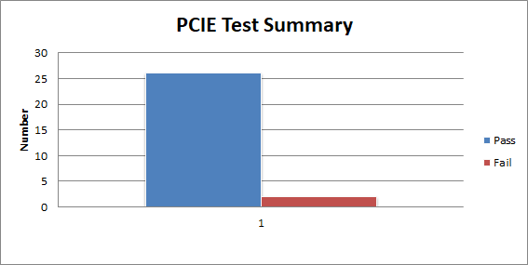
PCIE Test Summary
Pass | Fail
26 | 2

Slide 3
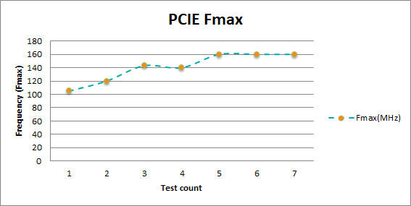
PCIE Test 1

Slide 4
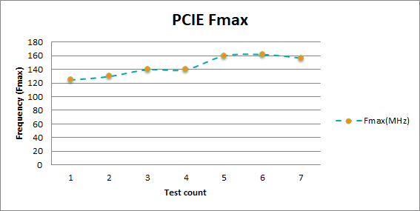
PCIE Test 2

Slide 5
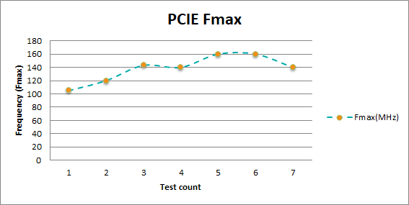
PCIE Test 3

Slide 6
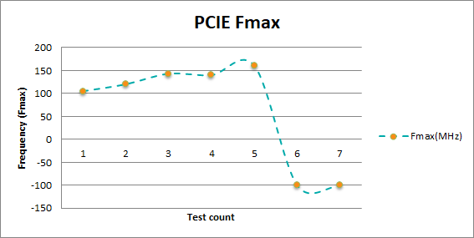
PCIE Test 4

