Slide 1

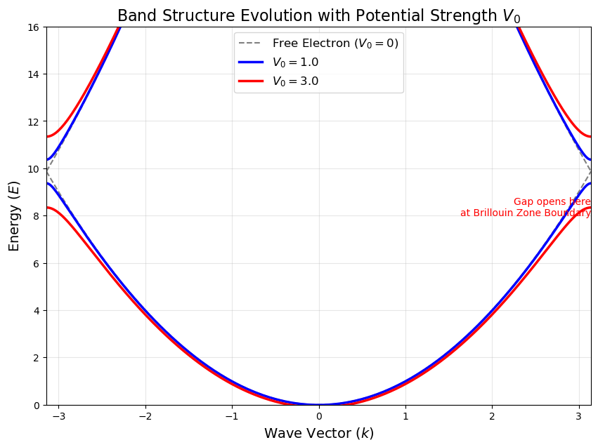

Bloch Theorem &
Visualization of Energy Band
Reporter: Wei-Jun, Gao

Slide 2


Agenda
Introduction
Monte Carlo Method & Process
Result & Conclusion

Slide 3

Part 1: Introduction
Ideas & Foundations

Slide 4
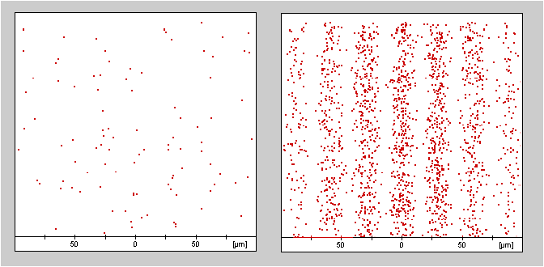
Electron Double-Slit experiment
a few electrons
a lot of electrons
https://perg.phys.ksu.edu/vqmorig/tutorials/online/prep/

Slide 5

How about lots of atoms?
......
A single atom
A lot of atom

Slide 6
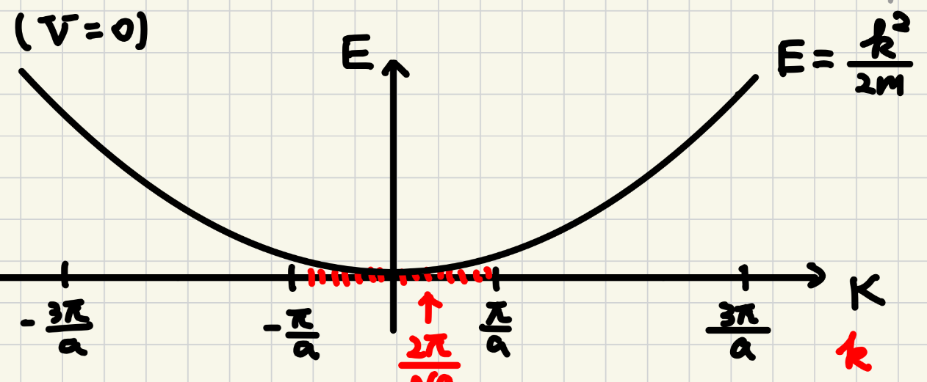
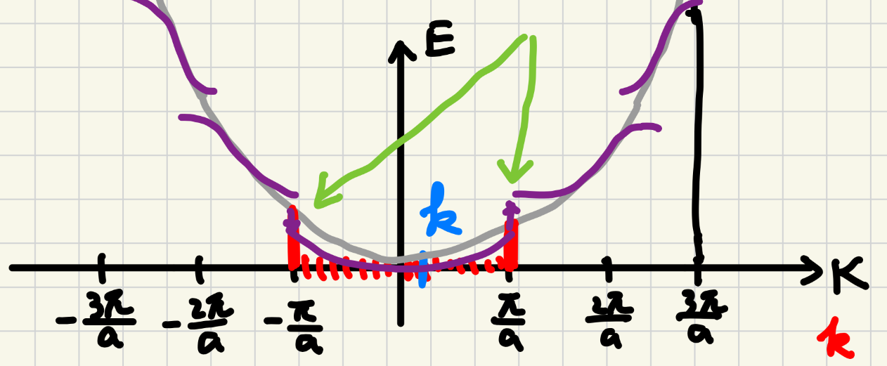
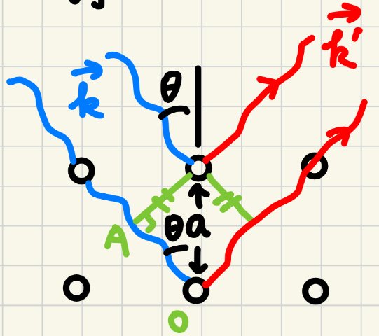
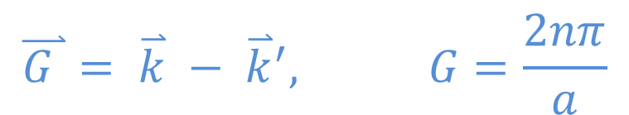
Bloch Theorem
Nearly Free Electron Model
Schrödinger’s Equation with periodic potential energy
Free Electron
Inverse Fourier transform & Bragg Diffraction
Substitute back to
the Schrödinger’s Eq!
Free Free Electron
Notes:
k 可以算動量以及動能，然後因為這裡的電子位能很小所以也可以近似用k去算總能量<
這裡把洪載明上課講的大K跟k’一起到G向量了

Slide 7
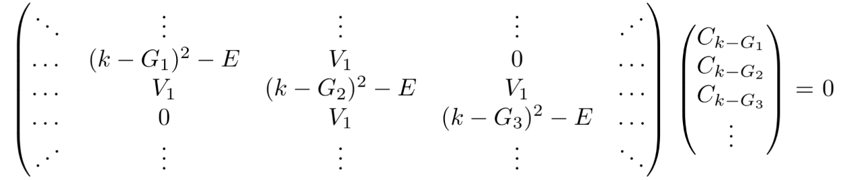

Bloch Theorem
Eigenvalues & Solve the Hamiltonian Matrix (By python)

Slide 8
Part 2: Process
Monte Carlo method & Visualization

Slide 9
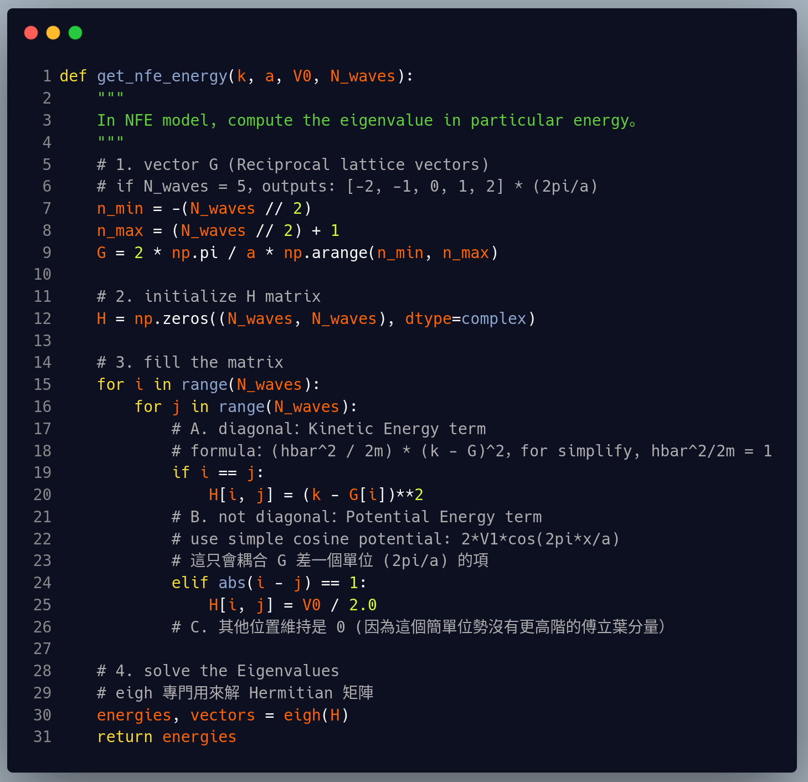
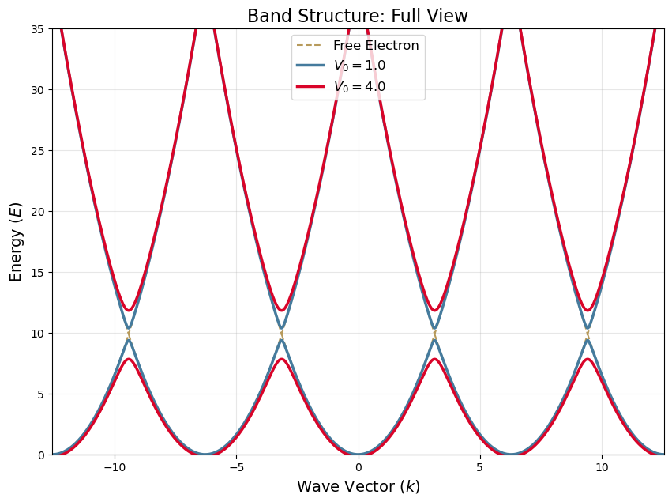
Python make it happen!
Arguments: k, a, V0, N_waves
動量、晶格常數、位能、矩陣大小
設定有幾個點
填入矩陣並且解它
解它：eigh

Slide 10
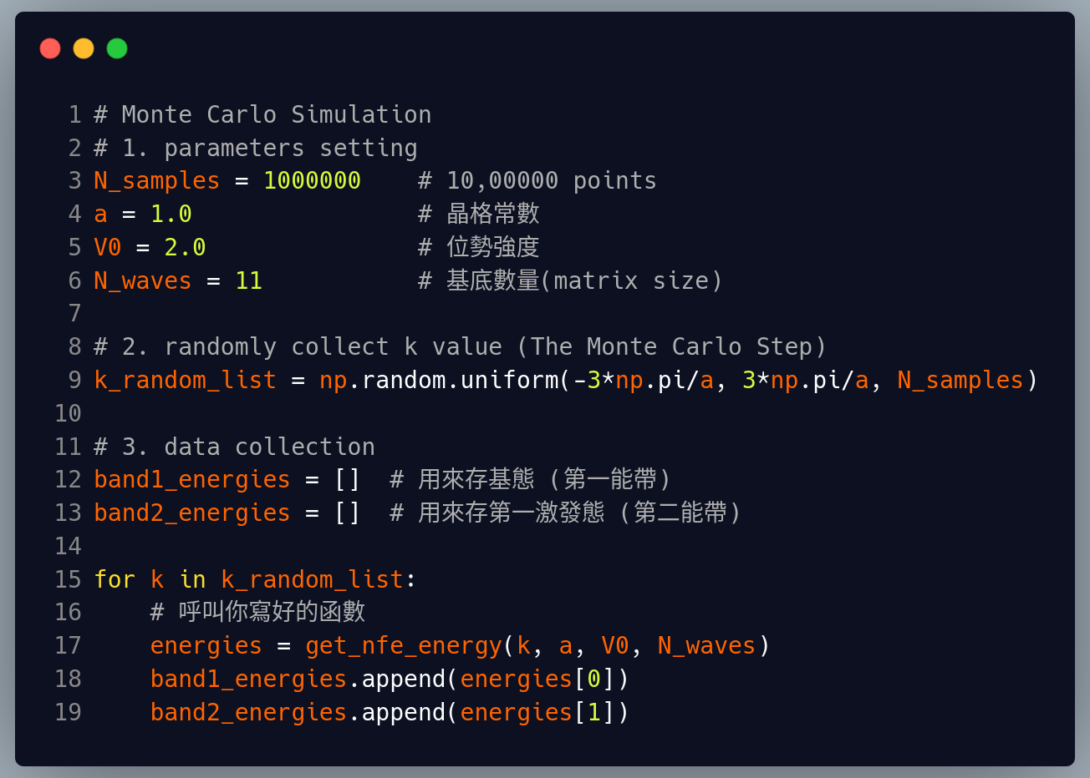
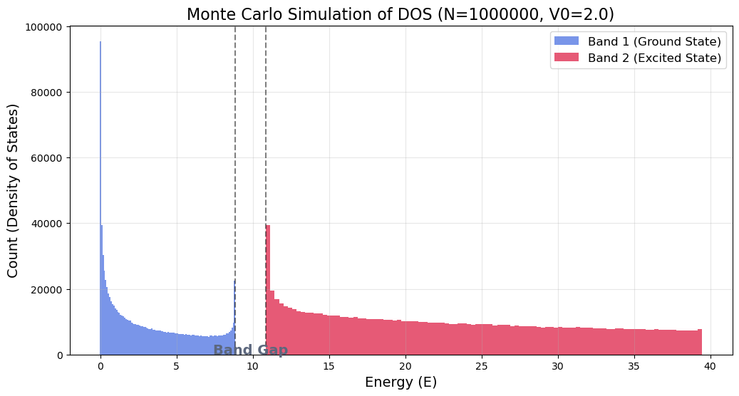
Monte Carlo Method

Slide 11
Huge V0: Huge energy gap

Slide 12
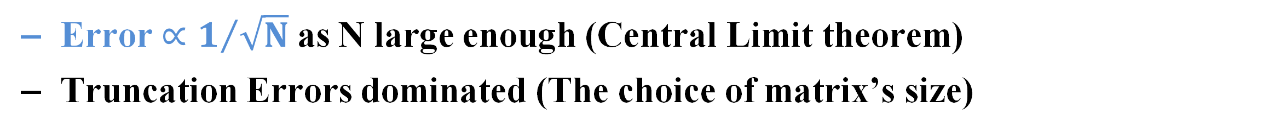
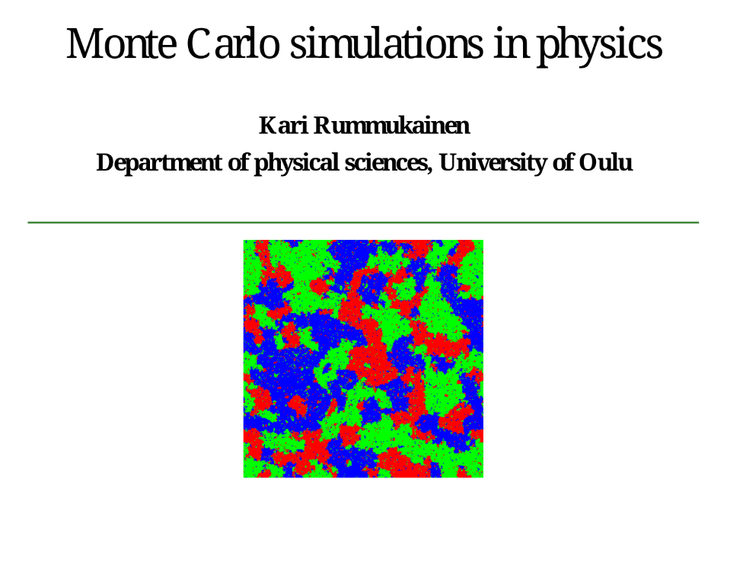
Some potential errors
https://www.oulu.fi/tf/montecarlo/lectures/mc_notes1.pdf

Slide 13
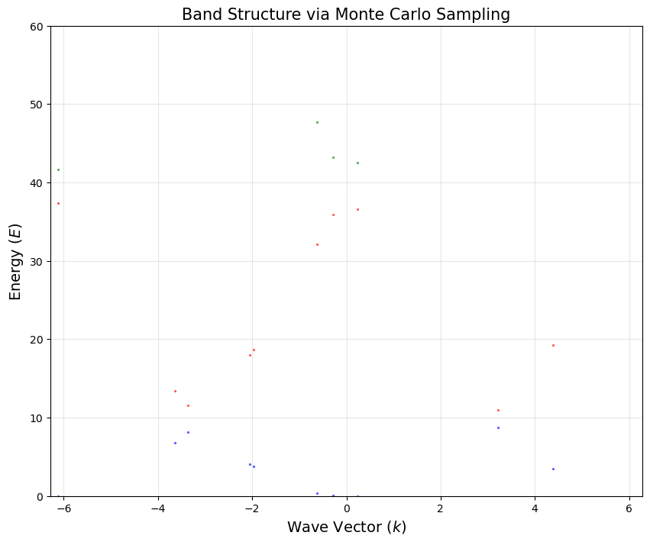
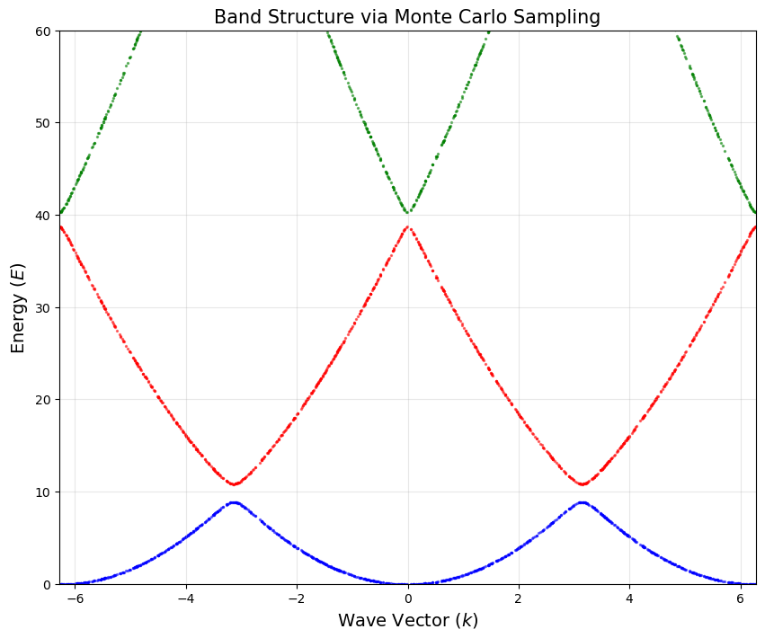
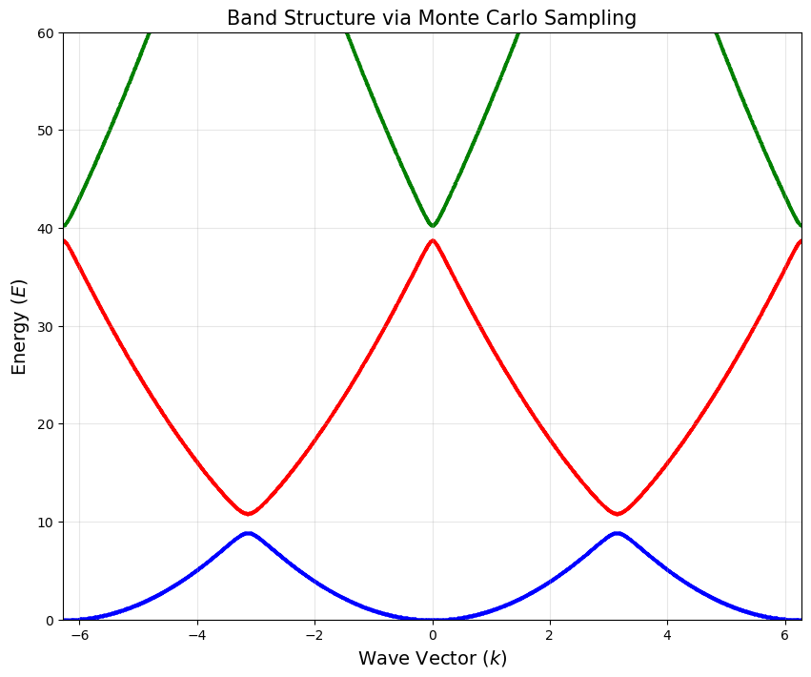
Monte Carlo Method in Energy Band
Furthermore, graph the energy band by Monte Carlo method!
N = 10
N = 1000
N = 10000

Slide 14
Part 3: Summary
Errors & Conclusion

Slide 15
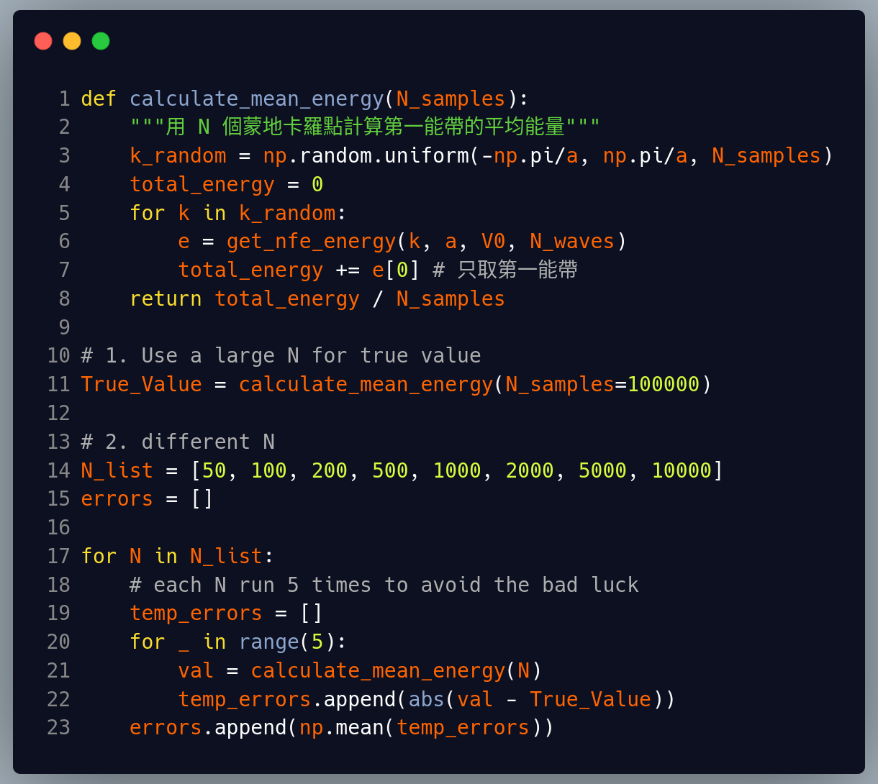
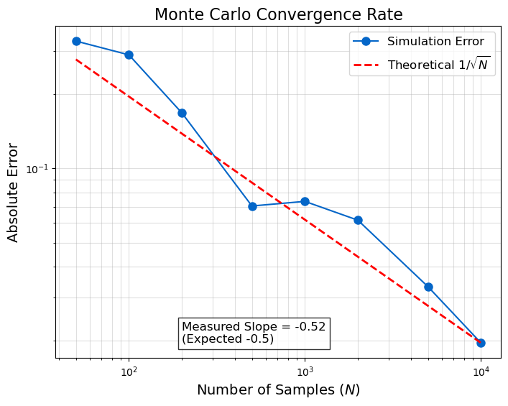

Errors Analysis - Convegence of Monte Carlo

Slide 16
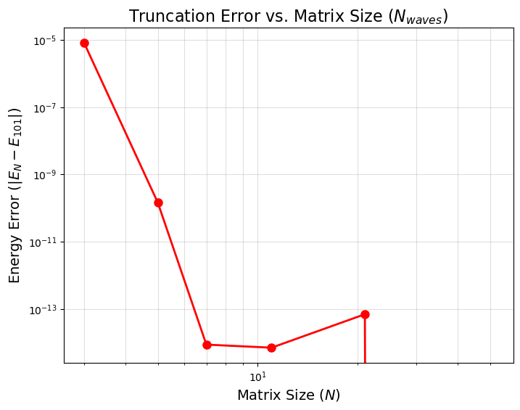
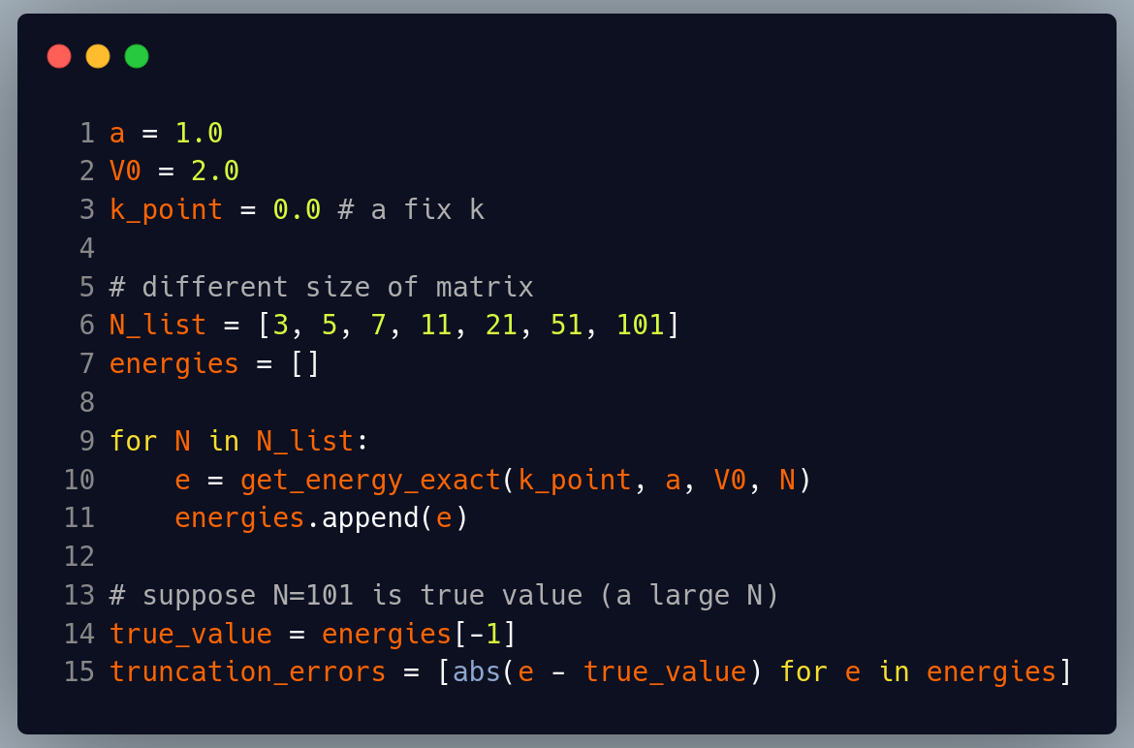
Errors Analysis - Truncation Error

Slide 17

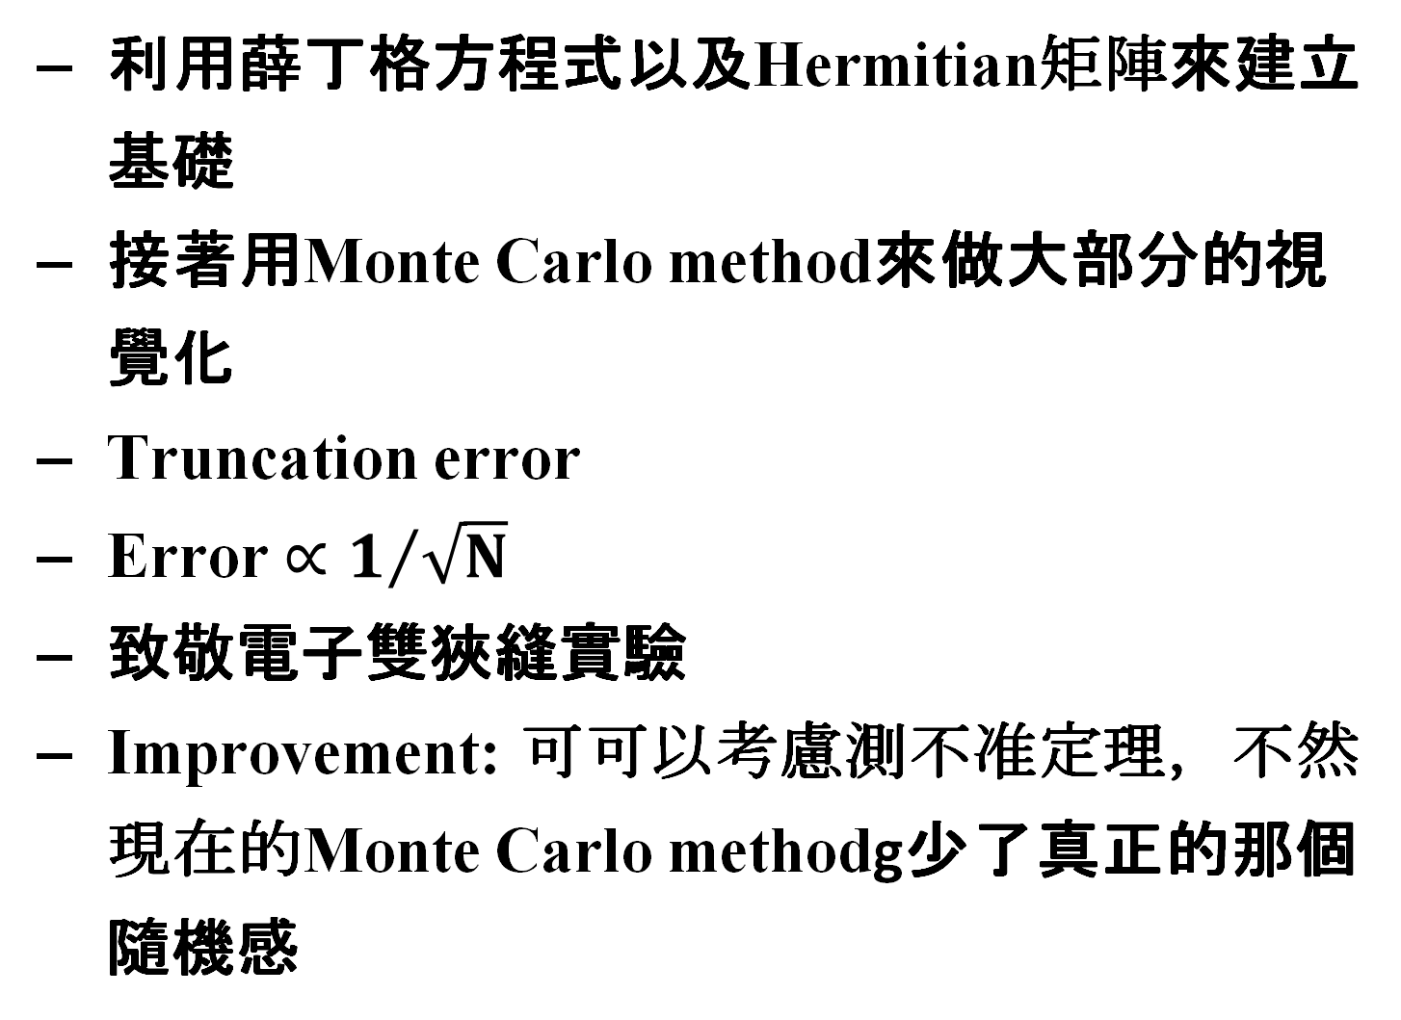
Conclusion

Slide 18

Main References
A. Gomez, "Bloch_theorem_Notebook_2ADENS/Bloch_Wannier.ipynb at main · axgmz/Bloch_theorem_Notebook_2ADENS" (2022).
https://github.com/axgmz/Bloch_theorem_Notebook_2ADENS/blob/main/Bloch_Wannier.ipynb
2. K. Rummukainen, “Monte Carlo simulations in physics”.
https://www.oulu.fi/tf/montecarlo/lectures/mc_notes1.pdf

Slide 19
Thank You

